Slide 1
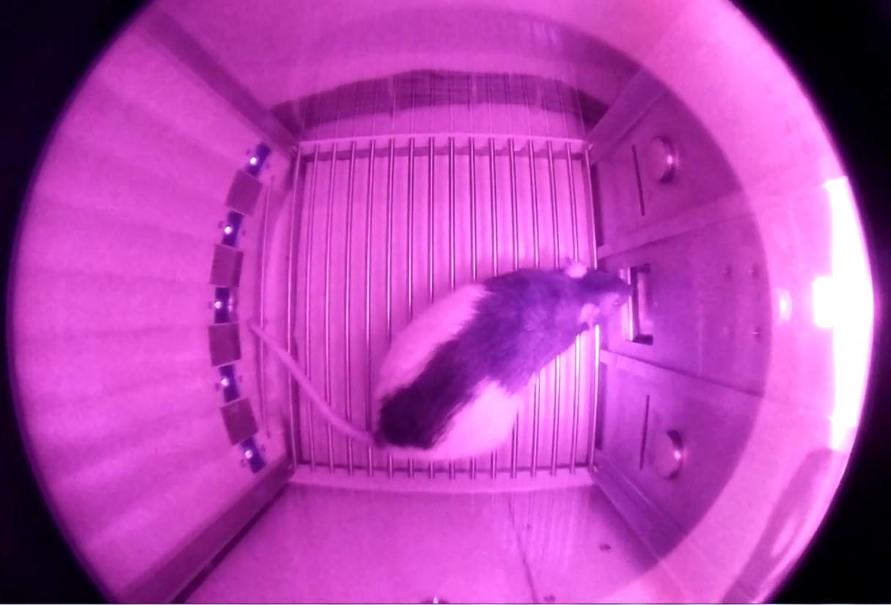
Press button to
start/stop recordings
Camera status LED
starts to shine
Electrical outlet
Operant chamber
Camera

