Slide 1
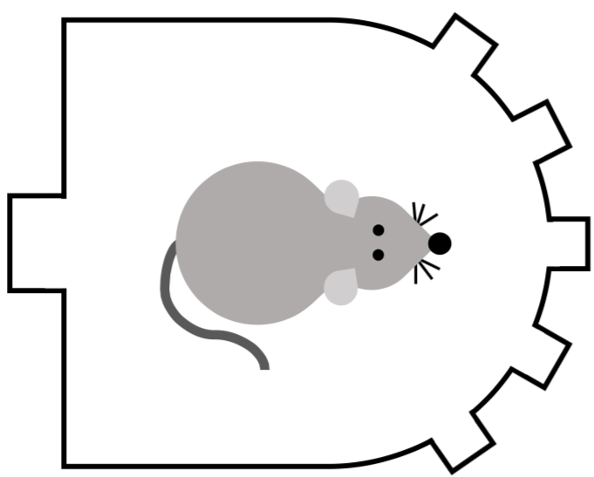
Protocol step indicator:
Shines throughout
each individual trial
Protocol step | Timestamp logged by system
Trial #1 Start | 00:00
Trial #1 Cue presentation | 00:05
Trial #1 Response | 00:08
Trial #1 Retrieval | 00:10
Trial #2 Start | 00:00
Trial #2 Cue presentation | 00:05
Trial #2 Response | 00:09
Trial #2 Retrieval | 00:12
Cue presentation
Retrieval
Trial start
Response
Break

