Slide 1
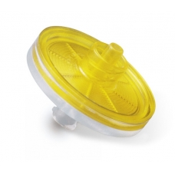

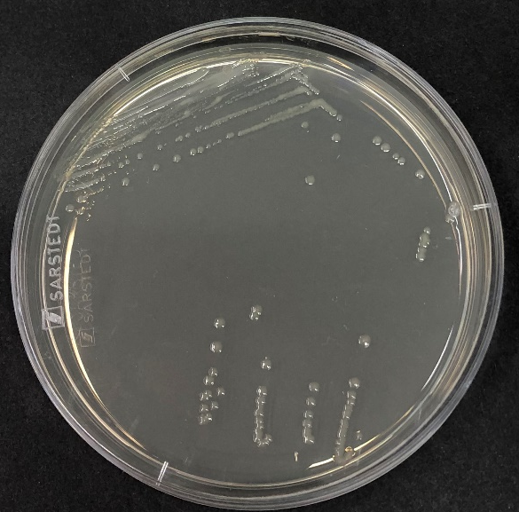
Urine sample
Strain identification
DNA isolation
Semi-liquid
osmoprotective
medium
Incubate at 30 °C
for up to 1 month
Re-streak on
standard culture
media

