Slide 1
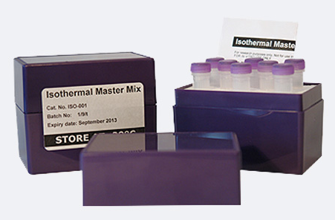
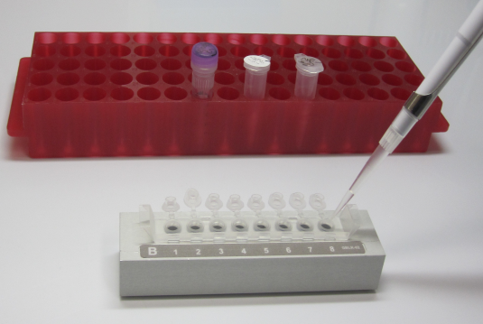
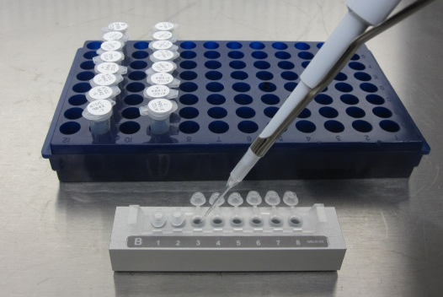
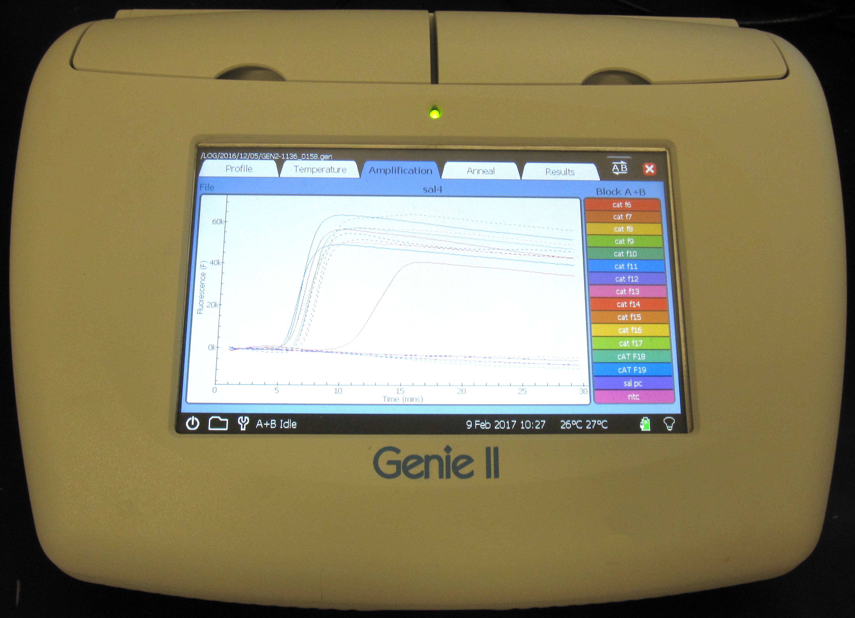
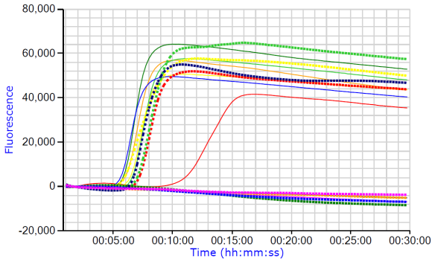
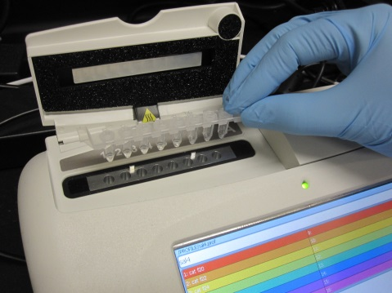
Prepare master mix
Distribute to wells
Add DNA templates*
Run LAMP
(amplification graph generated in real-time)
Load into the LAMP instrument
*DNA templates can be prepared from enrichment broths of animal food samples for screening purpose or cultures of presumptive Salmonella isolates for confirmation purpose.

