Slide 1
4.1.3 Counting foci in body wall muscle from acquired images using ImageJ/FIJI
→= 44
Arrows → represent a foci

Slide 2
4.2.2 Calculating the fraction paralyzed, for each condition and replicate
paralyzed
Paralyzed % =
X 100
total worms
10 mobile worms
10 paralyzed worms
10
Paralyzed % =
x 100 = 50%
20

Slide 3
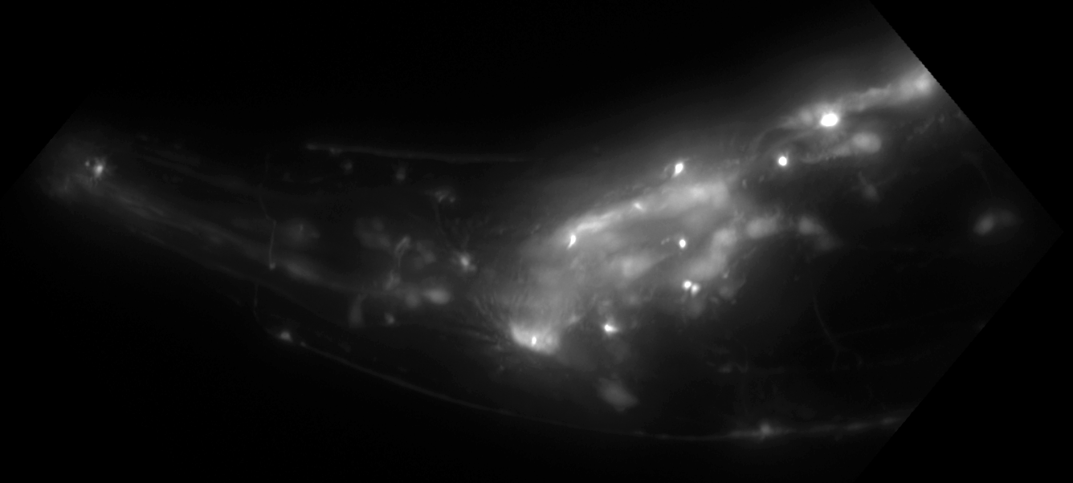
5.1.3 Counting foci in the nerve ring using
ImageJ/FIJI
=10
Arrows → represent a foci
Bracket () represents scored area

