Slide 1
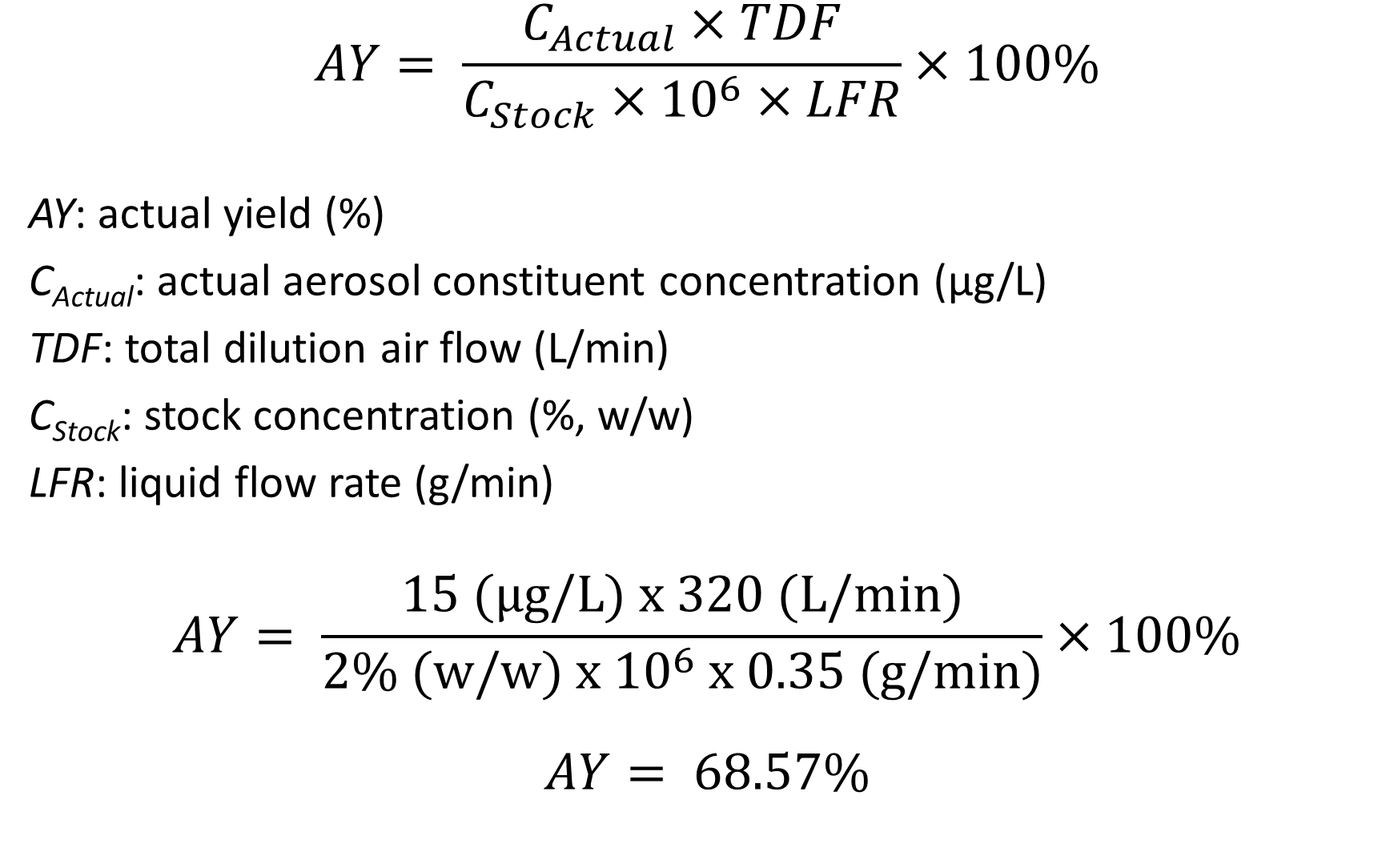
$$AY= \frac{C_{Actual}×TDF}{C_{Stock}×{10}^{6}×LFR}×100\%$$
AY: actual yield (%)
C_{Actual}: actual aerosol constituent concentration (µg/L)
TDF: total dilution air flow (L/min)
C_{Stock}: stock concentration (%, w/w)
LFR: liquid flow rate (g/min)
$$AY= \frac{15 (µg/L) x 320 (L/min)}{2\% (w/w) x {10}^{6} x 0.35 (g/min)}×100\%$$
$$AY= 68.57\%$$

Slide 2
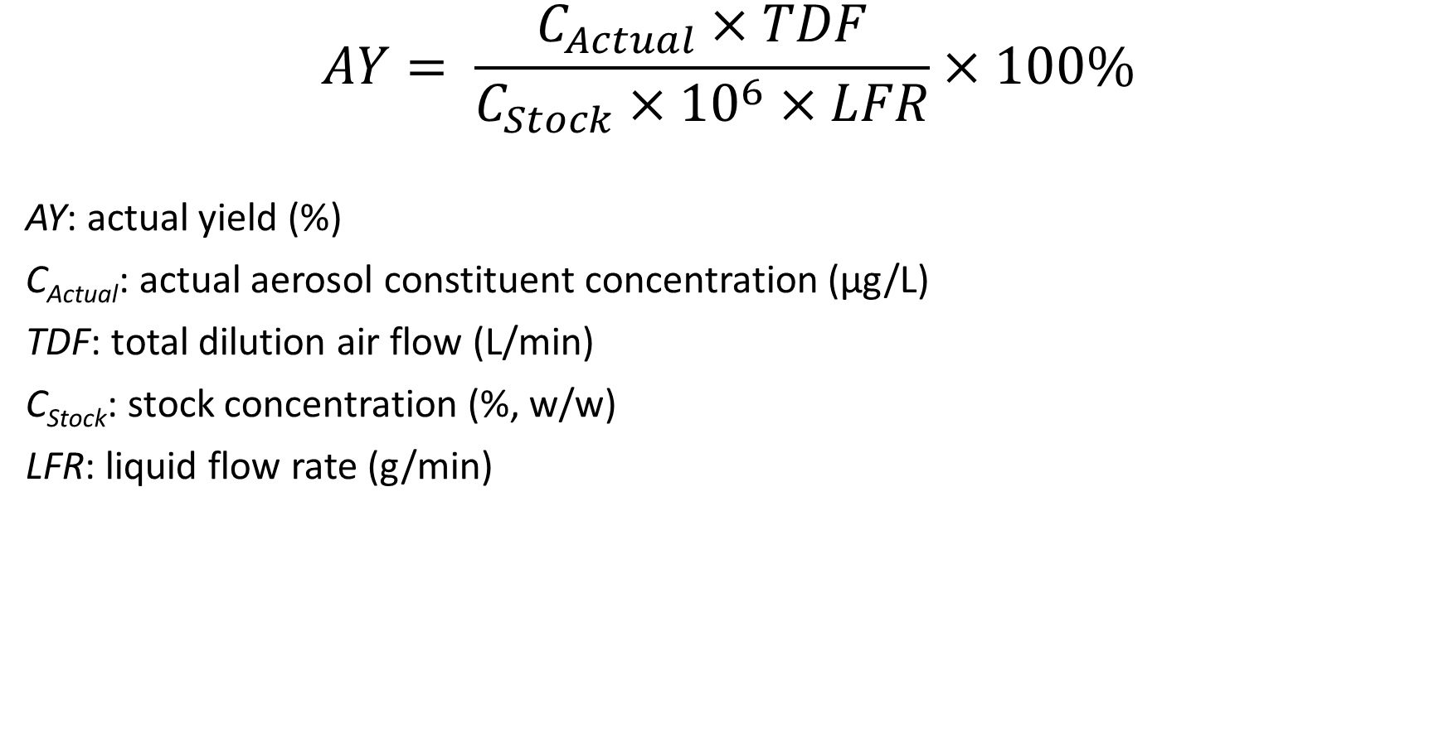
VO: Perform further fine-tuning of aerosol concentration by using the same calculations for adjustment of Total dilution air flow or liquid flow rate.
$$AY= \frac{C_{Actual}×TDF}{C_{Stock}×{10}^{6}×LFR}×100\%$$
AY: actual yield (%)
C_{Actual}: actual aerosol constituent concentration (µg/L)
TDF: total dilution air flow (L/min)
C_{Stock}: stock concentration (%, w/w)
LFR: liquid flow rate (g/min)

Slide 3
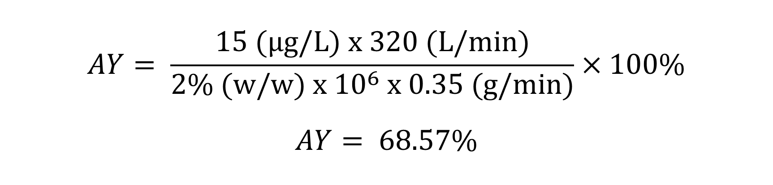
VO: Using a solution containing 2 percent nicotine, with a measured nicotine aerosol concentration of 15 micrograms per liter, Total dilution air flow of 320 Liters per minute, and Liquid flow rate of 0.35 grams per minute will result in 68.57 percent nicotine actual yield
$$AY= \frac{15 (µg/L) x 320 (L/min)}{2\% (w/w) x {10}^{6} x 0.35 (g/min)}×100\%$$
$$AY= 68.57\%$$

Slide 4
VO: Perform further fine-tuning of aerosol concentration by using the same calculations for adjustment of Total dilution air flow or liquid flow rate.
$$AY= \frac{C_{Actual}×TDF}{C_{Stock}×{10}^{6}×LFR}×100\%$$
AY: actual yield (%)
C_{Actual}: actual aerosol constituent concentration (µg/L)
TDF: total dilution air flow (L/min)
C_{Stock}: stock concentration (%, w/w)
LFR: liquid flow rate (g/min)

Slide 5
VO: Using a solution containing 2 percent nicotine, with a measured nicotine aerosol concentration of 15 micrograms per liter, Total dilution air flow of 320 Liters per minute, and Liquid flow rate of 0.35 grams per minute will result in 68.57 percent nicotine actual yield
$$AY= \frac{15 (µg/L) x 320 (L/min)}{2\% (w/w) x {10}^{6} x 0.35 (g/min)}×100\%$$
$$AY= 68.57\%$$

