Slide 1
Screen Captures
JOVE Paper

Slide 2
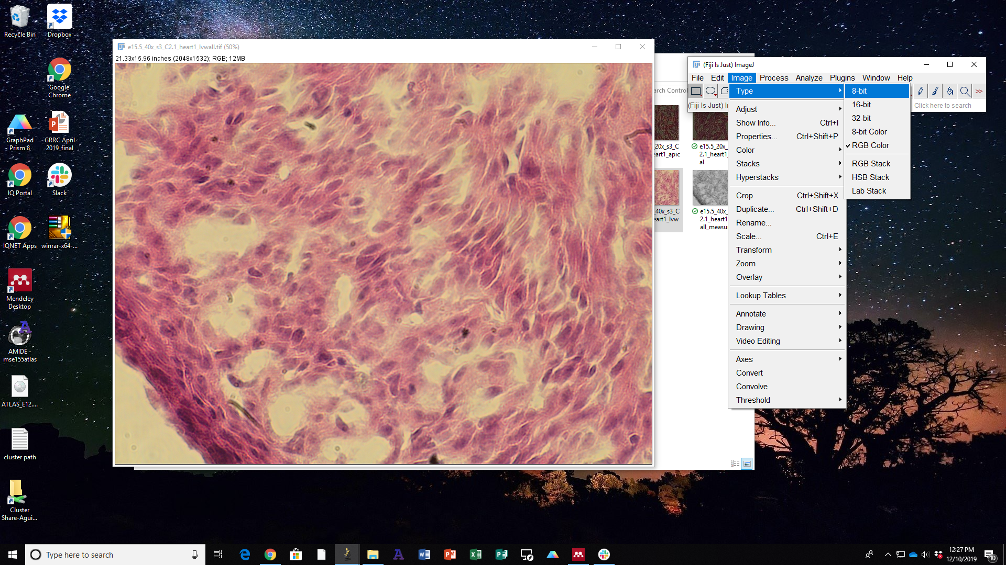
Step 9.3 Before Setting 8-bit – Navigating ImageJ

Slide 3
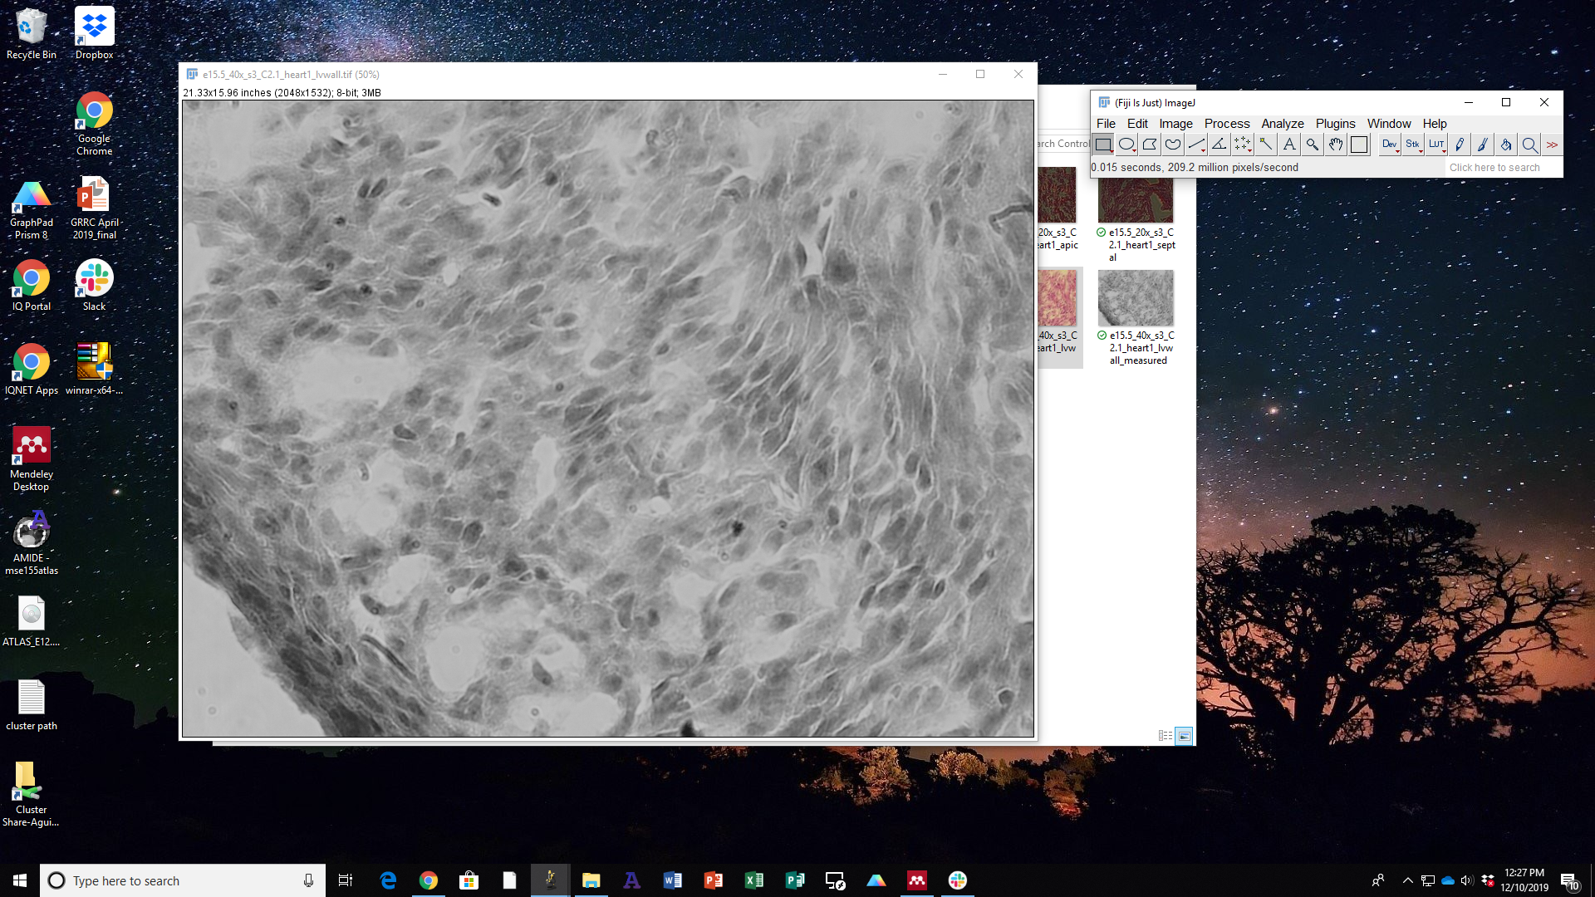
Step 9.3 After

Slide 4
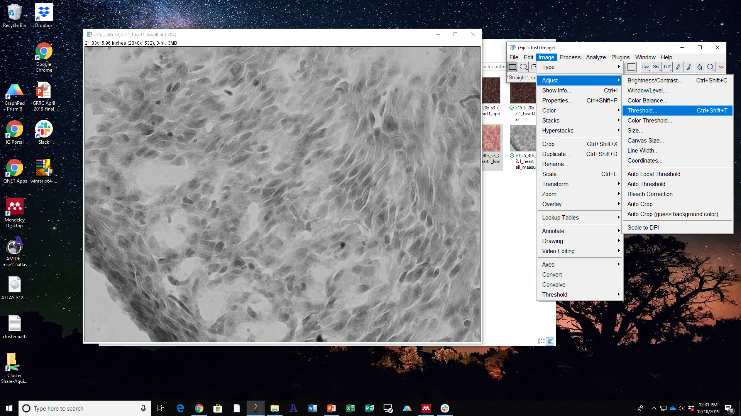
Step 9.4.1 Before Thresholding – Navigating ImageJ

Slide 5
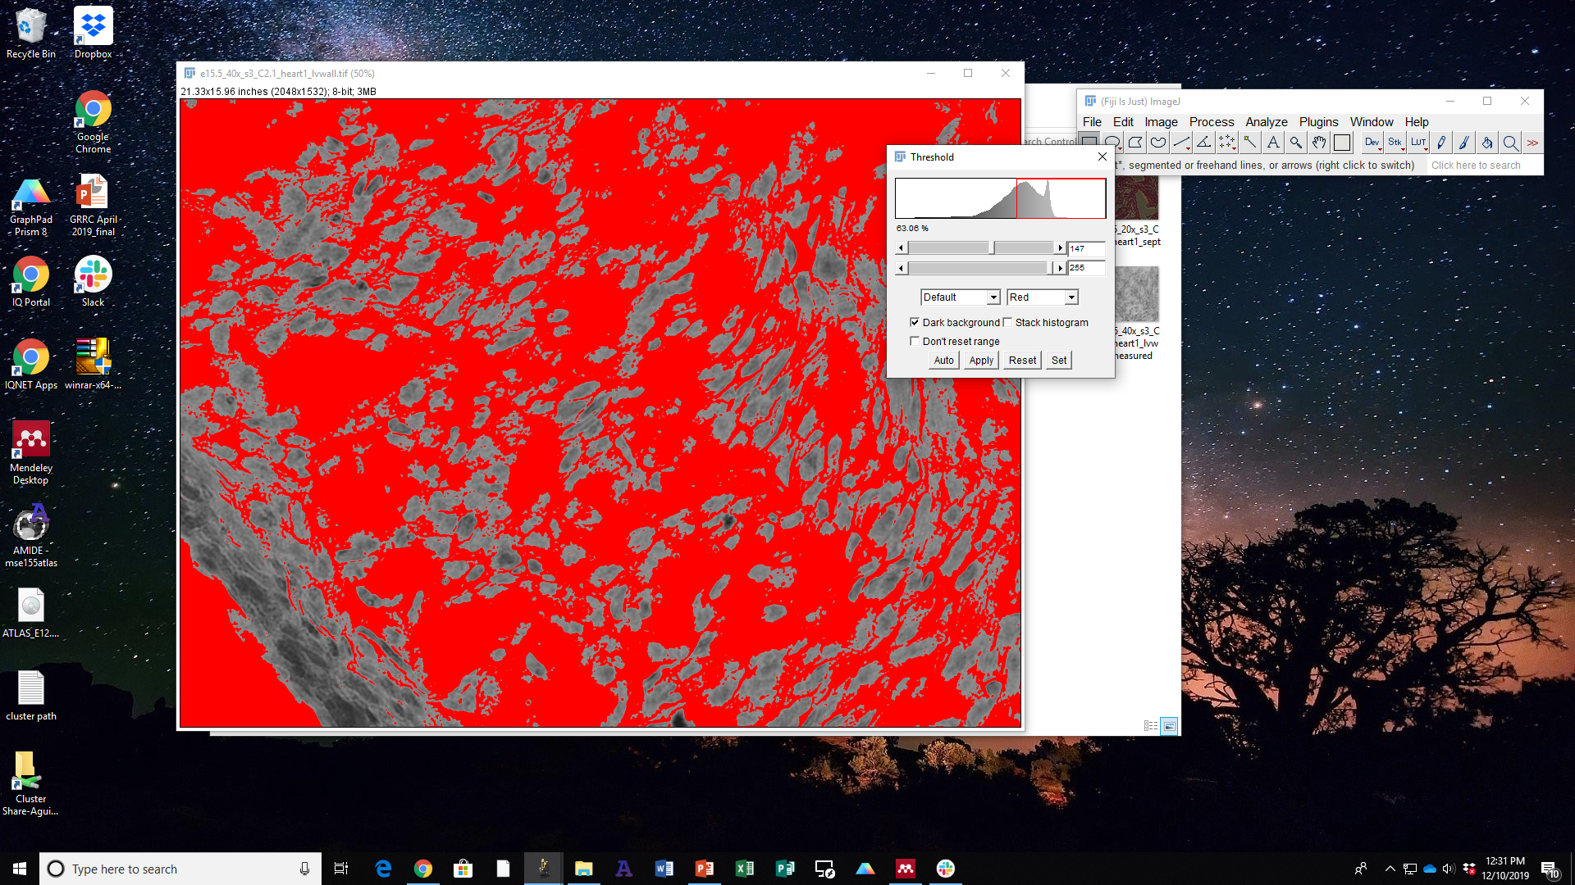
Step 9.4.1 – Immediately After Clicking on Threshold

Slide 6
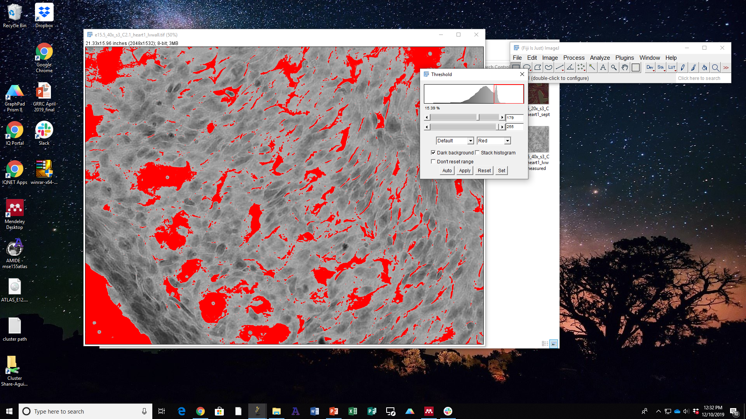
Step 9.4.1 – After Adjusting Top Button, Highlighting only the Background

Slide 7

Step 9.4.1 – Closing out the Threshold Window

Slide 8
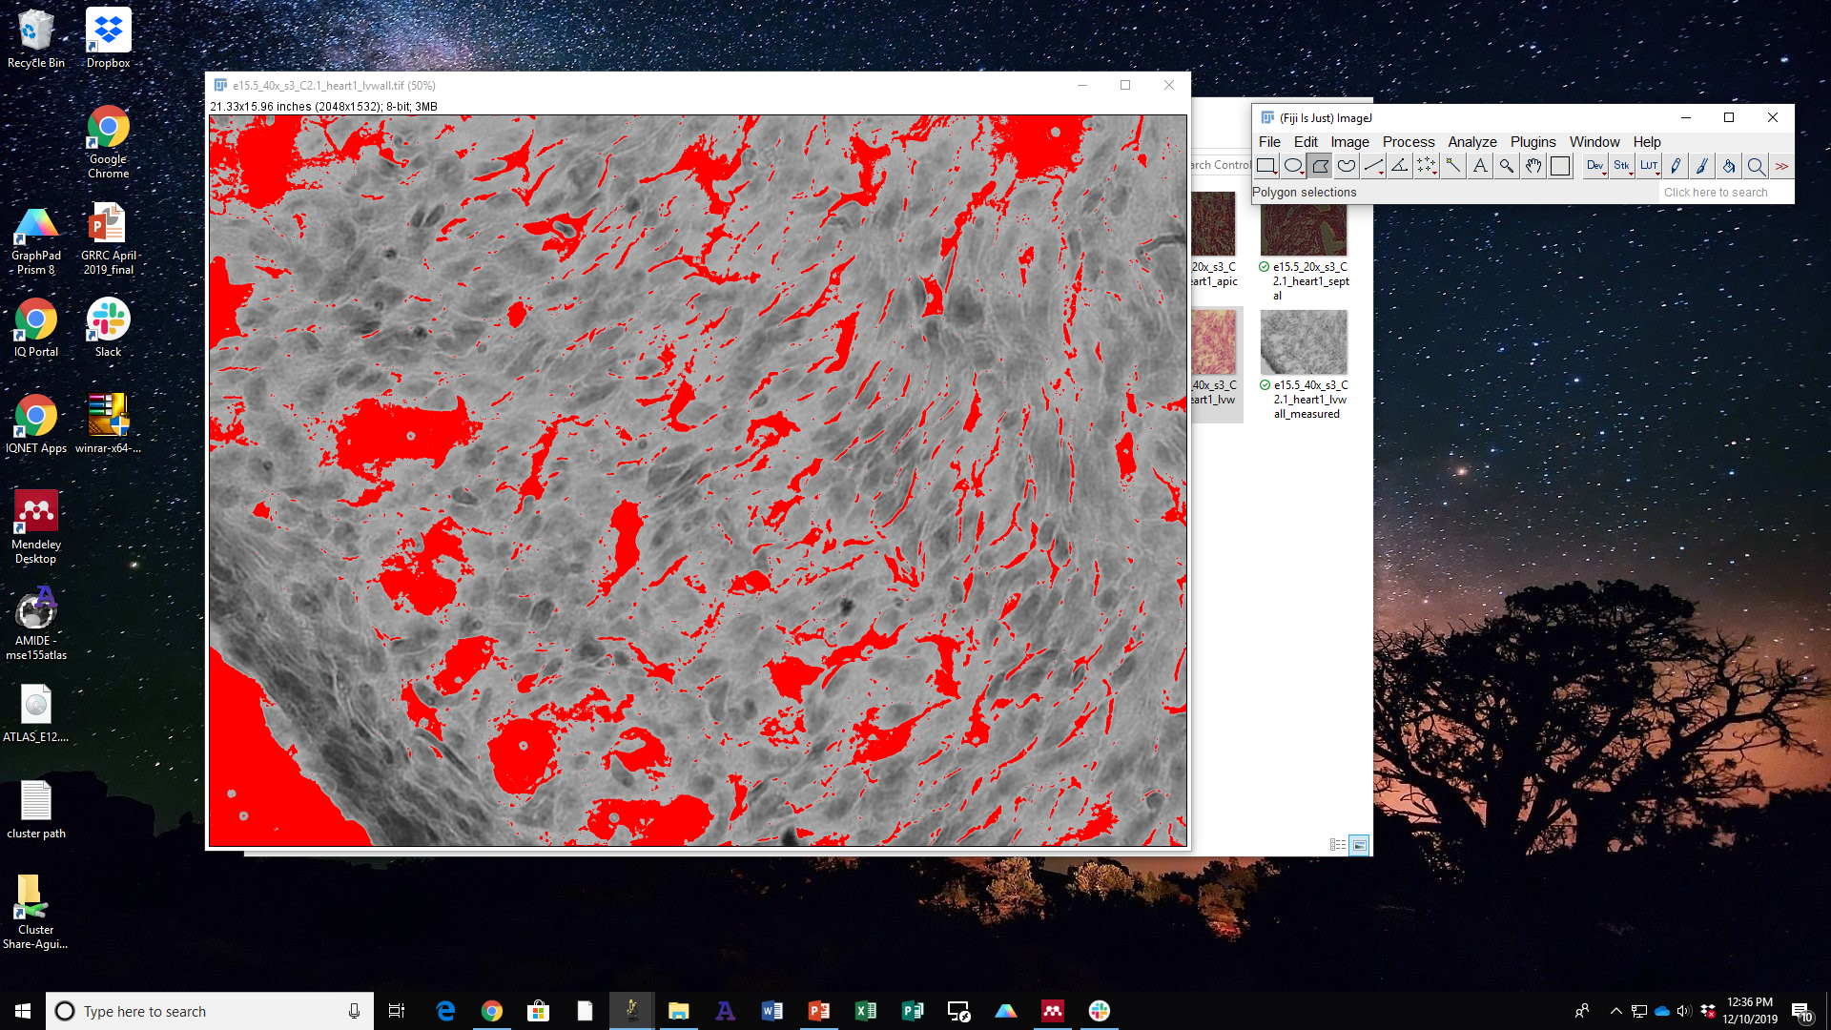
Step 9.5 – Selecting Polygon Selection Tool

Slide 9

Step 9.5 – After Using Polygon Selection Tool – Ensuring only the space in which the tissue is occupying is selected

Slide 10
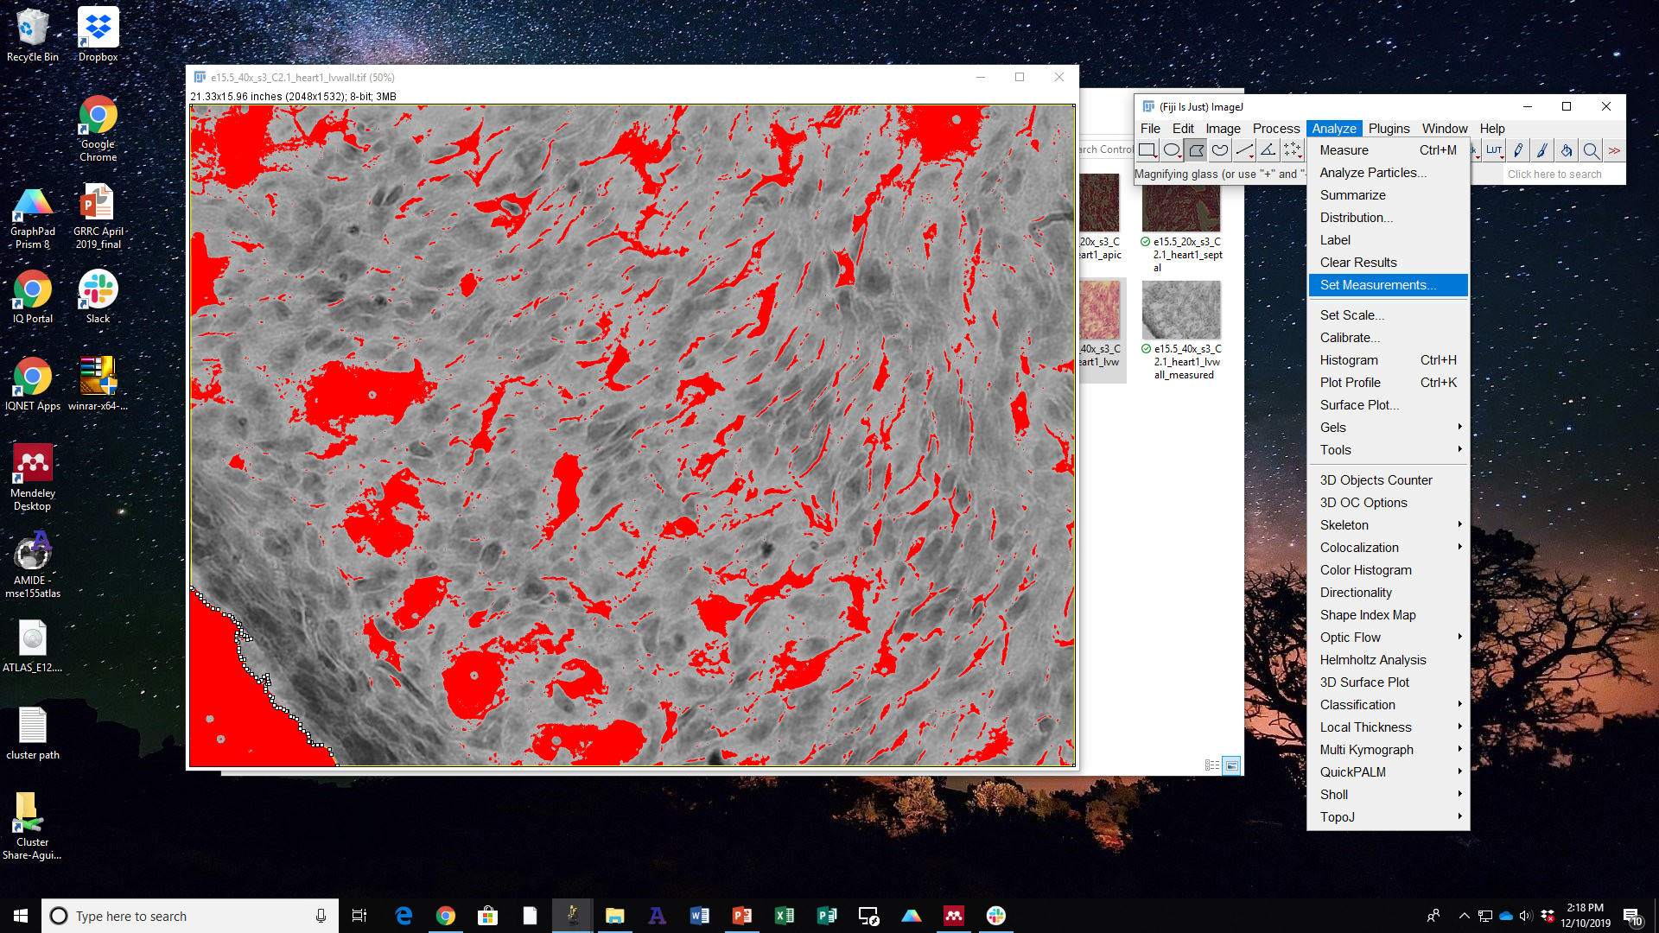
Step 9.6 – Before Setting Area Limits – Navigating ImageJ

Slide 11
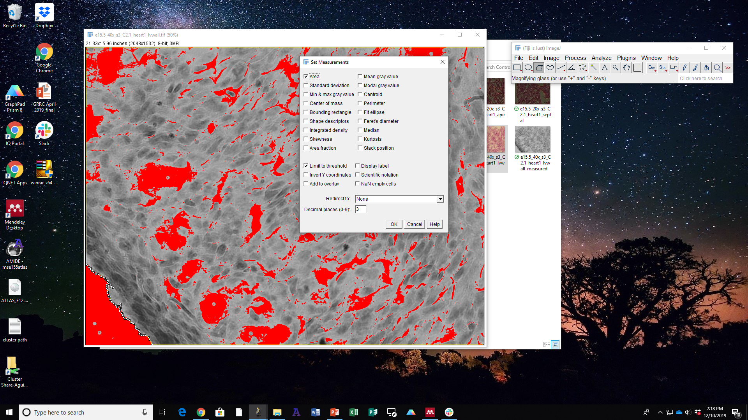
Step 9.6 –Setting Area Limits – Navigating ImageJ

Slide 12
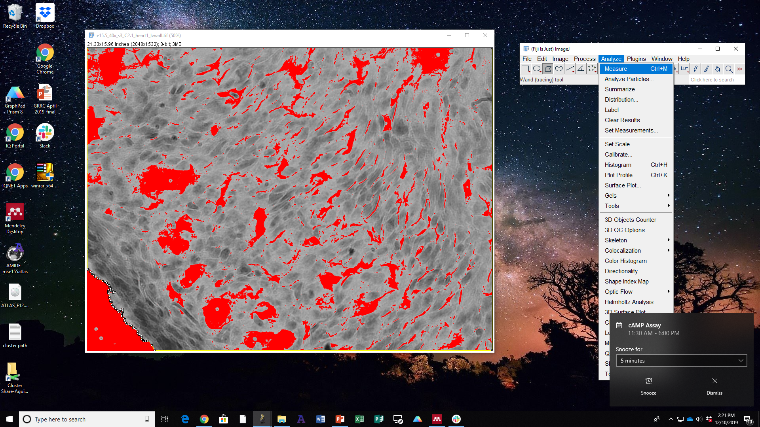
Step 9.7 – Measuring Area of Background – Navigating ImageJ

Slide 13
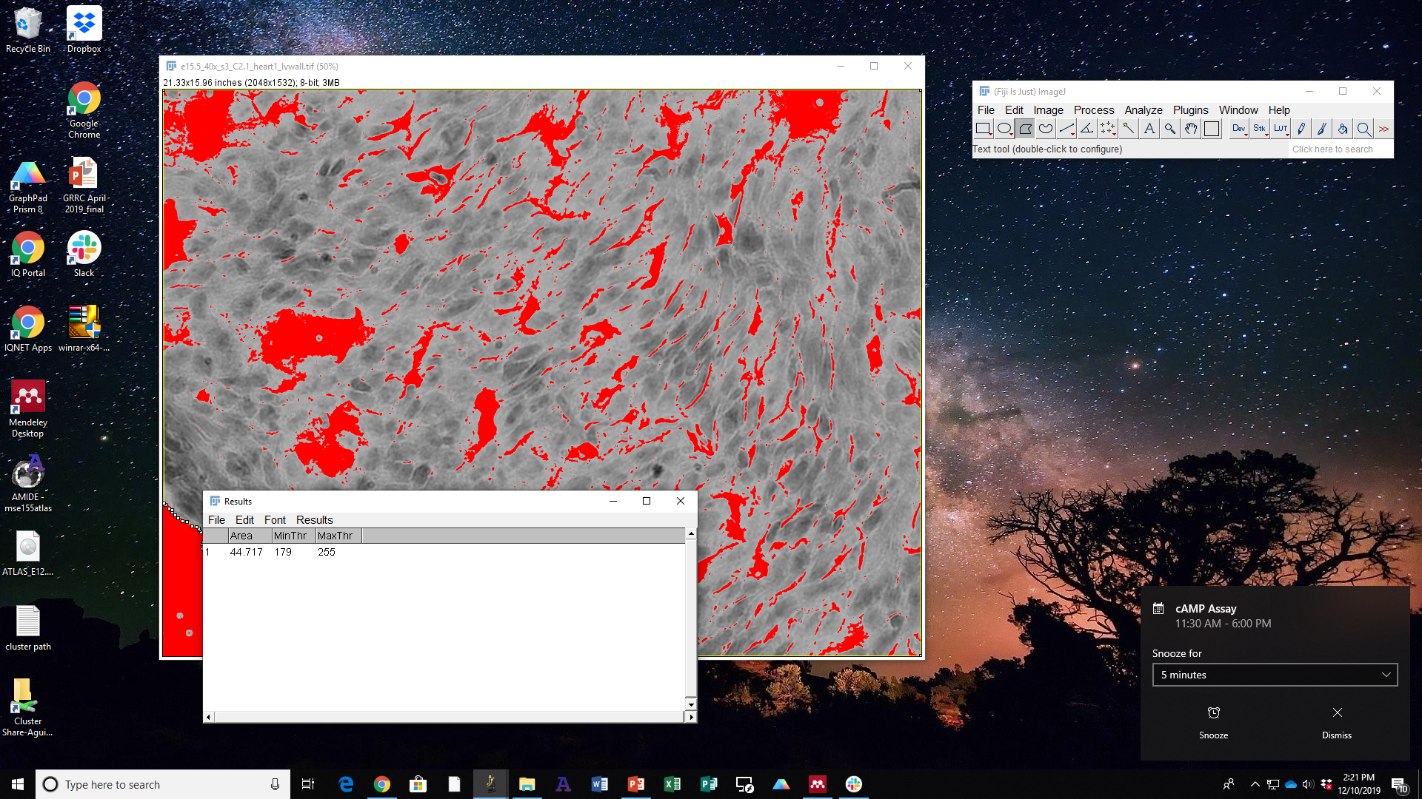
Step 9.7 – Measuring Area of Background

