Slide 1
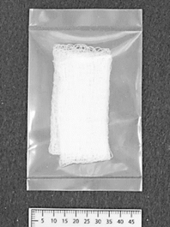
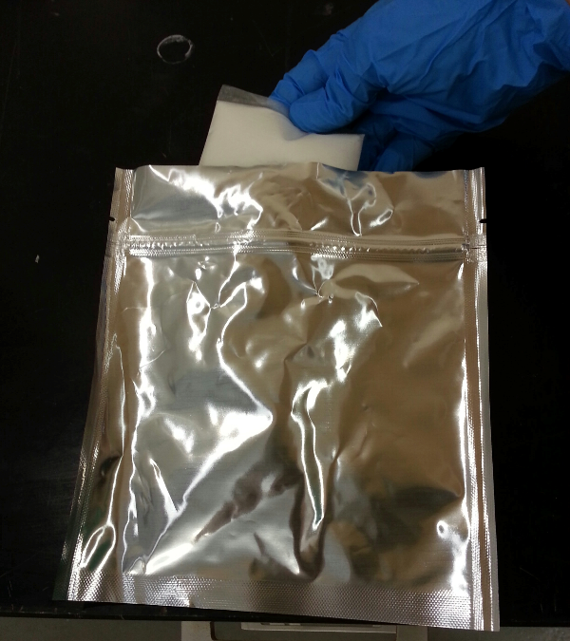
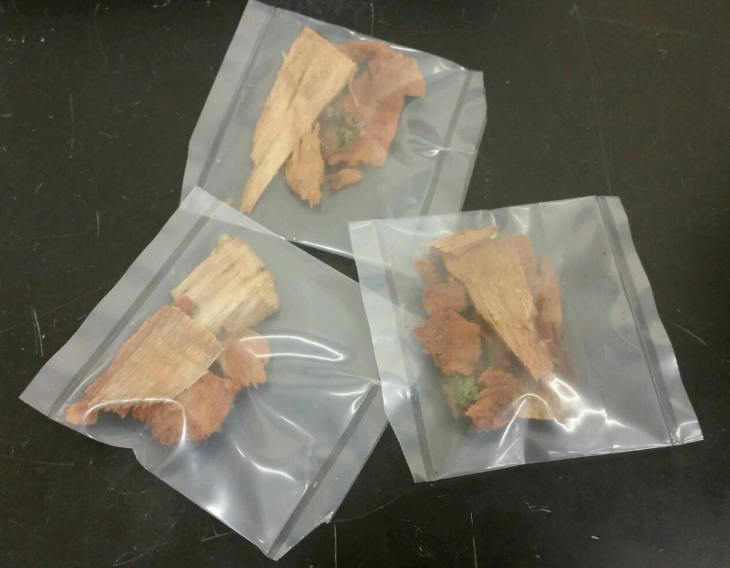
Figure 1.
A
B
C

Slide 2
Figure 2.

Slide 3
A
Figure 3.
B
C

Slide 4
Figure 4.

Slide 5
Figure 5.
1000 ng/s
100 ng/s
10 ng/s
Piperonal

Slide 6
Table 1.
Bag thickness | Permeation rate (mg/min) | R-squared
1 MIL | 0.108 | 0.974
4 MIL | 0.042 | 0.991
8 MIL | 0.00499 | 0.990
4 MIL in metal bag w/ 1/8" hole | 0.000179 | 0.972
Table 2.
Piperonal COMPS permeation rate | Number of alerts | % alert
0 ng/s (blank) | 0 | 0%
10 ng/s | 4 | 25%
100 ng/s | 7 | 44%
1000 ng/s | 12 | 75%

