Slide 1
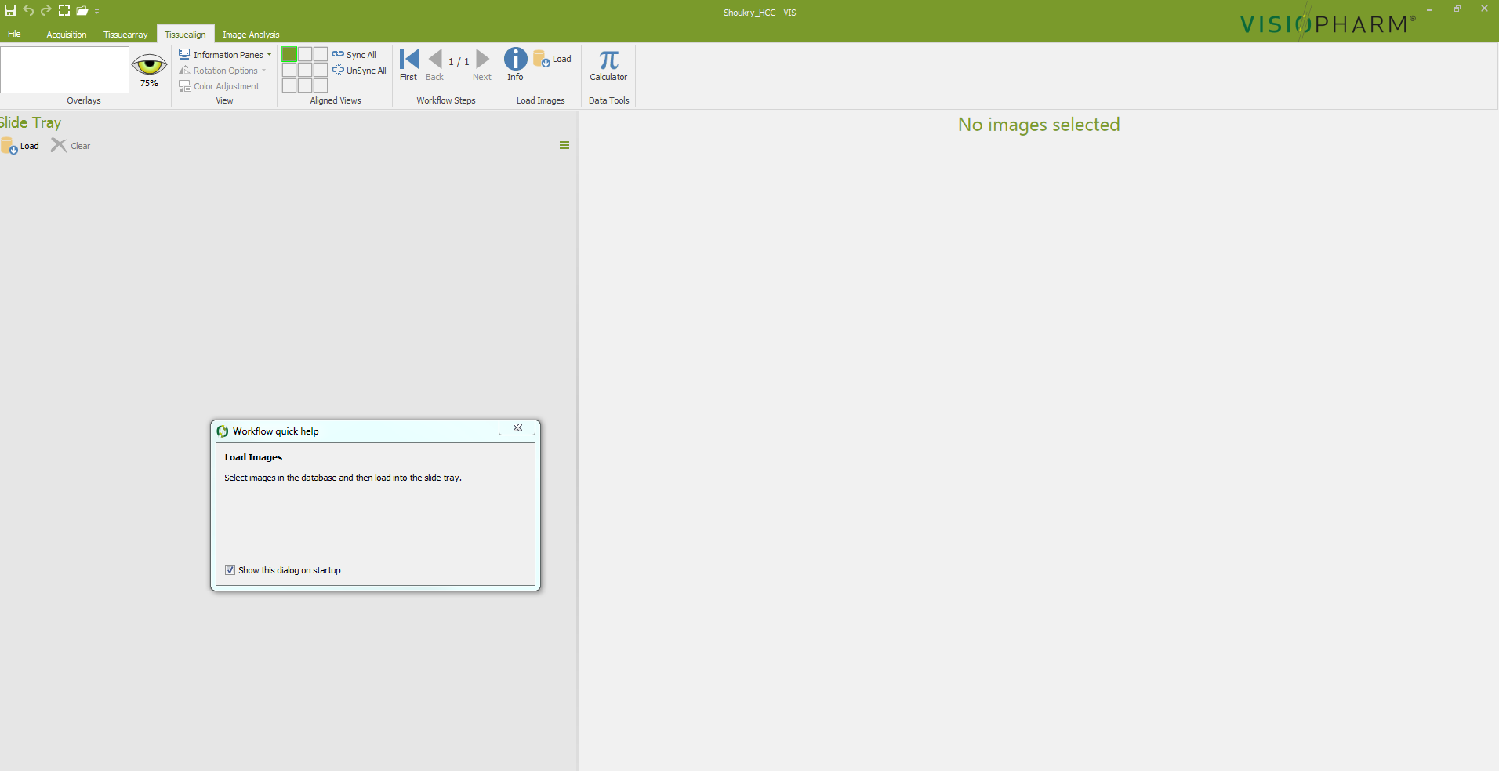
6.2. Perform tissue detection using the user-defined protocol APP 1 (parameters in Table 1)
6.2.1. Open the Image Analysis module of VIS by clicking the Image Analysis tab in the ribbon (red arrow)

Slide 2
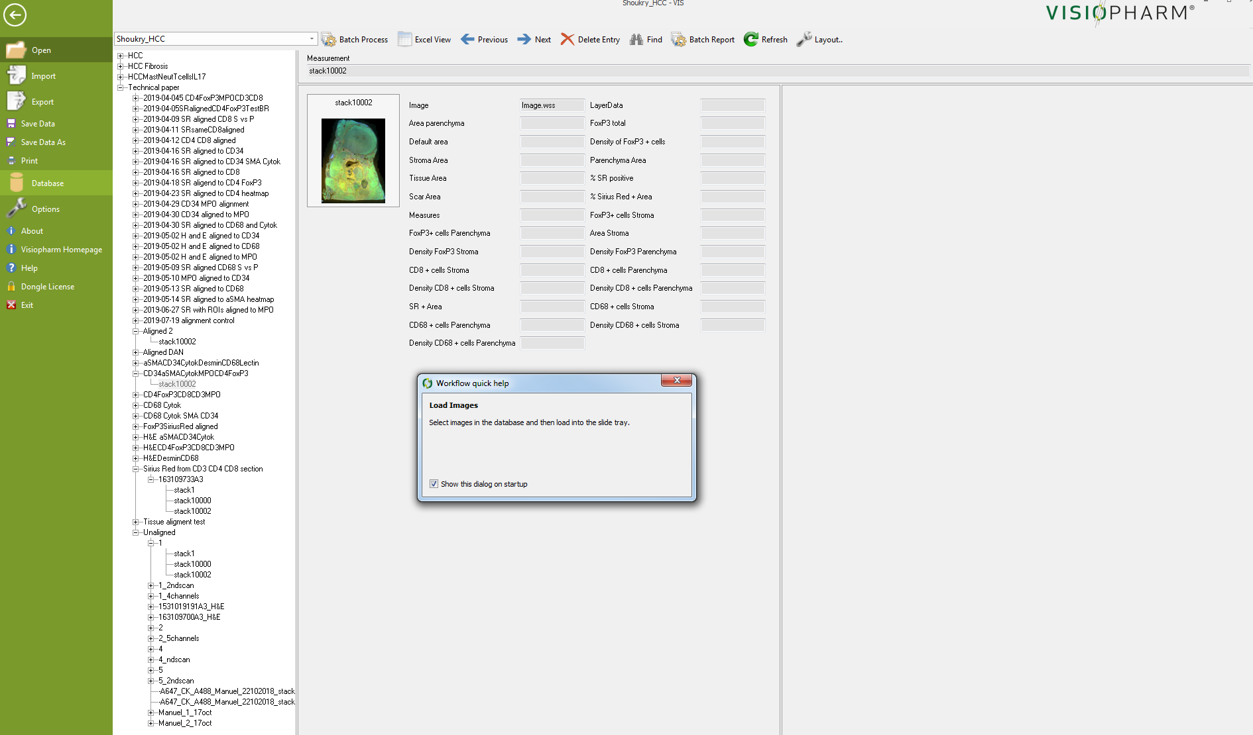
6.2.2. Import the composite (aligned) image by going to File | Database and selecting the image of interest and clicking back (red arrow) and then the Image Analysis tab

Slide 3
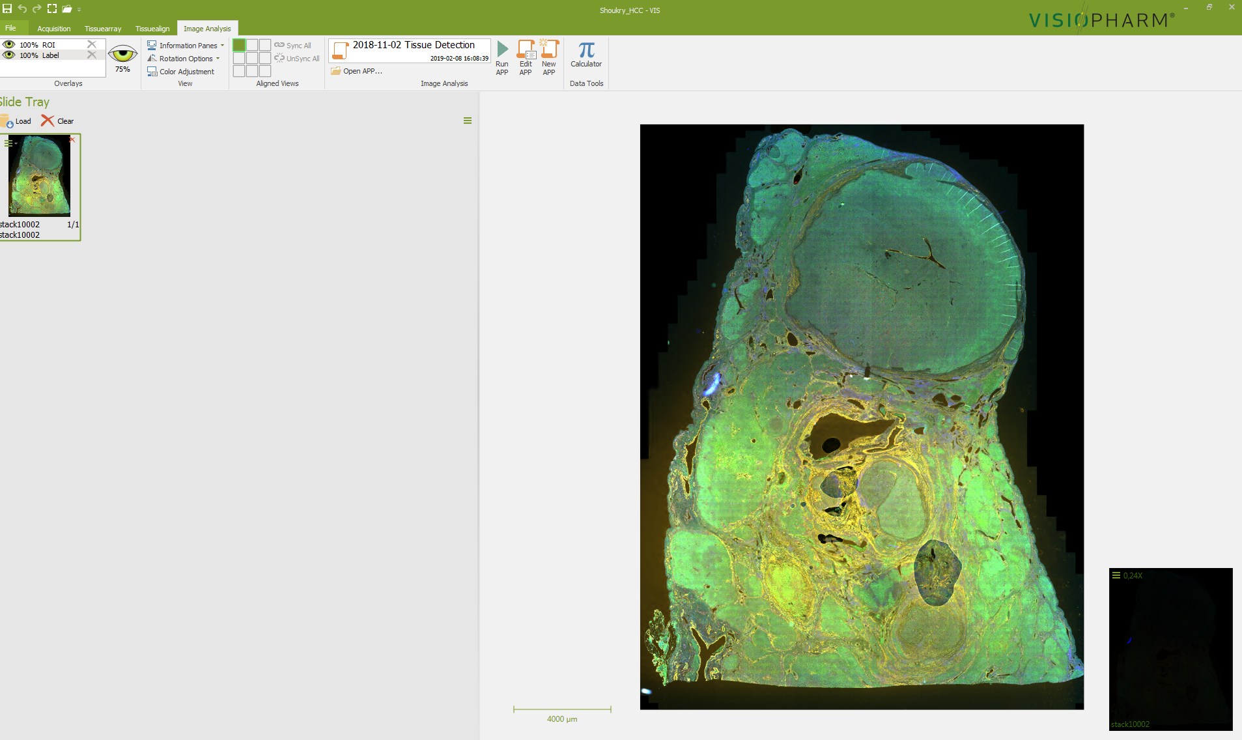
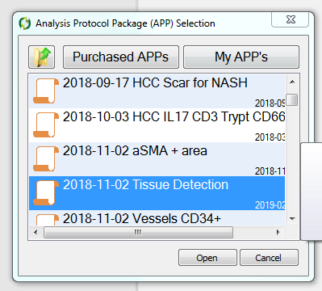
6.2.3. Open the APP selection dialog, by clicking on the Open APP icon (red arrow) and select which APP to use. In this case select APP 1 for tissue detection and open it.

Slide 4
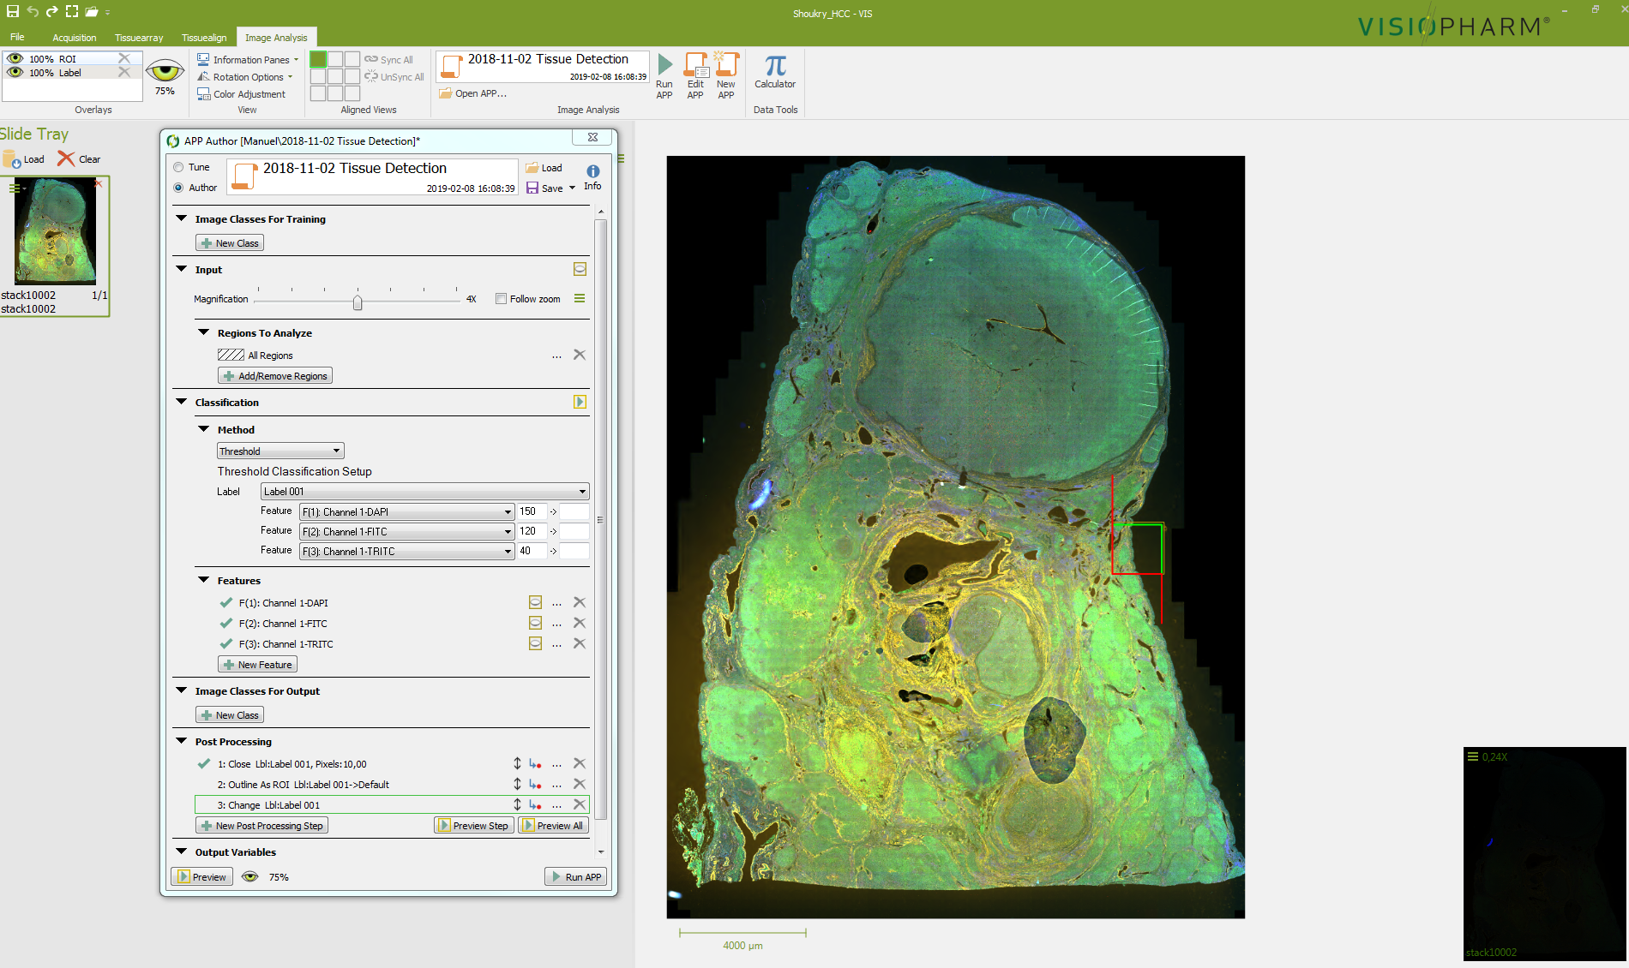
6.2.4. Once APP 1 is opened, confirm that APP1 is working properly by going to a selected tissue location and clicking on the preview button (red arrow). If the results are satisfactory (see results next slide), go to the next step.

Slide 5
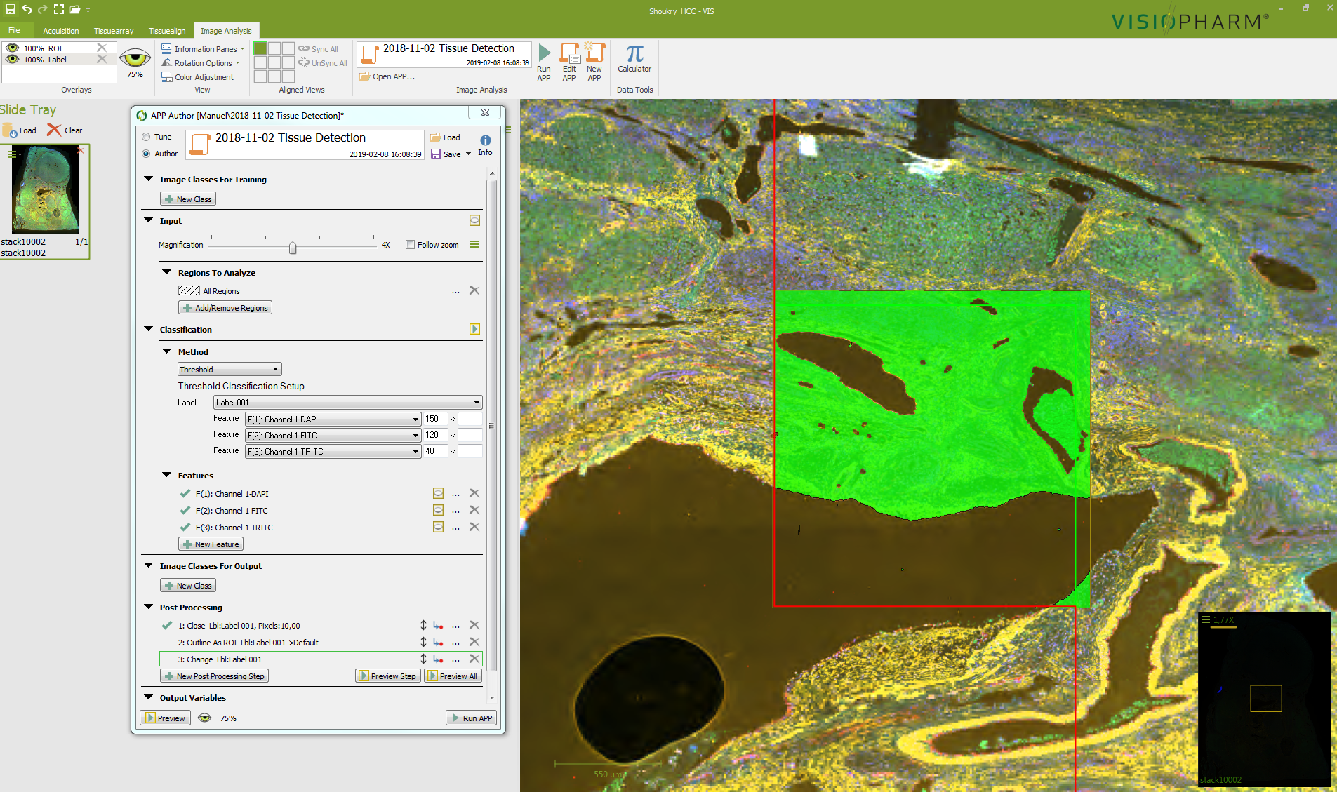

Slide 6
6.2.5. Click to run APP 1 (red arrow) and process the image using the selected APP.

Slide 7
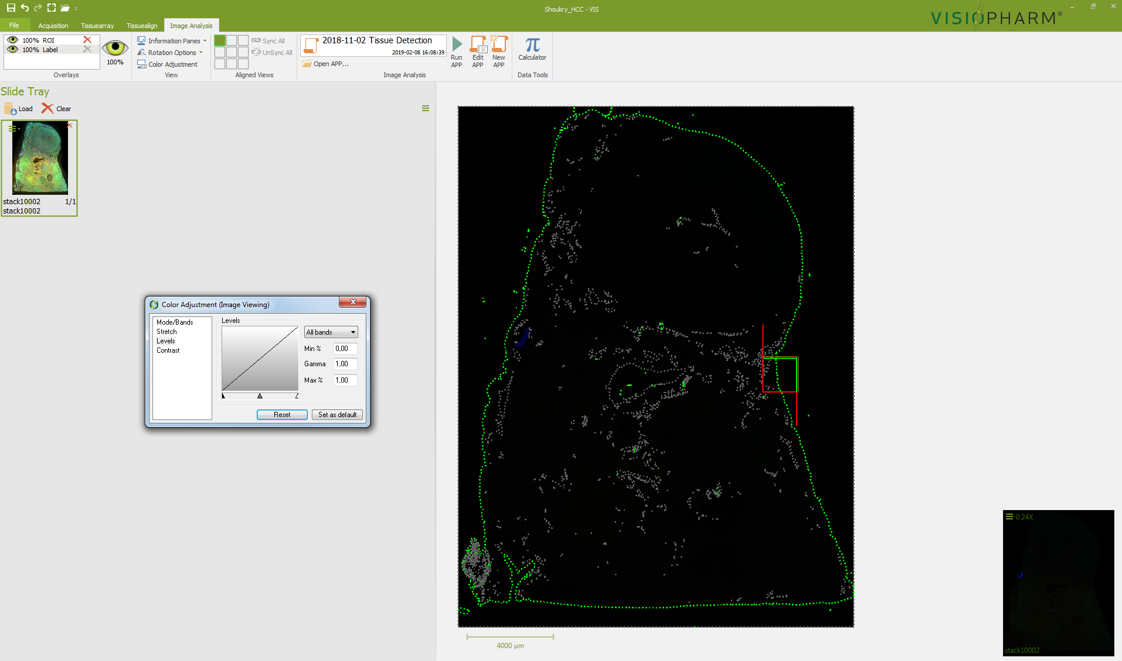
6.2.6. Export the data (images, measurements, etc.) when the analysis is done by clicking File/Export.
Here are the results of APP 1 ( a region of interest delineating the tissue):

