Slide 1
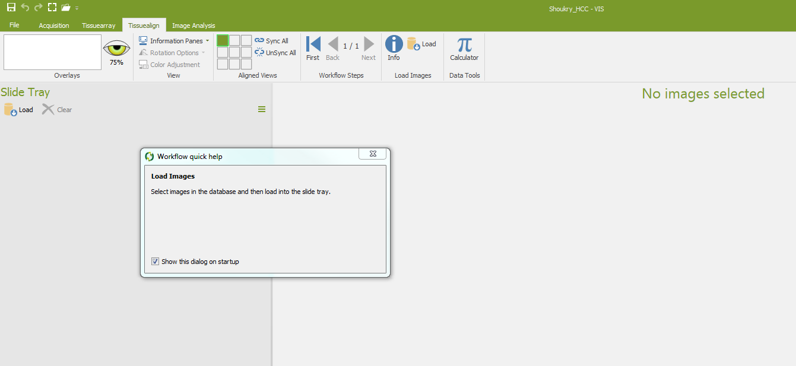
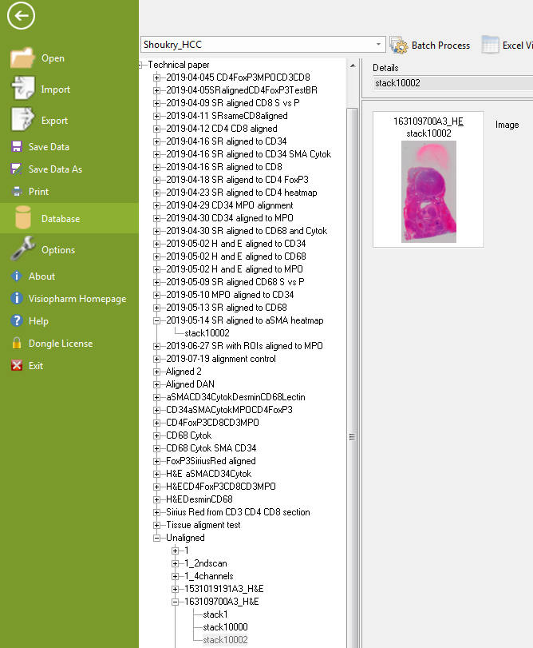
Section 6 Tissue Align
Steps:
1. Open the Tissuealign module interphase (red arrow). Select images in the database and load them into the slide tray in the order you want them to be aligned (image below)
Example: Go to File/Database and select the image (image below blue arrow)

Slide 2
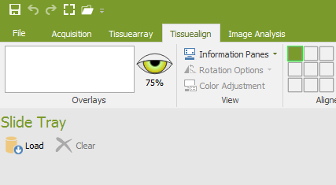
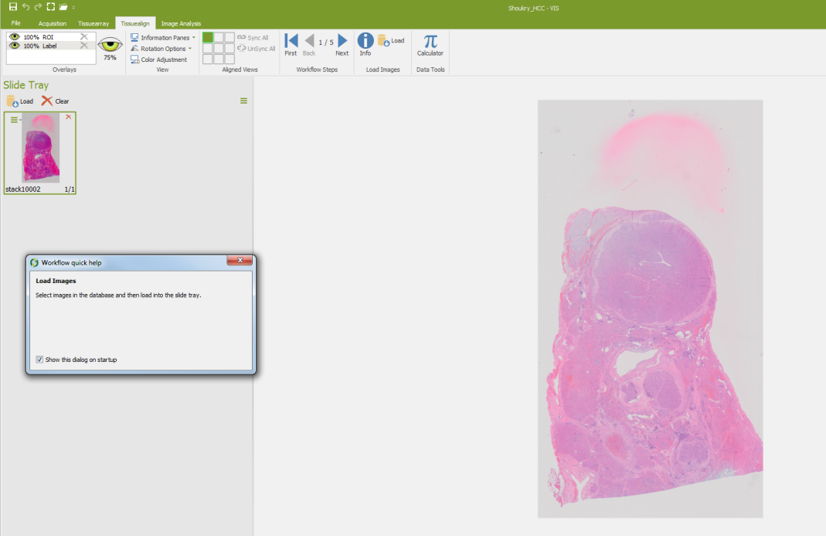
Go back to tissuealign and load the image (image below red arrow)
The image will then show in the slide tray and in the working area (image below)
Repeat these steps for all the images to be aligned (image next page)

Slide 3
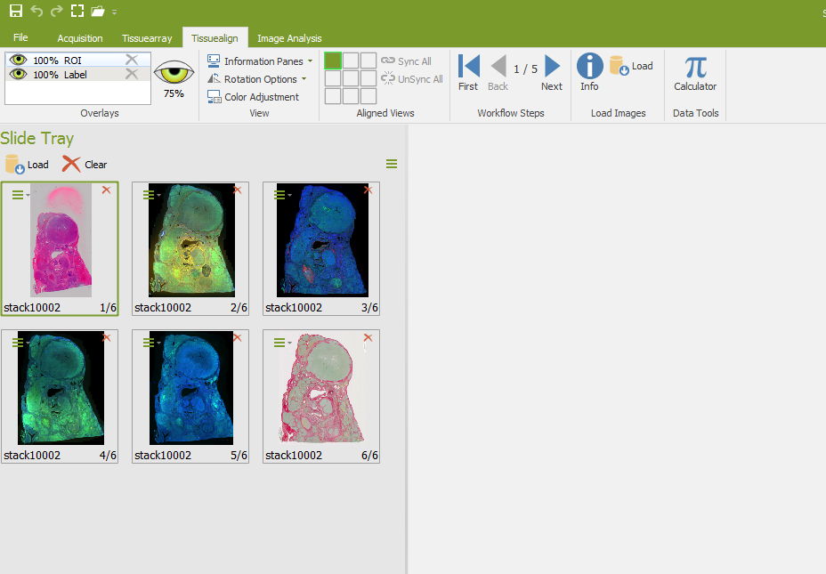

Slide 4

Link the images by pressing Next in the workflow steps (image below red arrow)

Slide 5
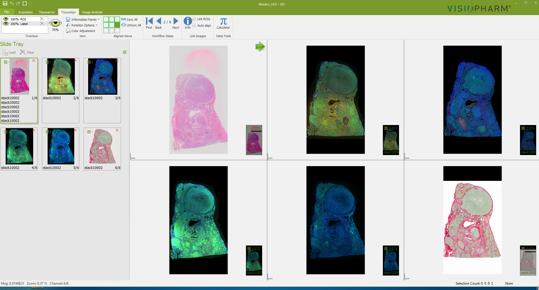
And then drag and drop the images 2,3,4,5, and 6 (orderly) on top of image 1 to link them.

Slide 6
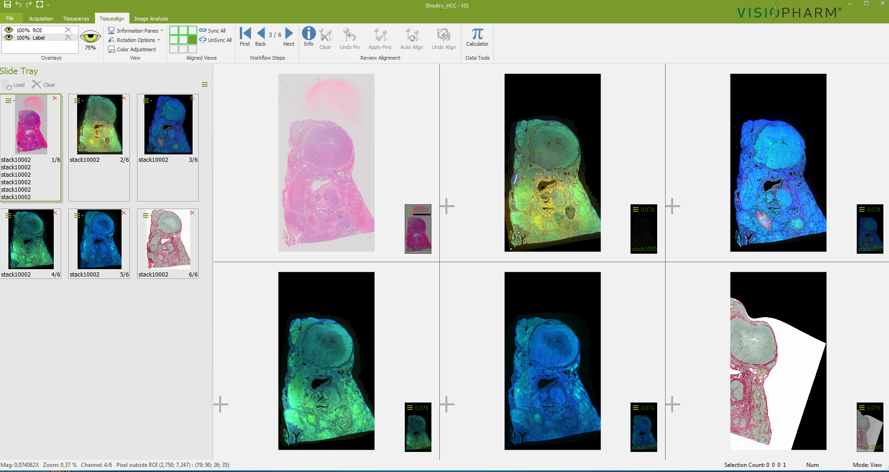
Perform Autoalignment by clicking next in the workflow steps blue arrow.
Results of autoalignment
If not satisfied with the results of the auto alignment which is the case here, the alignment can be improved or corrected using pins. Pins are used to indicate the location of homologous tissue structures in linked images so that the algorithm can use them as a reference for correcting the alingment. Two possibilities are available: semi-automatic alignment and manual alignment.

Slide 7
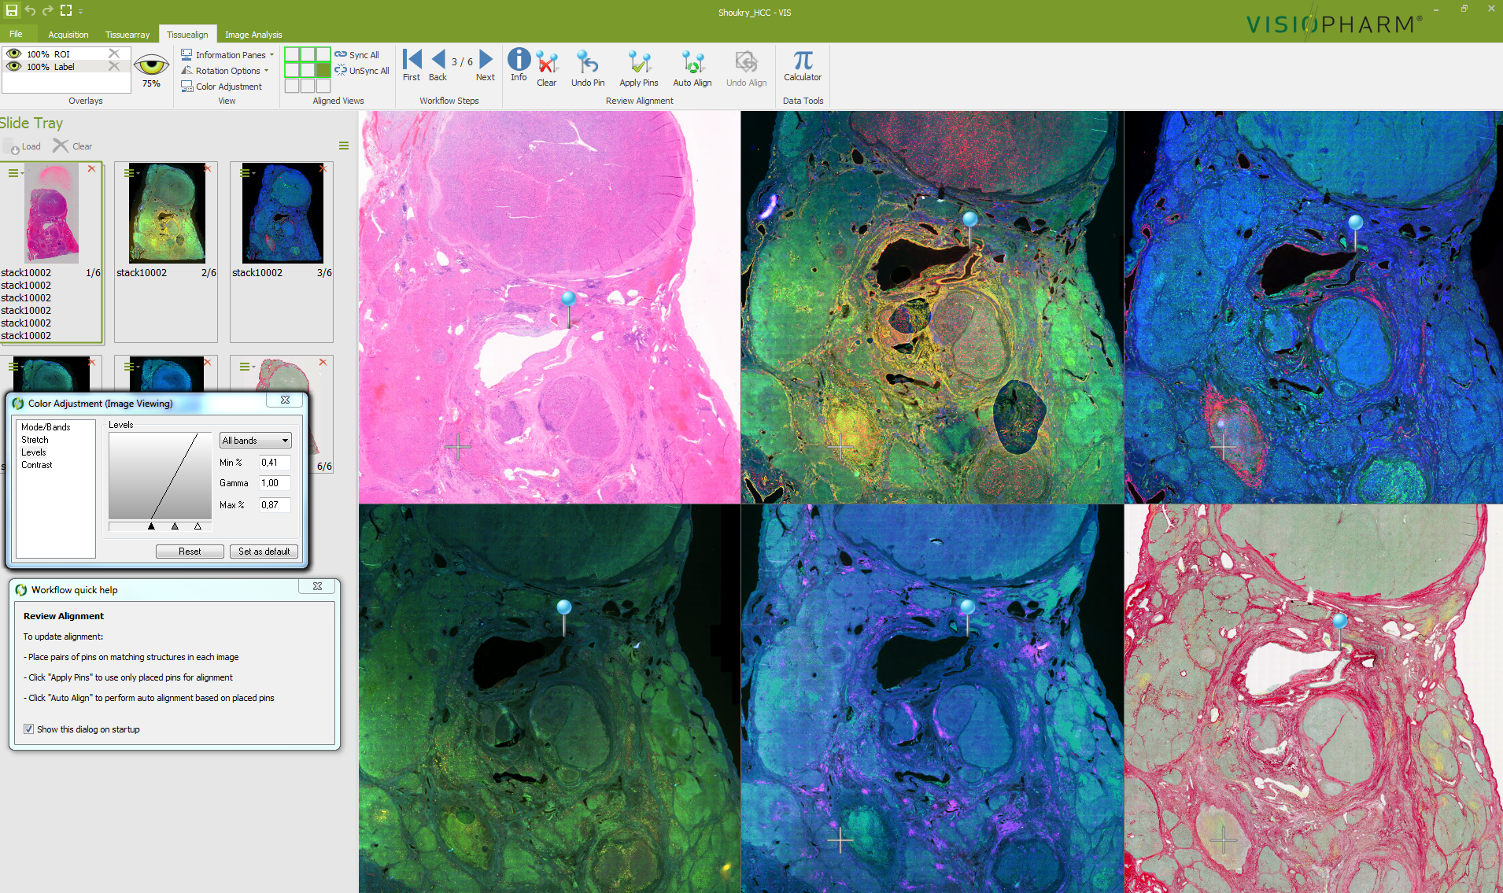
Place pins indicating homologous structures on linked images

Slide 8
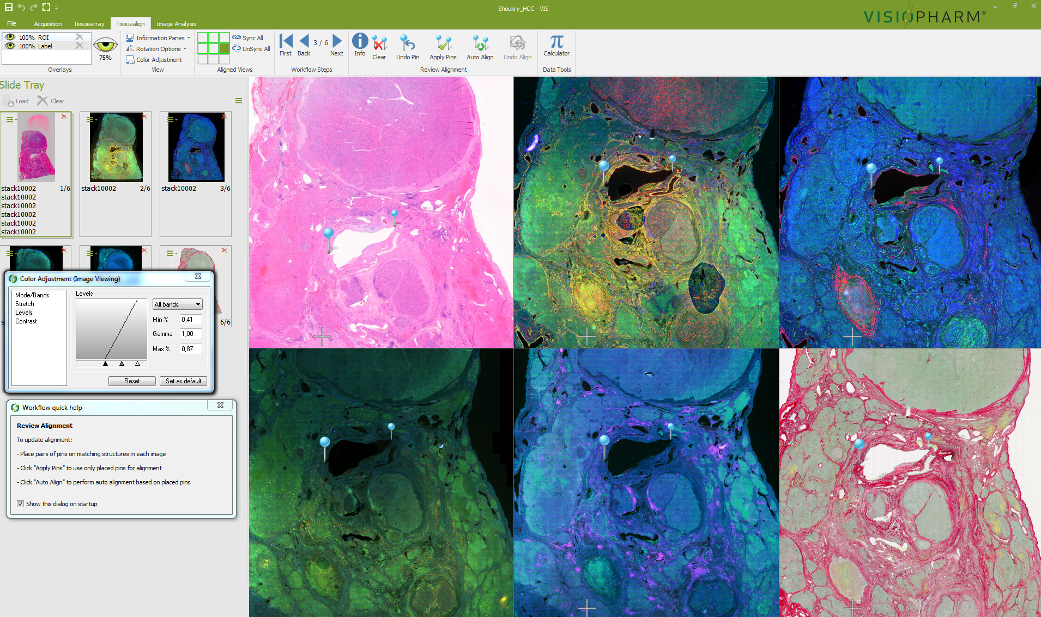

Slide 9
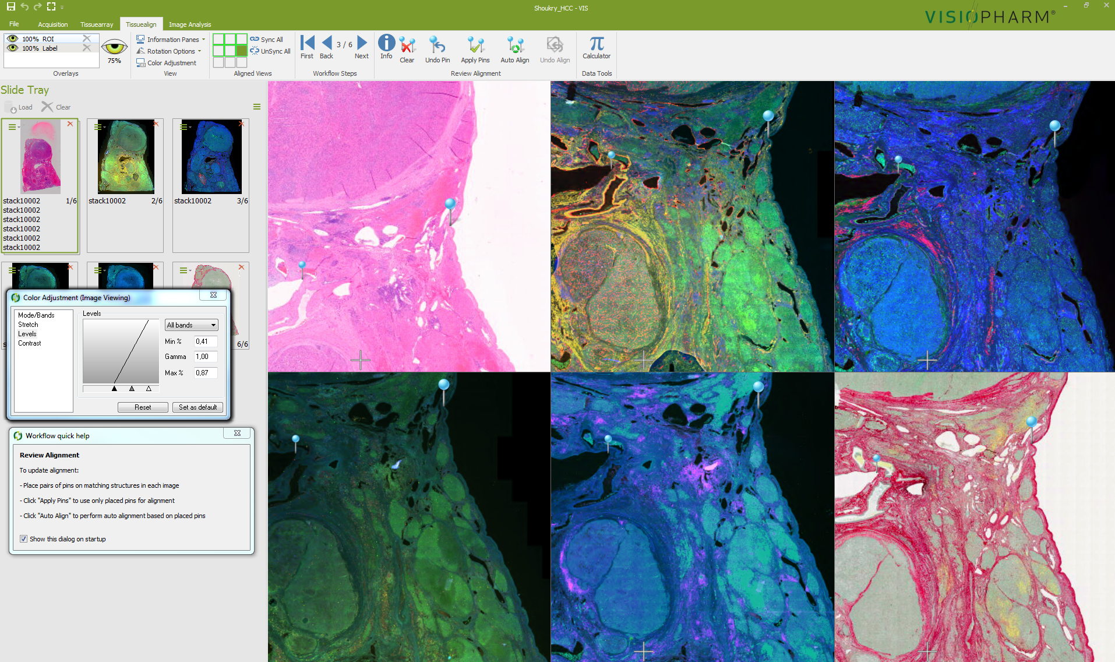

Slide 10
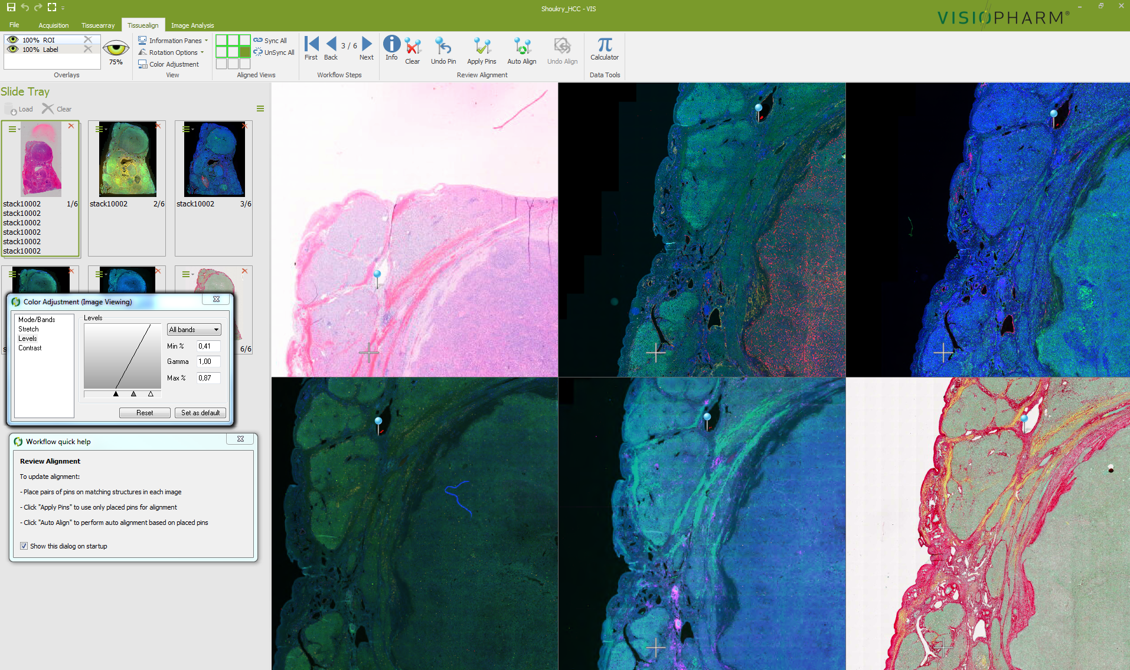

Slide 11
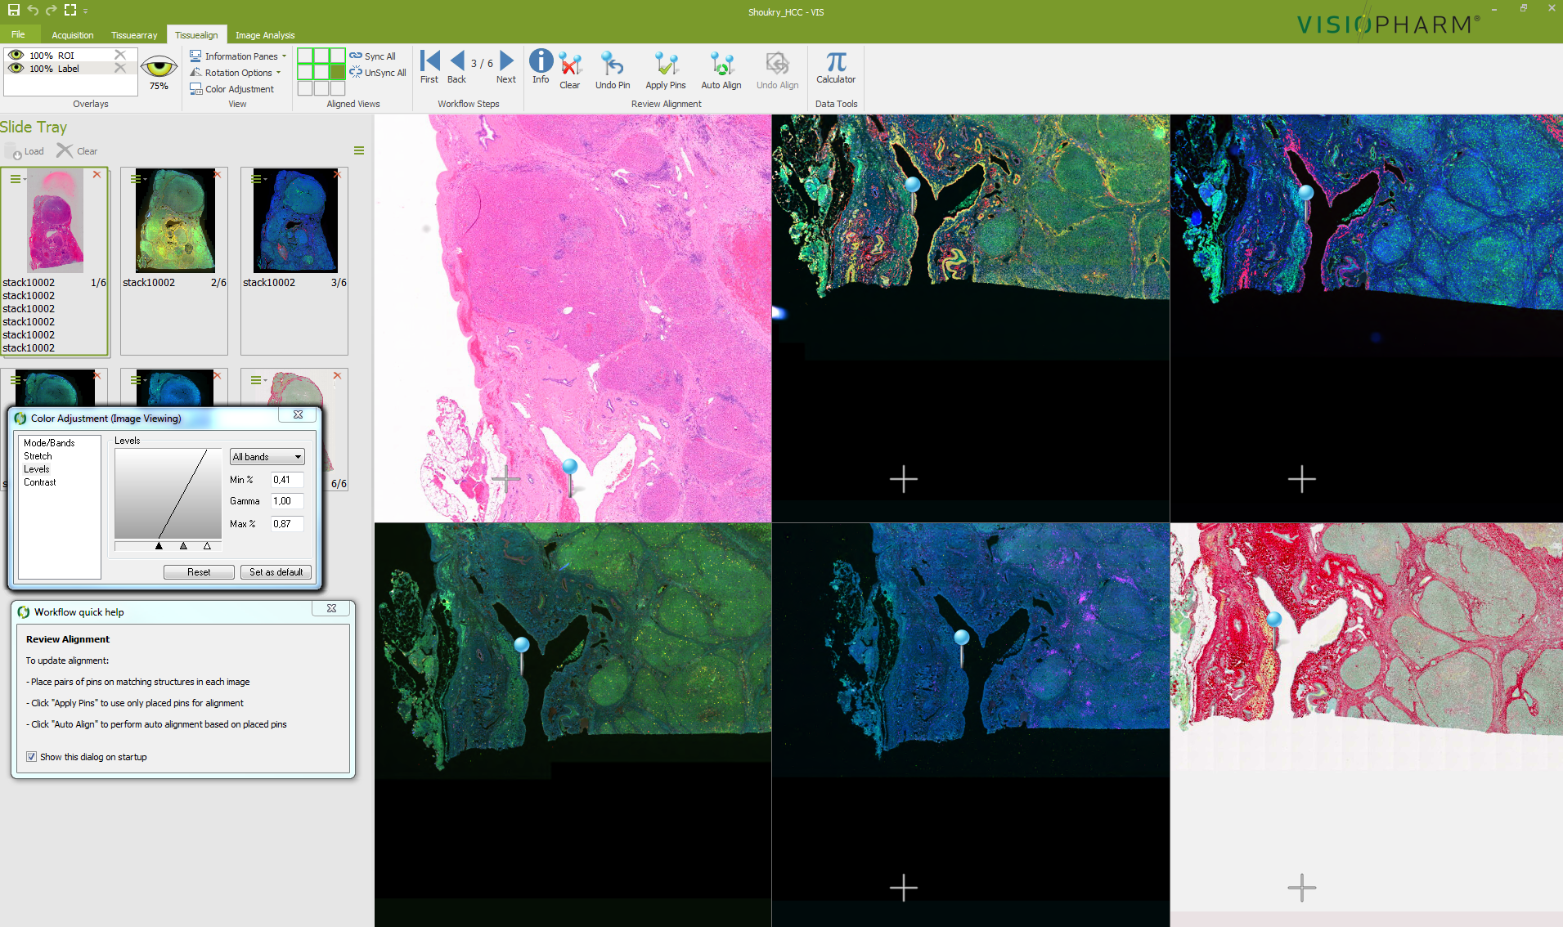

Slide 12
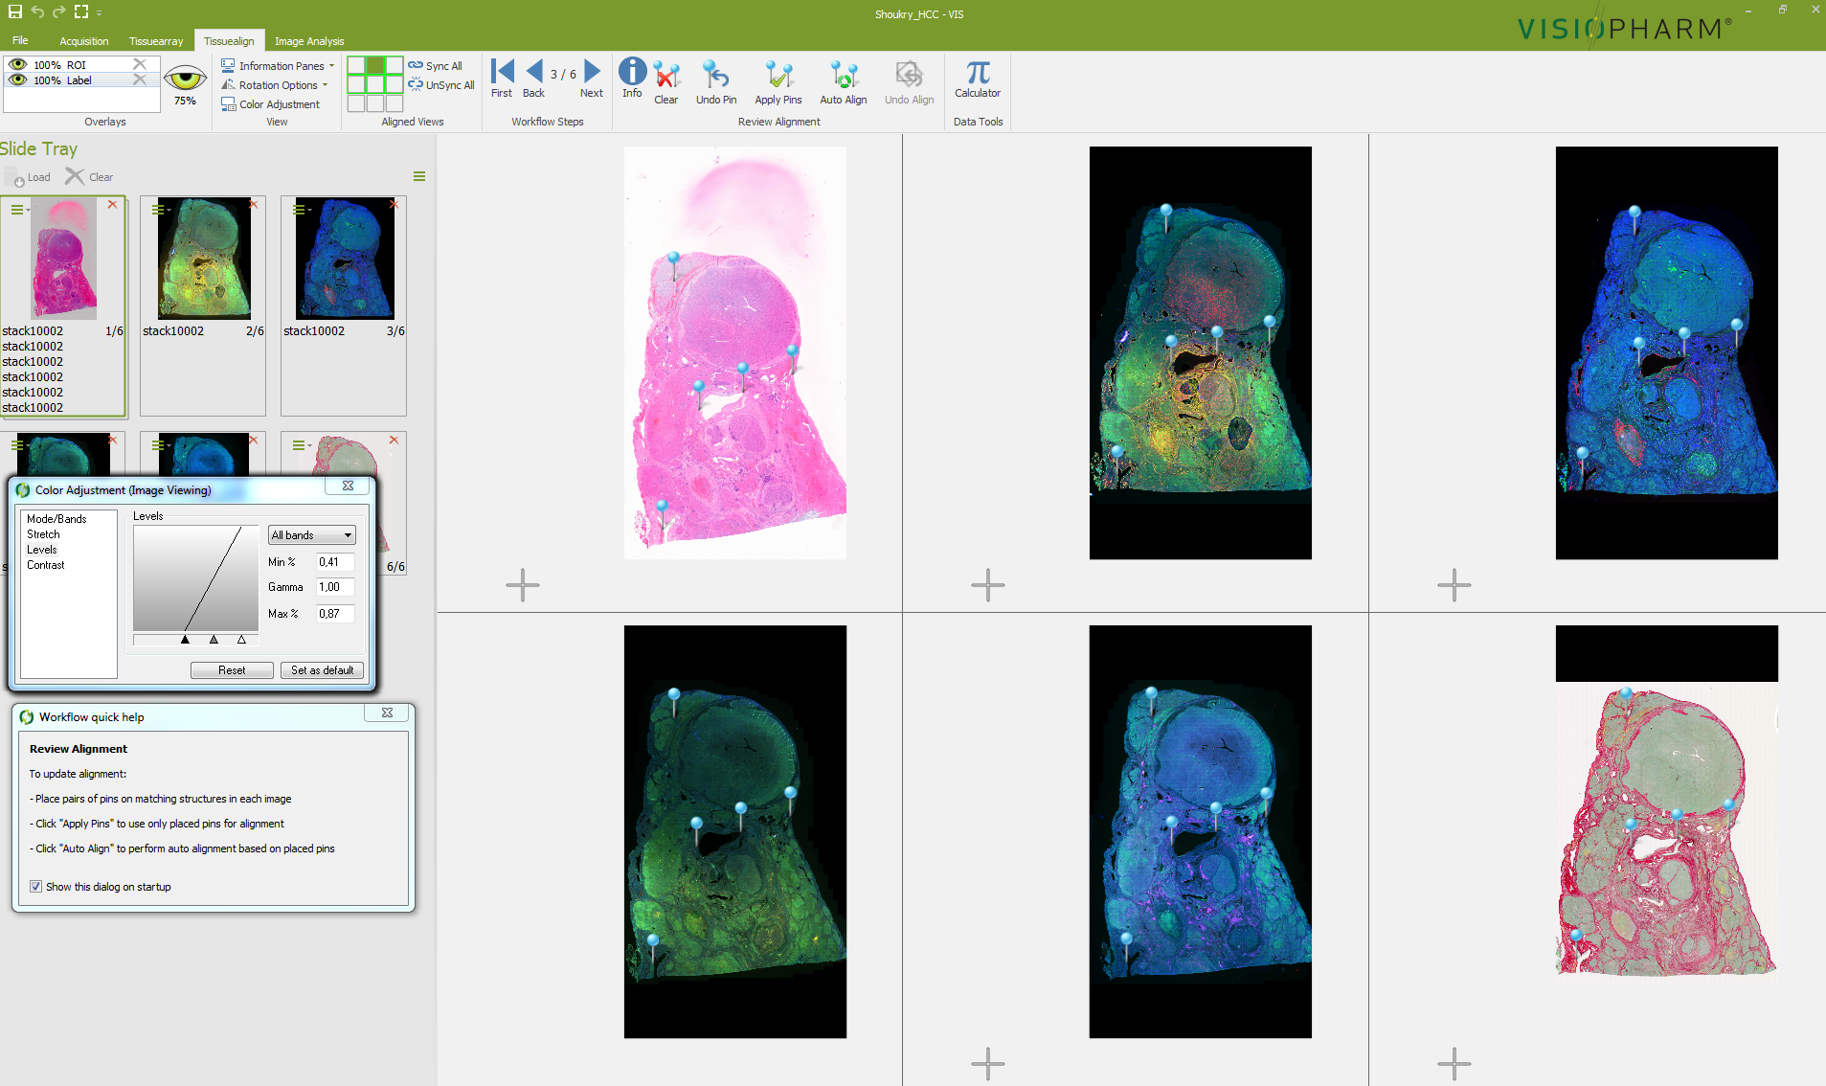

Next press either the Apply Pins or the Auto Align button (red arrows below) for manual alingment or semi-automatic alignment respectively (results below). If satisfied with the alignment press next in the workflow steps and save the composite image generated by the protocol

