Slide 1
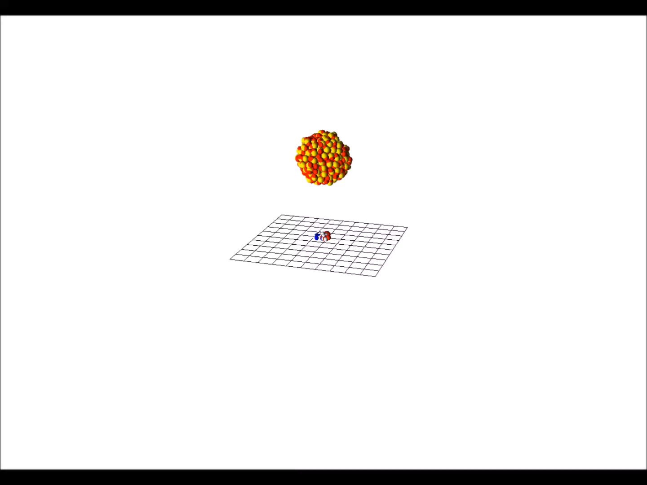
Molecular dynamics simulations of cluster-induced desorption

Slide 2
Triggering the ion trap and pulsed nozzle
„main trigger“
2Hz
„clear trap“ signal
function generator
ion trap
delay generator
pulsed nozzle
starts measuring cycle („clear trap“) within 2 ms after trigger
+ Δt_{n}
Voltage
Δt_{n}
time

Slide 3
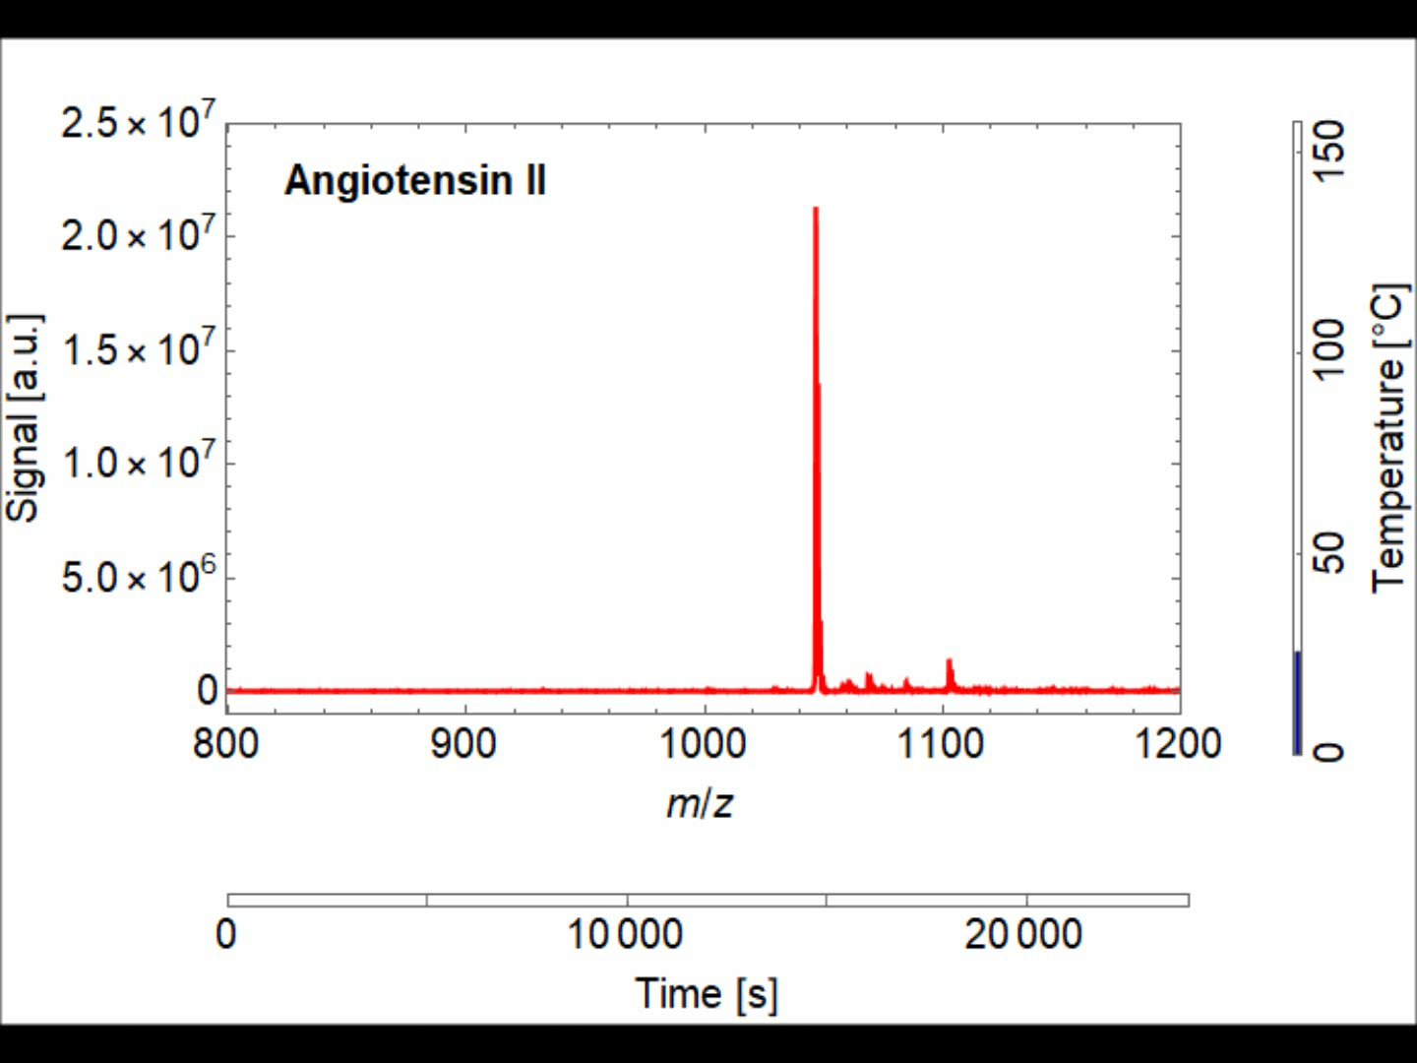
Thermal degradation of angiotensin II

Slide 4
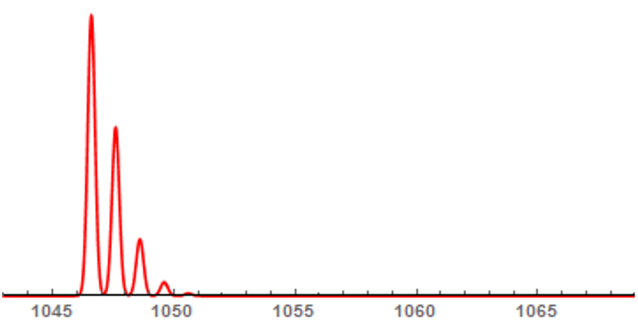
H/D exchange in angiotensin II
m/z
0s
250s
500s

Slide 5
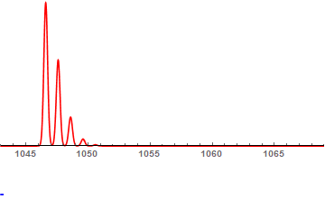
H/D exchange in angiotensin II
m/z = 1063.7
m/z
0s
250s
500s

