Slide 1
















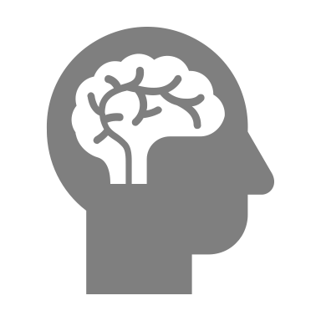





Individual needs
Responsiveness
Attunement
Entrainment
Stimulation
Communicative
musicality
Synchronization
Stabilization
Relaxation
Parental
self-efficacy
Infant-directed
singing
Empowerment
Flexibility
Creativity
Parent-infant
bonding
Meaningful
interaction

