Slide 1
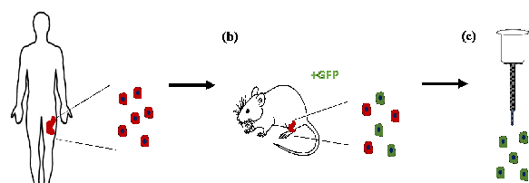




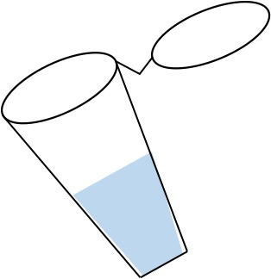
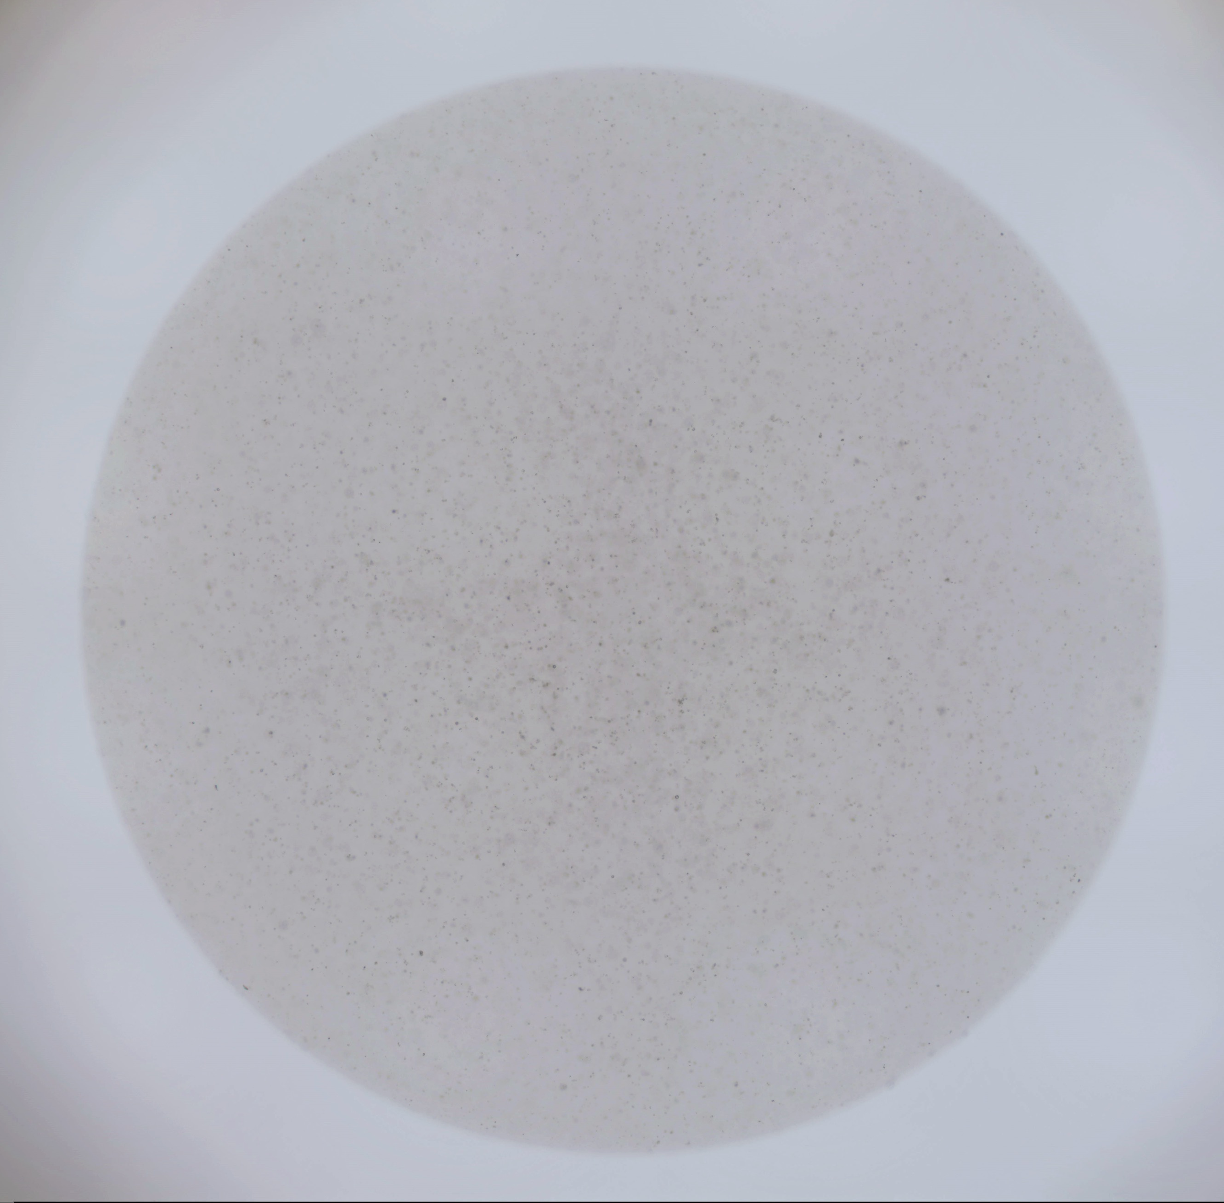
Doming Options for 3D Cultured Organoids
Primary Tumor from patients
Patient Derived
Xenograft
Tumor
Cells Ready to Dome
Attached Round Dome
Protocol 1
Protocol 3
Floating Dome from
Attached Round Dome
Protocol 4
Floating Dome
Parafilm Beads Method
Protocol 2
Protocol 5
Tips for Slide Preparation Histology & IFC
3D Cultured
Organoids
Protocol 8
Protocol 6
Organoids Processing for Histology Agarose Spin Down Method
In Vitro Images Stitching
Protocol 7
Figure 1.

Slide 2
(a) Attached Dome
(b) From Attached Dome
to Floating Dome
(c) Parafilm Beads
Figure 2.

Slide 3
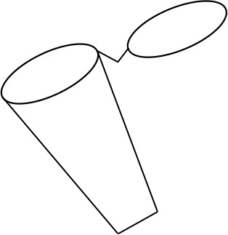
22 G needle
Successful
Agarose Embedding
20 min
Agarose
Cell Pellet
Without
a process
to detach
the cell pellet
from the wall
20 min
Warning
Loss of partial or full cell pellet

Slide 4
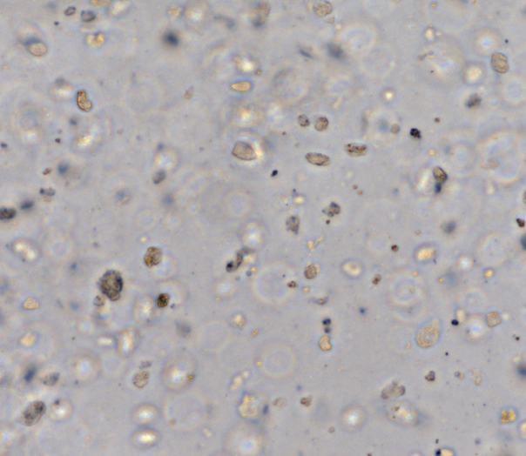
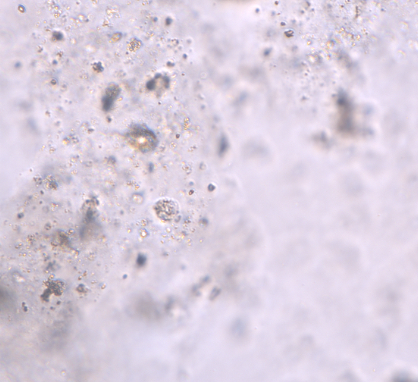
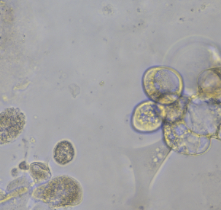
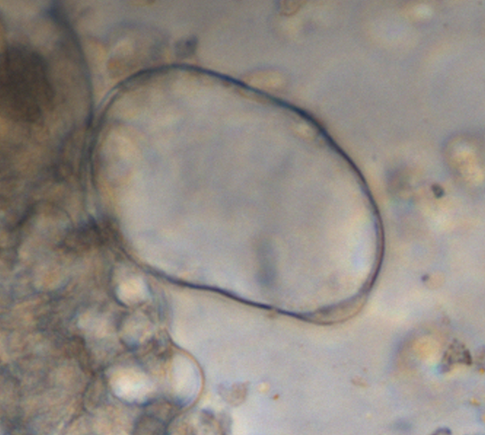
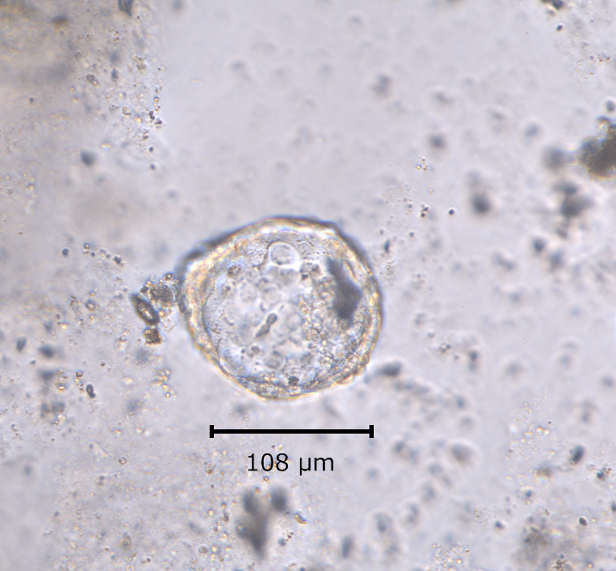
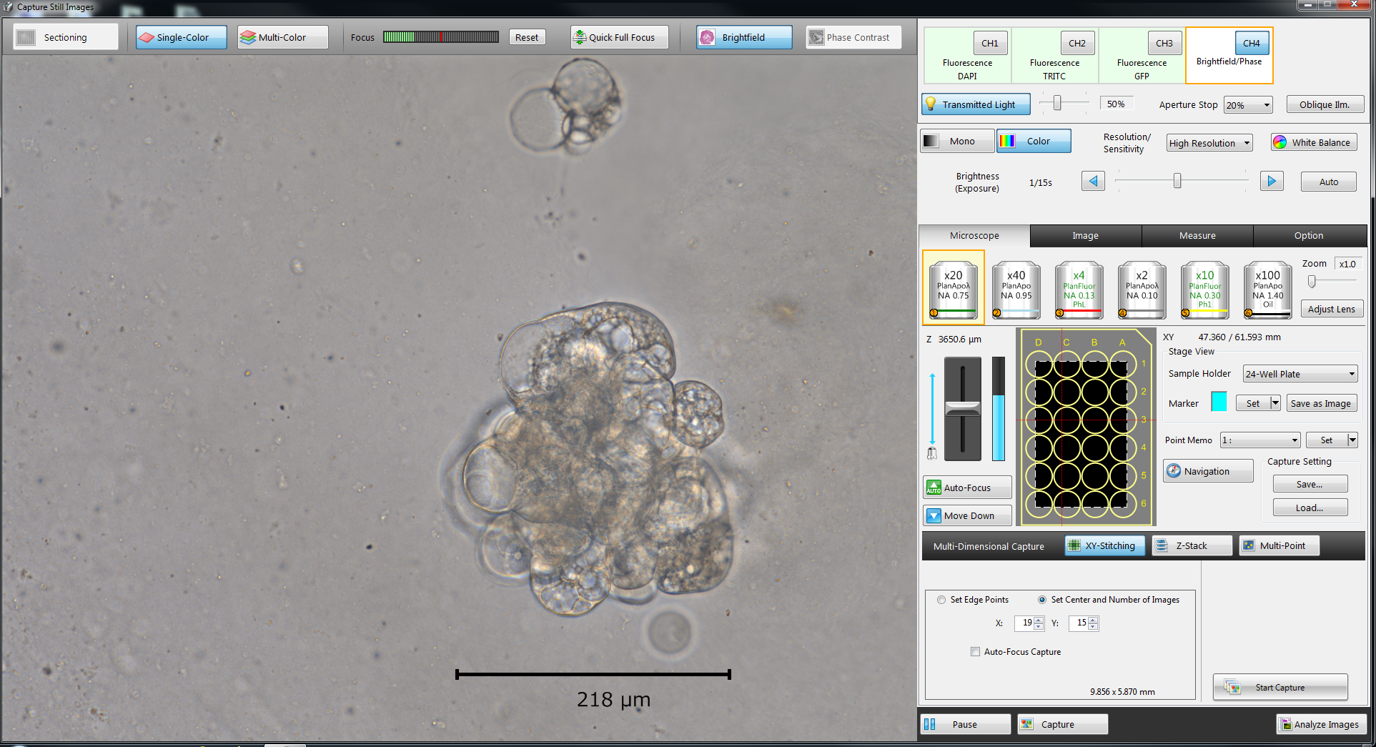
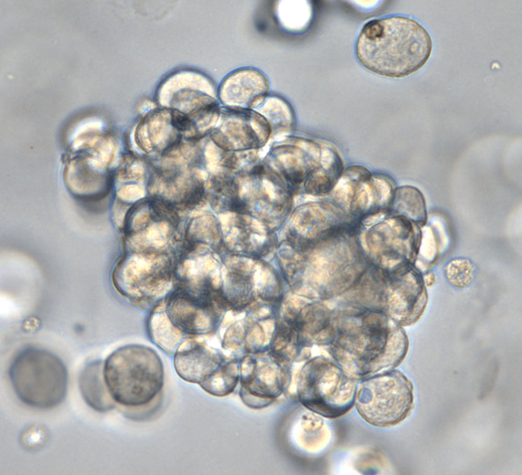
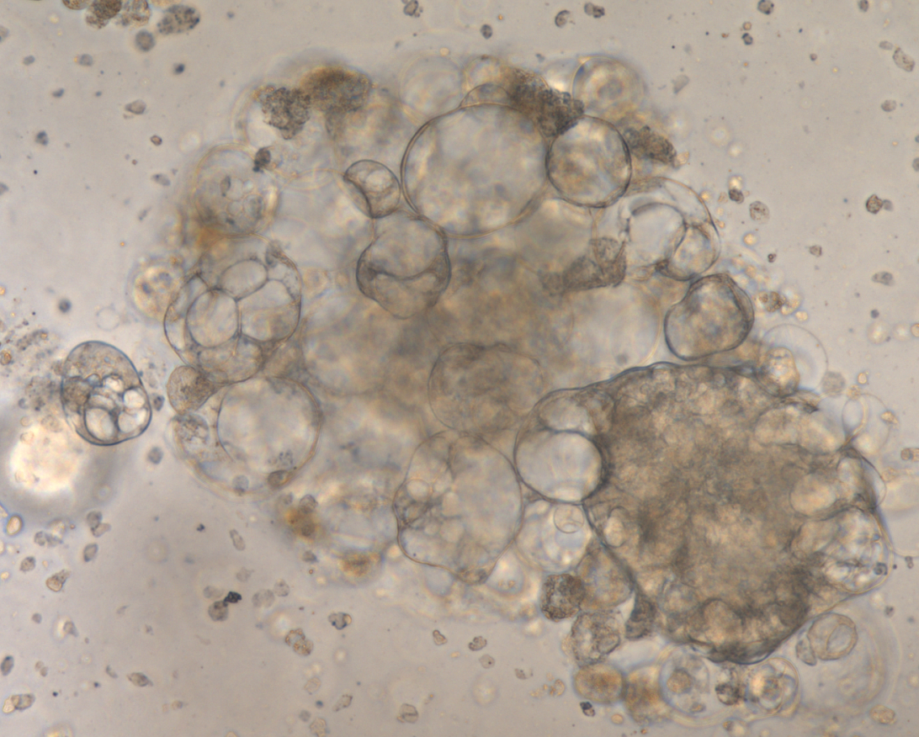
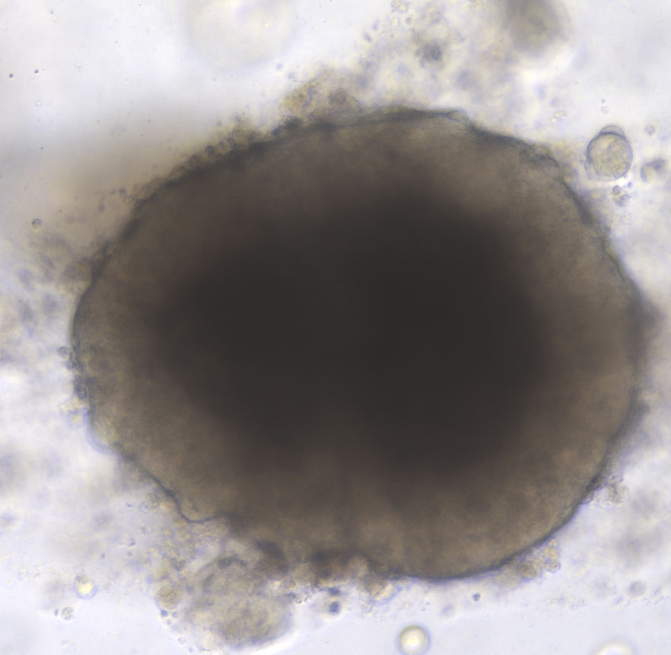
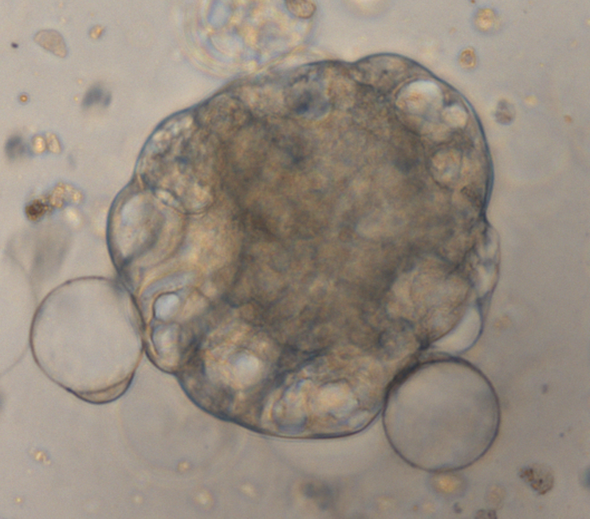
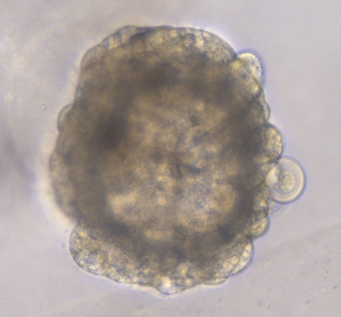
from Patient Derived Xenograft
from Patient Tumor
PCSD1
PCSD13
PCSD18
PCSD22
Single Cells
Cyst
Spheroids
Scale Bar
Black = 50 um
Red = 100 um
Organoid
Figure 4.

Slide 5
Raw Stitched Image
Analyzed Stitched Image
2000 μm
Figure 5.

Slide 6
CK5 CK8 DAPI
CK5 CK8 DAPI
CK5 CK8 DAPI
200 μm
Figure 6.

