Slide 1
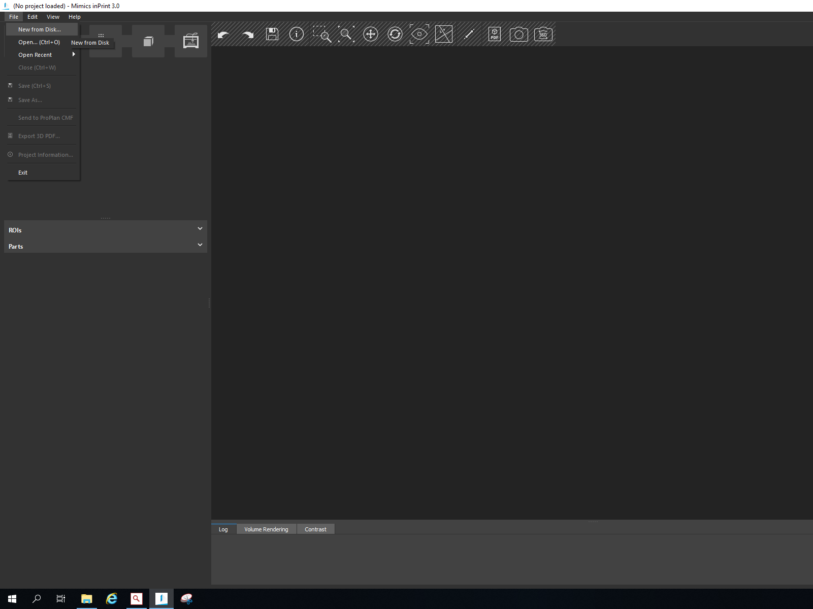
MIMICS software
Step 3 guideline
Contains all mouseclicks !

Slide 2
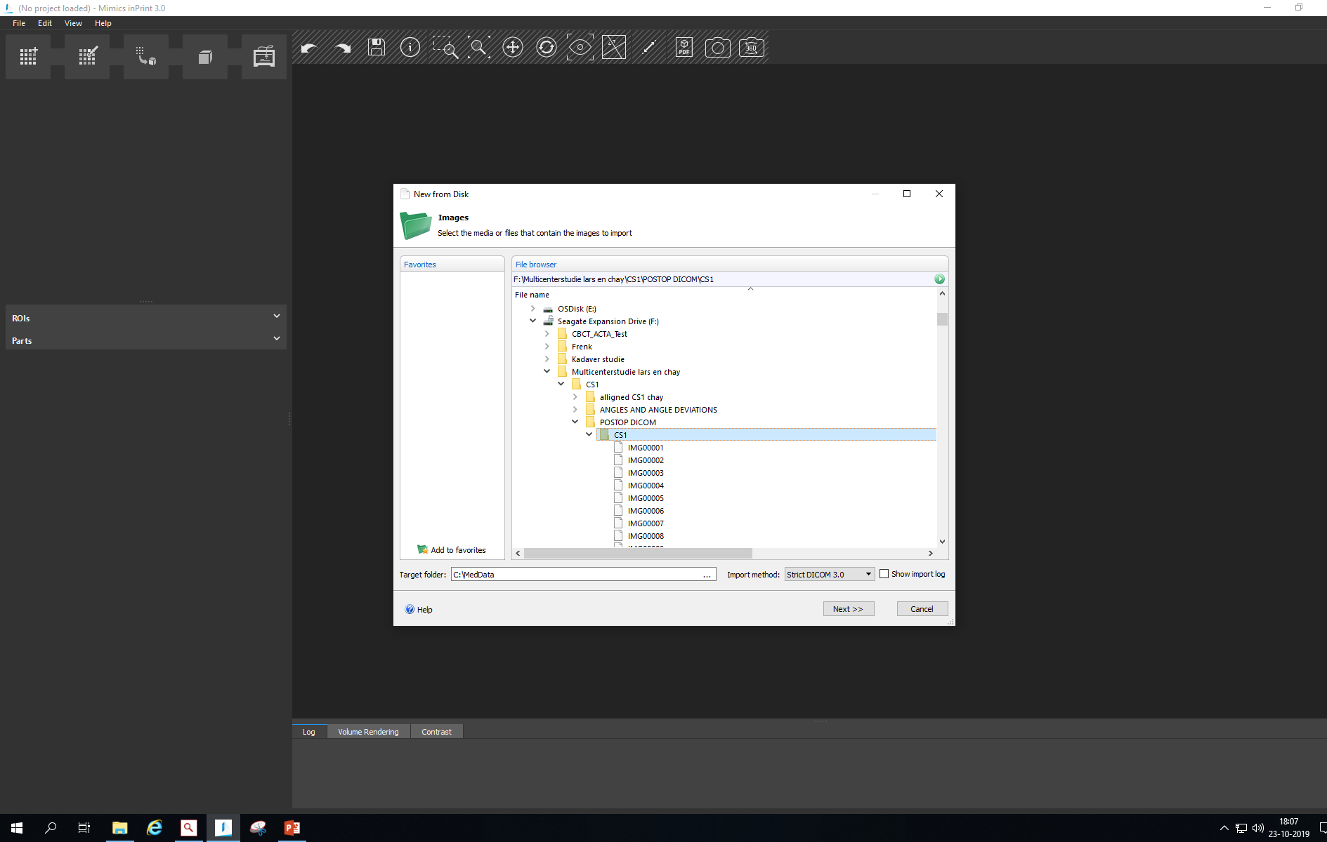

Slide 3
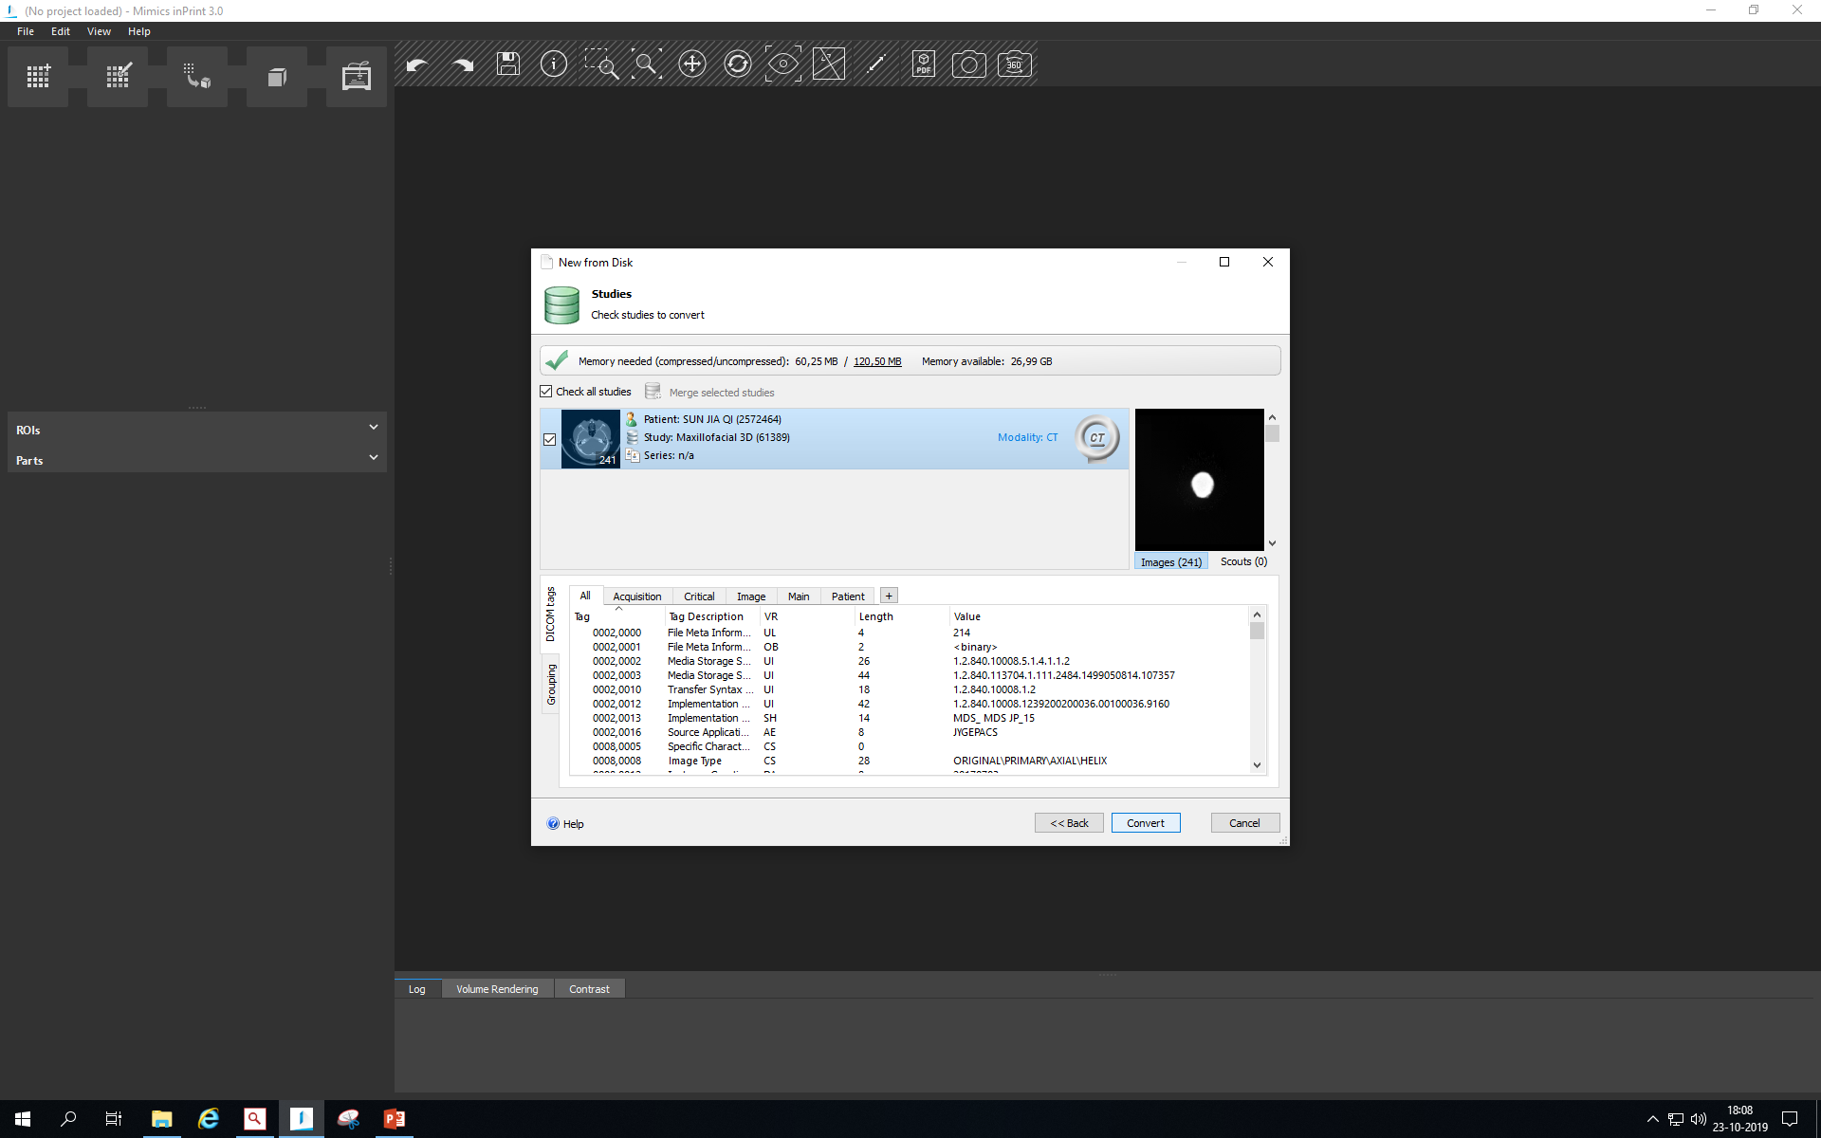

Slide 4
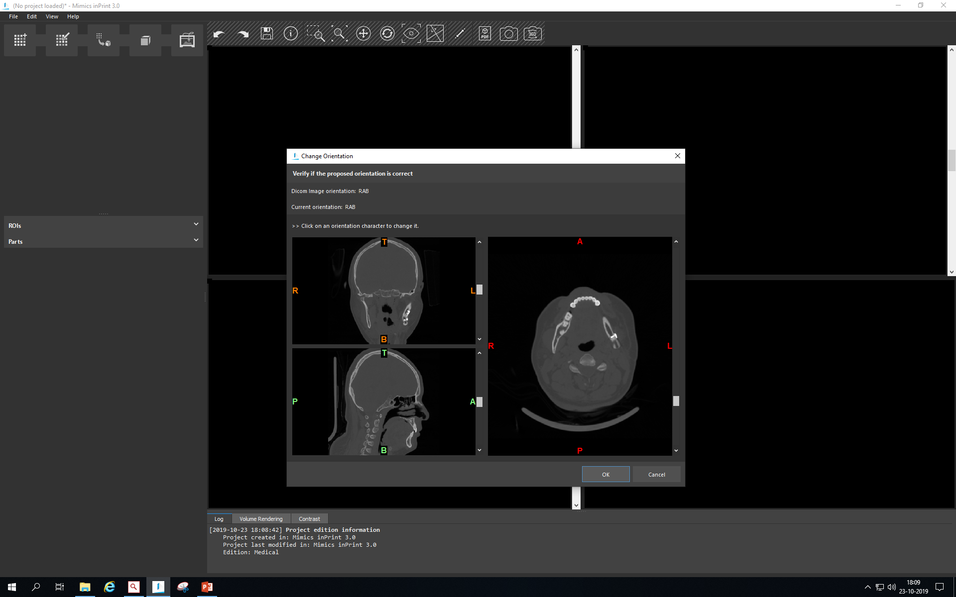

Slide 5
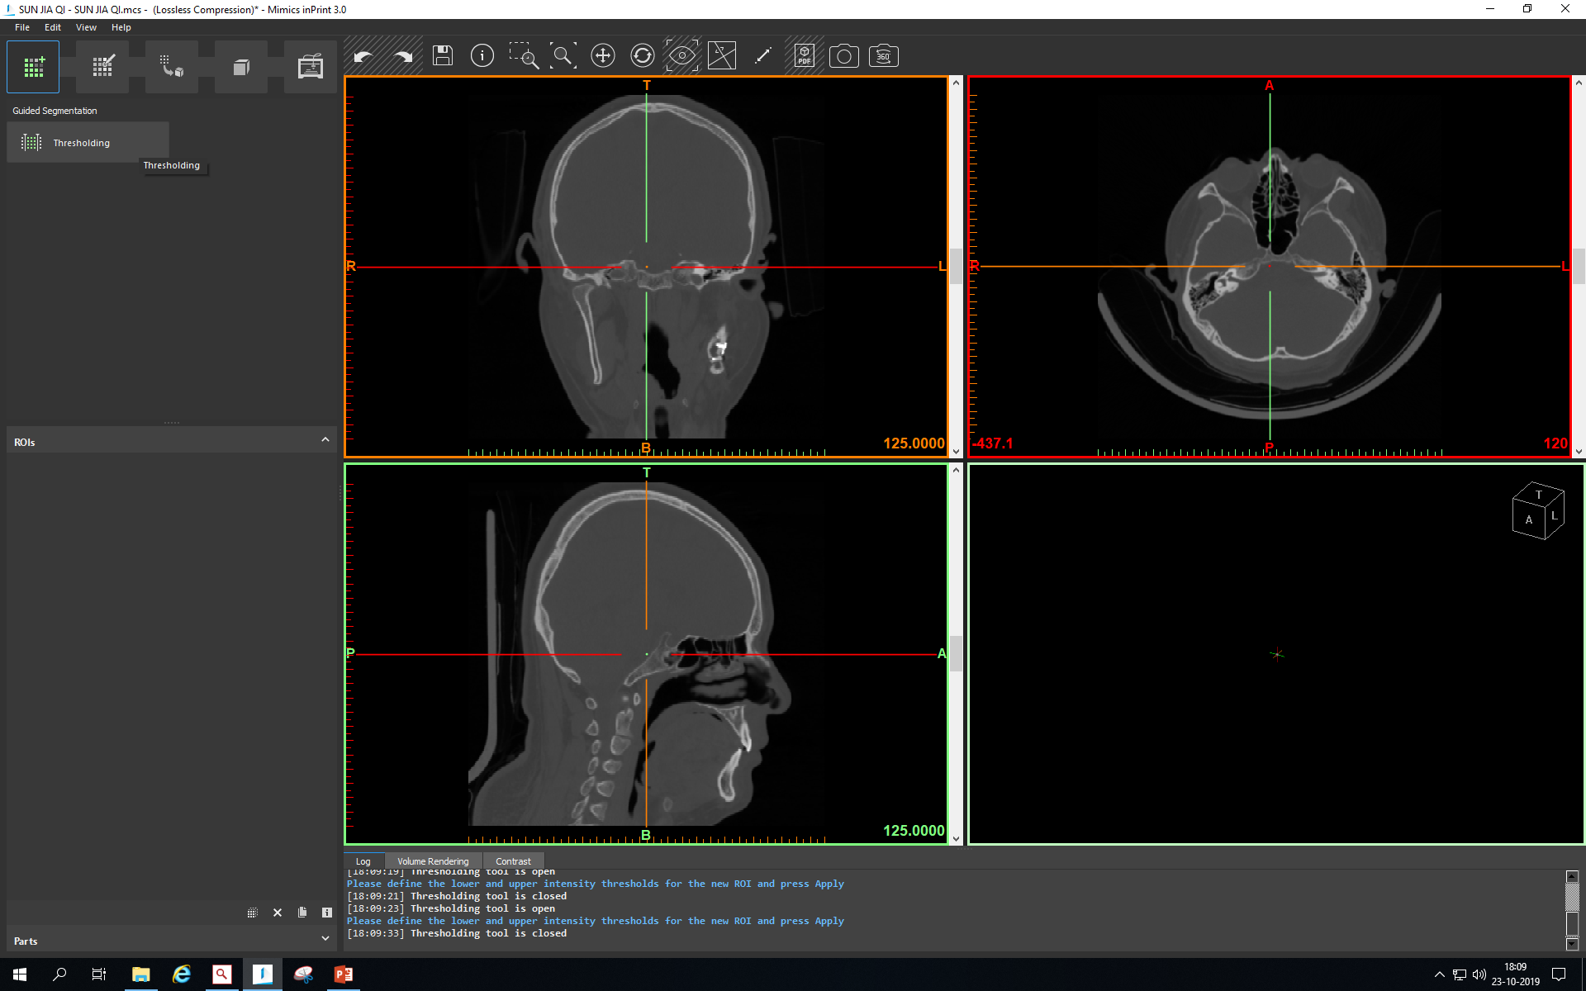

Slide 6
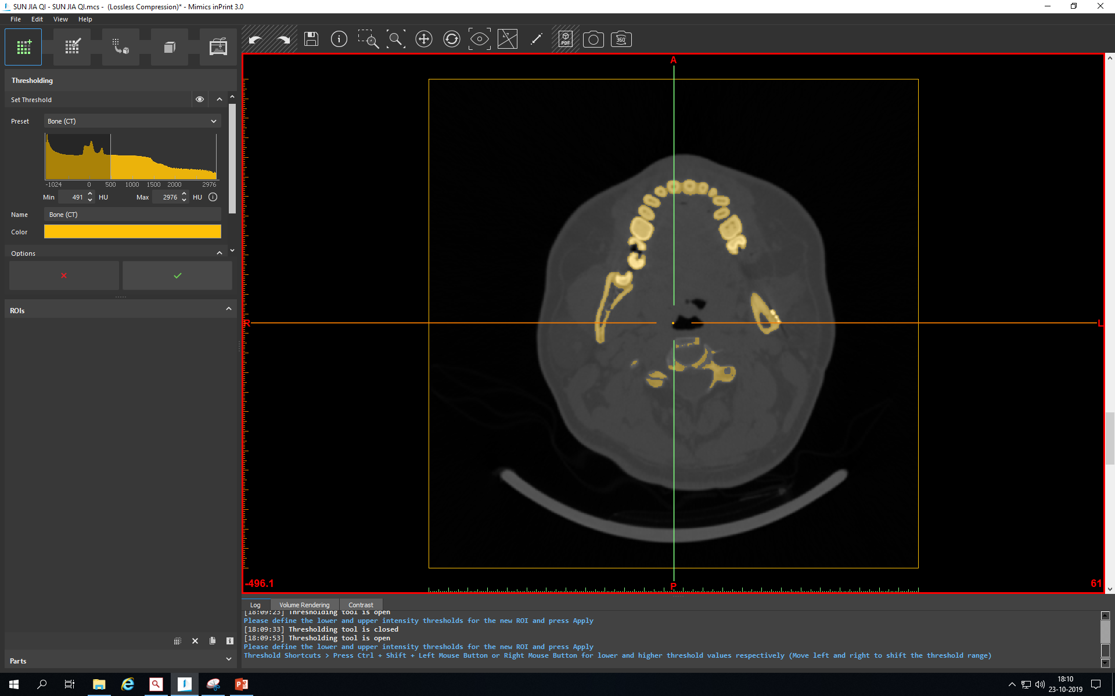

Slide 7
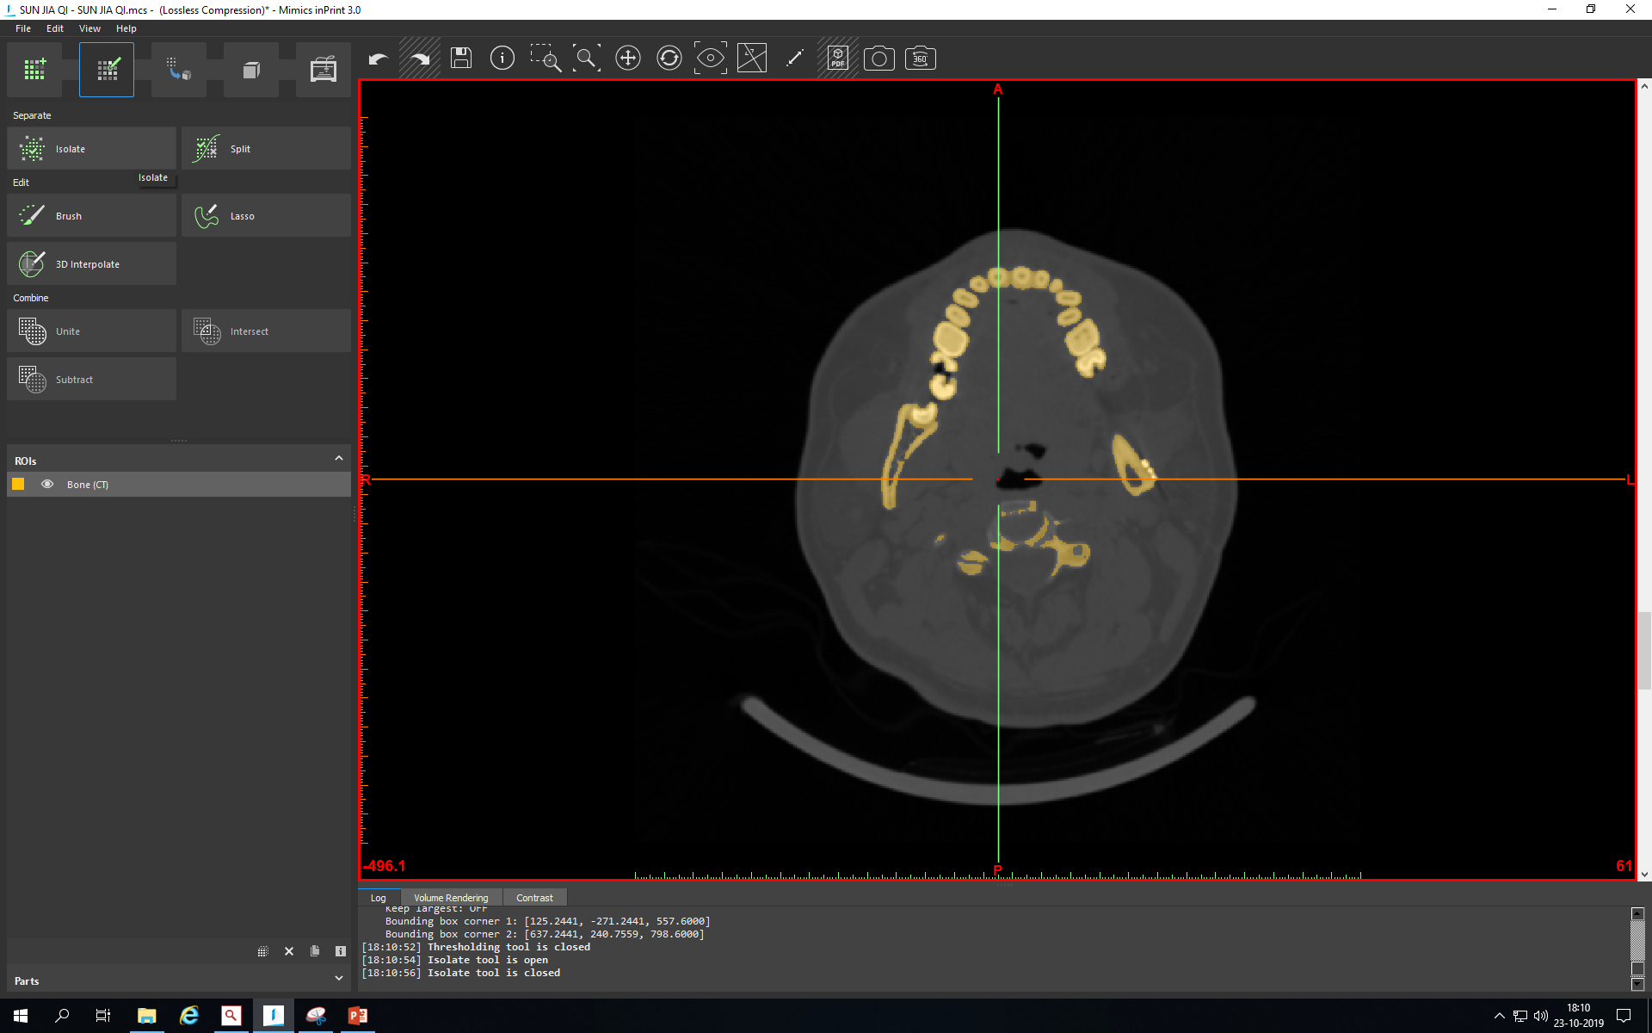

Slide 8
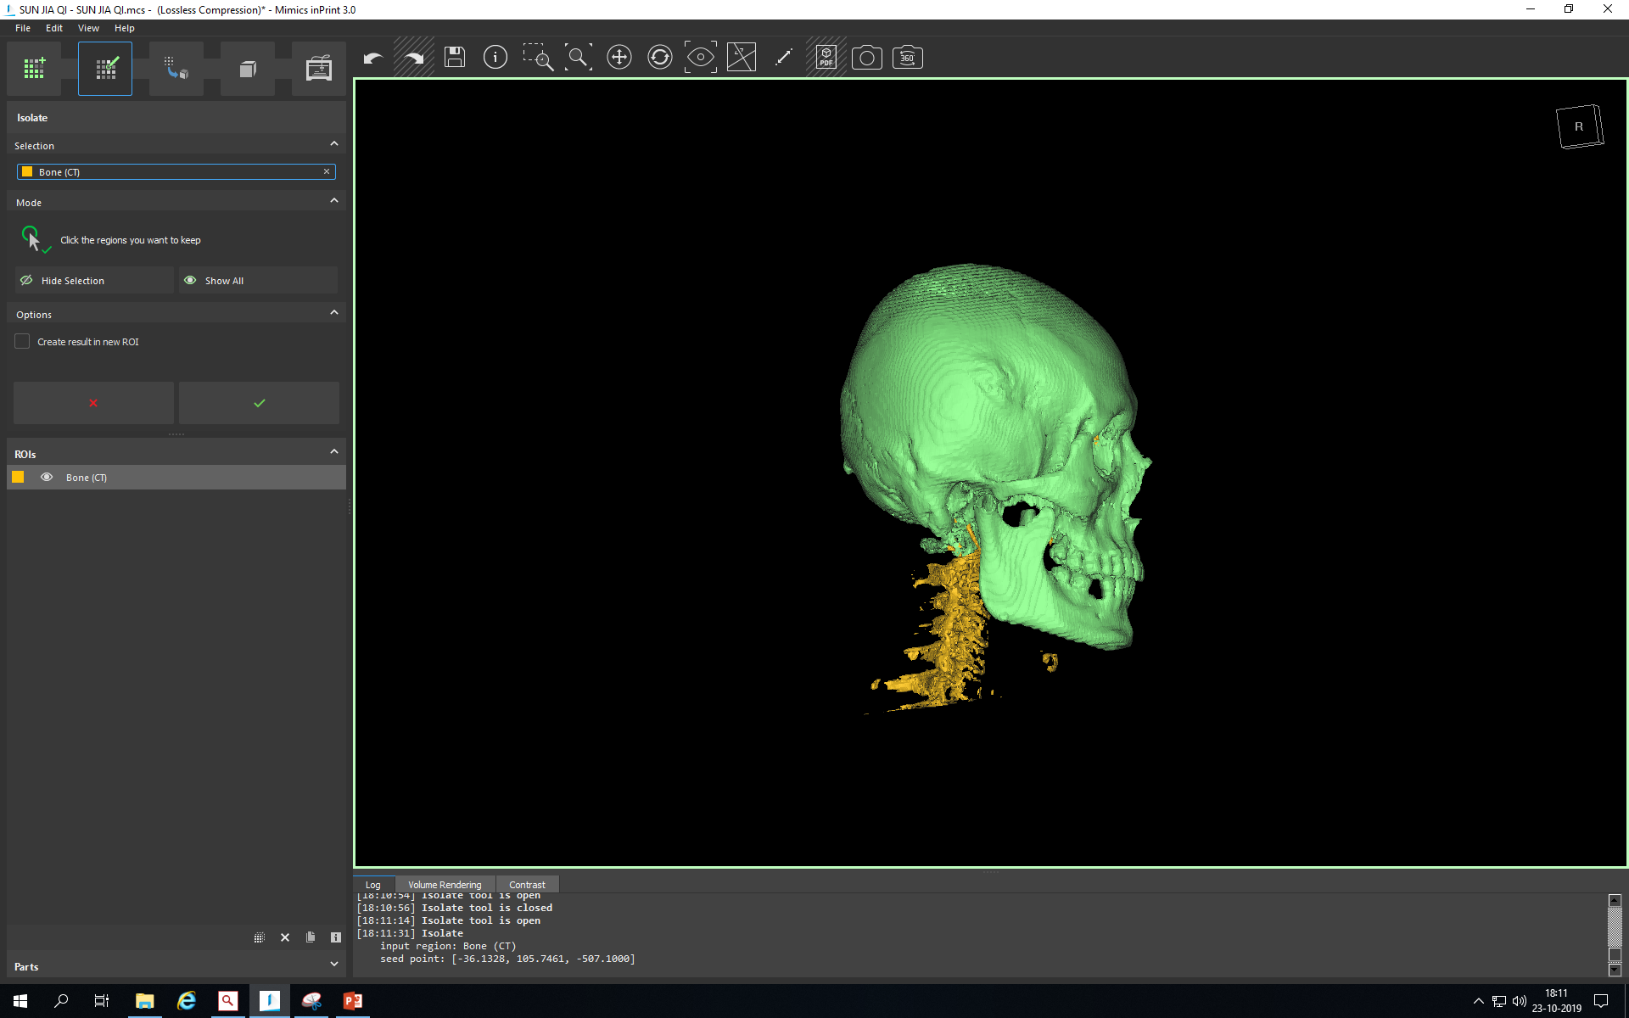

Slide 9
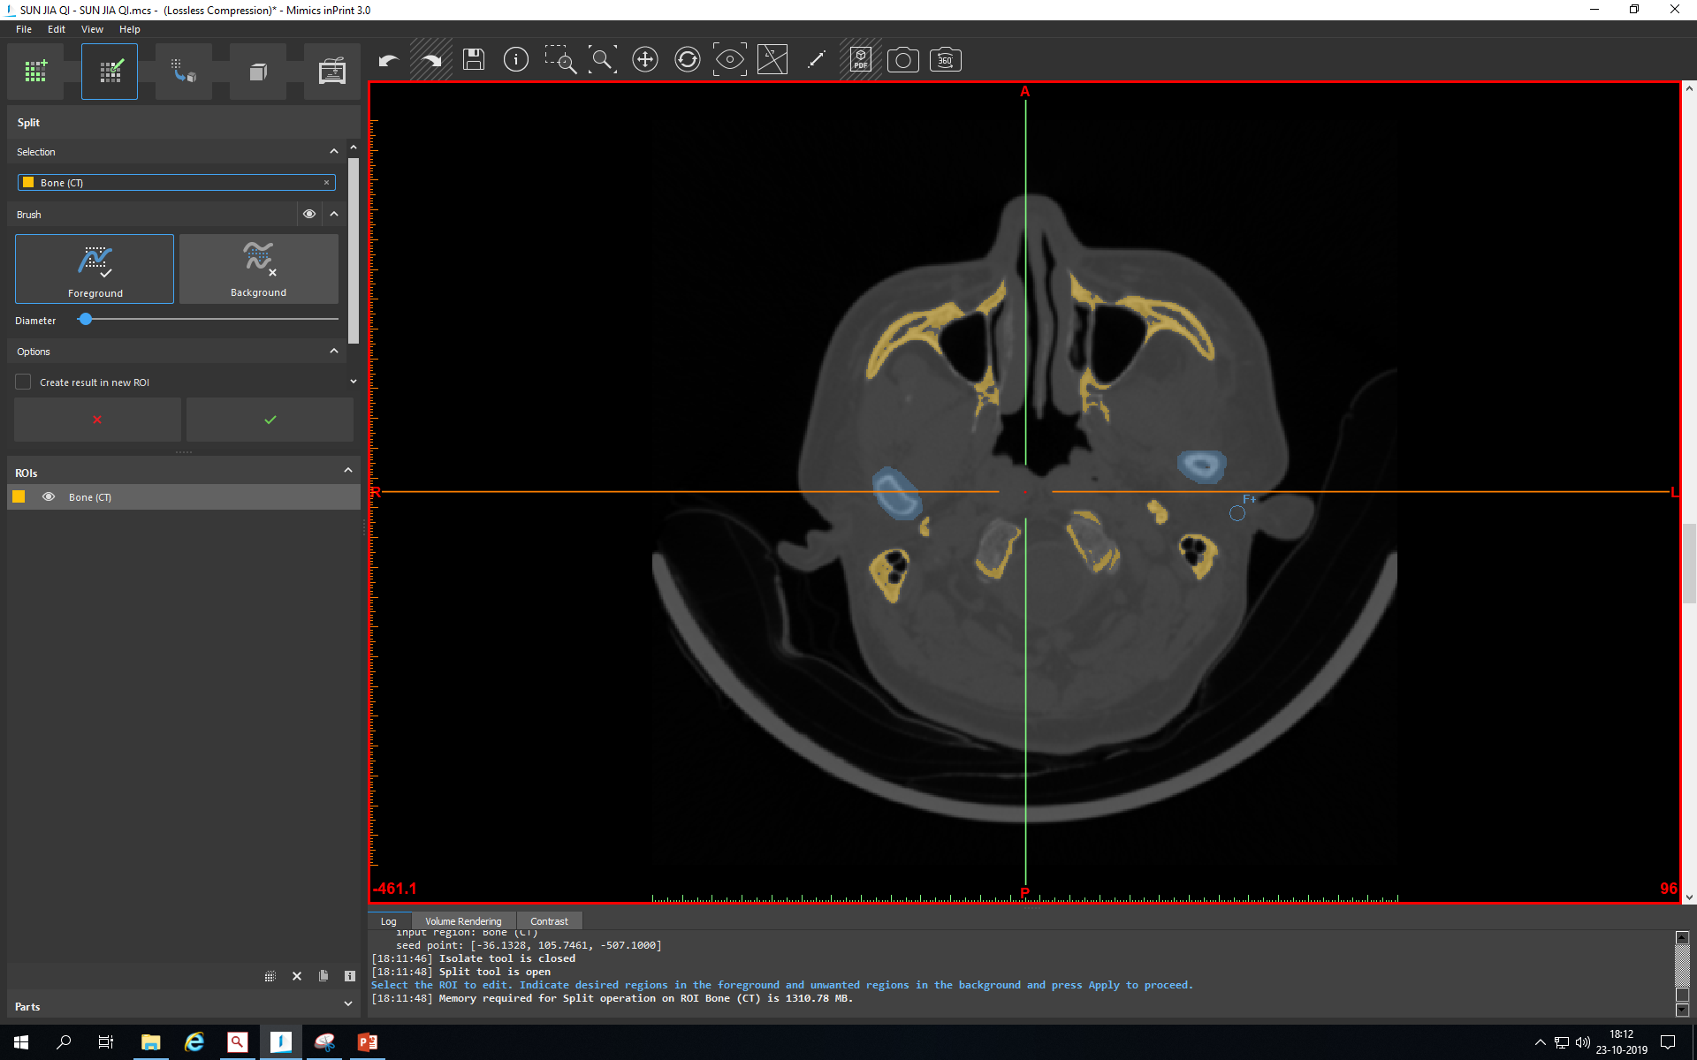

Slide 10
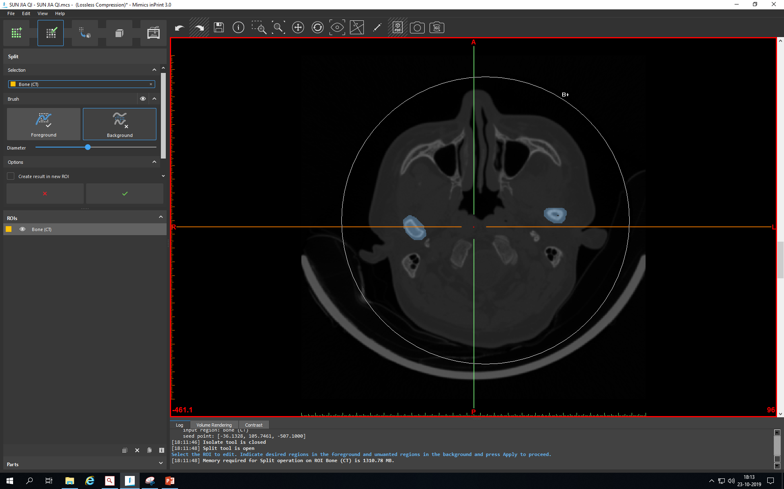

Slide 11
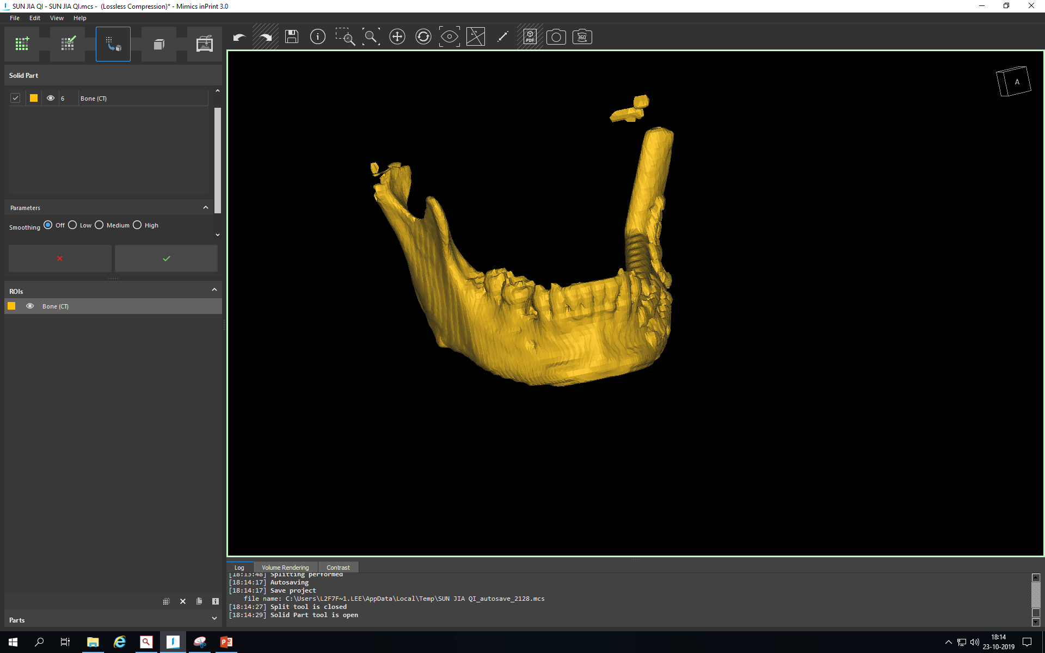

Slide 12
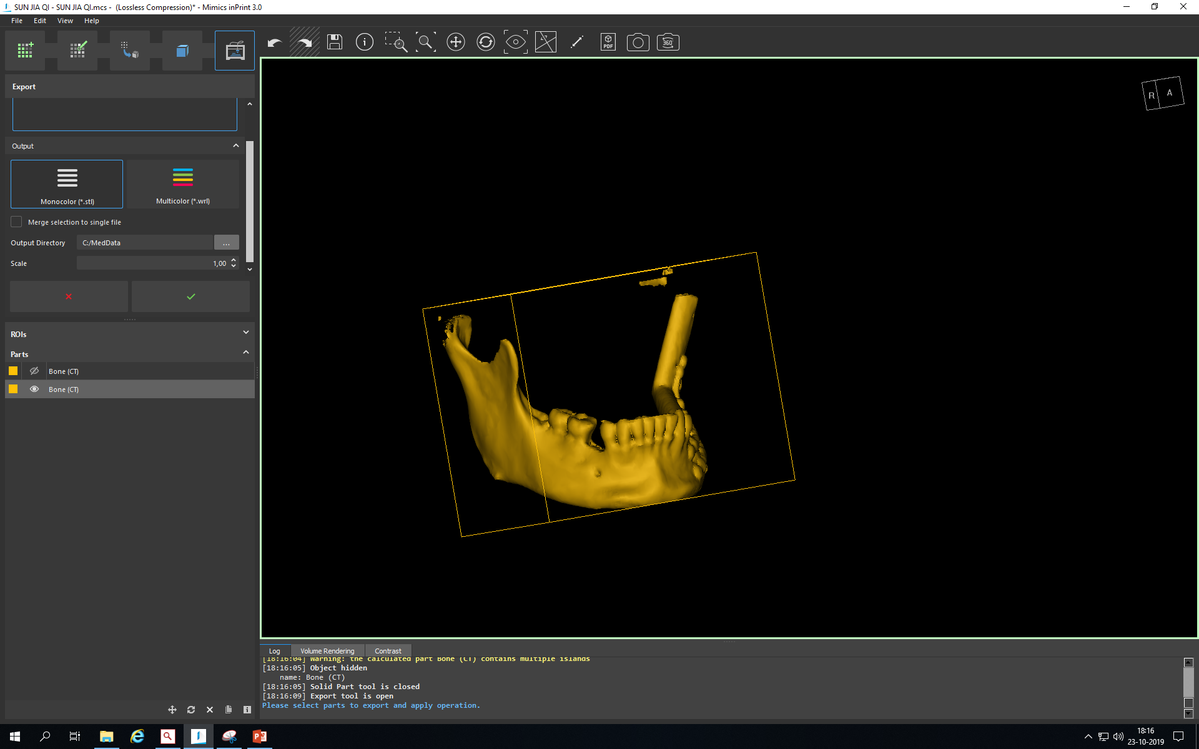

Slide 13
GOM, guideline step 4, contains all mouseclicks
The explorer menu at the left contains elements to facilitate the guideline to our own needs, but are currently not applicable for portraying the guideline
Don’t mind the red spheres (slide 20), these are not applicable in this simplified version

Slide 14
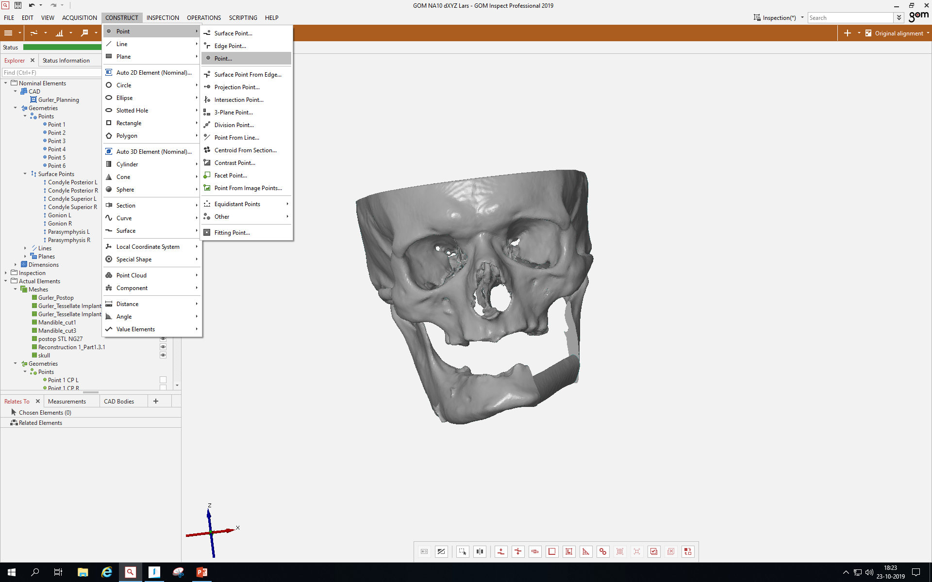

Slide 15
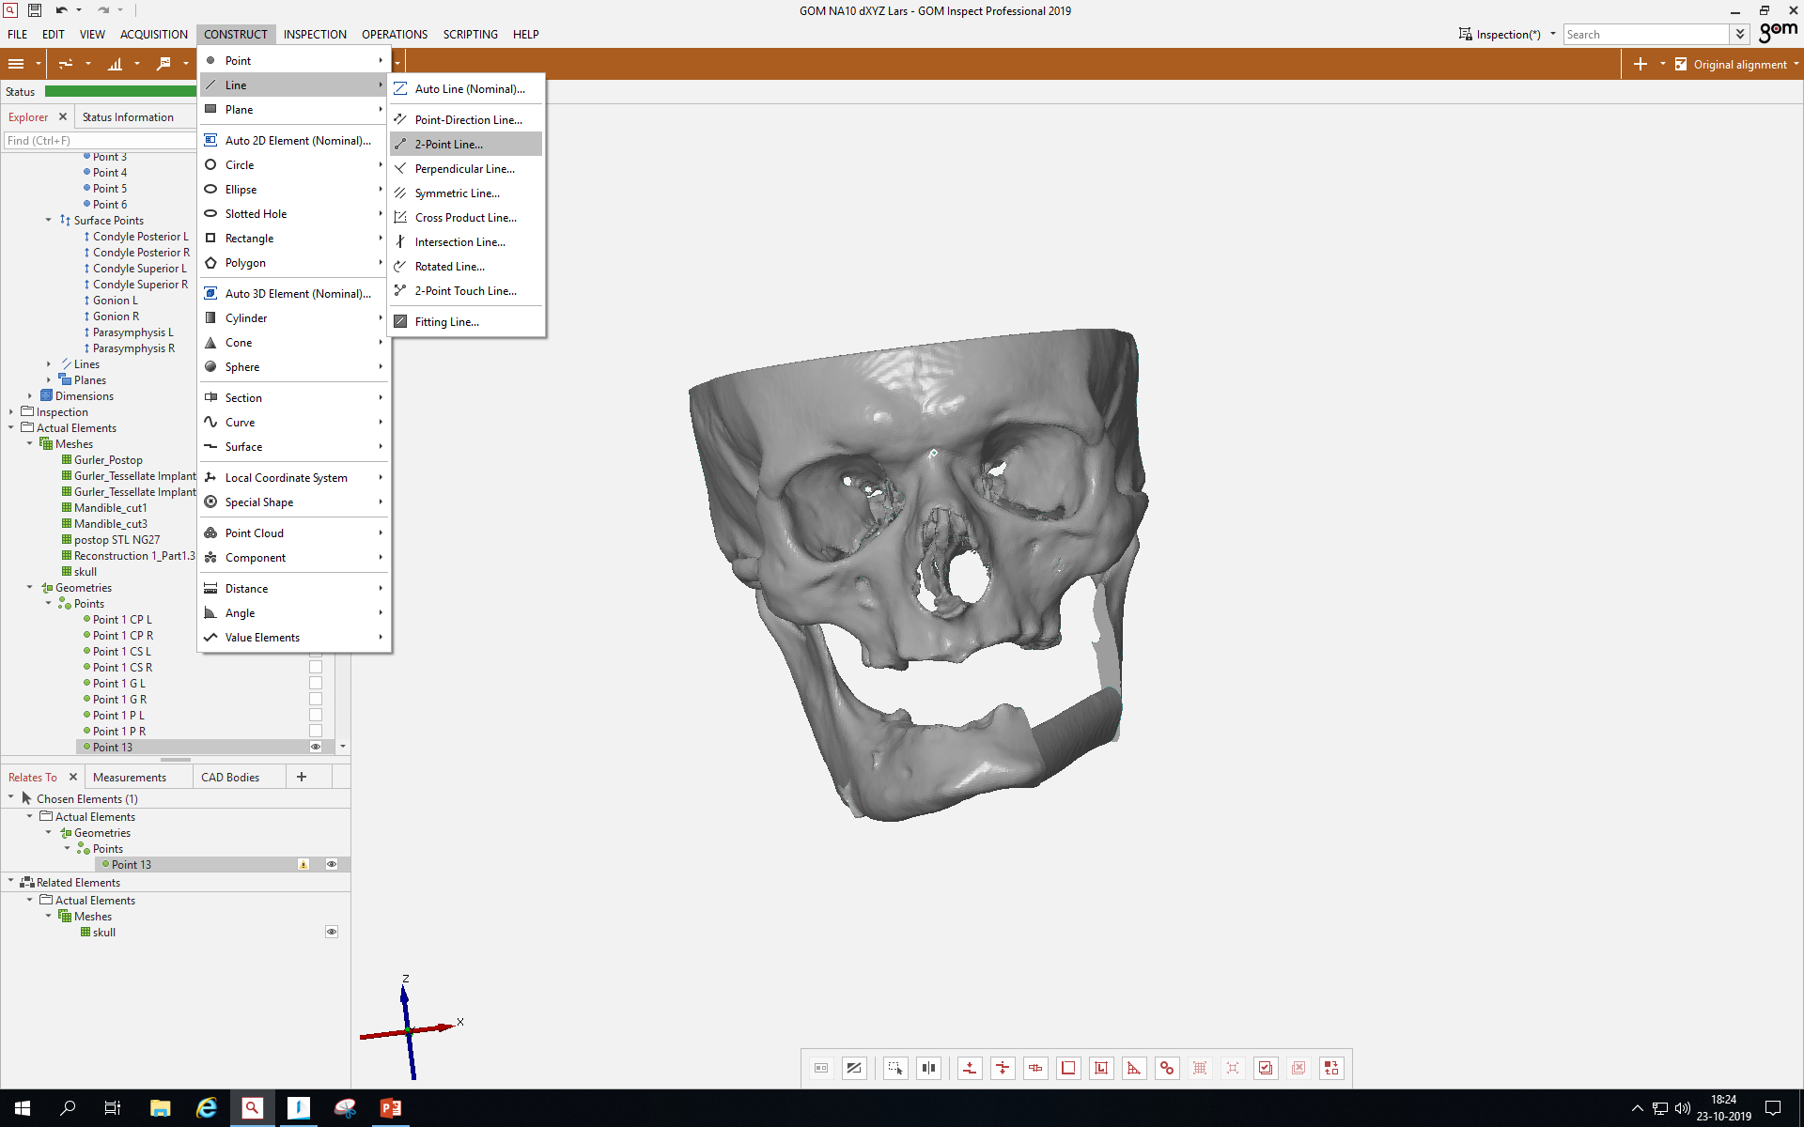

Slide 16
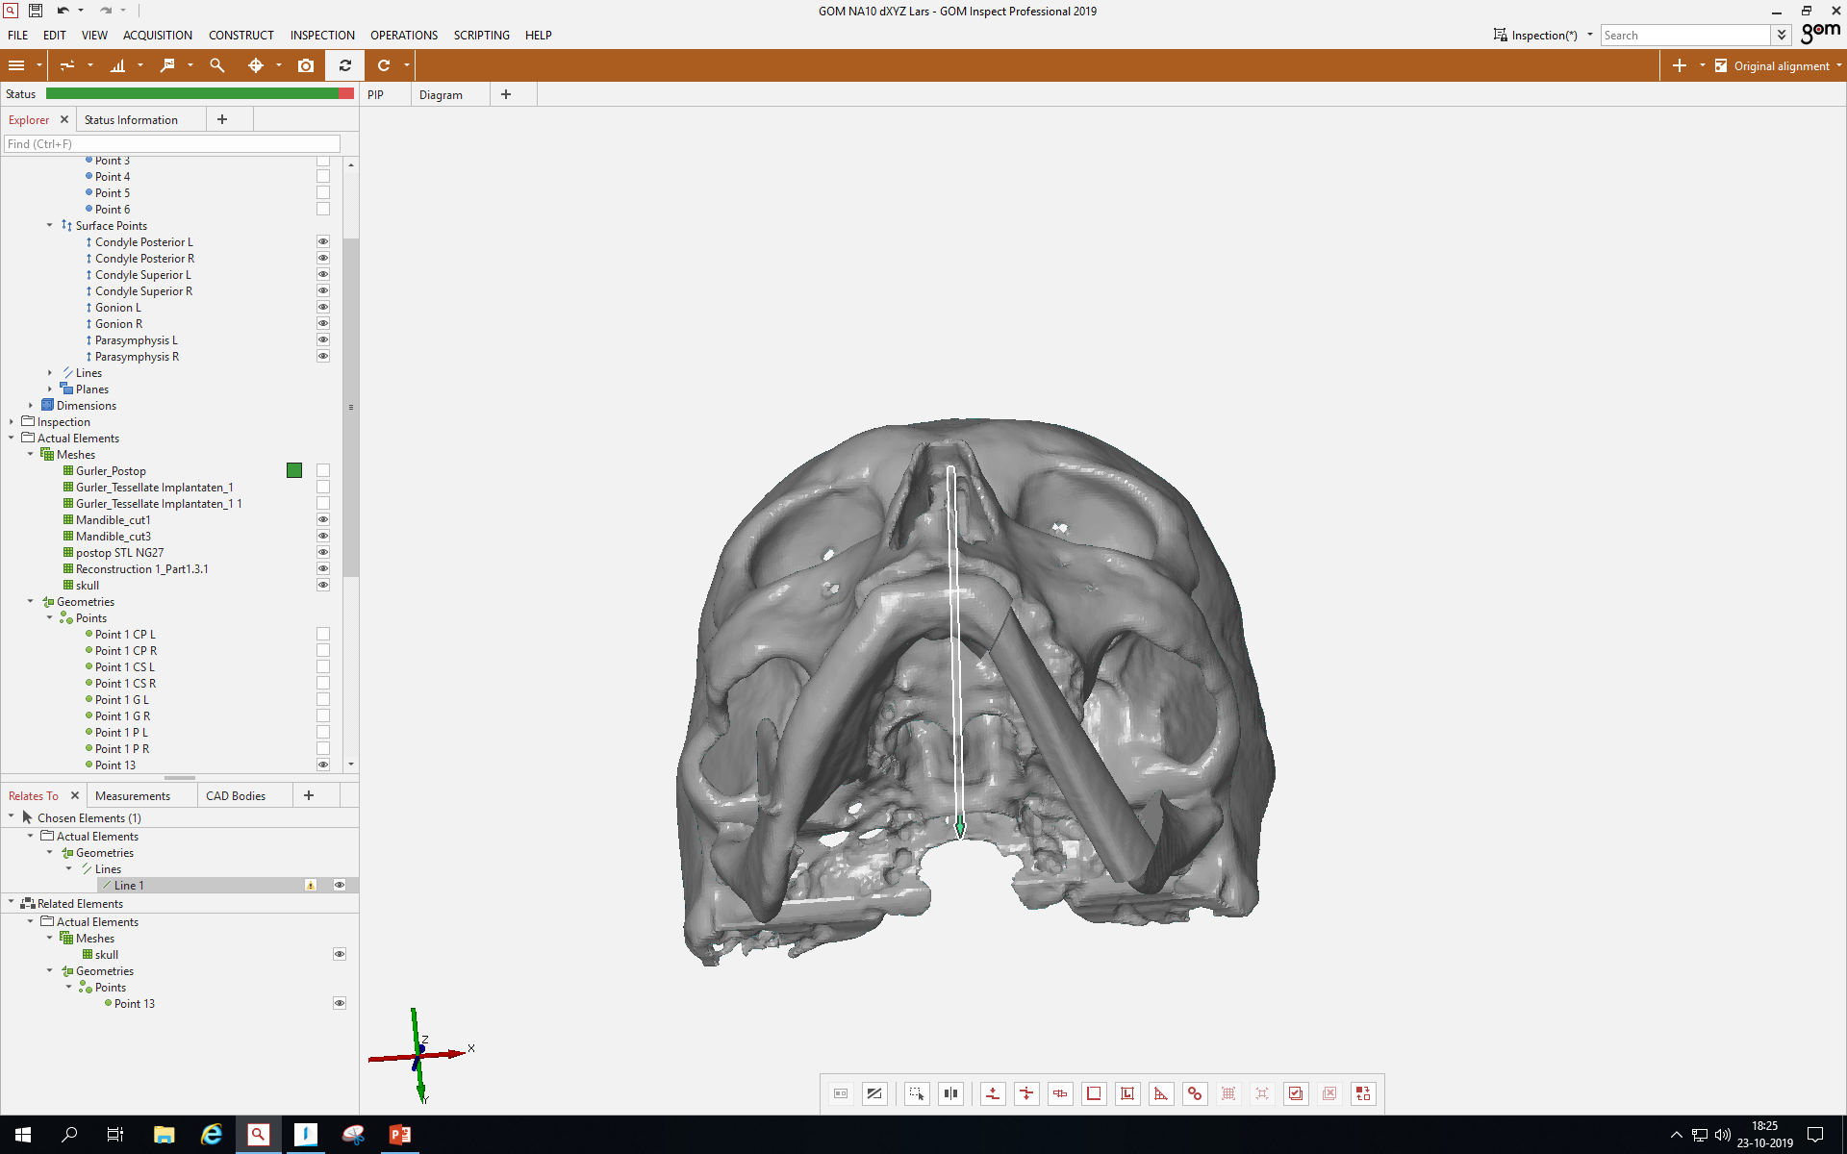

Slide 17
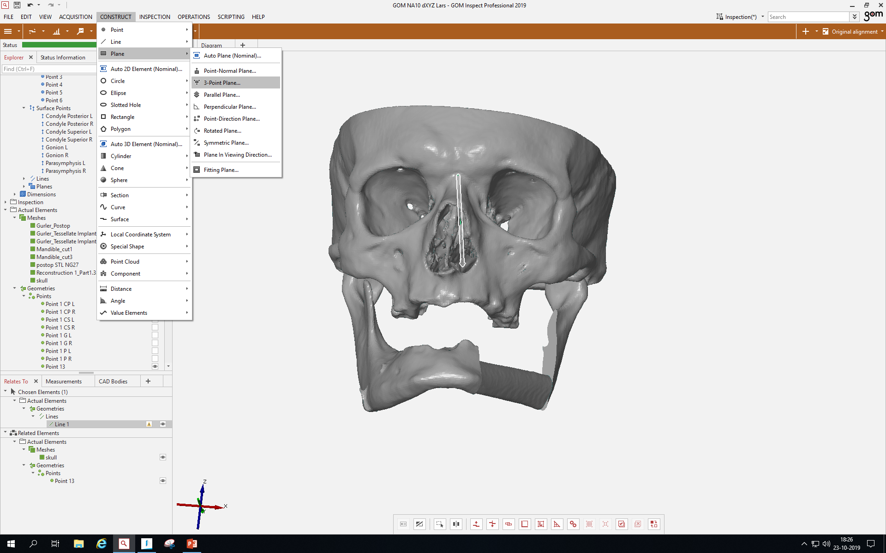

Slide 18
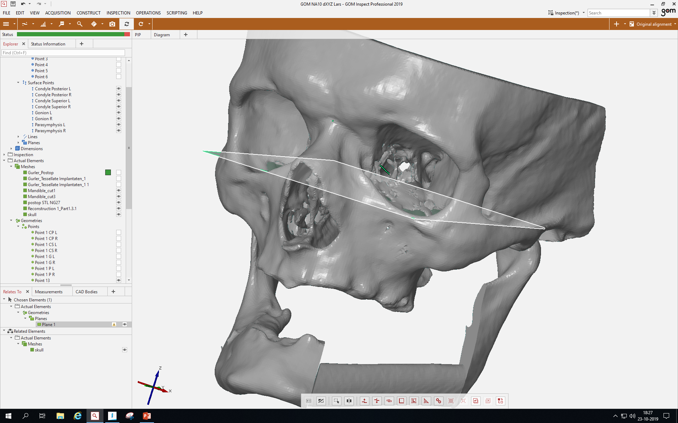

Slide 19
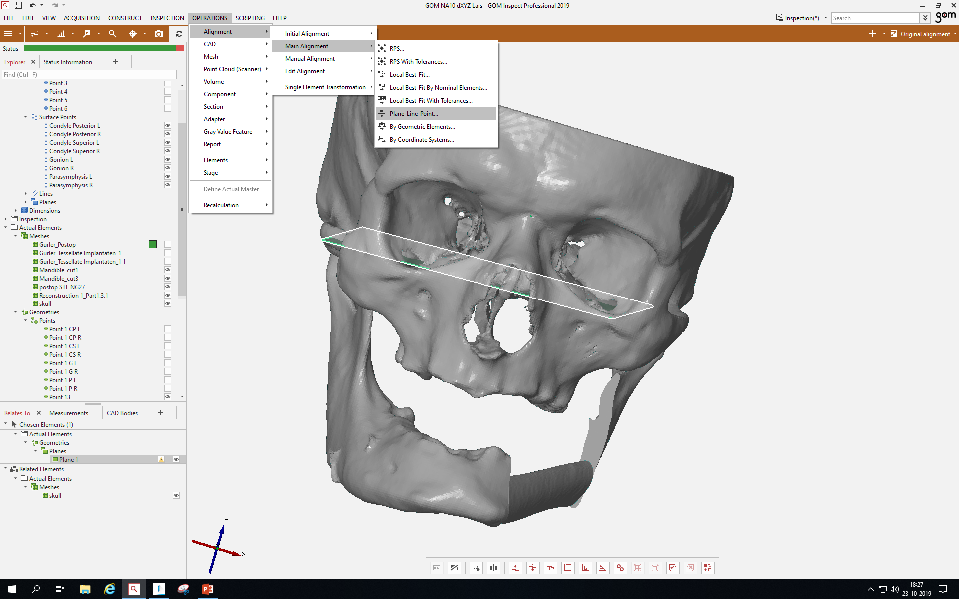

Slide 20
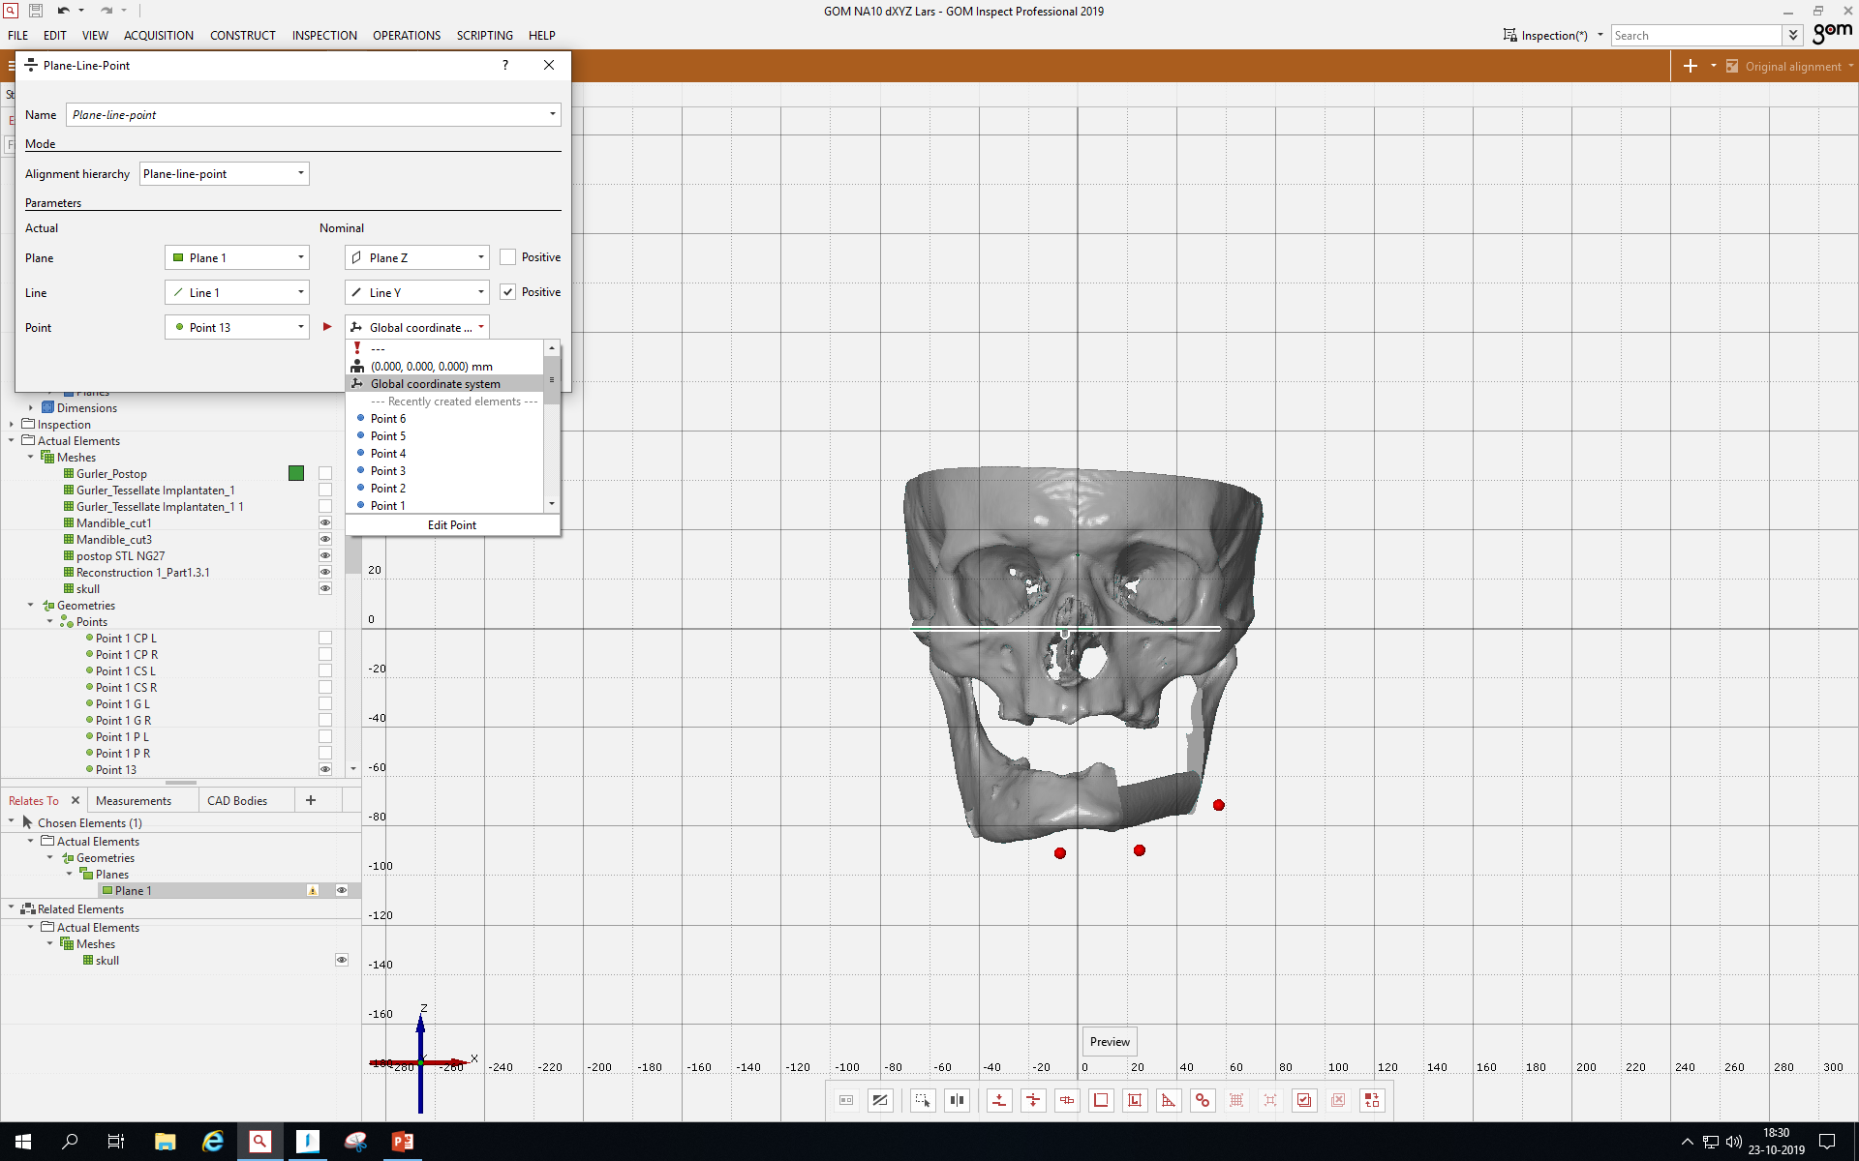

Slide 21
GOM, guideline step 5, contains all mouseclicks
Don’t mind the red spheres, green arrows, the round red planes and the green plane (all slides), these are not applicable in this simplified version and only for own simplified needs.

Slide 22
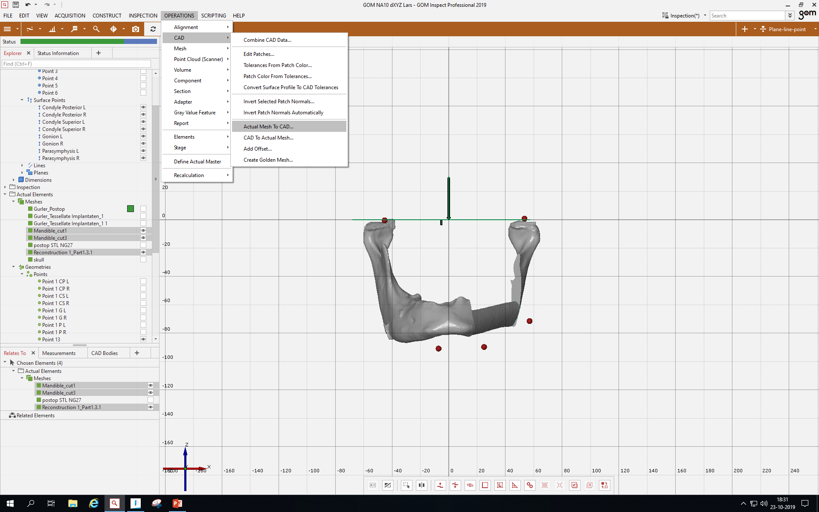

Slide 23
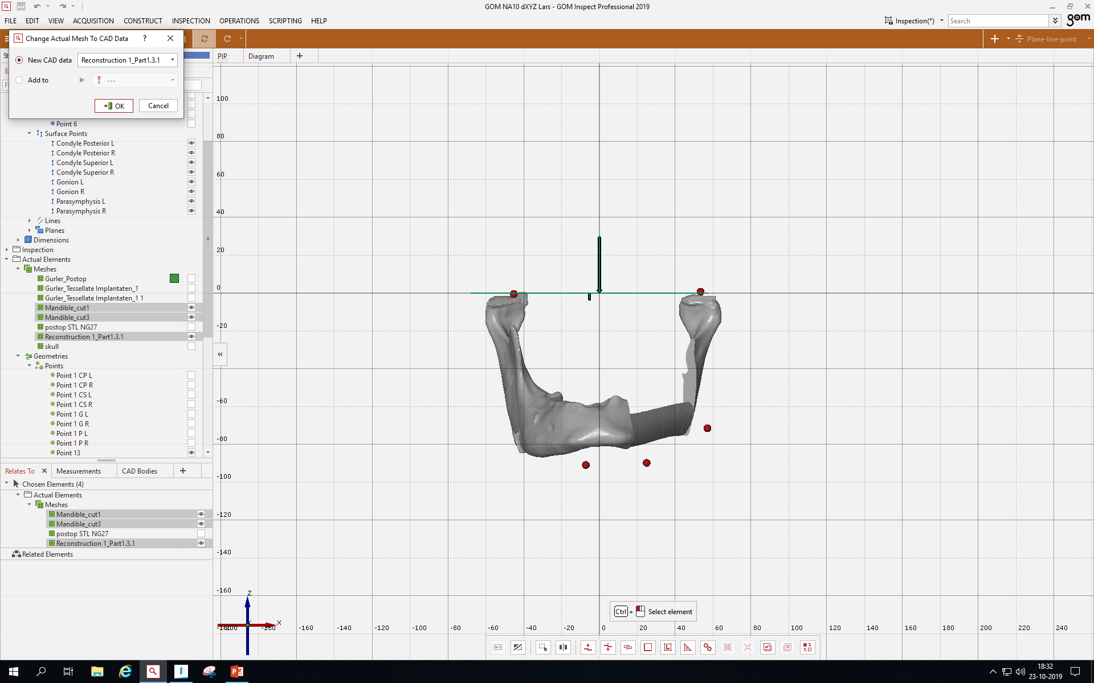

Slide 24
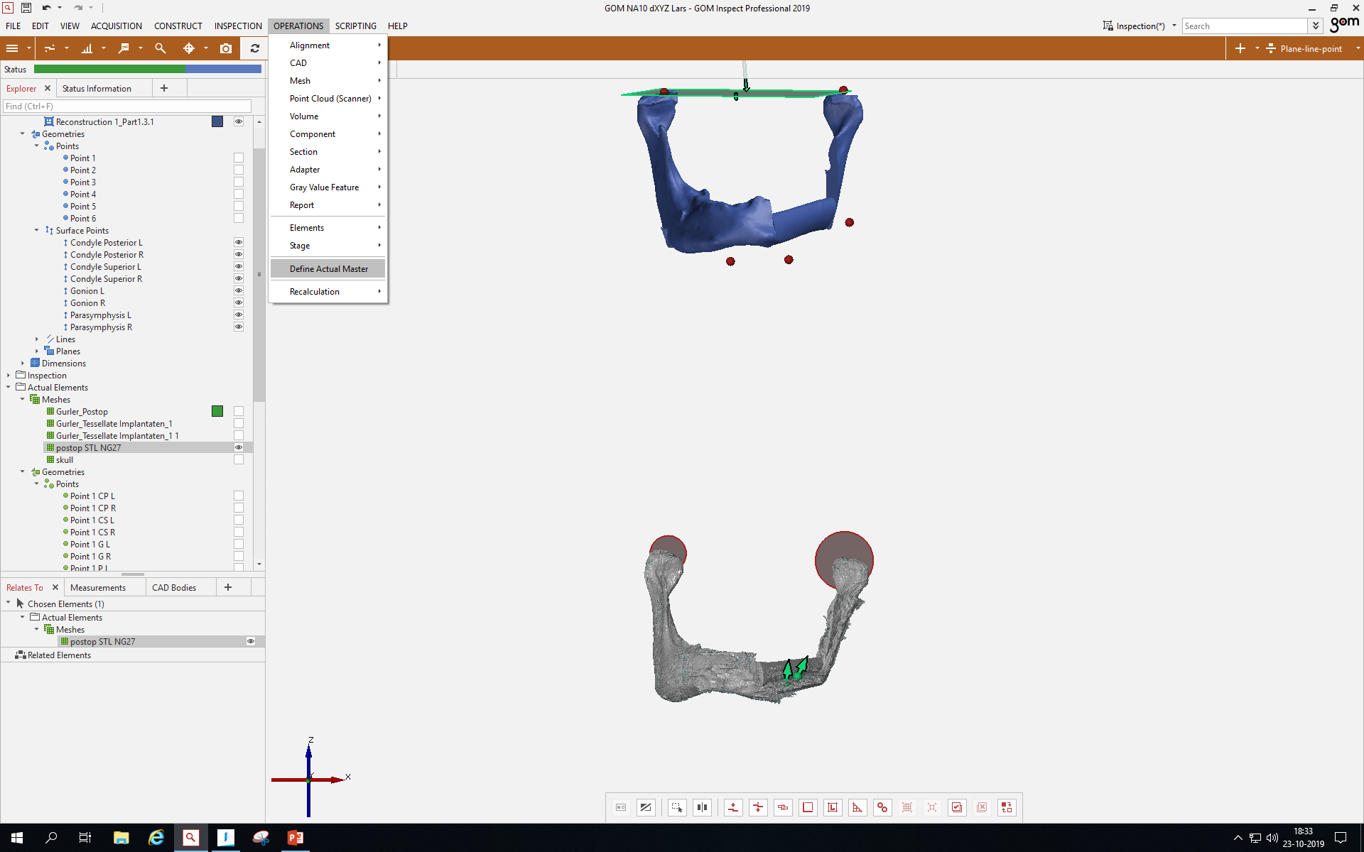

Slide 25
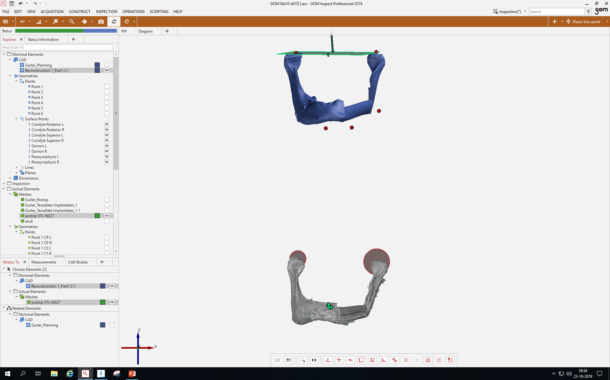

Slide 26
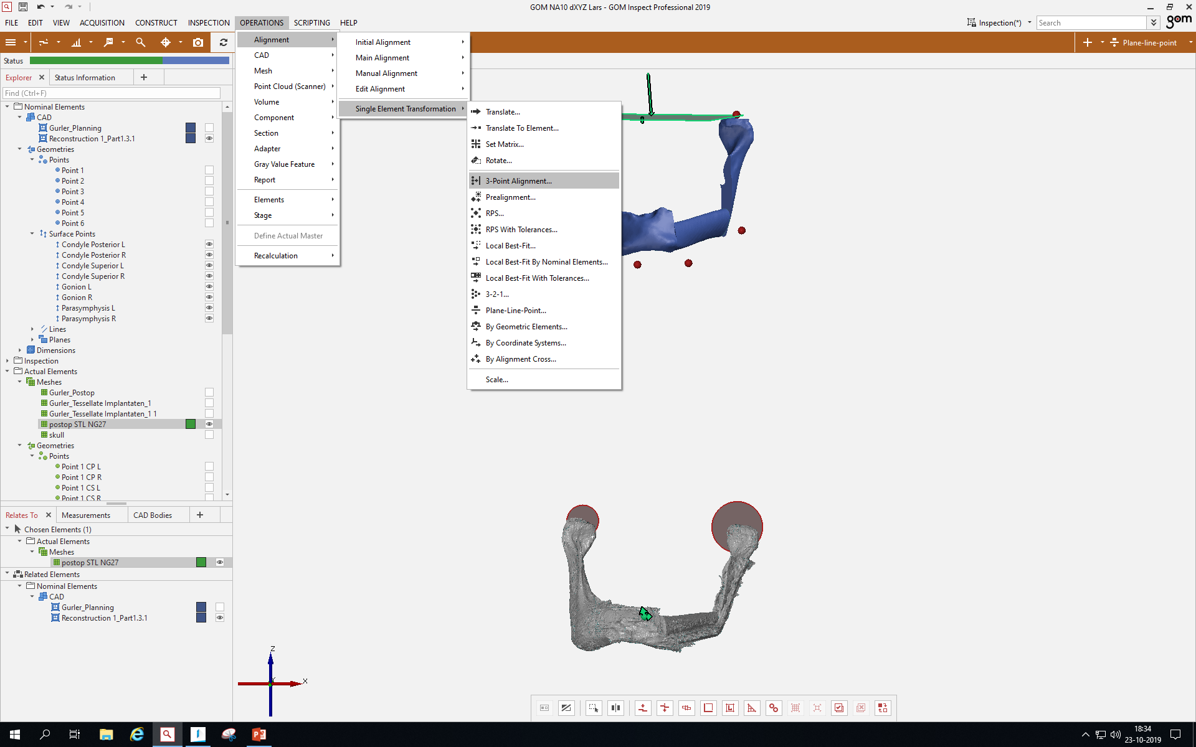

Slide 27
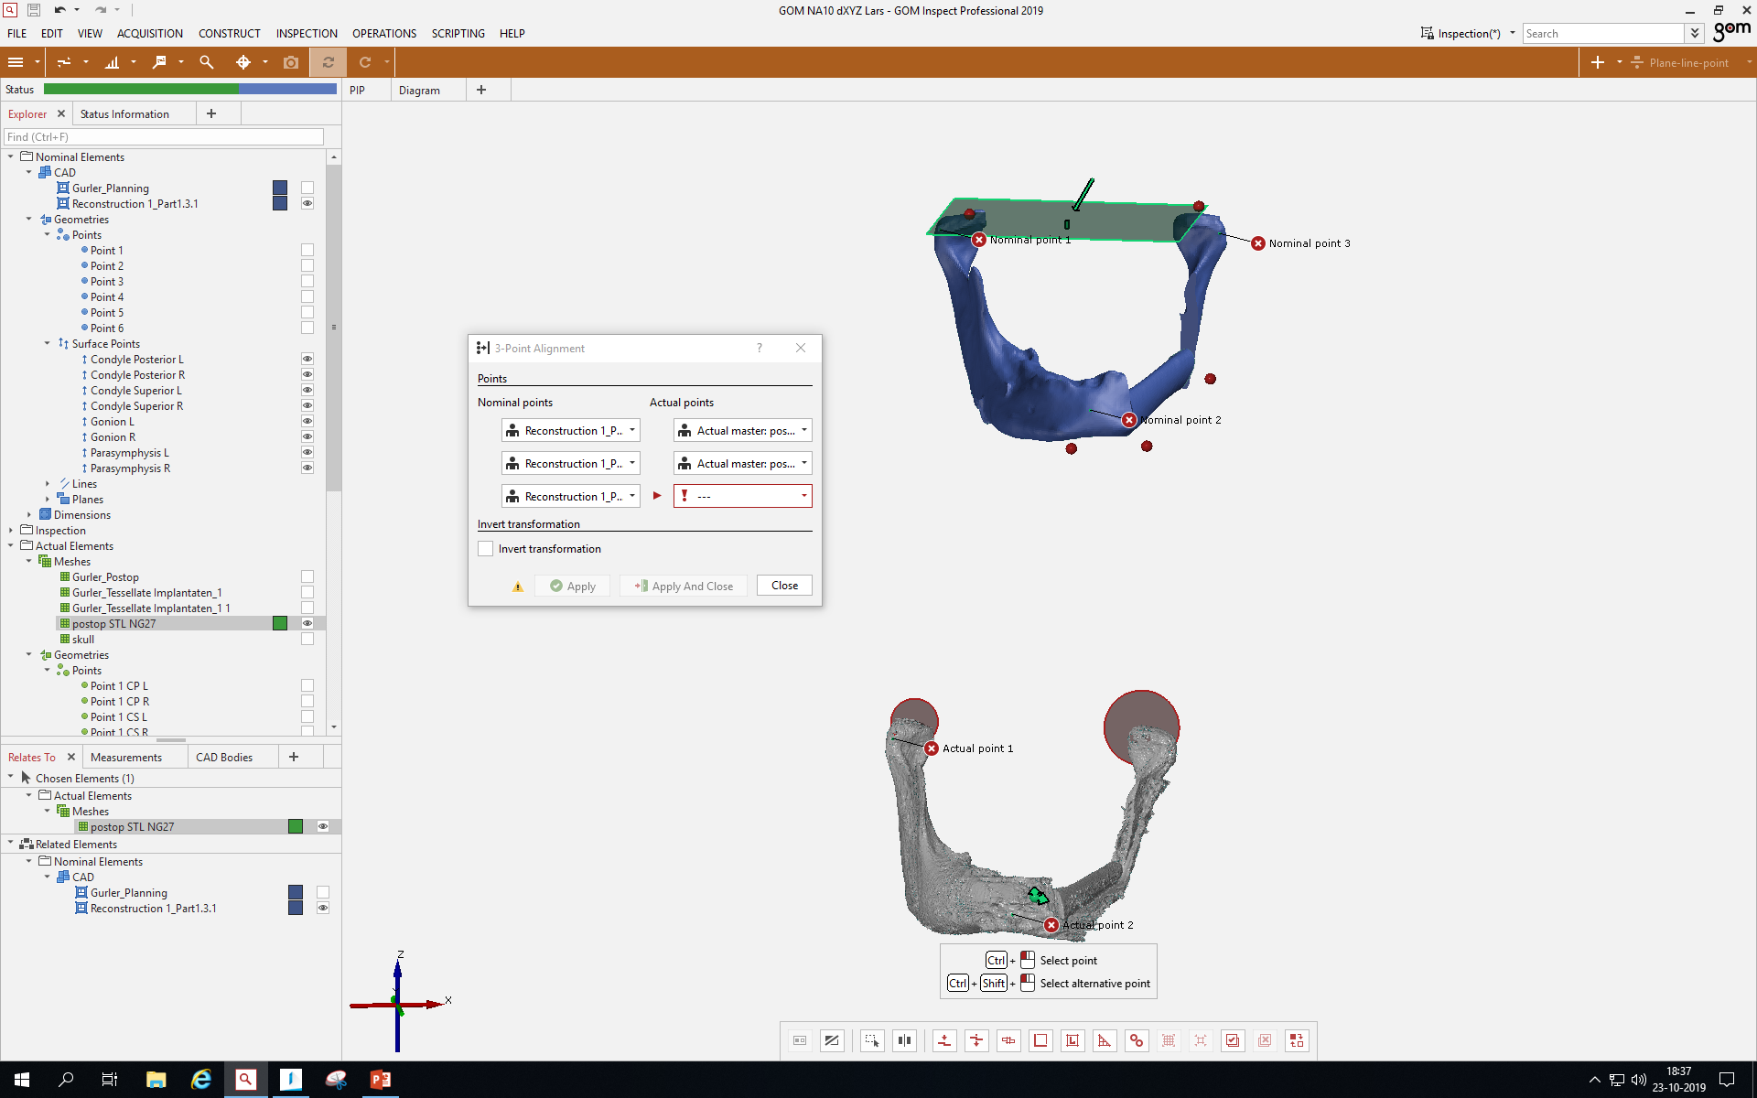

Slide 28
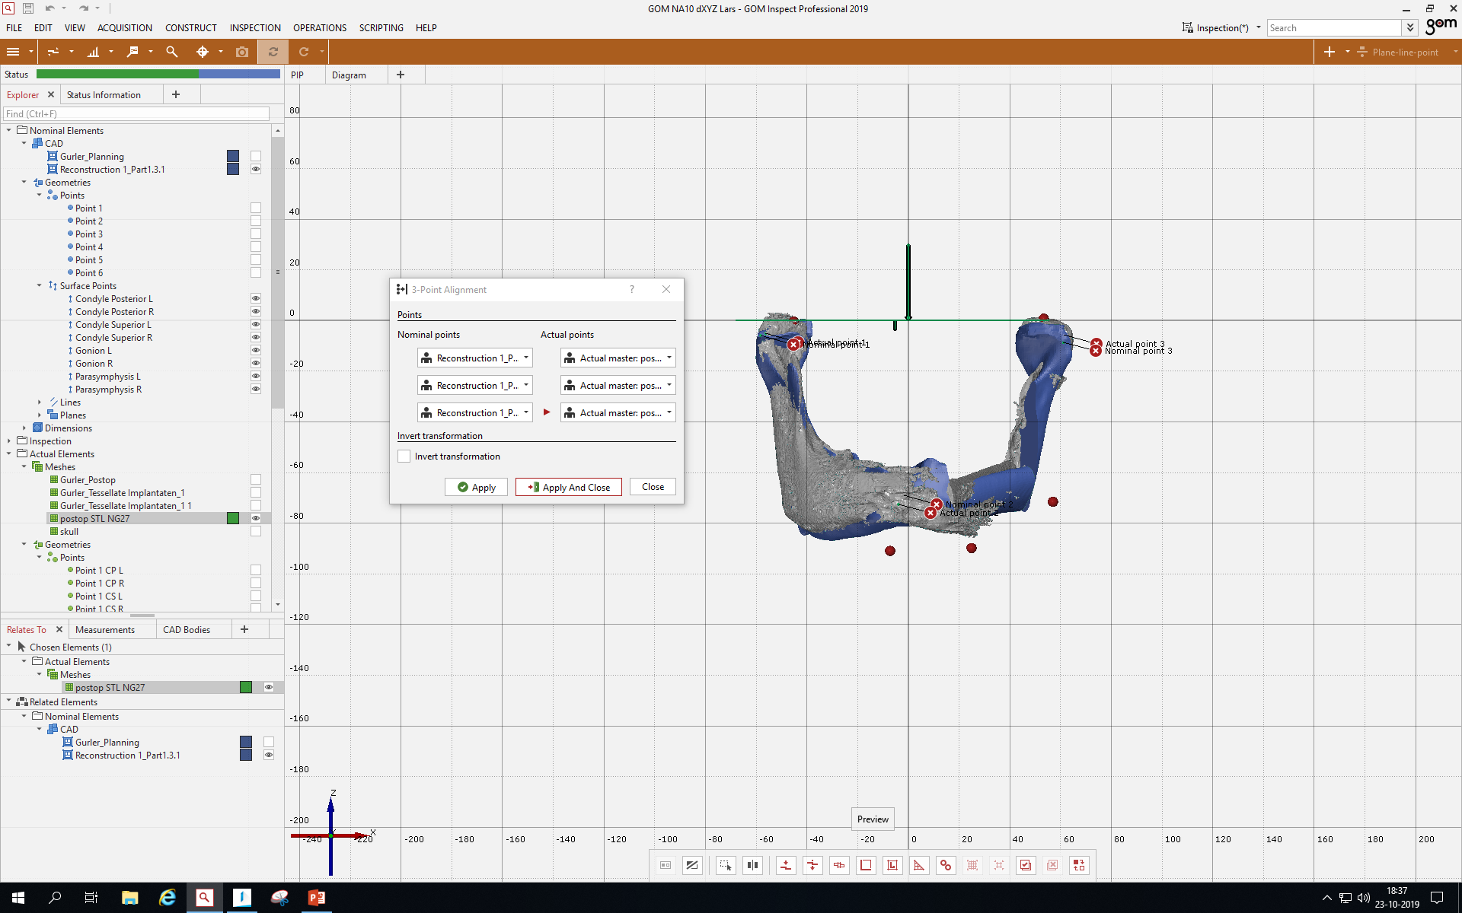

Slide 29
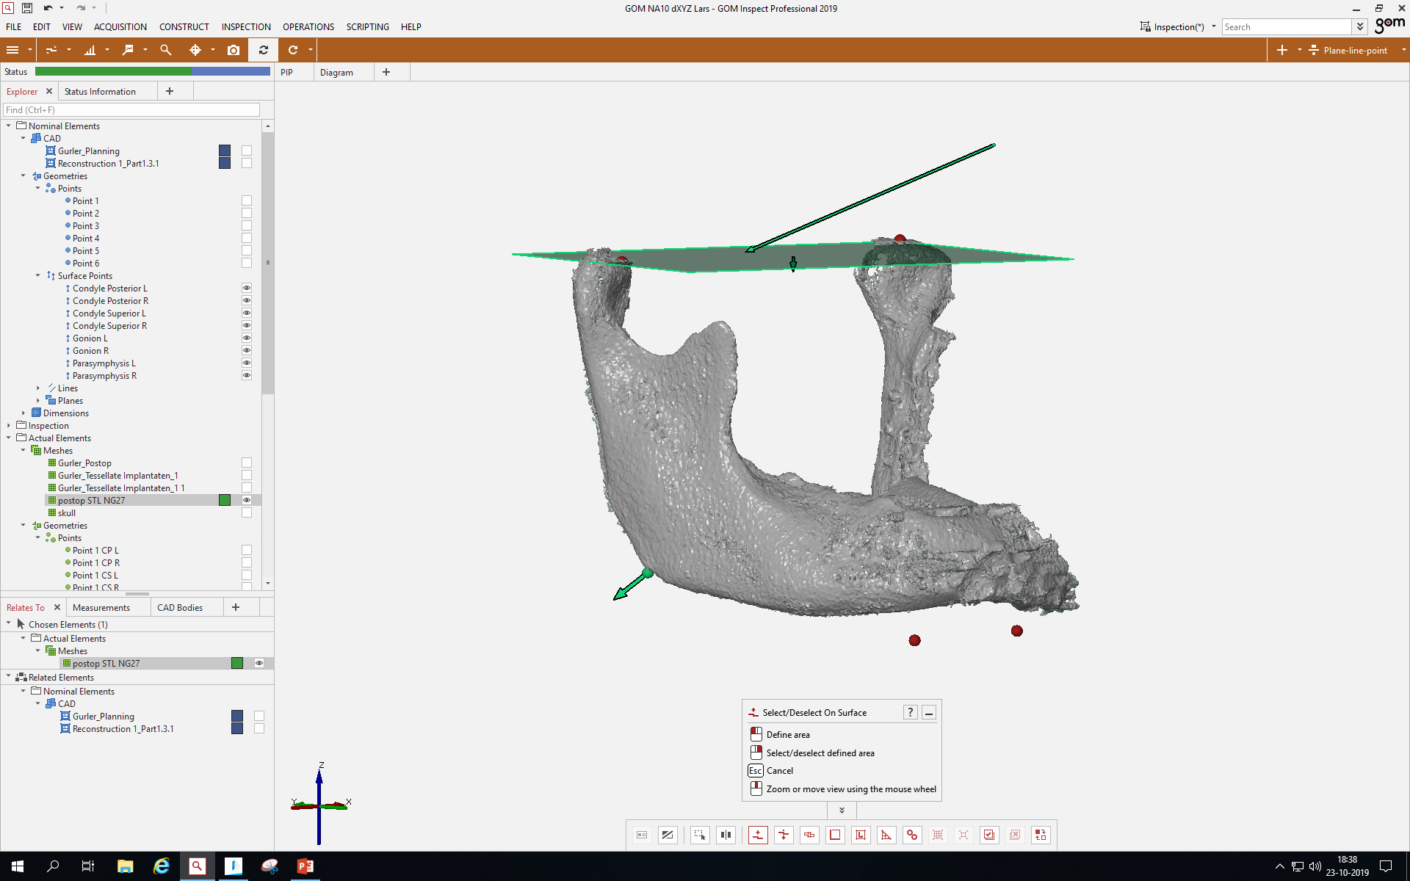

Slide 30
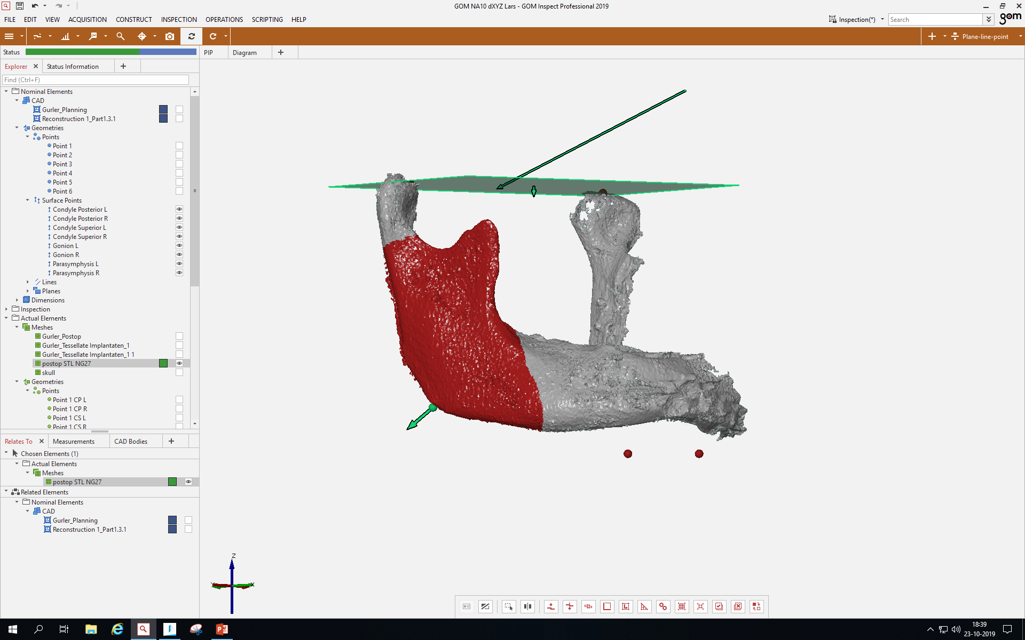

Slide 31
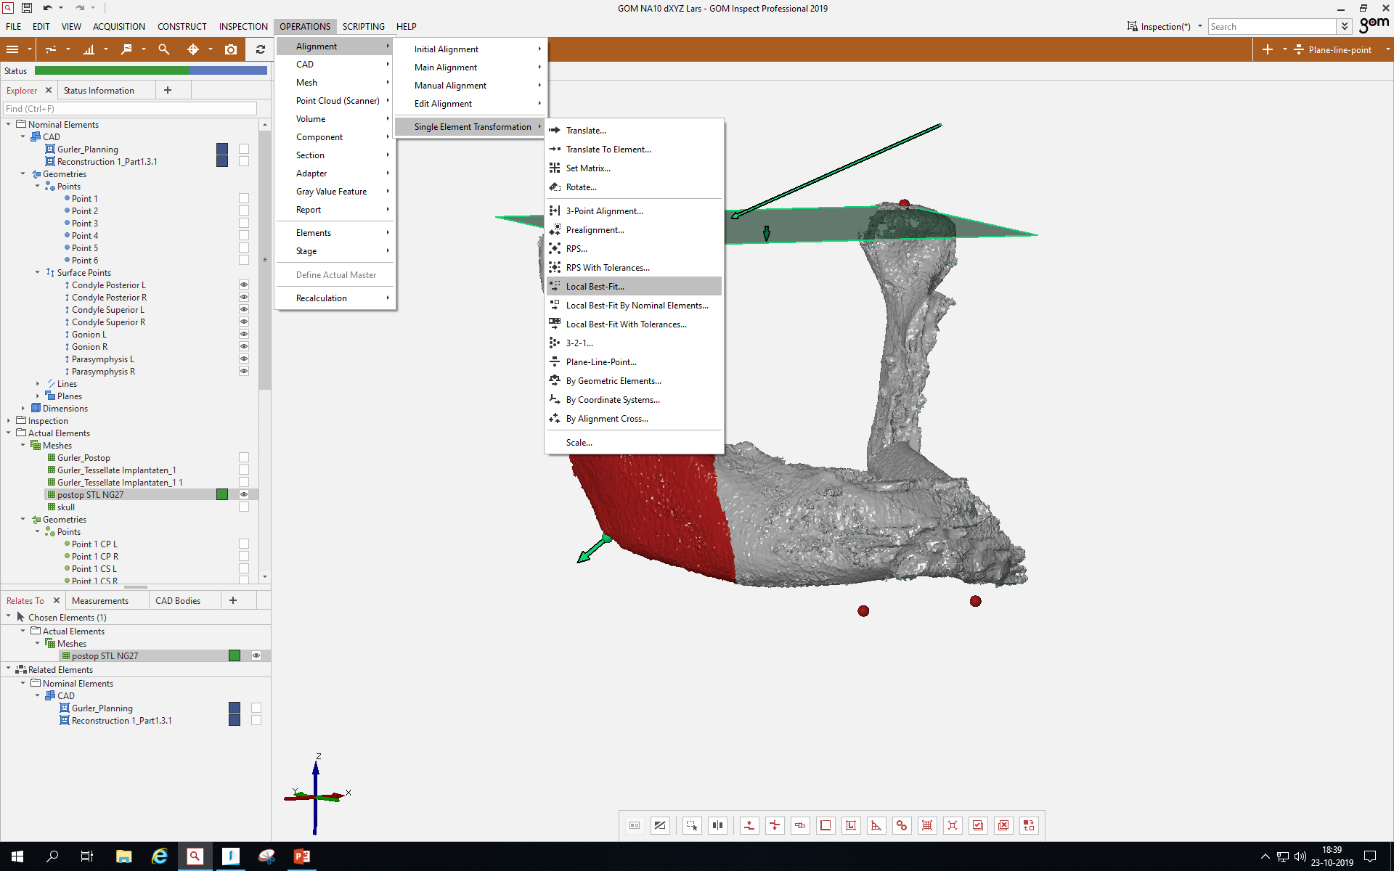

Slide 32
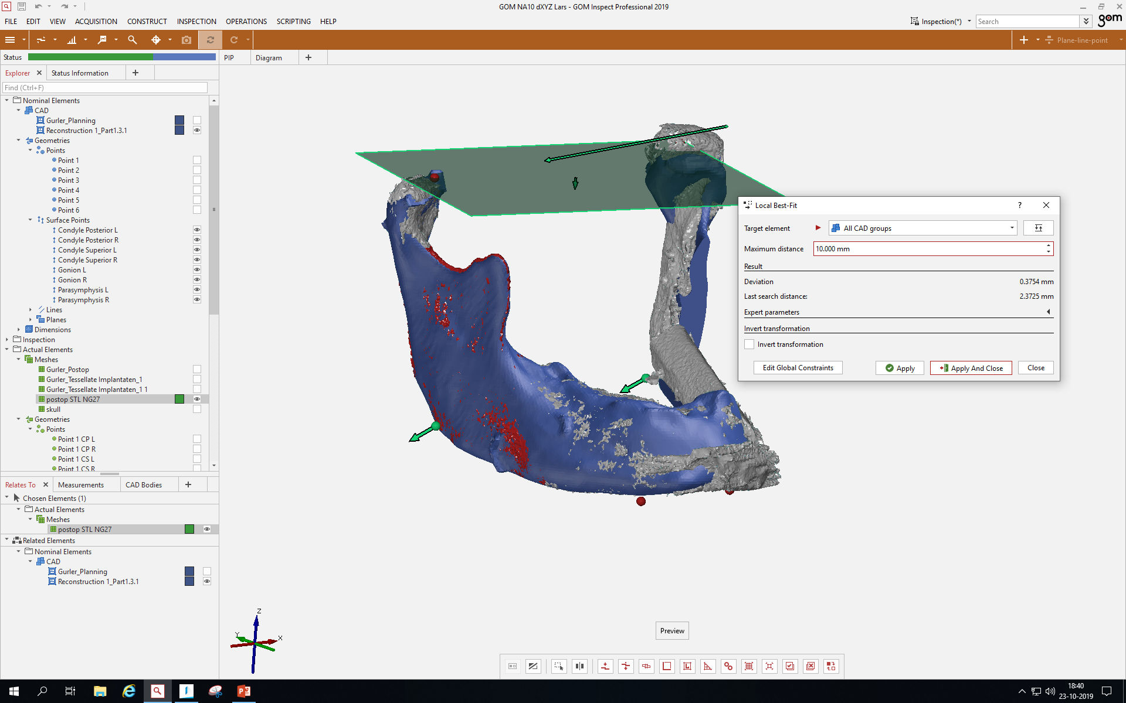

Slide 33
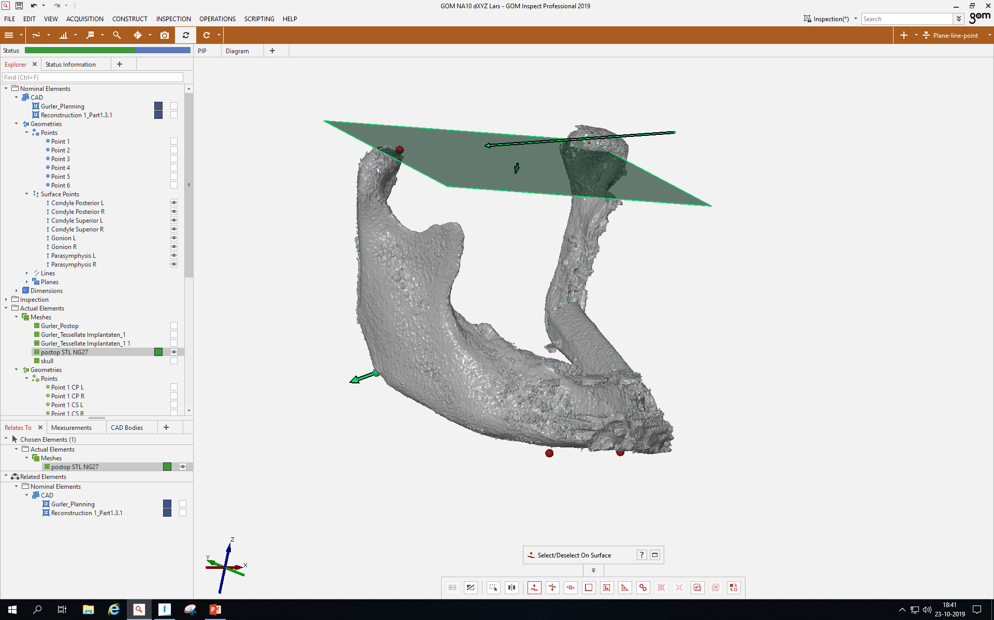

Slide 34
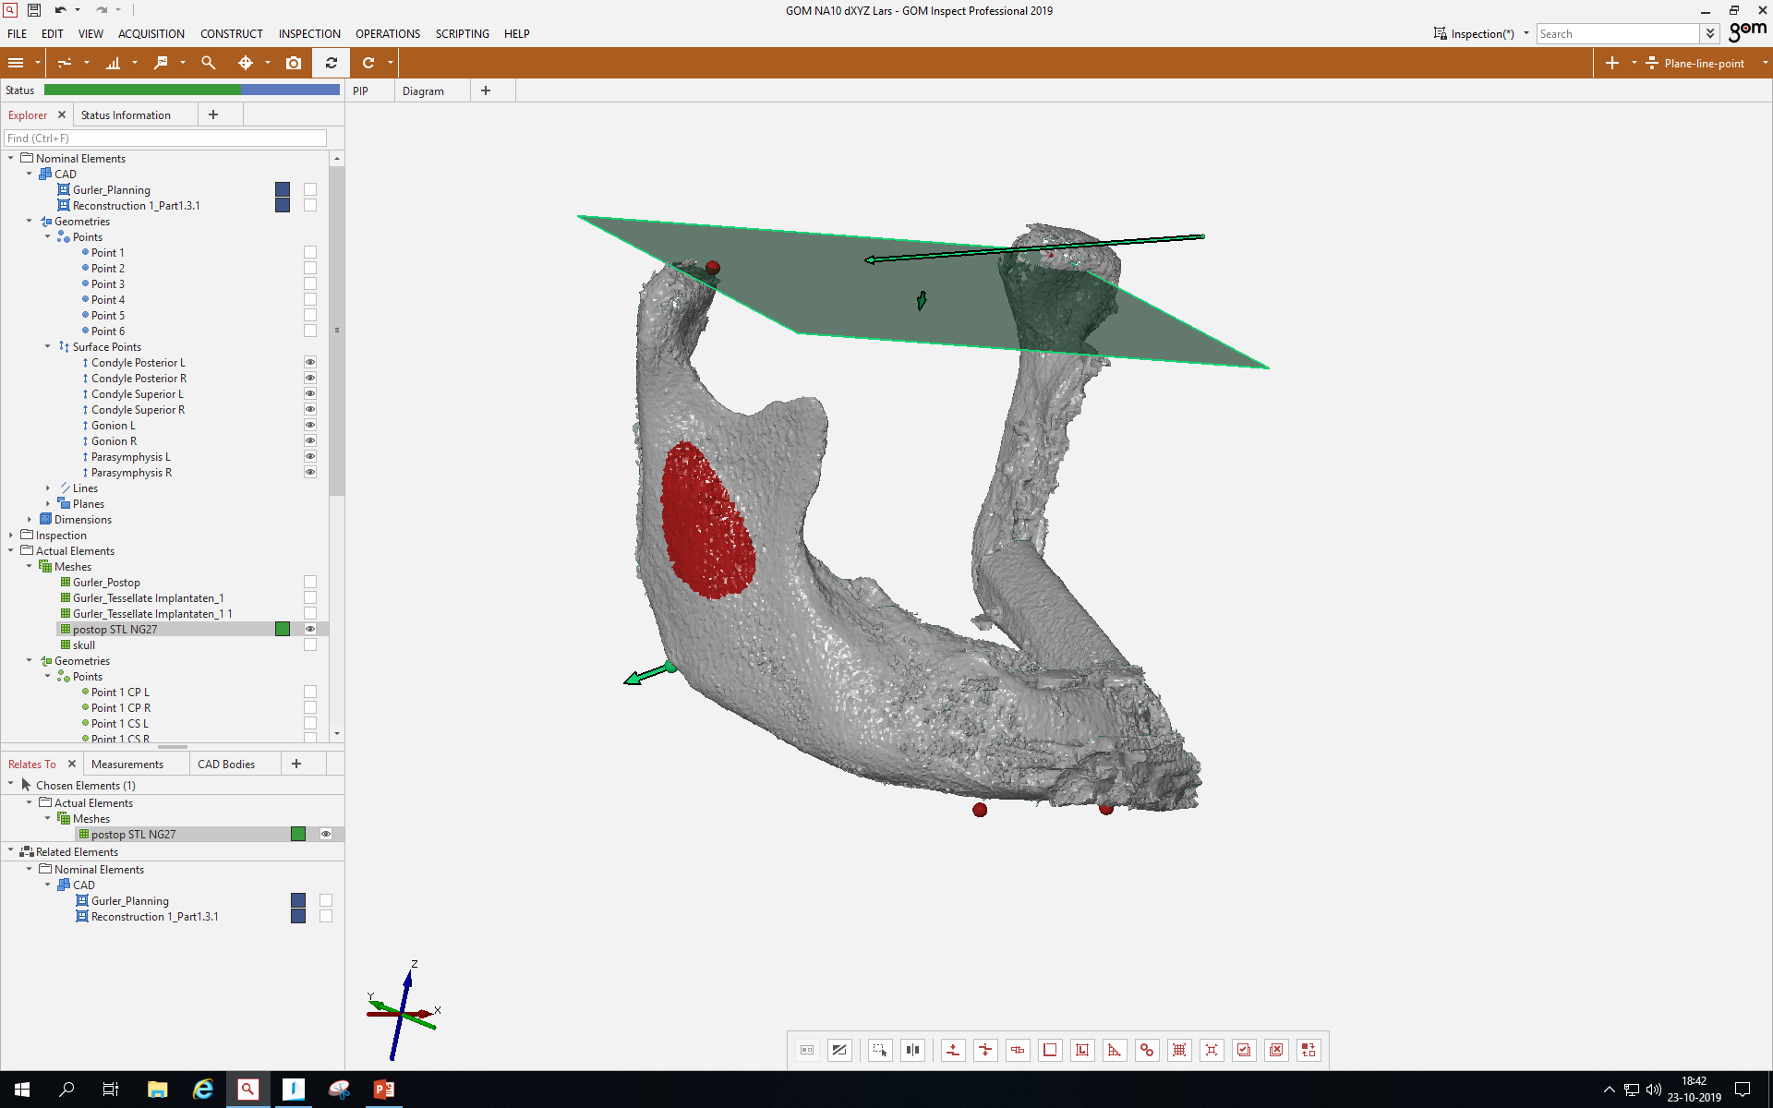

Slide 35
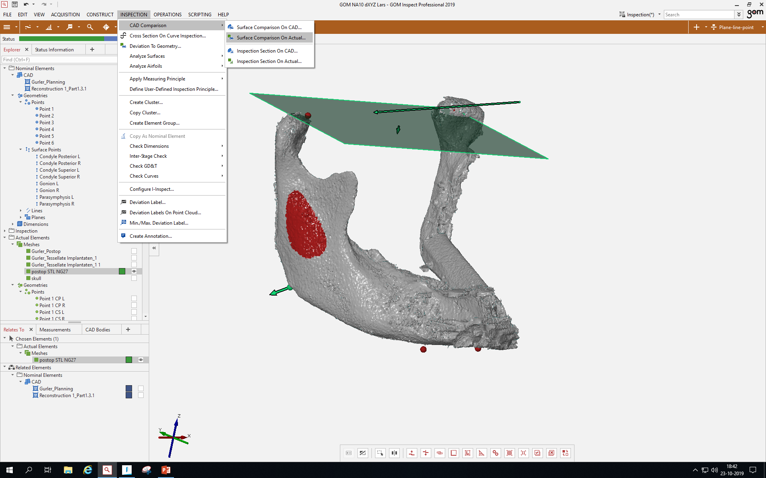

Slide 36
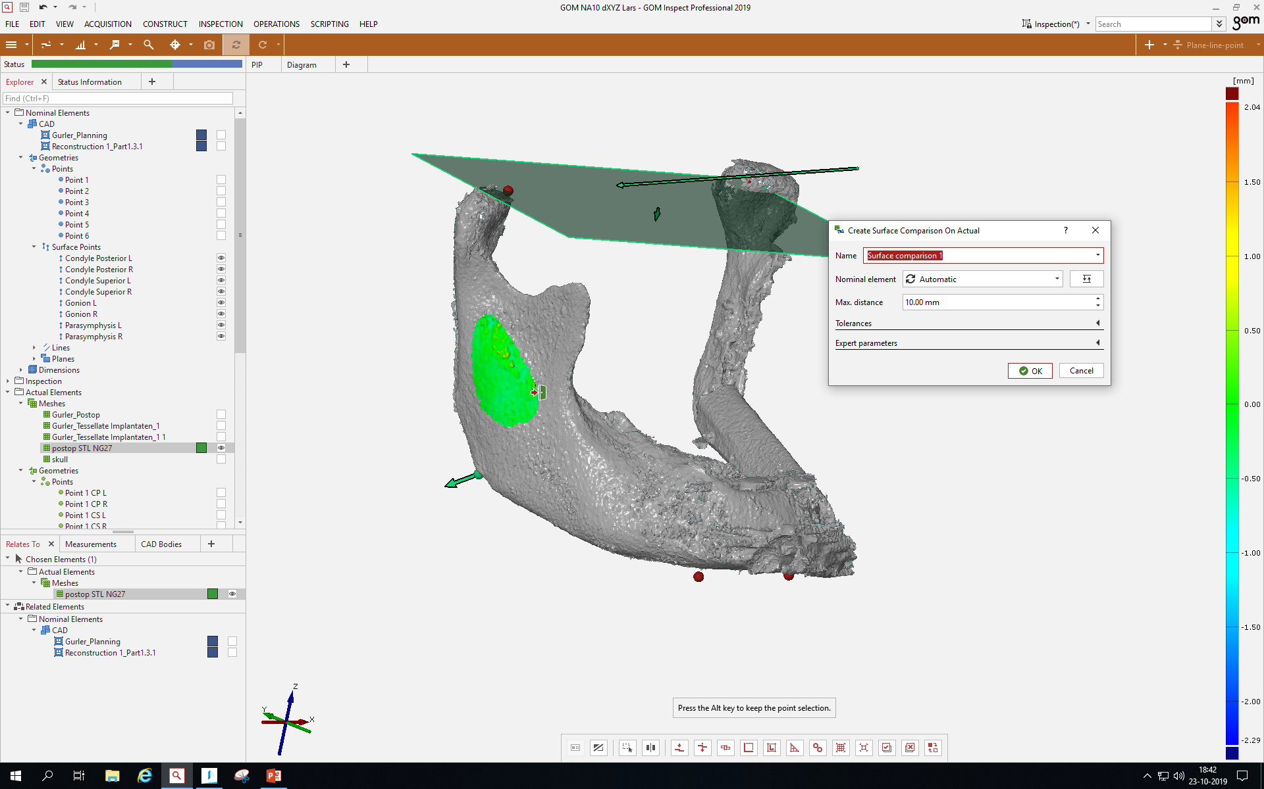

Slide 37
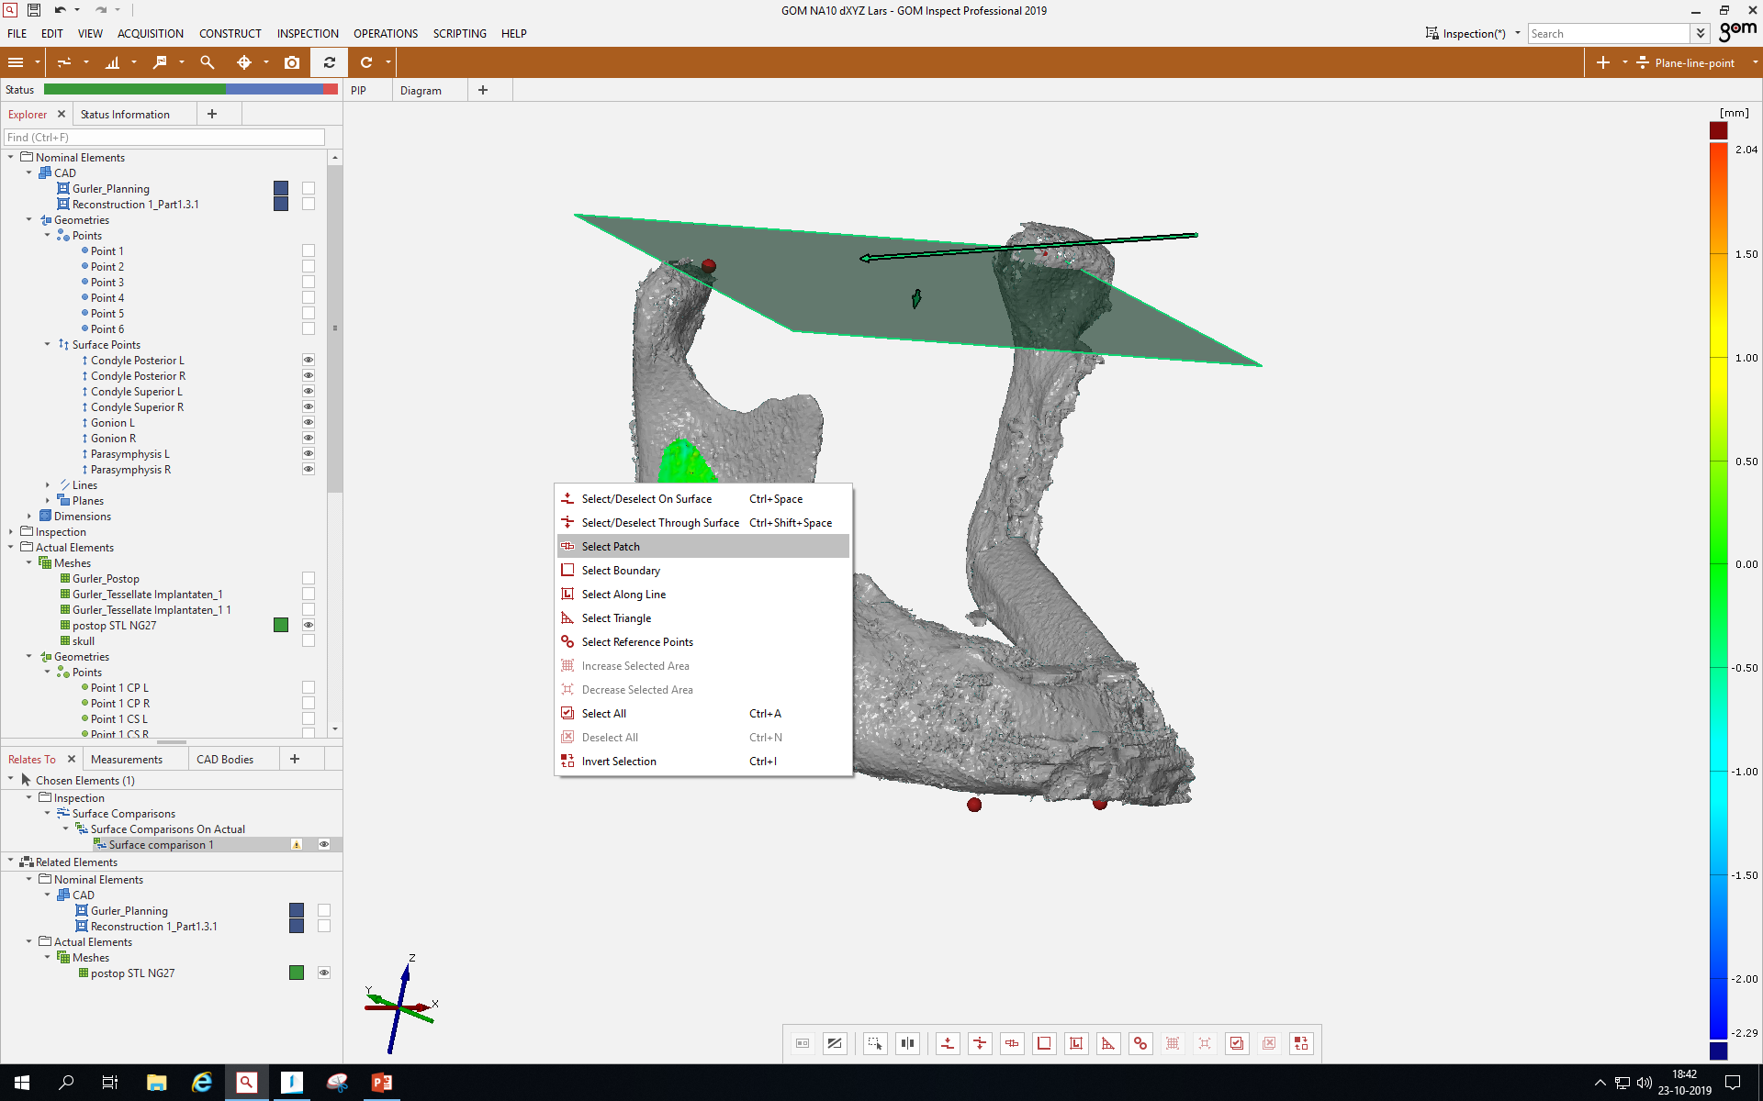

Slide 38
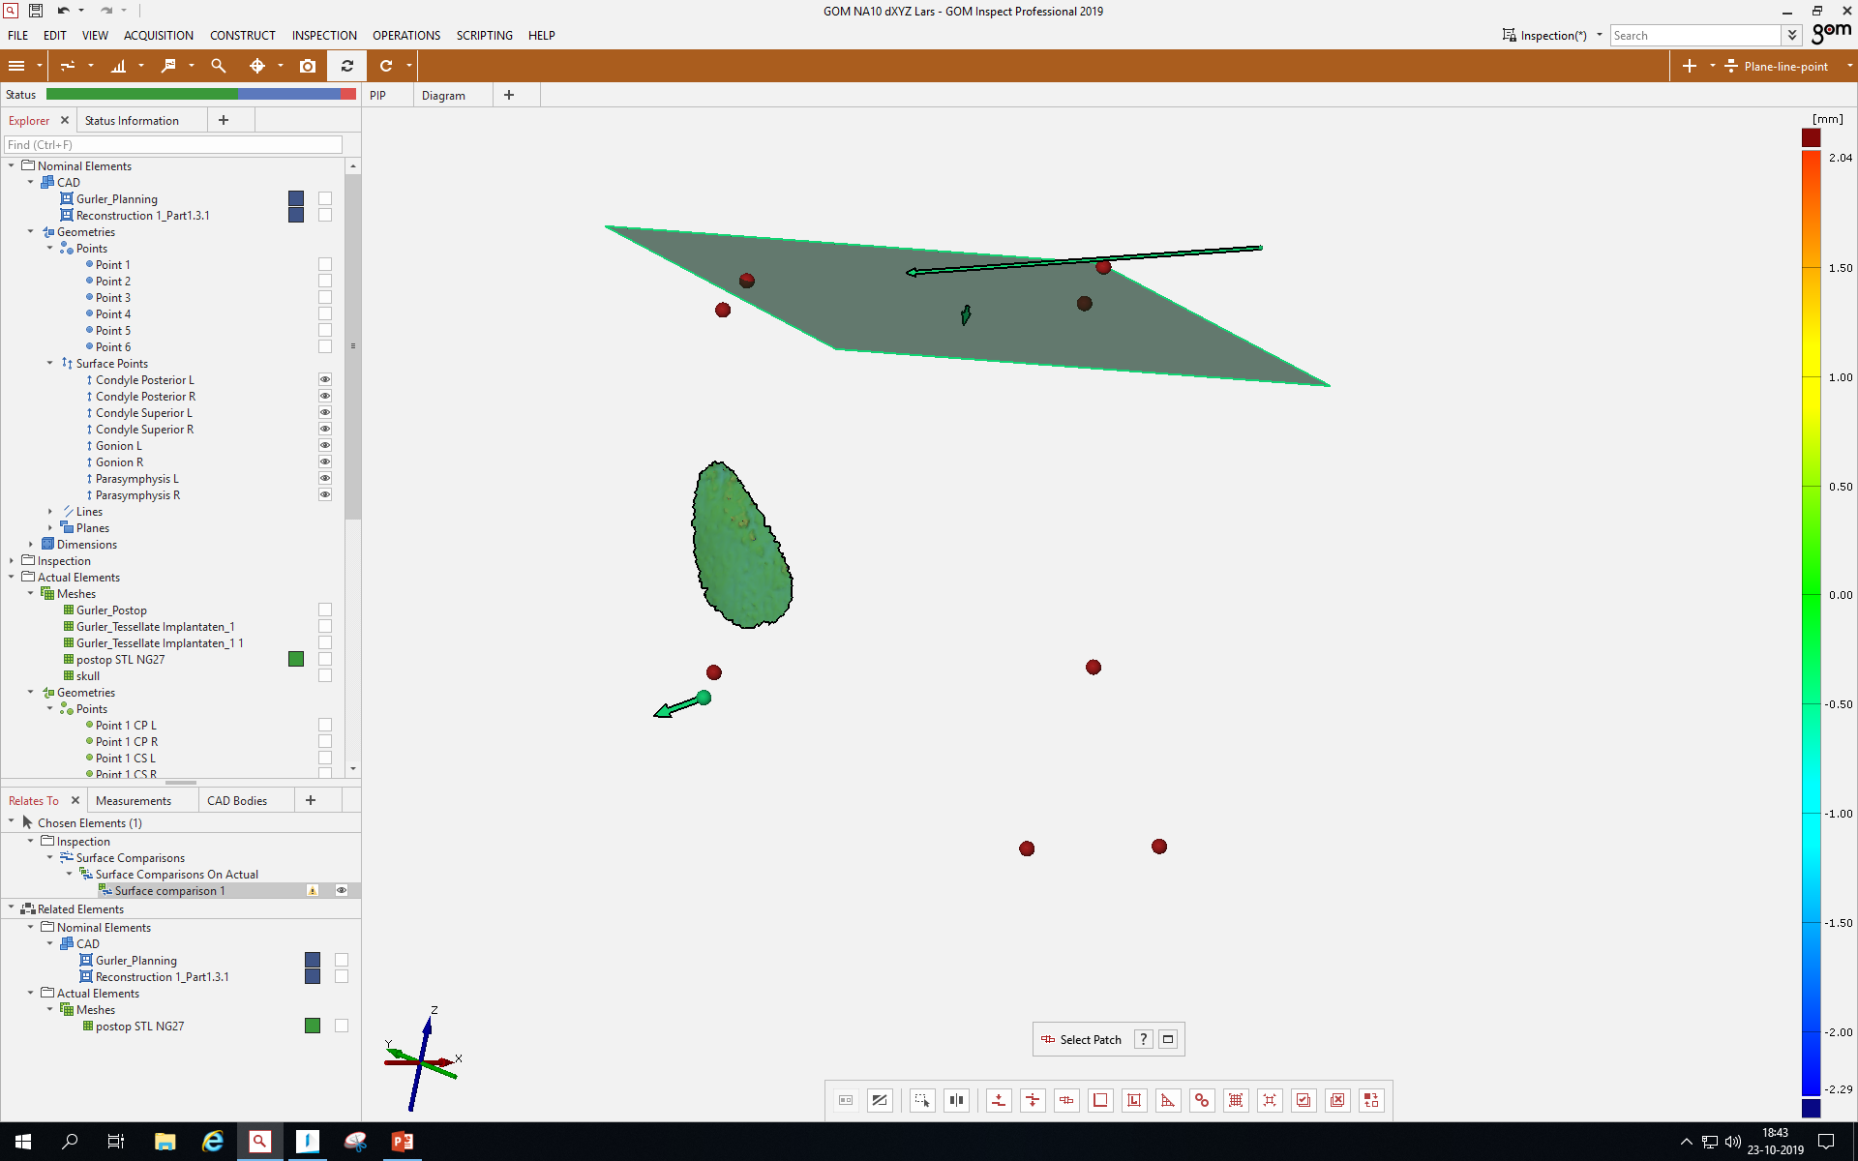

Slide 39
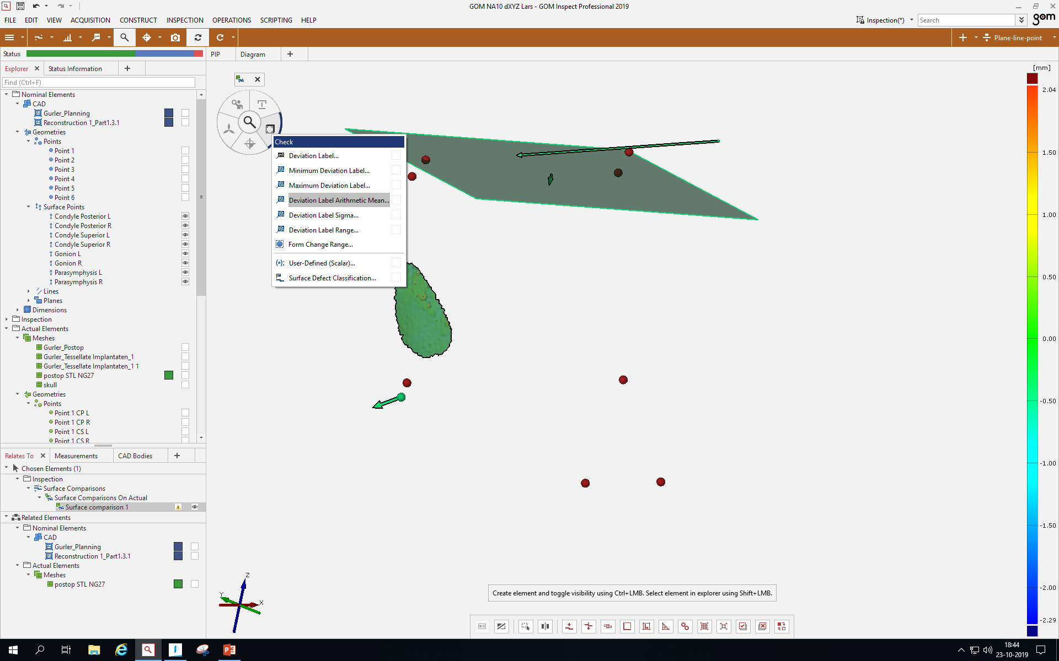

Slide 40
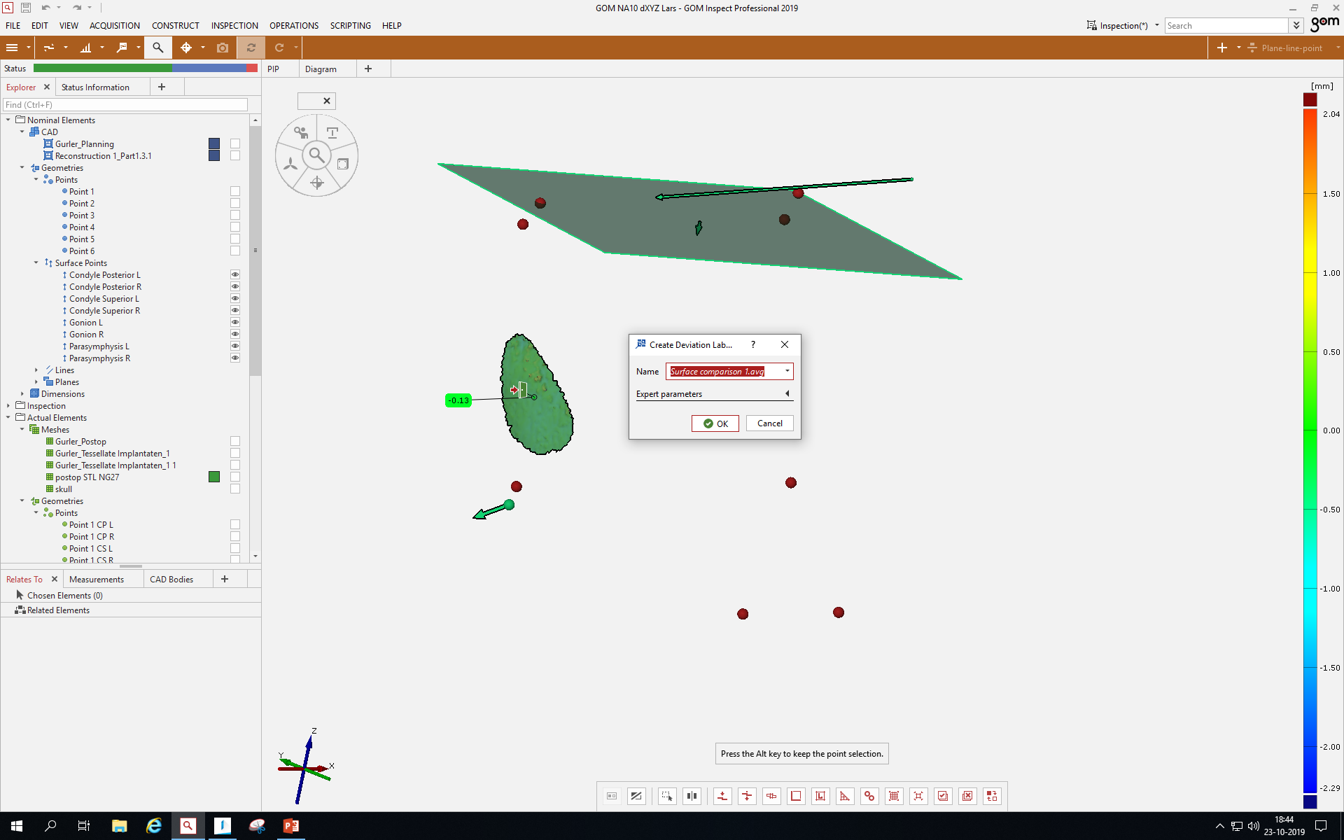

Slide 41
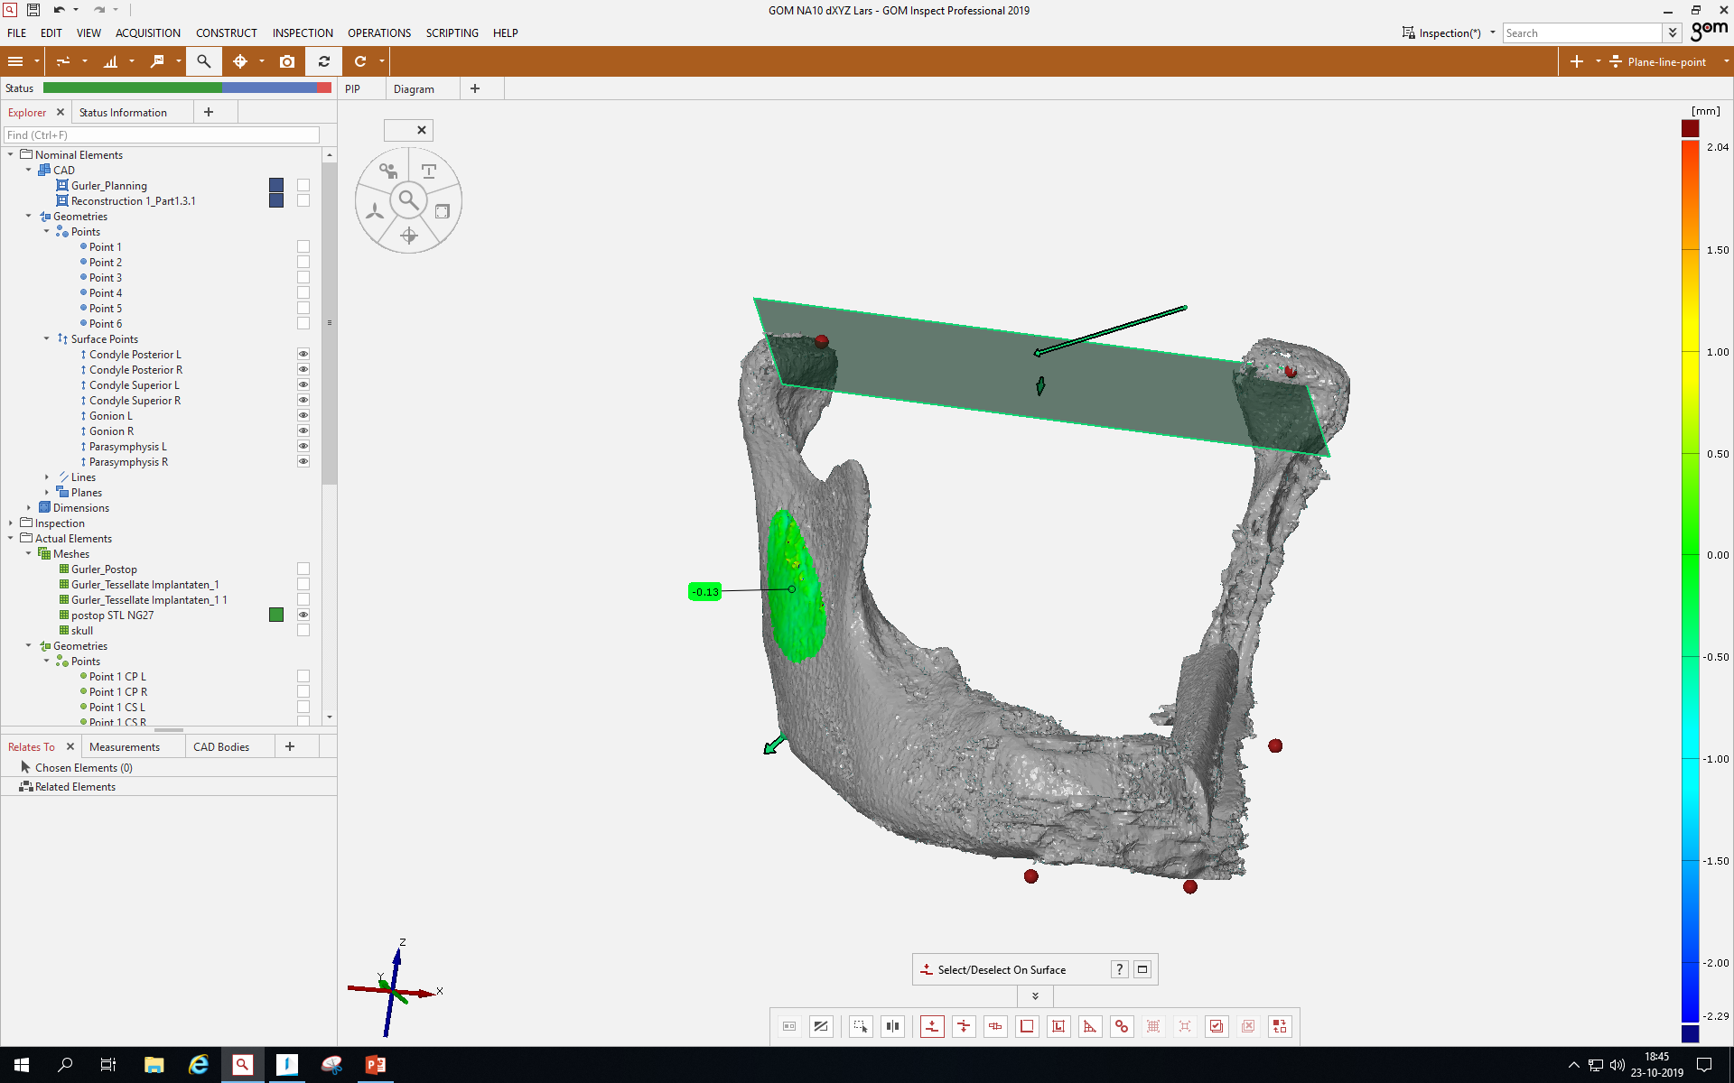

Slide 42
GOM step 6, contains all mouseclicks
Don’t mind the red spheres, green arrows, the round red planes and the green plane (all slides), these are not applicable in this simplified version and only for own simplified needs.
Don’t mind the volume assessment patch which is still visible (previous step 5)

Slide 43
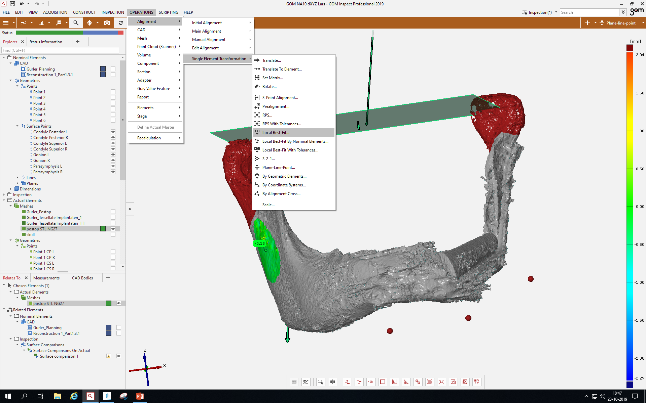

Slide 44
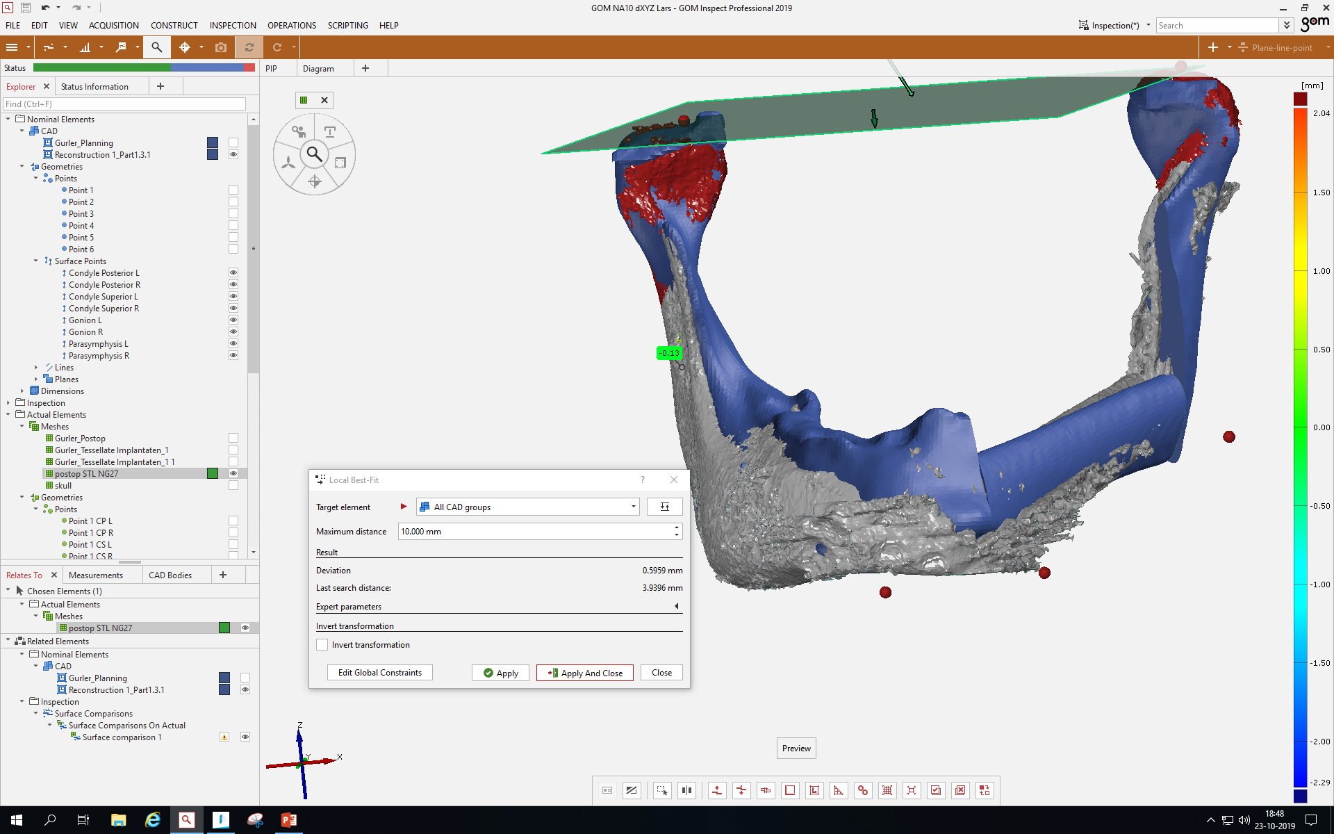

Slide 45
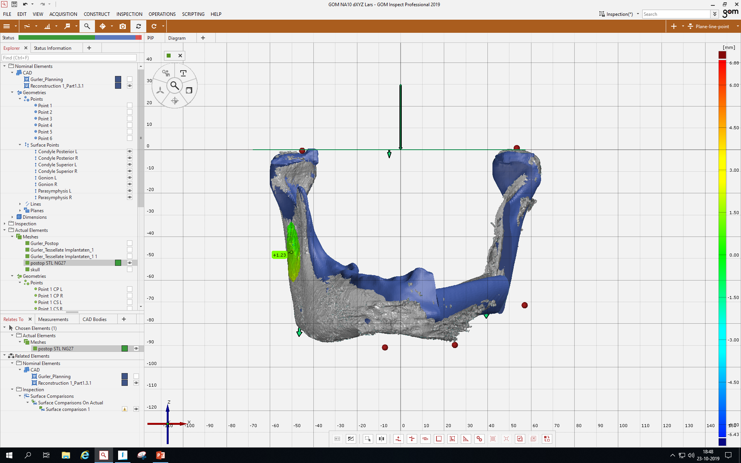
alligned

Slide 46
GOM step 7, contains all mouseclicks
Don’t mind the red spheres, green and red arrows, the round red planes and the green plane (all slides), these are not applicable in this simplified version and only for own simplified needs.
Don’t mind the volume assessment patch which is still visible (previous step 5)

Slide 47
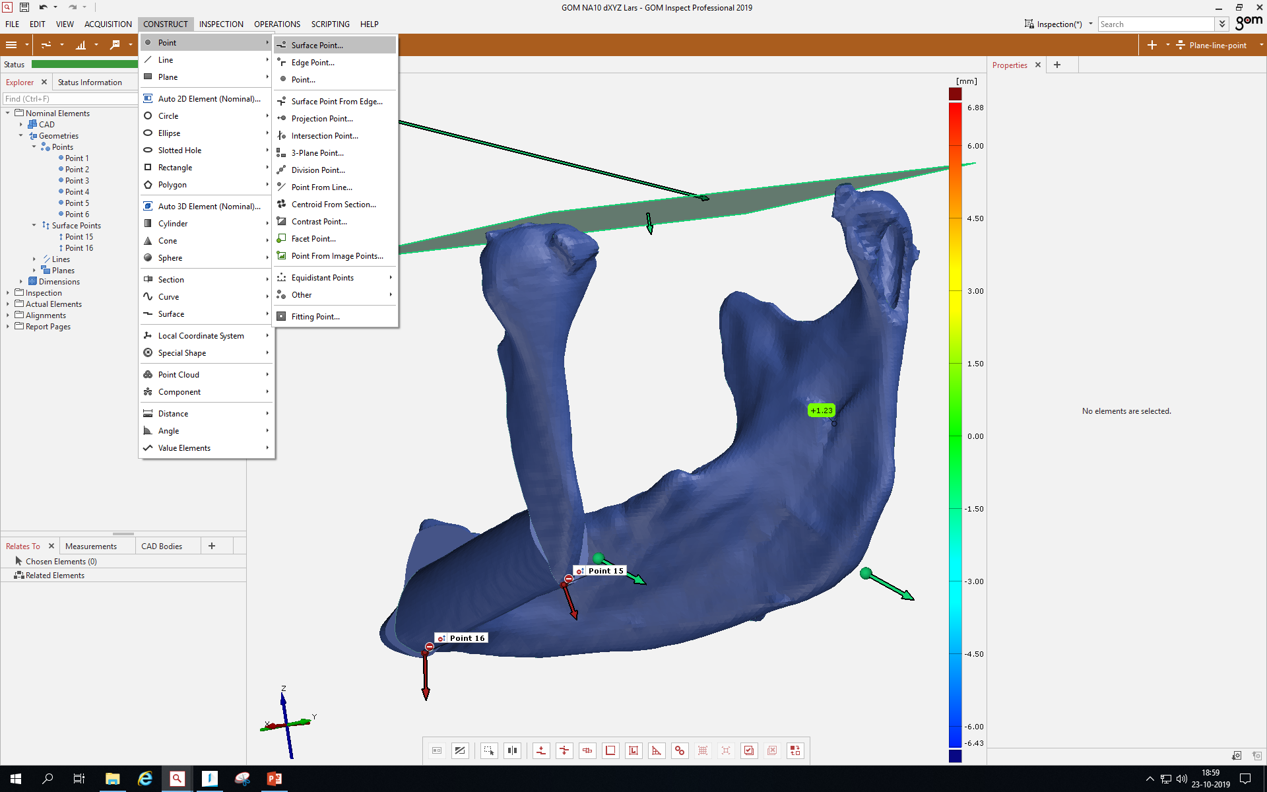

Slide 48
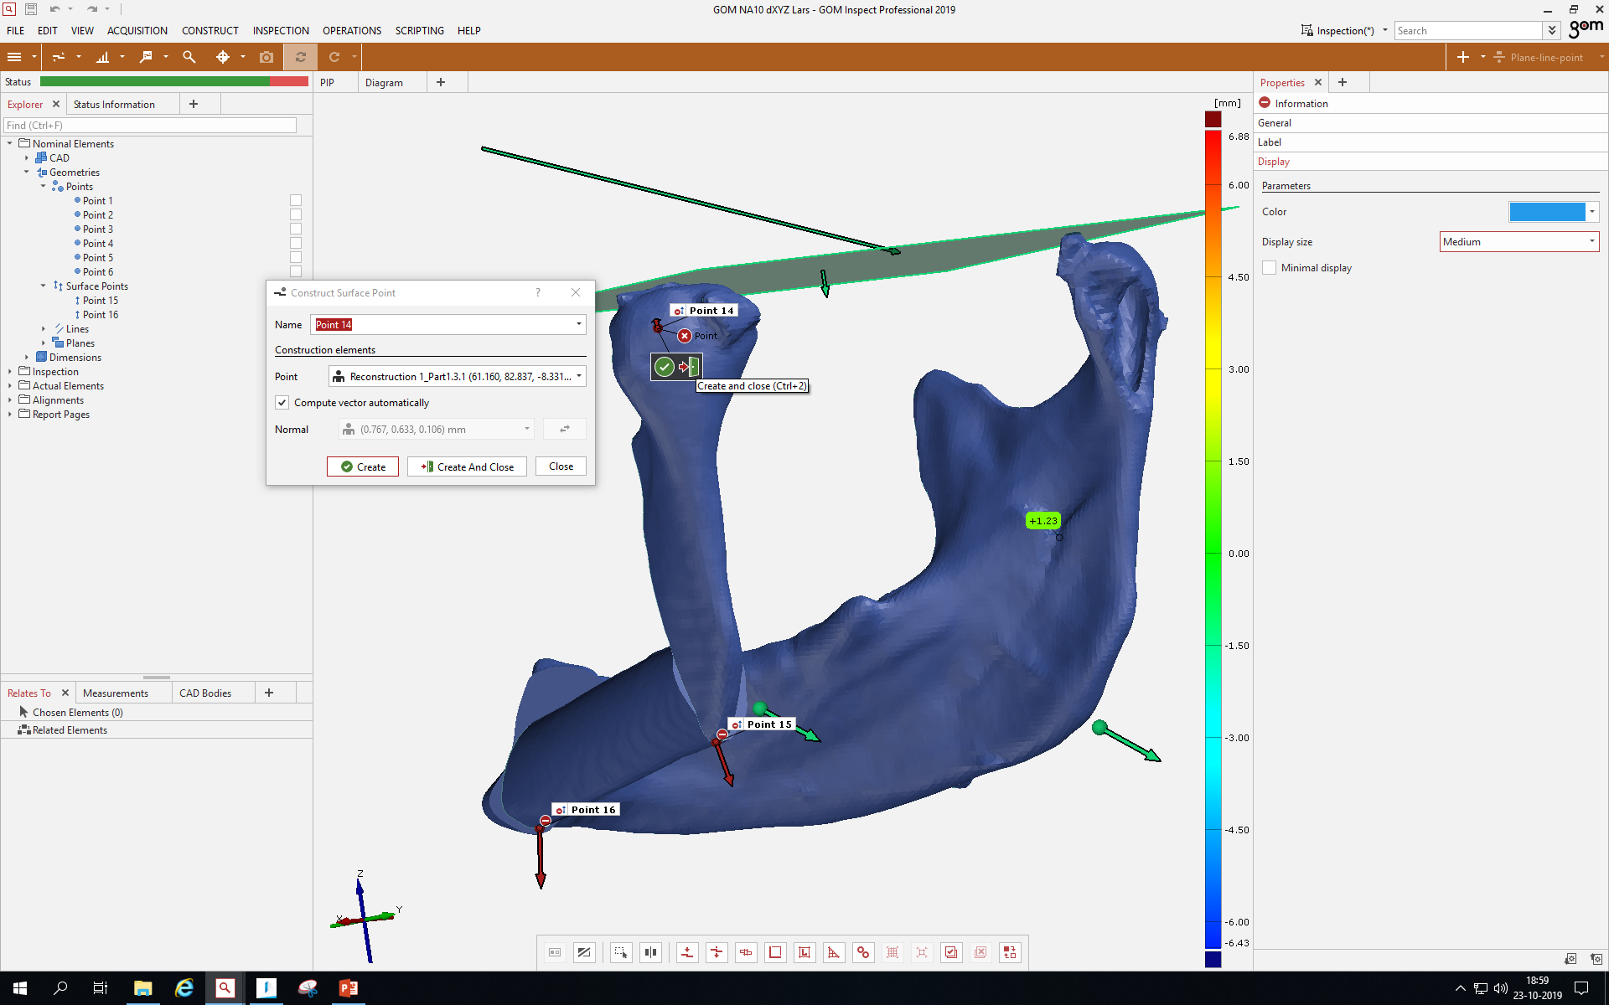

Slide 49
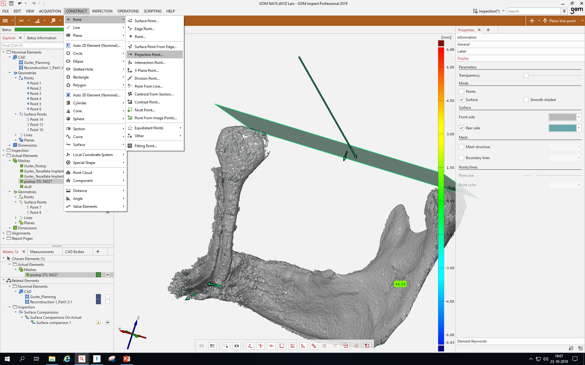

Slide 50
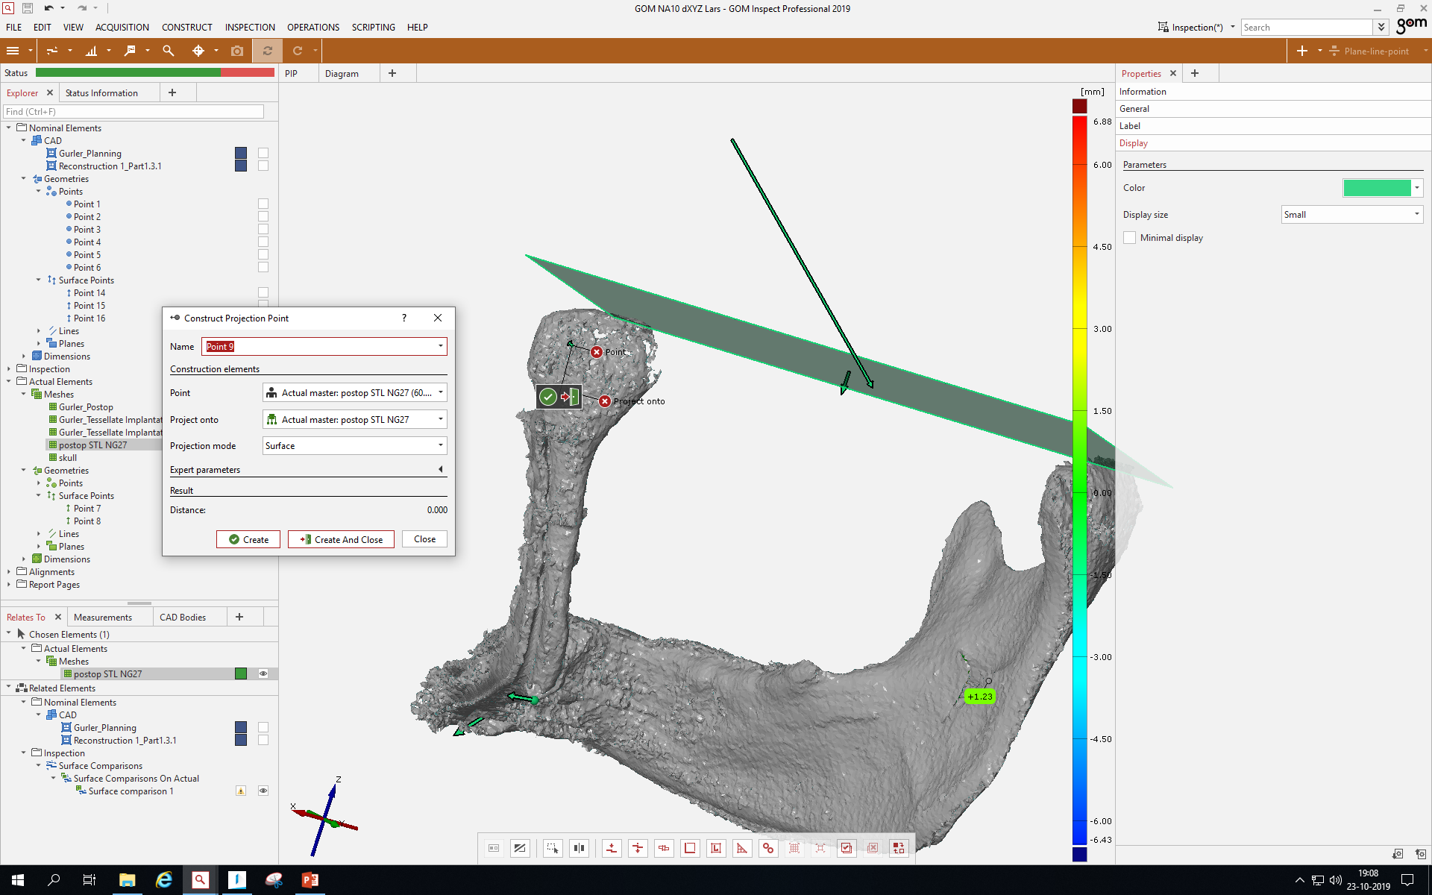

Slide 51
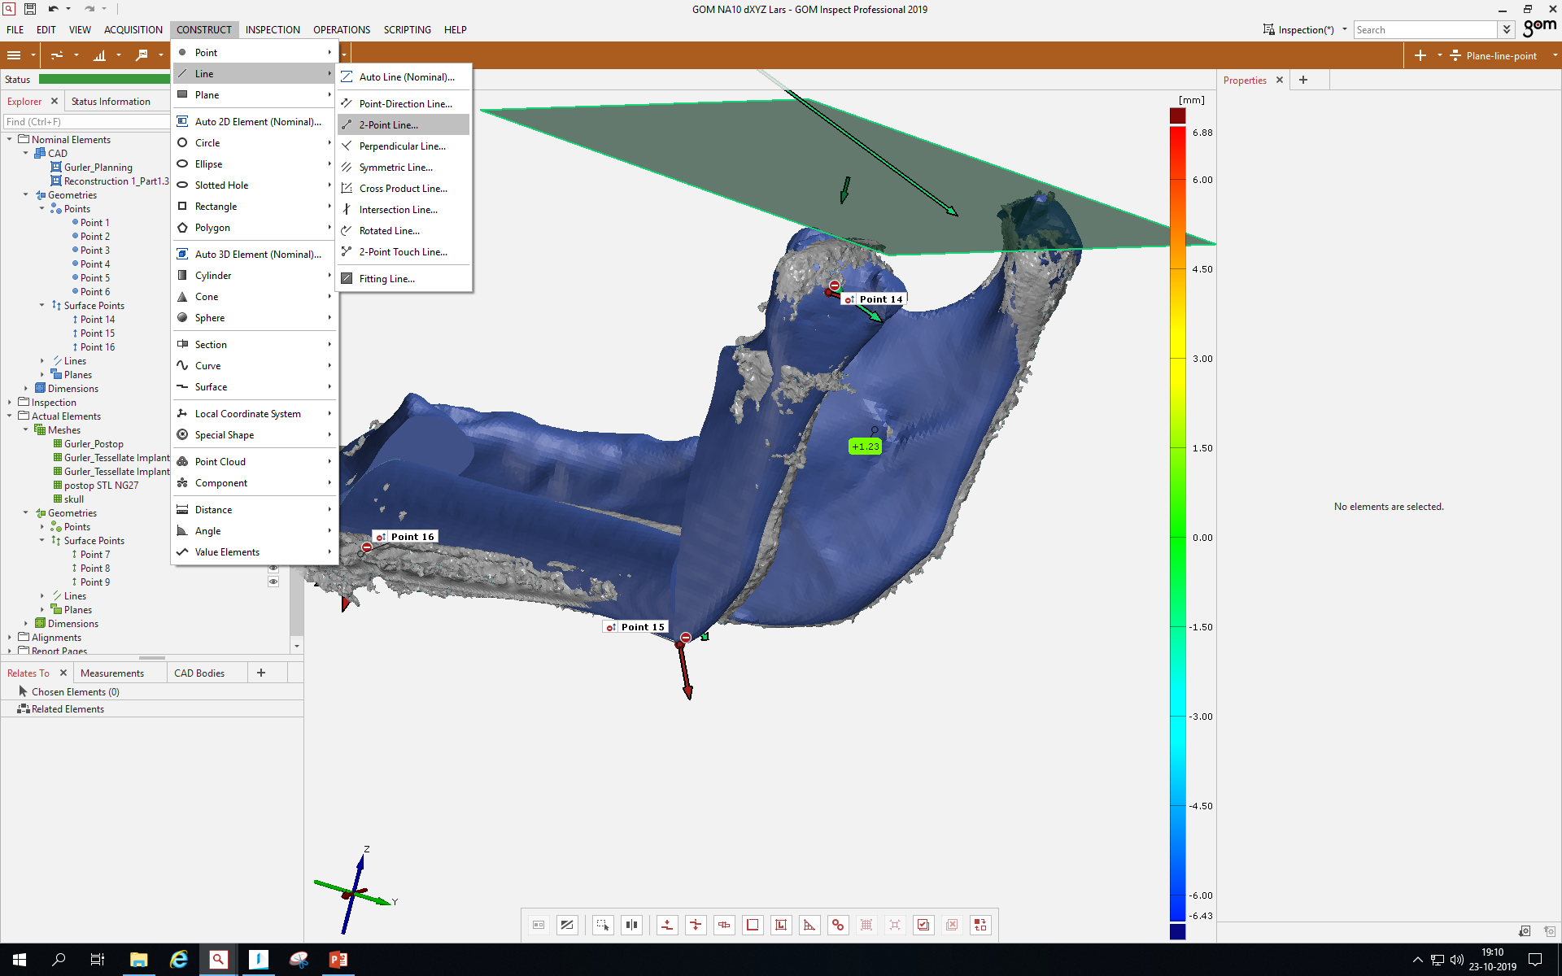

Slide 52
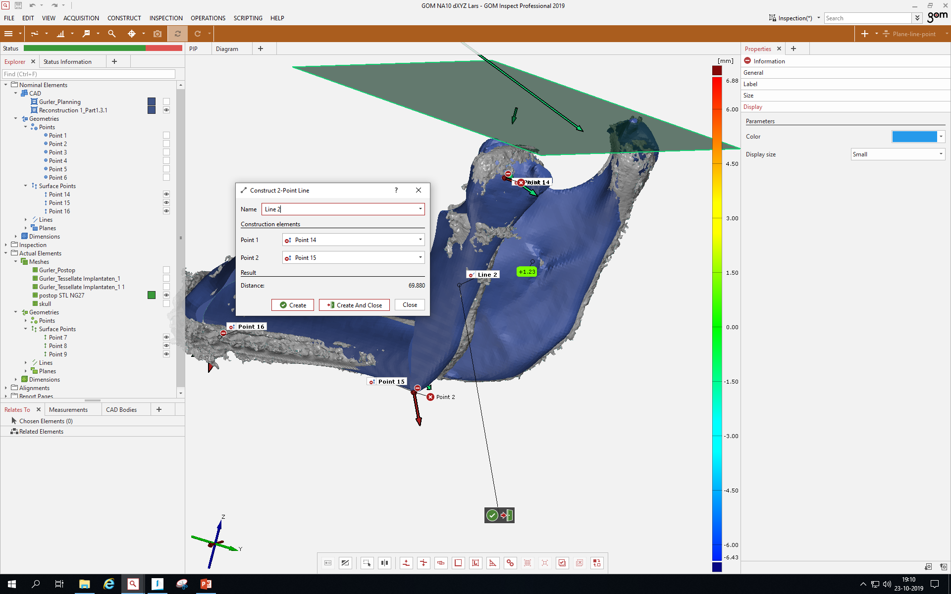
Zelfde bij postop (actual)

Slide 53
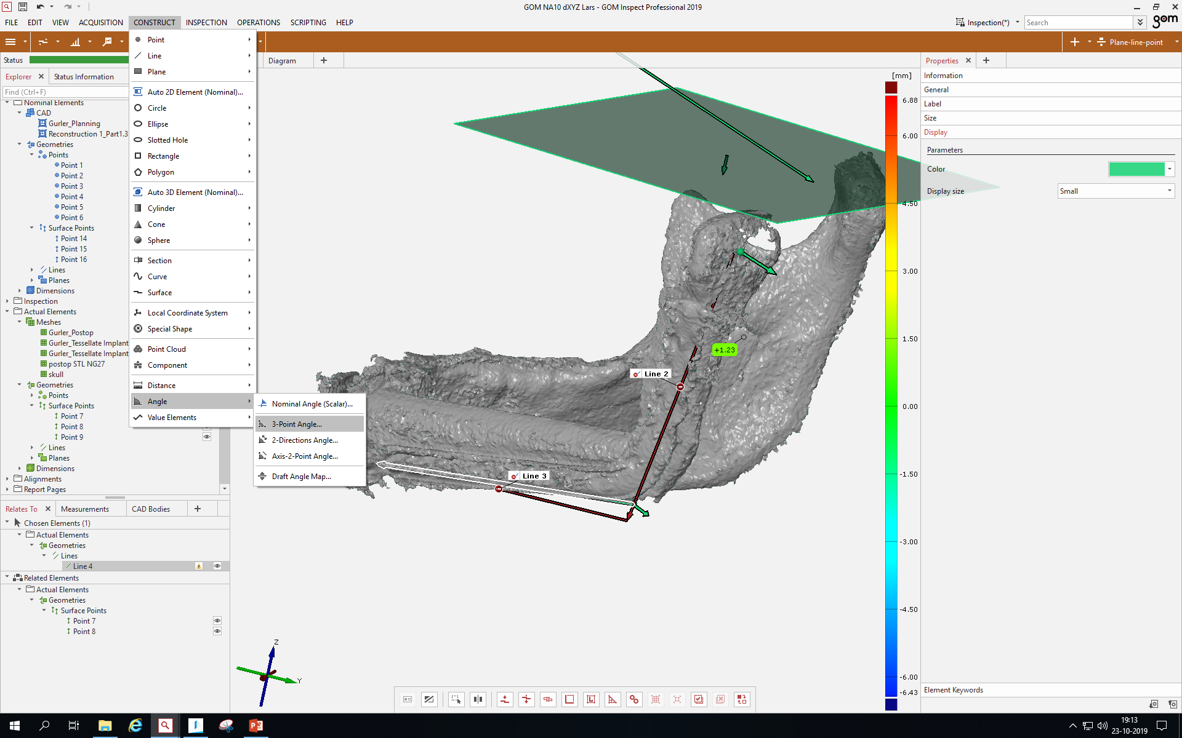

Slide 54
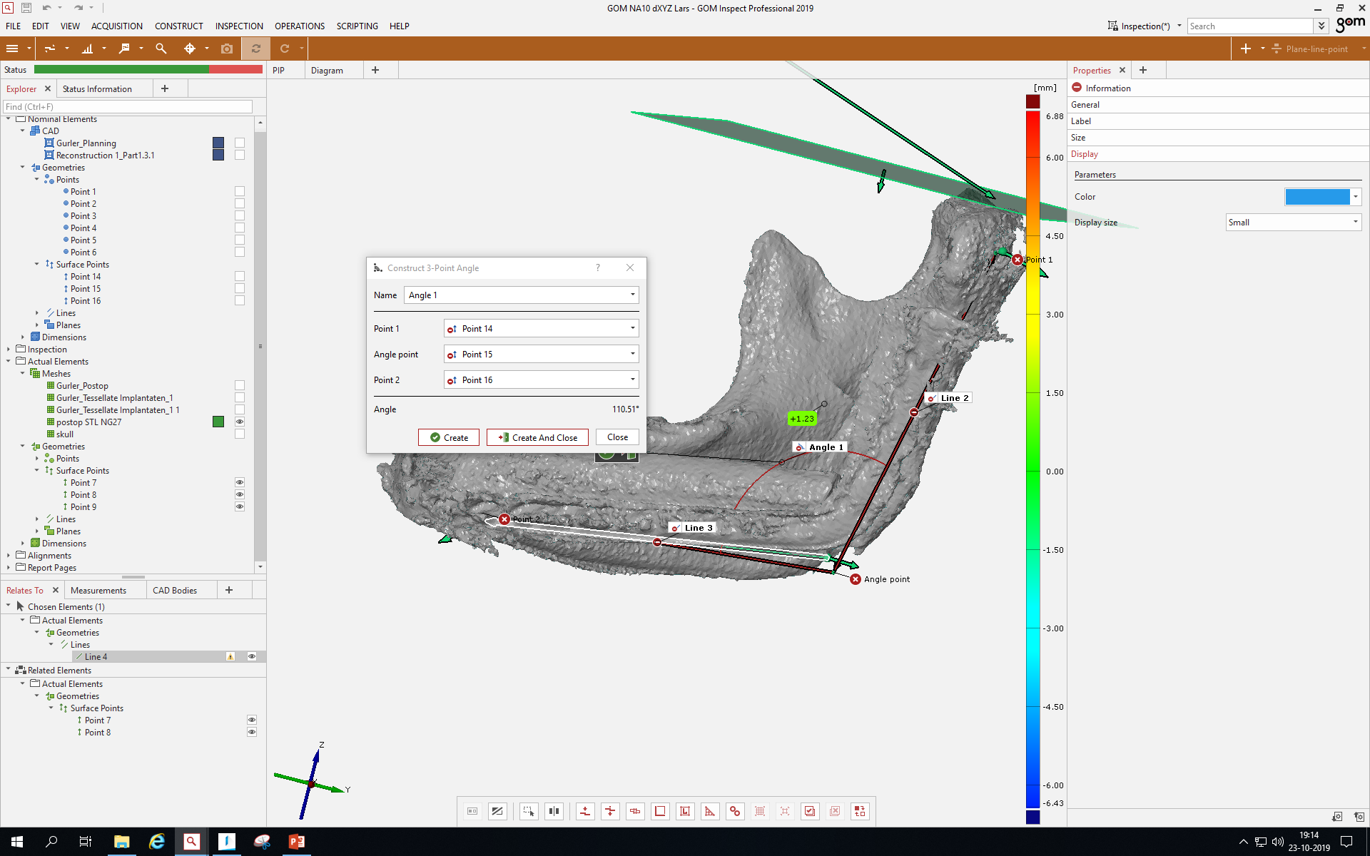

Slide 55
GOM step 8, contains almost all mouseclicks
Don’t mind the red spheres, green and red arrows, the round red planes and the green plane (all slides), these are not applicable in this simplified version and only for own simplified needs.
Don’t mind the volume assessment patch which is still visible (previous step 5)
What misses is the following:
8.3. Right mouse button click on Point 1 of the first dental implant in the “Mandible Pre-op” file. Click Measuring Principle | Link to Actual Element. Select Surface Point 1 of the “Mandible Post-op” file. Click the magnifying glass on the toolbar above. A round toolbar pops up in the screen. Click Check and select dXYZ. Repeat this procedure for all dental implants.

Slide 56


Slide 57


Slide 58

dXYZ

