Slide 1
Data aggregation workflow overview
1
2
Translate synlet pairs to human orthologs
3
Retrieve synlet interactions for various organisms
Add drugs targeting synthetic lethal genes
Druggable synlet gene pairs
Druggable synlet gene pairs
5
Identify drug pairs triggering synlet gene pairs
Drugs used in indication of interest
Drugs used in indication of interest
4
Collect drugs from clinical guidelines
4
Retrieve drugs currently under investigation

Slide 2
Step 1
Data retrieval from BioGrid
Manually (step-1-1-0_biogrid_download.mkv)
Programmatically
Restrict to relevant columns and filter for synlet interactions (slides)
Identify organism with synlet interactions (slides)

Slide 3
Step 1.2 Structure of the BioGrid file
1
#BioGRID Int… ID
2
Entrez Gene Int… A
3
Entrez Gene Int… B
4
BioGRID ID Int.. A
5
BioGRID ID Int… B
6
Syste… Name Int… A
7
Syste… Name Int… B
8
Official Sym… Int… A
9
Official Sym… Int… B
10
Synonyms Inter… A
11
Synonyms Inter… B
12
Experimental System
13
Exp… Sys… Type
14
Author
15
Pubmed ID
16
Organism Int… A
17
Organism Int… B
18
Throughput
19
Score
20
Modification
21
Phenotypes
22
Qualifications
23
Tags
24
Source Database

Slide 4
Step 1.2 Structure of the BioGrid file
1
#BioGRID Int… ID
8
Official Sym… Int… A
9
Official Sym… Int… B
12
Experimental System
16
Organism Int… A
17
Organism Int… B

Slide 5
Step 1.2 restrict to synlet
1
#BioGRID Int… ID
8
Official Sym… Int… A
9
Official Sym… Int… B
12
Experimental System
16
Organism Int… A
17
Organism Int… B
103
MAP2K4
FLNC
Two-hybrid
9606
9606
246348
eso1
rad21
Synthetic Lethality
284812
284812
Synthetic Lethality
117
MYPN
ACTN2
Two-hybrid
9606
9606
80516
Synthetic Lethality
559292
559292
BUD6
SWE1
Synthetic Lethality
80645
Synthetic Lethality
CDC42
BEM1
Synthetic Lethality
559292
559292
465966
Negative Genetic
clk-2
mex-6
Negative Genetic
6239
6239

Slide 6
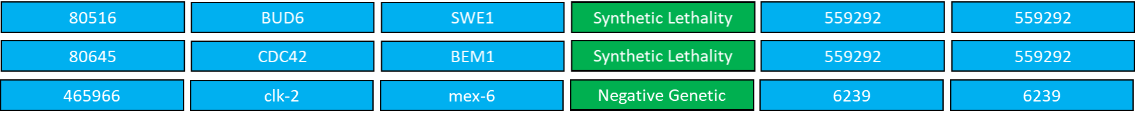
Step 1.2 restrict to synlet
1
#BioGRID Int… ID
8
Official Sym… Int… A
9
Official Sym… Int… B
12
Experimental System
16
Organism Int… A
17
Organism Int… B

Slide 7
Step 1.3 identify gene usage by species
1
#BioGRID Int… ID
8
Official Sym… Int… A
9
Official Sym… Int… B
12
Experimental System
16
Organism Int… A
17
Organism Int… B
246348
eso1
rad21
Synthetic Lethality
284812
284812
Synthetic Lethality
80516
Synthetic Lethality
559292
559292
BUD6
SWE1
Synthetic Lethality
80645
Synthetic Lethality
CDC42
BEM1
Synthetic Lethality
559292
559292
465966
Negative Genetic
clk-2
mex-6
Negative Genetic
6239
6239
Gene occurence by organism
284812: 2
559292: 4
6239: 2

Slide 8
Step 2
2.1 retrieve orthologs (step2-1-seq0_biomart.mkv, step2-1-seq1_rename_and_print_out_header.mkv)
2.2 map synlet pairs (slides)

Slide 9
Step 2.2 map synlet (prepare mapping)
s_cerevisae.txt:
mapping.txt
CSE4
HIST1H3H
tax_id/gene_symbol
human_gene_symbol
CSE4
HIST1H3I
COX2
MT-CO2
MT-CYB
COX3
MT-CYB
c_elegans.txt:
nduo-1
MT-ND1
ctb-1
MT-CYB
asp-8
PGC

Slide 10
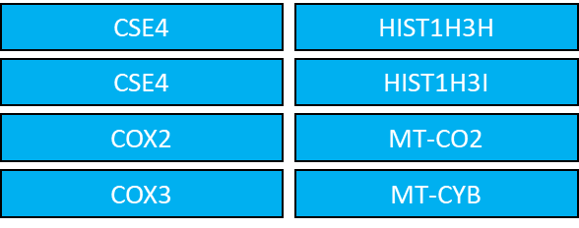
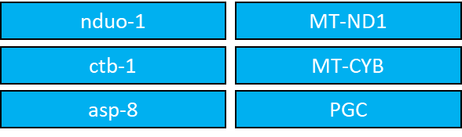
Step 2.2 map synlet (prepare mapping)
s_cerevisae.txt:
mapping.txt
CSE4
HIST1H3H
tax_id/gene_symbol
human_gene_symbol
CSE4
HIST1H3I
559292/CSE4
CSE4
HIST1H3H
COX2
MT-CO2
559292/CSE4
CSE4
HIST1H3I
COX3
MT-CYB
COX2
559292/COX2
MT-CO2
559292/COX3
COX3
MT-CYB
nduo-1
6239/nduo-1
MT-ND1
c_elegans.txt:
ctb-1
6239/ctb-1
MT-CYB
nduo-1
MT-ND1
asp-8
6239/asp-8
PGC
ctb-1
MT-CYB
asp-8
PGC

Slide 11
Step 2.2 map synlet (prepare mapping)
s_cerevisae.txt:
mapping.txt
CSE4
HIST1H3H
tax_id/gene_symbol
human_gene_symbol
CSE4
HIST1H3I
559292/CSE4
CSE4
HIST1H3H
COX2
MT-CO2
559292/CSE4
CSE4
HIST1H3I
COX3
MT-CYB
COX2
559292/COX2
MT-CO2
559292/COX3
COX3
MT-CYB
nduo-1
6239/nduo-1
MT-ND1
c_elegans.txt:
ctb-1
6239/ctb-1
MT-CYB
nduo-1
MT-ND1
asp-8
6239/asp-8
PGC
ctb-1
MT-CYB
9606/CDK16
CDK16
asp-8
PGC
9606/PRKCD
PRKCD

Slide 12
Step 2.2 map synlet (add join keys)
#BioGRID Int… ID
#BioGRID Int… ID
Experimental System
Official Sym… Int… A
Official Sym… Int… B
Experimental System
Organism Int… A
Organism Int… B
1960322
1960322
Negative Genetic
ORC2
AAP1
Negative Genetic
559292
559292
166788
166788
Synthetic Lethality
RAD27
AAT2
Synthetic Lethality
559292
559292
285938
285938
Synthetic Lethality
YNG2
AAT2
Synthetic Lethality
559292
559292
1414445
1414445
Synthetic Lethality
KRAS
A2M
Synthetic Lethality
9606
9606

Slide 13
Step 2.2 map synlet (add join keys)
#BioGRID Int… ID
Official Sym… Int… A
Official Sym… Int… B
Experimental System
Organism Int… A
Organism Int… B
Key Interactor A
Key Interactor B
1960322
ORC2
AAP1
Negative Genetic
559292
559292
559292/ORC2
559292/AAP1
166788
RAD27
AAT2
Synthetic Lethality
559292
559292
559292/RAD27
559292/AAT2
285938
YNG2
AAT2
Synthetic Lethality
559292
559292
559292/YNG2
559292/AAT2
1414445
KRAS
A2M
Synthetic Lethality
9606
9606
9606/KRAS
9606/A2M

Slide 14
Step 2.2 map synlet (merge)
#BioGRID Int… ID
Official Sym… Int… A
Official Sym… Int… B
Experimental System
Organism Int… A
Organism Int… B
Key Interactor A
Key Interactor B
1960322
ORC2
AAP1
Negative Genetic
559292
559292
559292/ORC2
559292/AAP1
166788
RAD27
AAT2
Synthetic Lethality
559292
559292
559292/RAD27
559292/AAT2
285938
YNG2
AAT2
Synthetic Lethality
559292
559292
559292/YNG2
559292/AAT2
1414445
KRAS
A2M
Synthetic Lethality
9606
9606
9606/KRAS
9606/A2M
tax_id/gene_symbol
human_gene_symbol
559292/ORC2
ORC2
ORC2
559292/YNG2
ING3
ING3
559292/AAP1
NPEPPS
NPEPPS
9606/KRAS
KRAS
KRAS
559292/AAT2
GOT1
GOT1
9606/A2M
A2M
A2M

Slide 15
Step 2.2 map synlet (merge)
#BioGRID Int… ID
Official Sym… Int… A
Official Sym… Int… B
Experimental System
Organism Int… A
Organism Int… B
Key Interactor A
Key Interactor B
human_gene_symbol
human_gene_symbol
1960322
ORC2
AAP1
Negative Genetic
559292
559292
559292/ORC2
559292/AAP1
166788
RAD27
AAT2
Synthetic Lethality
559292
559292
559292/RAD27
559292/AAT2
285938
YNG2
AAT2
Synthetic Lethality
559292
559292
559292/YNG2
559292/AAT2
1414445
KRAS
A2M
Synthetic Lethality
9606
9606
9606/KRAS
9606/A2M
tax_id/gene_symbol
human_gene_symbol
559292/ORC2
ORC2
ORC2
559292/YNG2
ING3
ING3
559292/AAP1
NPEPPS
NPEPPS
9606/KRAS
KRAS
KRAS
559292/AAT2
GOT1
GOT1
GOT1
9606/A2M
A2M
A2M

Slide 16
Step 3 Mapping synthetic lethal interaction partners to drug
3.1 Download (step-3-1-seq0_download_drugbank.mkv, step-3-1-seq1_download_drugbank.mkv)
3.1 extract columns and filter to human (slides)
3.2 add drug names to targets (slides)
3.3 Add to synlet

Slide 17
Step 3.1 extract columns and filter to human
1
ID
2
Name
3
Gene Name
4
GenBank Protein ID
5
GenBank Gene ID
6
UniProt ID
7
Uniprot Title
8
PDB ID
9
GeneCard ID
10
GenAtlas ID
11
HGNC ID
12
Species
13
Drug IDs

Slide 18
Step 3.1 extract columns and filter to human
3
Gene Name
12
Species
13
Drug IDs
13
Drug IDs
HDC
Humans
DB00114; DB00117
Humans
TMP1
Yeast
DB01099
Humans
GLS2
Humans
GLS2
Humans
DB00142
Humans
DB00142
Humans
AMT
Humans
AMT
Humans
DB00116; DB00157; DB04789
Humans
DB00116; DB00157; DB04789

Slide 19
Step 3.2 add drug names to targets
3
Gene Name
12
Species
13
Drug IDs
3
Gene Name
12
Species
13
Drug IDs
13
Drug IDs
HDC
Humans
DB00114; DB00117
HDC
Humans
DB00114
GLS2
Humans
DB00142
HDC
Humans
DB00117
AMT
Humans
DB00116; DB00157; DB04789
GLS2
Humans
DB00142
AMT
Humans
DB00116
AMT
Humans
DB00157
AMT
Humans
DB04789

Slide 20
Step 3.2 add drug names to targets
1
DrugBank ID
2
Accession Numbers
3
Common name
4
CAS
5
UNII
6
Synonyms
7
Standard InChI Key

Slide 21
Step 3.2 add drug names to targets
1
DrugBank ID
1
DrugBank ID
3
Common name
3
Common name
3
Common name
DB00114
DB00114
Pyridoxal phosphate
Pyridoxal phosphate
DB00117
DB00117
Histidine
Histidine
DB00142
DB00142
Glutamic Acid
Glutamic Acid
DB00116
DB00116
Tetrahydrofolic acid
Tetrahydrofolic acid
DB00157
DB00157
NADH
NADH
DB04789
DB04789
5-methyltetrahydrofolic acid
5-methyltetrahydrofolic acid

Slide 22
Step 3.2 add drug names to targets
Gene Name
Species
Drug IDs
Common name
HDC
Humans
DB00114
HDC
Humans
DB00117
GLS2
Humans
DB00142
AMT
Humans
DB00116
…
DrugBank ID
Common name
DB00114
Pyridoxal phosphate
Pyridoxal phosphate
DB00117
Histidine
Histidine
DB00142
Glutamic Acid
Glutamic Acid
…
…

Slide 23
Step 3.3 add to synlet
#BioGRID Int… ID
Official Sym… Int… A
Official Sym… Int… B
Experimental System
Organism Int… A
Organism Int… B
Key Interactor A
Key Interactor B
human_gene_symbol
human_gene_symbol
9606
9606
…
1414445
KRAS
A2M
Synthetic Lethality
9606/KRAS
9606/A2M
KRAS
A2M
1979284
ACT1
PRK1
Negative Genetic
559292
559292
559292/ACT1
559292/PRK1
ACTB
AAK1
285938
YNG2
AAT2
Synthetic Lethality
559292
559292
559292/YNG2
559292/AAT2
ING3
GOT1

Slide 24
Step 3.3 add to synlet
#BioGRID Int… ID
Official Sym… Int… A
Official Sym… Int… B
Experimental System
Organism Int… A
Organism Int… B
Key Interactor A
Key Interactor B
human_gene_symbol
human_gene_symbol
Drug IDs
Common name
Drug IDs
Common name
1414445
KRAS
A2M
Synthetic Lethality
9606
9606
9606/KRAS
9606/A2M
KRAS
A2M
1979284
ACT1
PRK1
Negative Genetic
559292
559292
559292/ACT1
559292/PRK1
ACTB
AAK1
285938
YNG2
AAT2
Synthetic Lethality
559292
559292
559292/YNG2
559292/AAT2
ING3
GOT1
1979284
ACT1
PRK1
Negative Genetic
559292
559292
559292/ACT1
559292/PRK1
ACTB
AAK1
Gene Name
Drug IDs
Common name
A2M
DB00102
Becaplermin
DB00102
Becaplermin
AAK1
DB12010
Fostamatinib
DB12010
Fostamatinib
DB12010
Fostamatinib
ACTB
DB04216
Quercetin
DB04216
Quercetin
ACTB
DB12695
Phenethyl Isothi…
DB12695
Phenethyl Isothi…
KRAS
DB07780
Farnesyl diphosphate
DB07780
Farnesyl diphosphate
GOT1
Pyridoxal phosphate
DB00114
Pyridoxal phosphate
DB00114

Slide 25
Step 3.3 add to synlet
#BioGRID Int… ID
Official Sym… Int… A
Official Sym… Int… B
Experimental System
Organism Int… A
Organism Int… B
Key Interactor A
Key Interactor B
human_gene_symbol
human_gene_symbol
Drug IDs
Common name
Drug IDs
Common name
1414445
KRAS
A2M
Synthetic Lethality
9606
9606
9606/KRAS
9606/A2M
KRAS
A2M
DB07780
Farnesyl diphosphate
DB00102
Becaplermin
1979284
ACT1
PRK1
Negative Genetic
559292
559292
559292/ACT1
559292/PRK1
ACTB
AAK1
DB04216
Quercetin
DB12010
Fostamatinib
285938
YNG2
AAT2
Synthetic Lethality
559292
559292
559292/YNG2
559292/AAT2
ING3
GOT1
DB00114
Pyridoxal phosphate
1979284
ACT1
PRK1
Negative Genetic
559292
559292
559292/ACT1
559292/PRK1
ACTB
AAK1
DB12695
Phenethyl Isothi…
DB12010
Fostamatinib
Gene Name
Drug IDs
Common name
A2M
DB00102
Becaplermin
DB00102
Becaplermin
AAK1
DB12010
Fostamatinib
DB12010
Fostamatinib
DB12010
Fostamatinib
ACTB
DB04216
Quercetin
DB04216
Quercetin
ACTB
DB12695
Phenethyl Isothi…
DB12695
Phenethyl Isothi…
KRAS
DB07780
Farnesyl diphosphate
DB07780
Farnesyl diphosphate
GOT1
Pyridoxal phosphate
DB00114
Pyridoxal phosphate
DB00114

Slide 26
Step 4 retrieve drugs (from clinical trials)
Two main sources:
Clinical guidelines
Clinicaltrials.gov (video on how to check mesh hierachy and following slide to point out required tables)

Slide 27
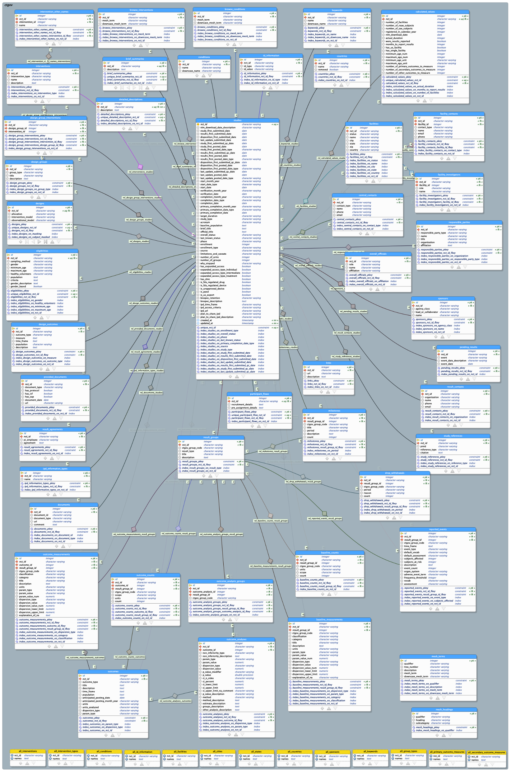
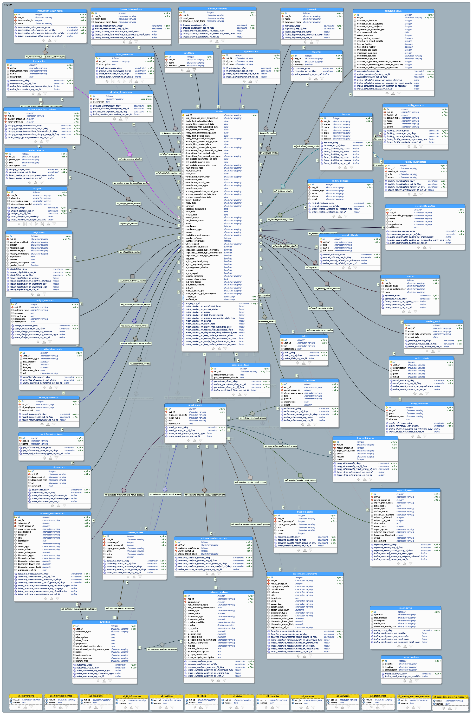
Step 4 retrieve drugs (from clinical trials)
AACT Databse Schema
filter for condition of interest
filter for interventional studies

