Slide 1
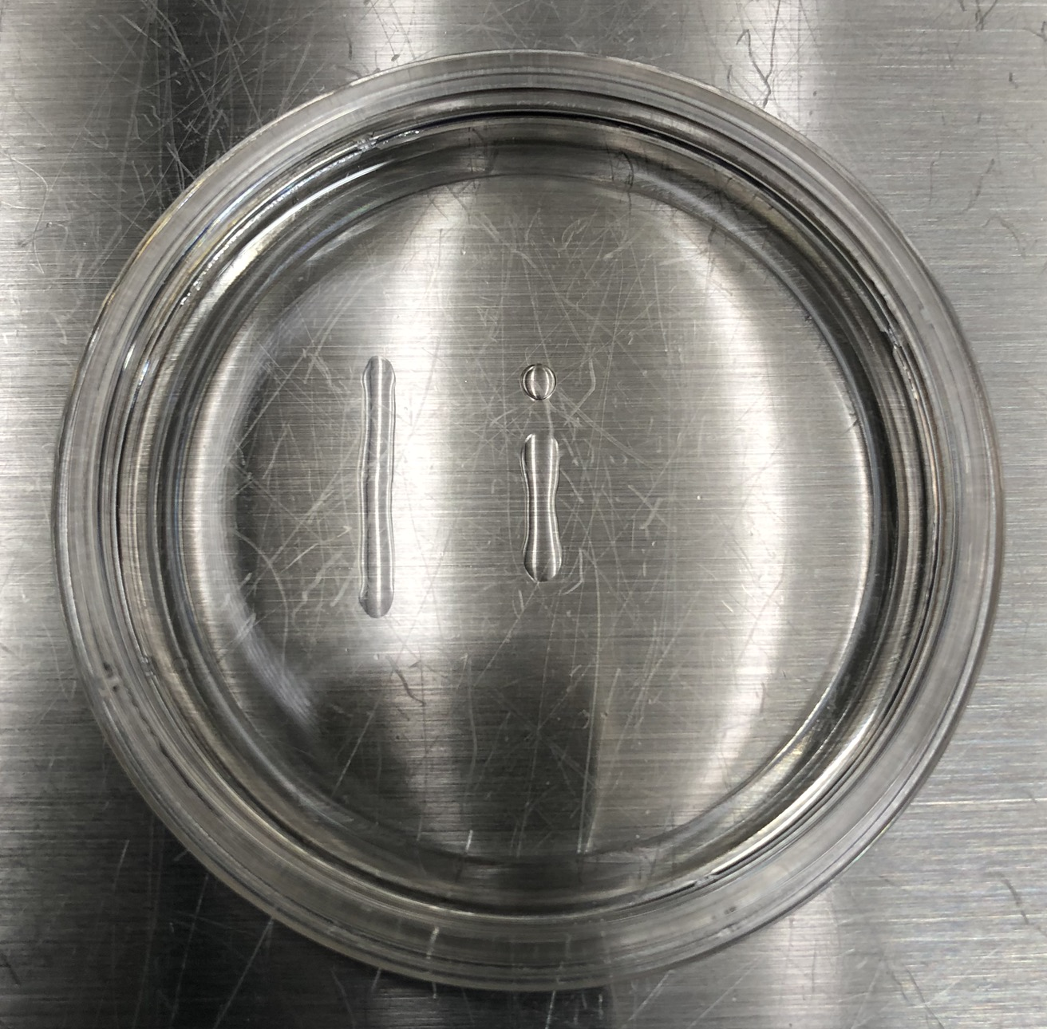
Figure 1.
7% PVP
for micropipette preparation
(5μL)
7% Polyvinylpyrrolidone (PVP) for sperm selection
(10μL)
Buffered medium
for ICSI
(8μL)
Glass bottom dish

