Slide 1
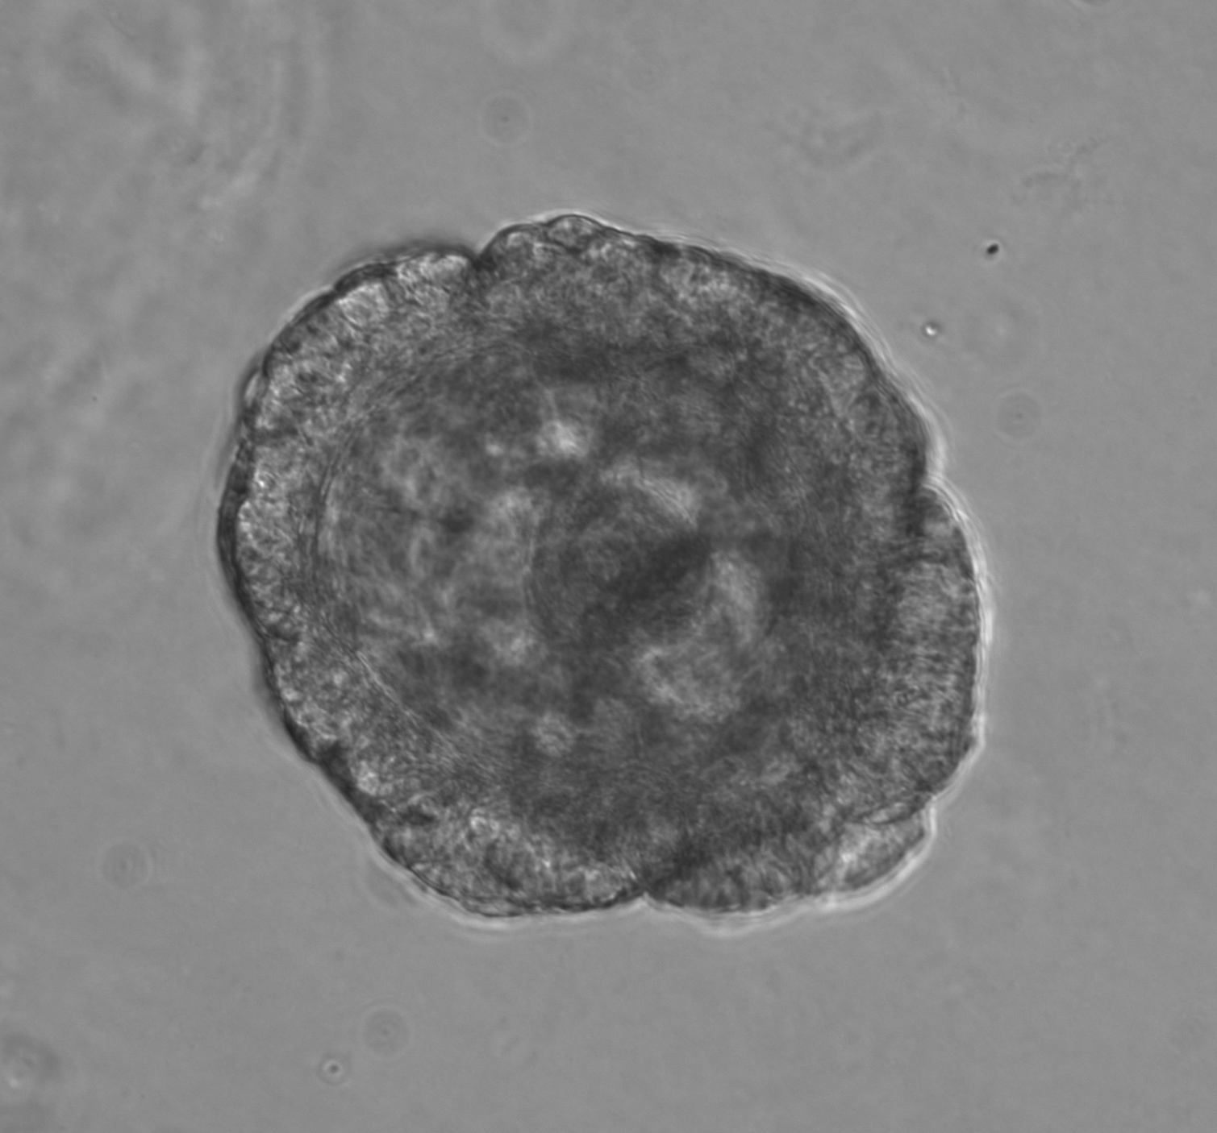
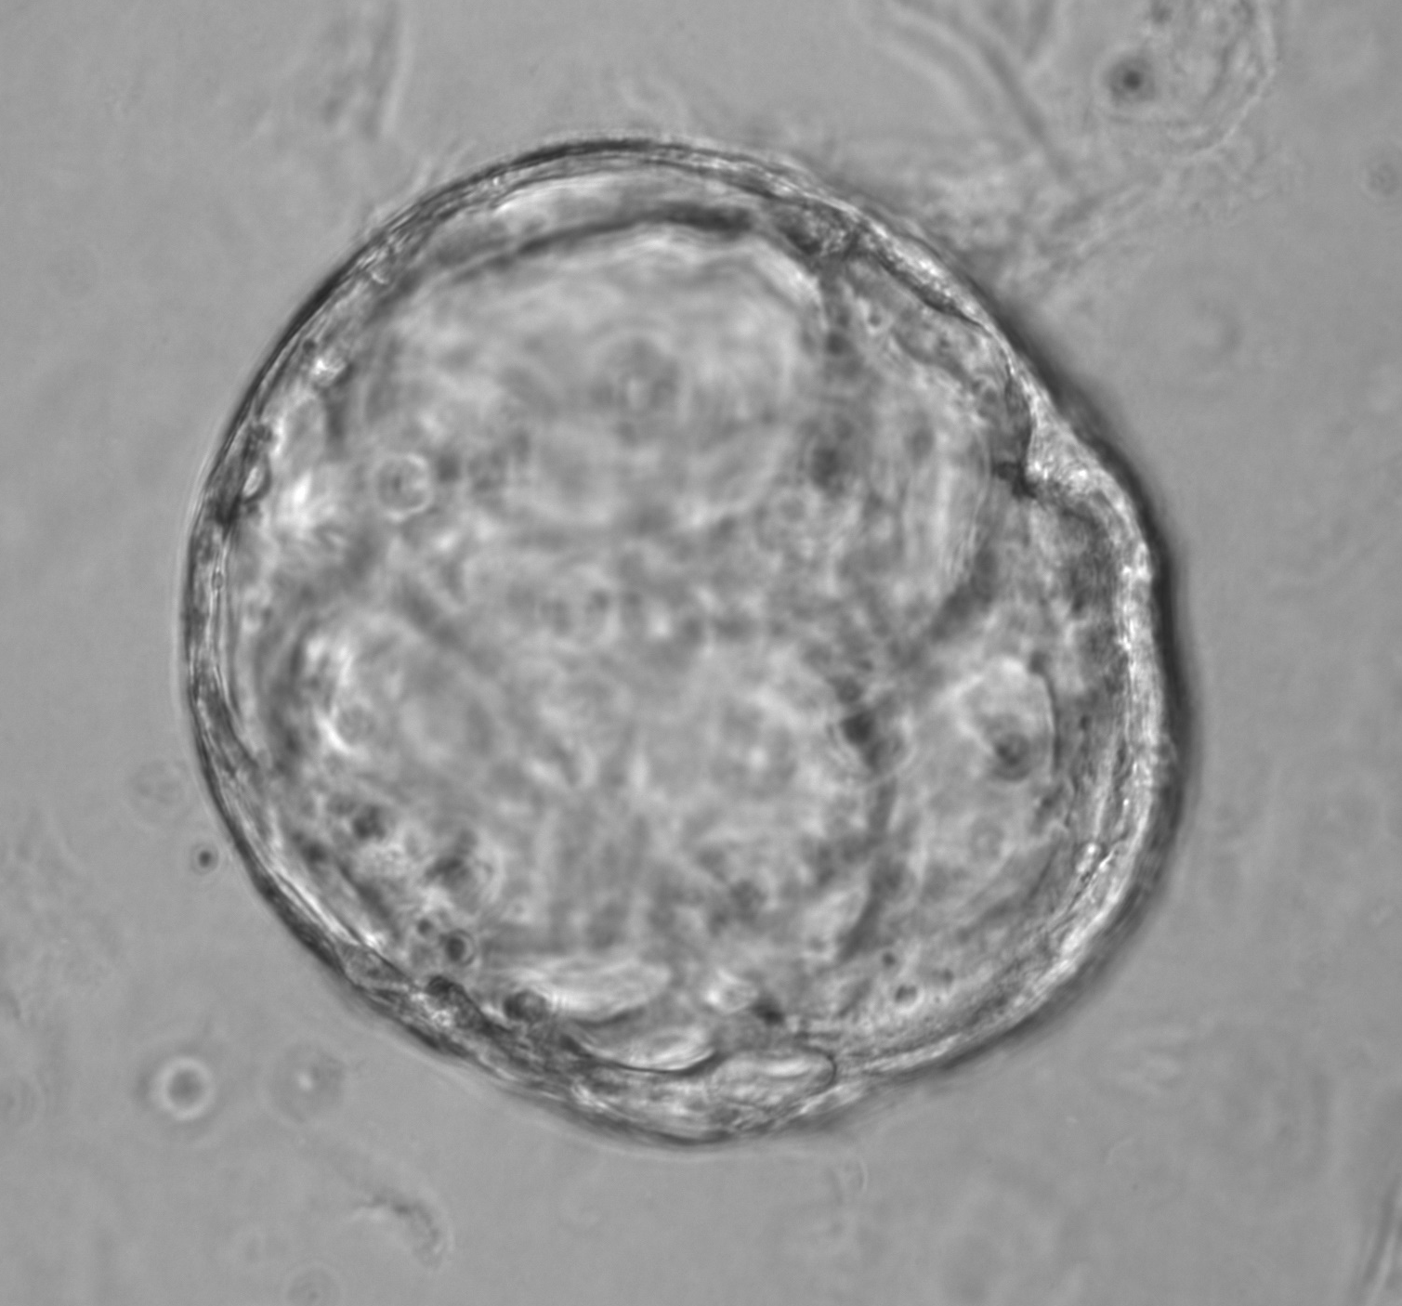
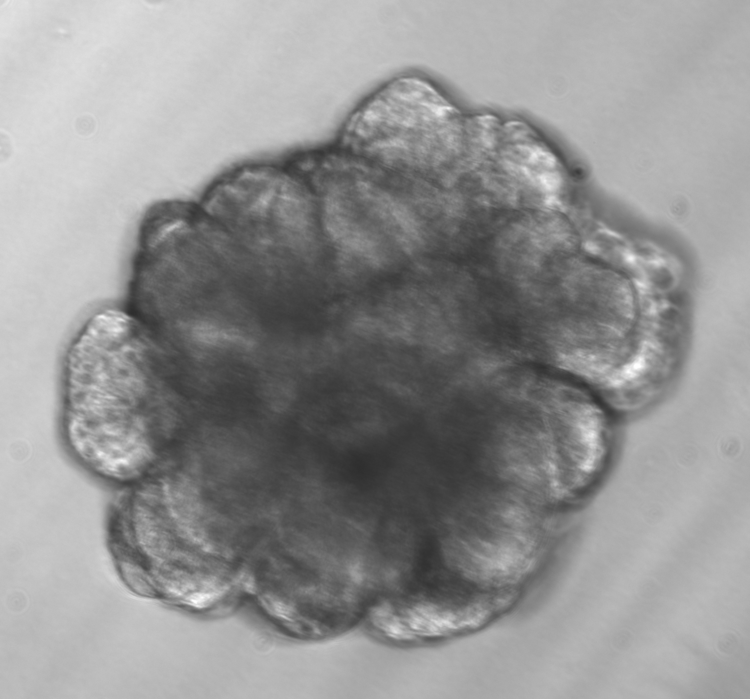
Figure 4
Primary Organoids
Basal
Luminal

Slide 2

Primary Organoids
Bas
Lum
K5
K8
HH3

Slide 3
Basal
Luminal

