Slide 1
Isolate cells, plate into organoid culture
1
2
3
4
5
6
Lum
A
B
C
Bas
D

Slide 2
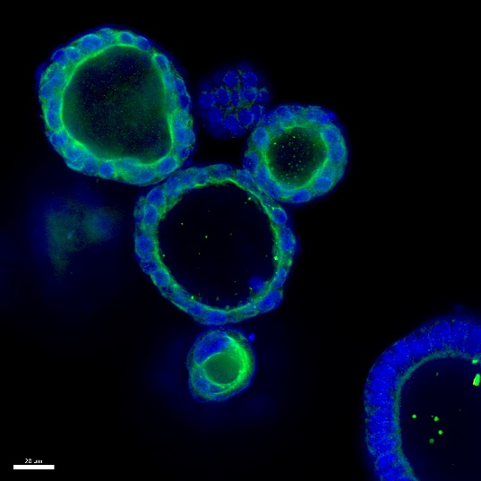
Figure 1
Mouse prostate
Isolate cells, plate into organoid culture
1
2
3
4
5
6
Lum
A
B
C
‘
Bas
D
z
Collect, proceed to downstream analysis
Allow organoid formation (5-7 days)
Western blot
Confocal Microscopy
1
2
3
4
5
6
A
B
C
D

