Slide 1
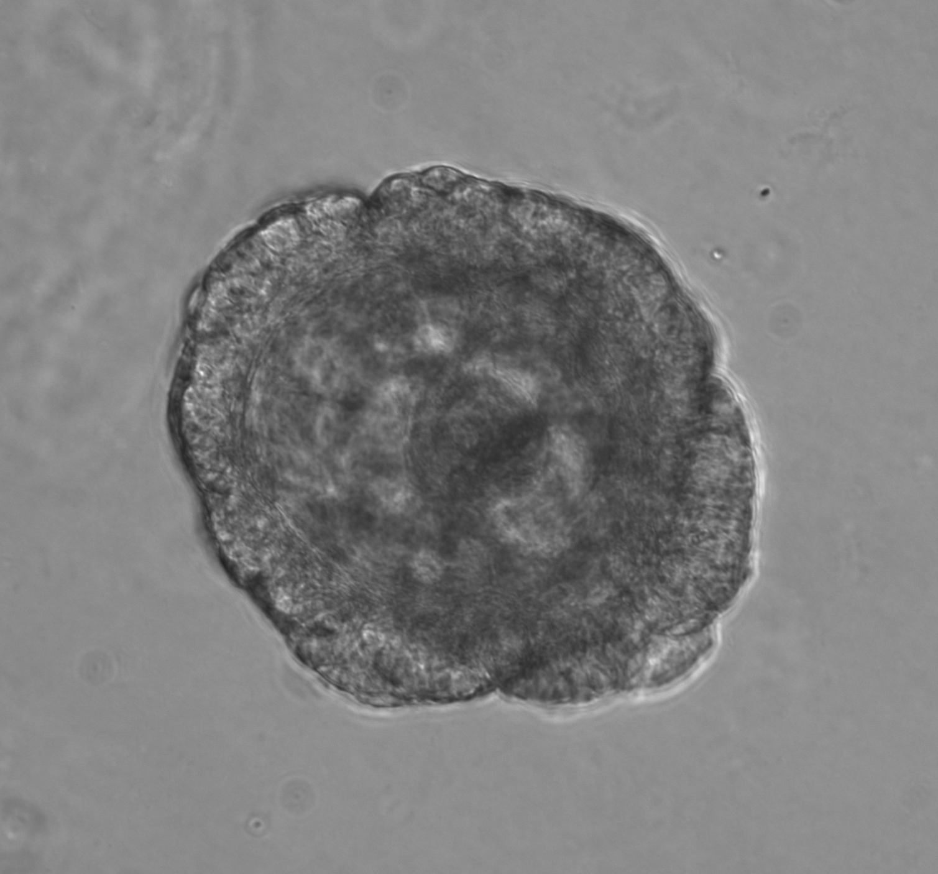
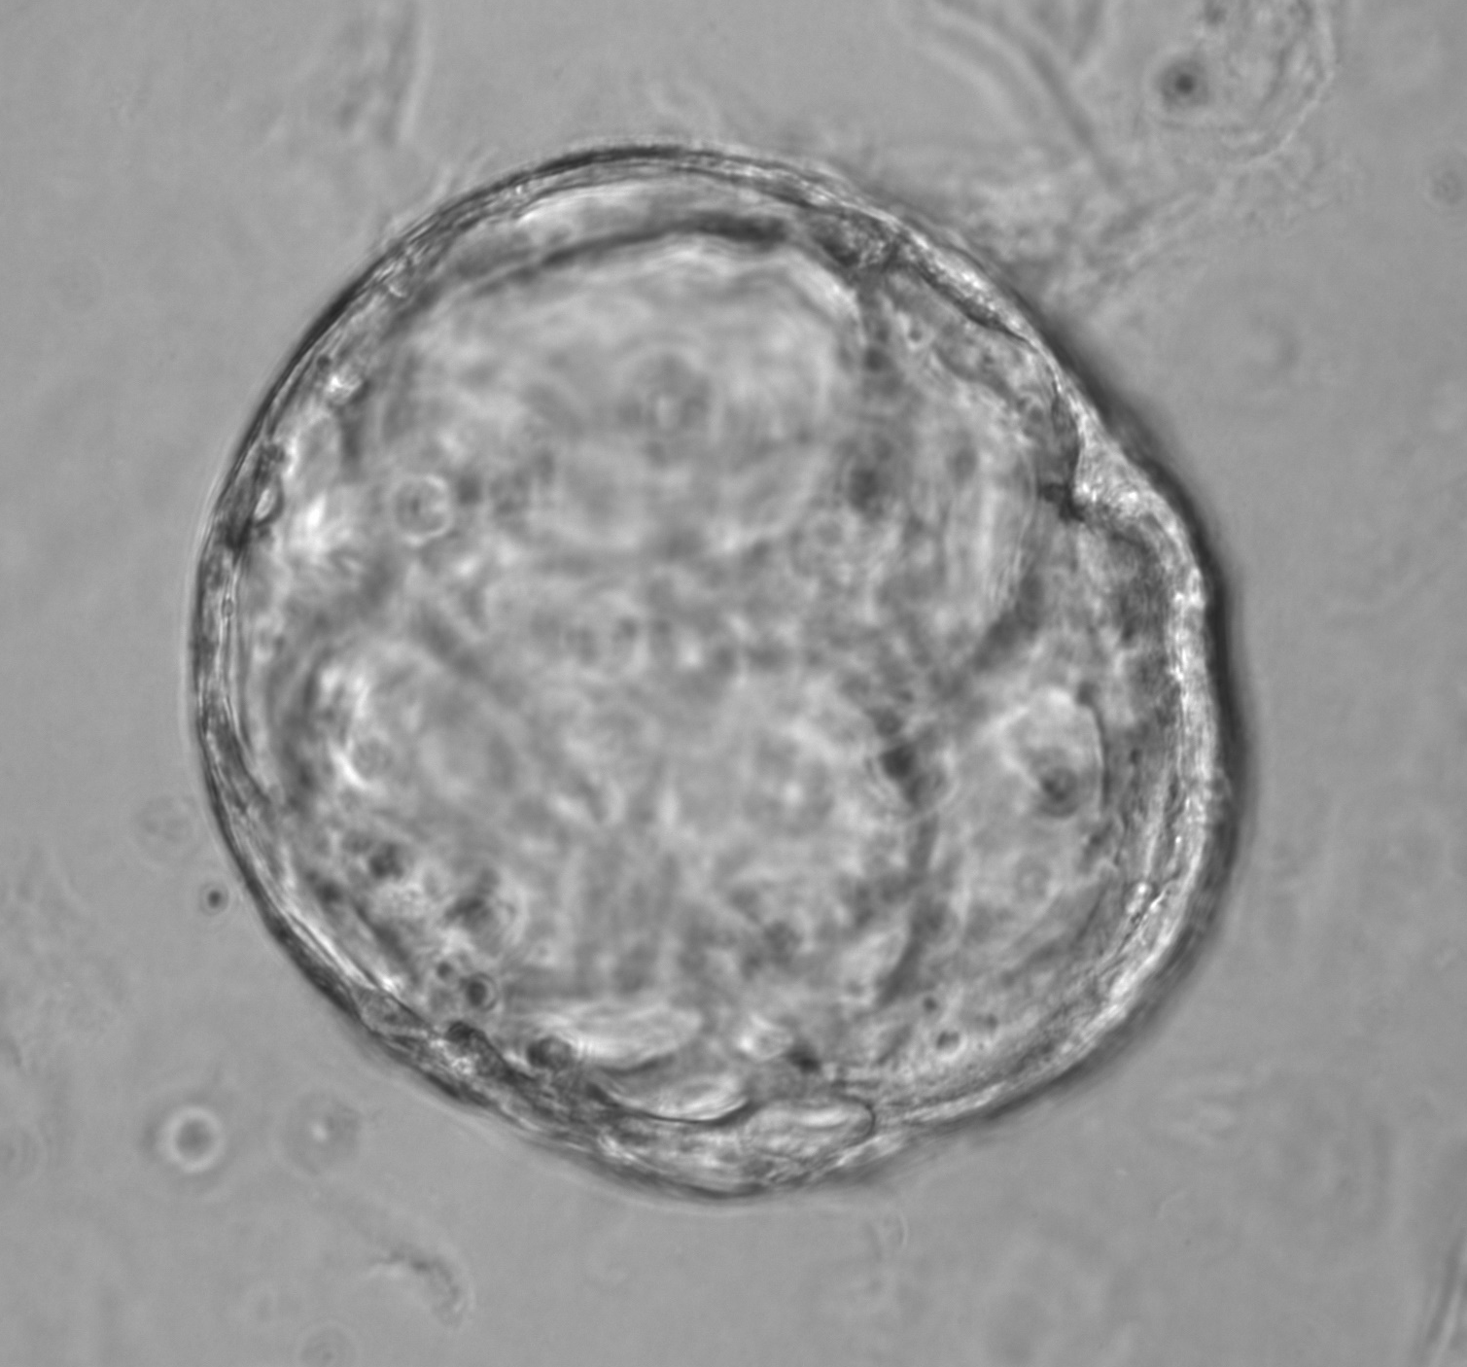
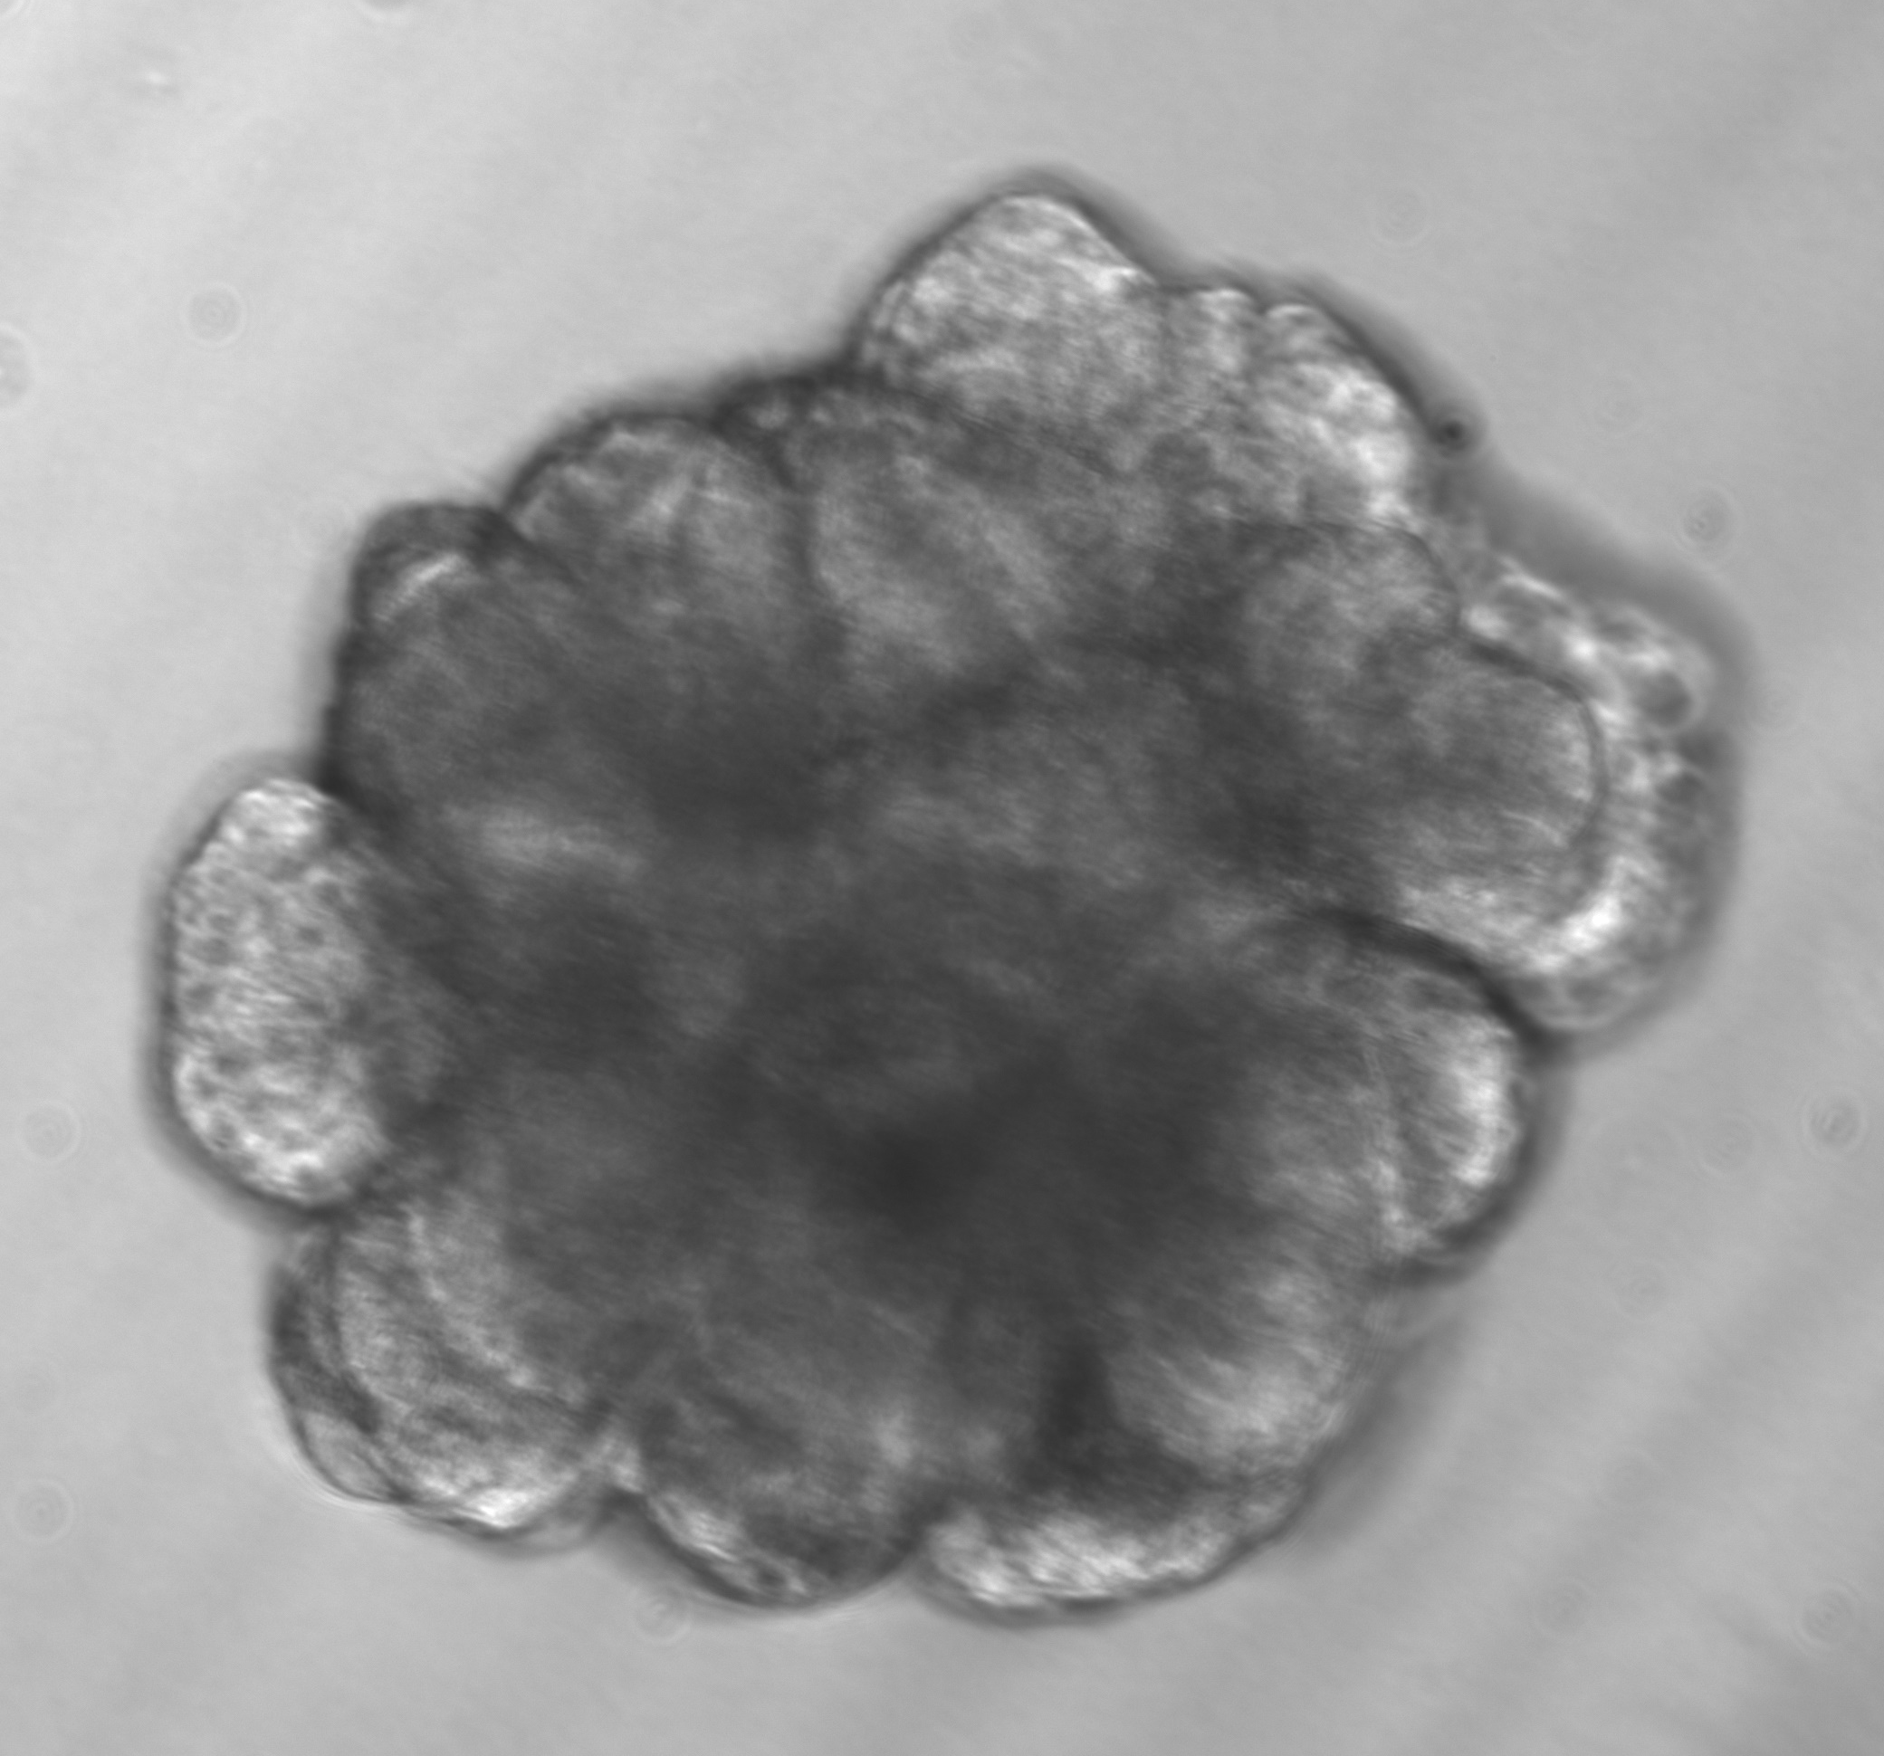

Figure 4
Primary Organoids
Primary Organoids
Bas
Lum
Basal
K5
K8
Luminal
HH3
Organoids
Top coverslip
Spacer
Spacer
Bottom coverslip
Basal
Luminal

