Slide 1
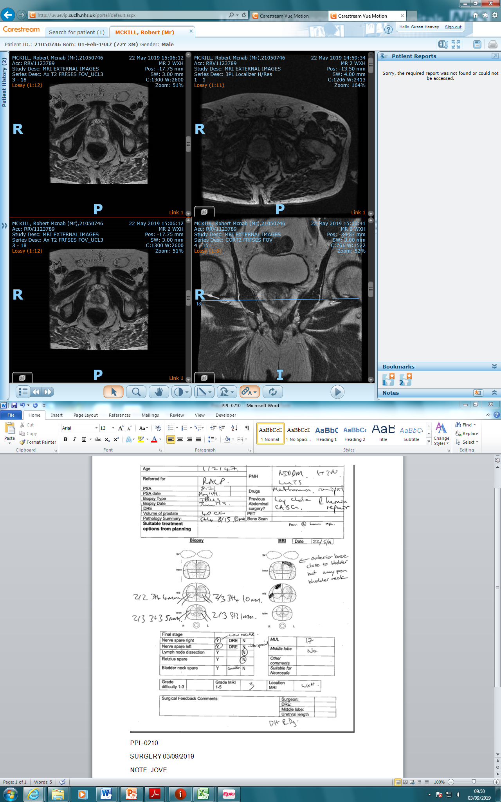
Axial T2 image

Slide 2
Prostate

Slide 3
Tumours

Slide 4
Corresponding coronal T2 image

Slide 5
Prostate

Slide 6
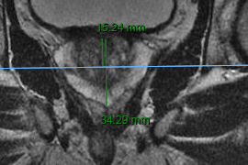
Base
Apex
Distance 34.29 mm

Slide 7
Distance 15.24 mm
Base
Slicing position

