Slide 1
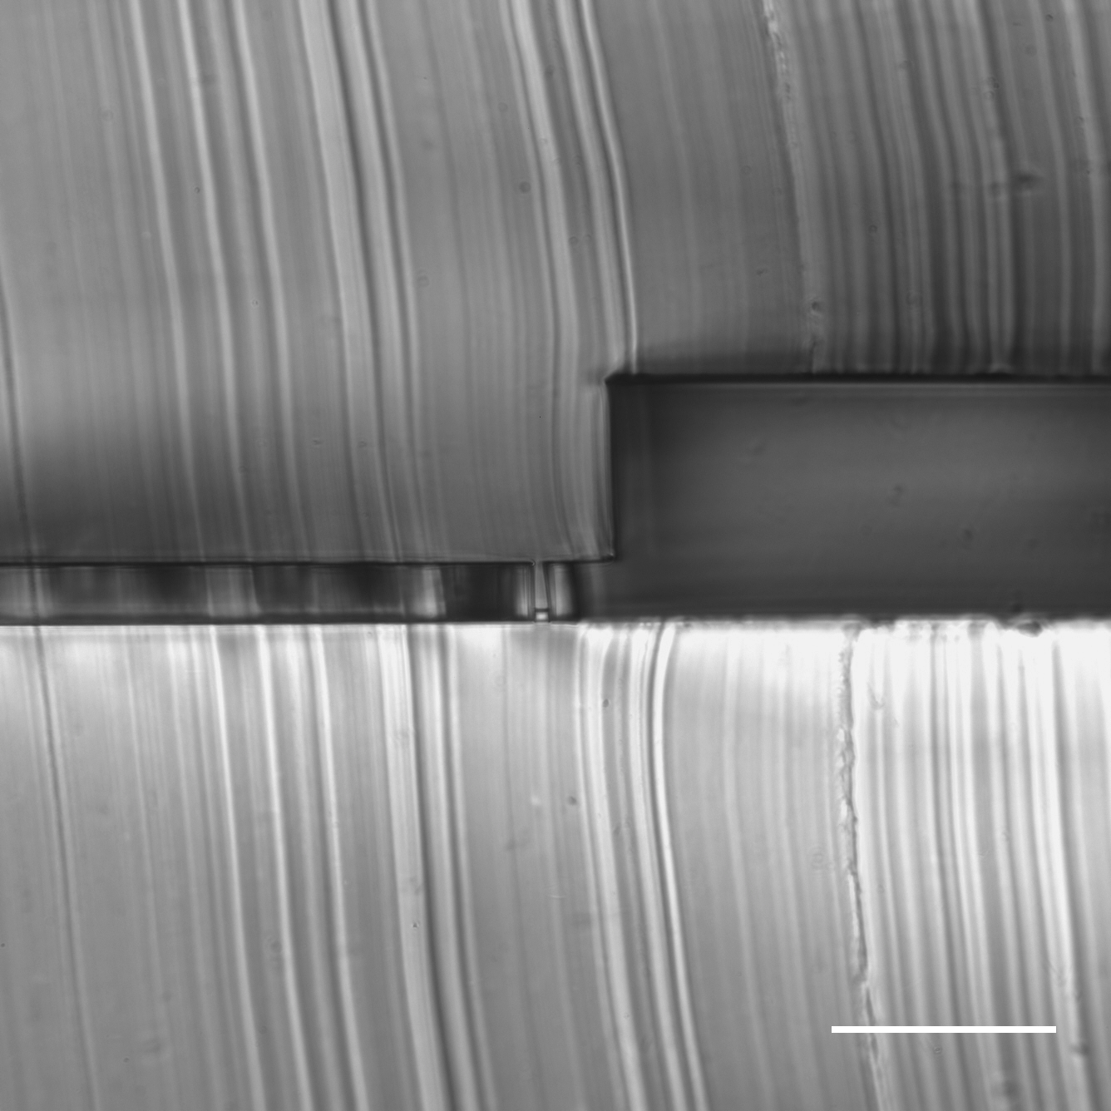
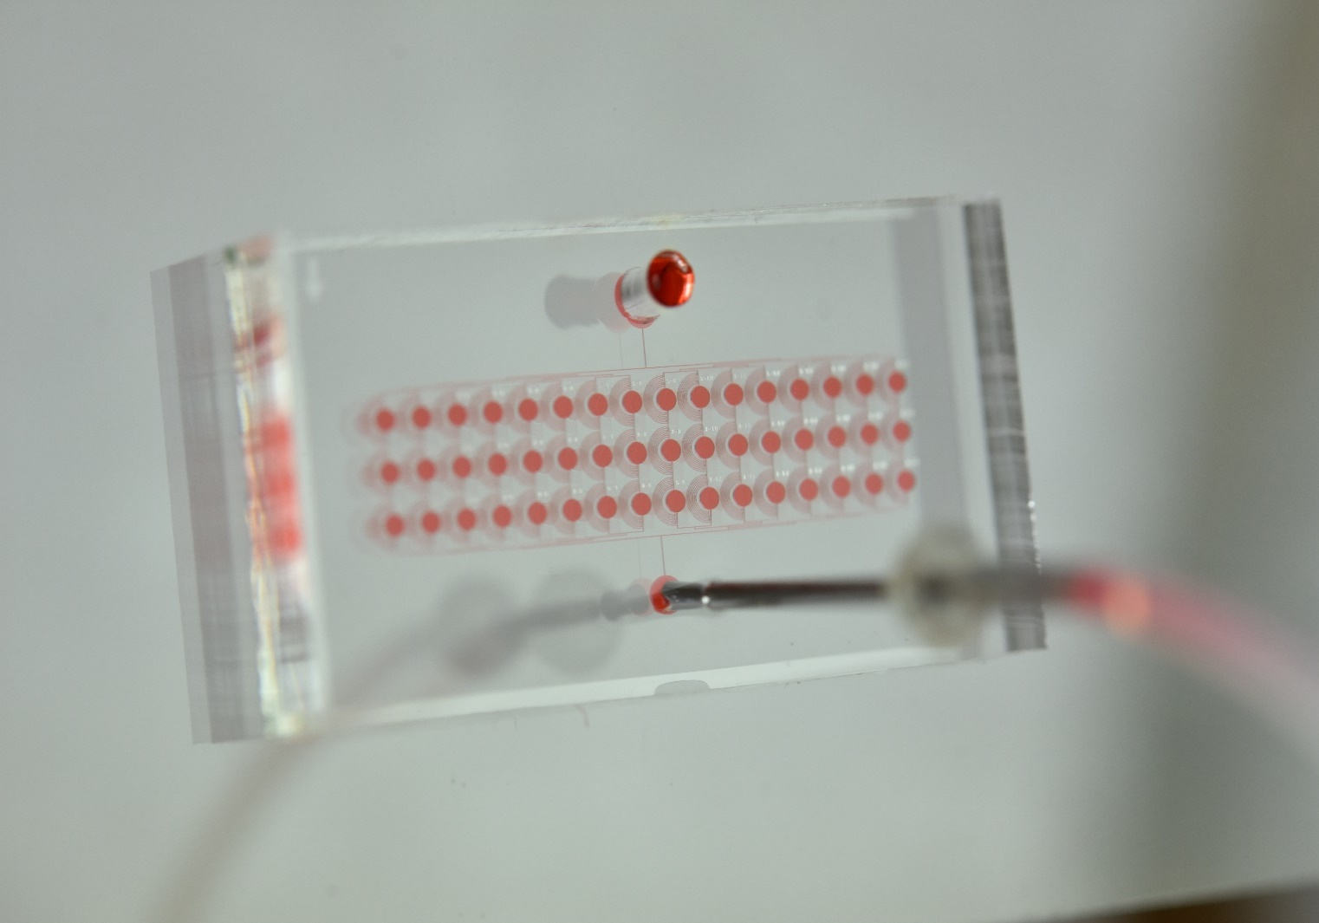
(A)
(B)
(C)
By-pass
channel
Culture
chamber
Inlet
By-pass
channel
Capture
site
Culture
chamber
Capture
site
Outlet
Figure 1. Photograph and Microscope Images of Hydrodynamic shuttling chip. (A) Microscope image of the PDMS sectional view. (B) A magnified view of single cell trapping unit. (C) Appearance of the chip containing 48 units. Scale bar: 100 μm.

