Slide 1
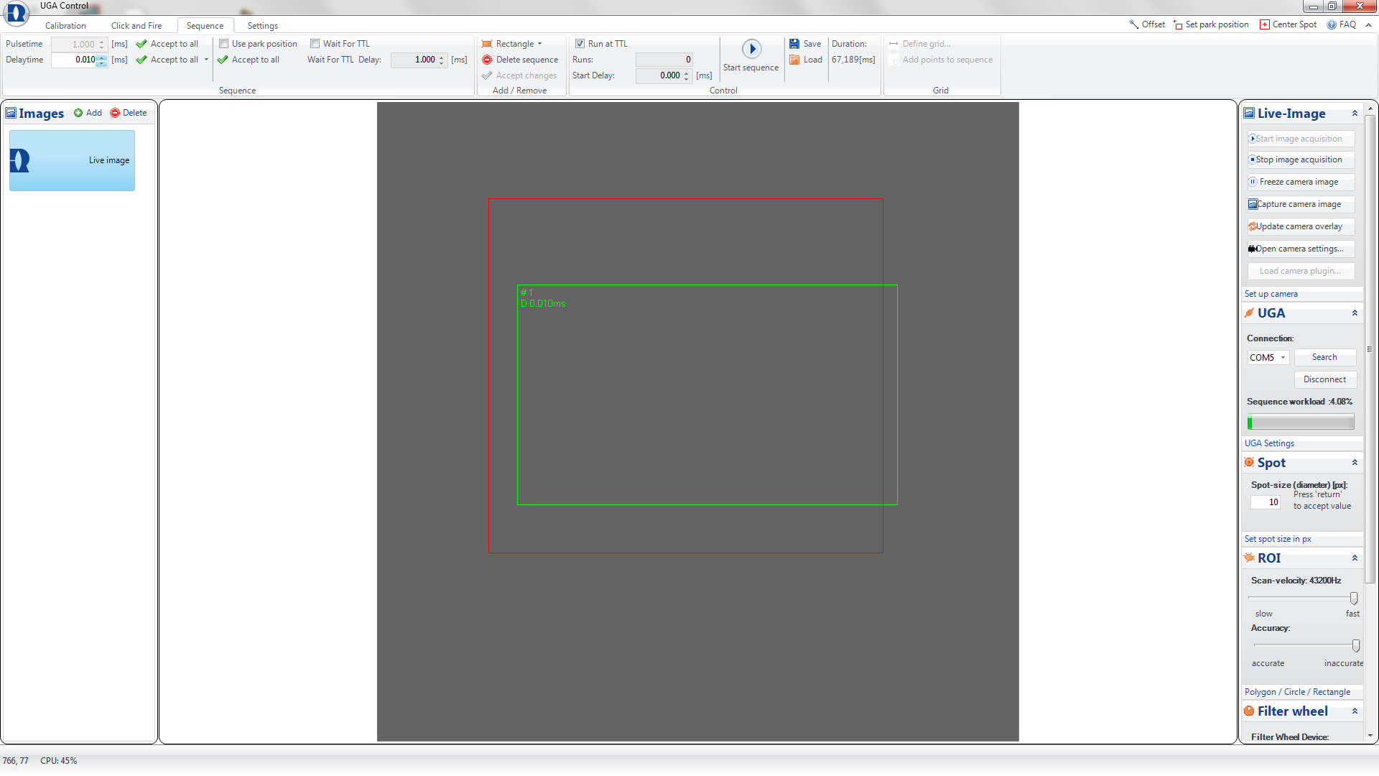
2.2.3 There is no any manipulations with software.
2.2.4 Preparation of the laser control software for the searching mode
Lase control software (Rapp OptoElectronics UGA)
Parameters mentioned in 2.1.5 and
3.1.4
Button to add the rectangular sequence
Parameters mentioned in 2.1.5
Rectangular scanning area for the bouton searching mode 2.3

Slide 2
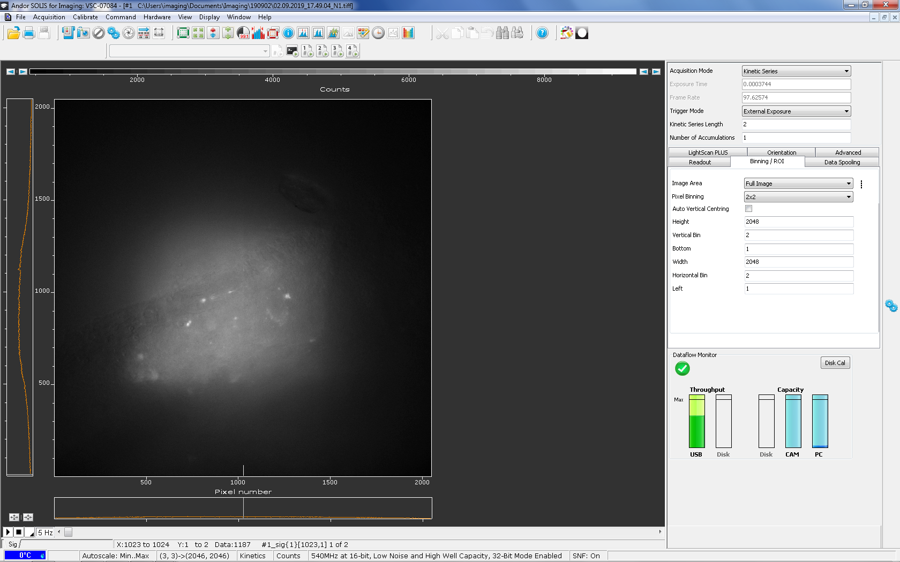
2.2.5 Acquisition of image with both autofluorescence and iGlu_{u} -positive structures using a high pass filter at 510 nm ("yellow image").
Acquisition button
Camera control software (Andor SOLIS)
Settings,
mentioned in
2.1.1 and 2.1.8
Recorded area (1px=0.2µm)
Illuminated
with laser
area

Slide 3
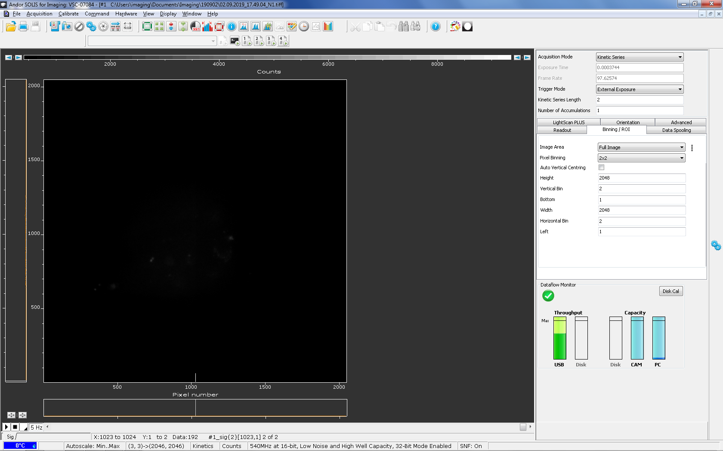
2.2.6 Acquisition of image with autofluorescence alone using a high pass filter at 600 nm (“red image").

Slide 4
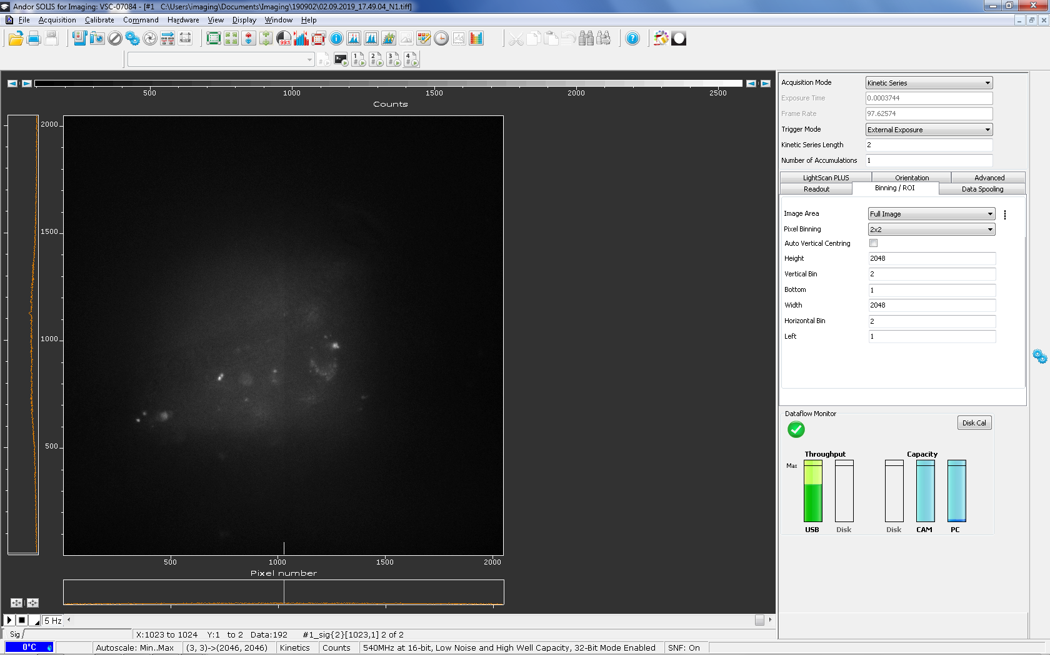
2.2.7 Rescaling of the “red image“ (autofluorescence only).
Rescaling button

Slide 5
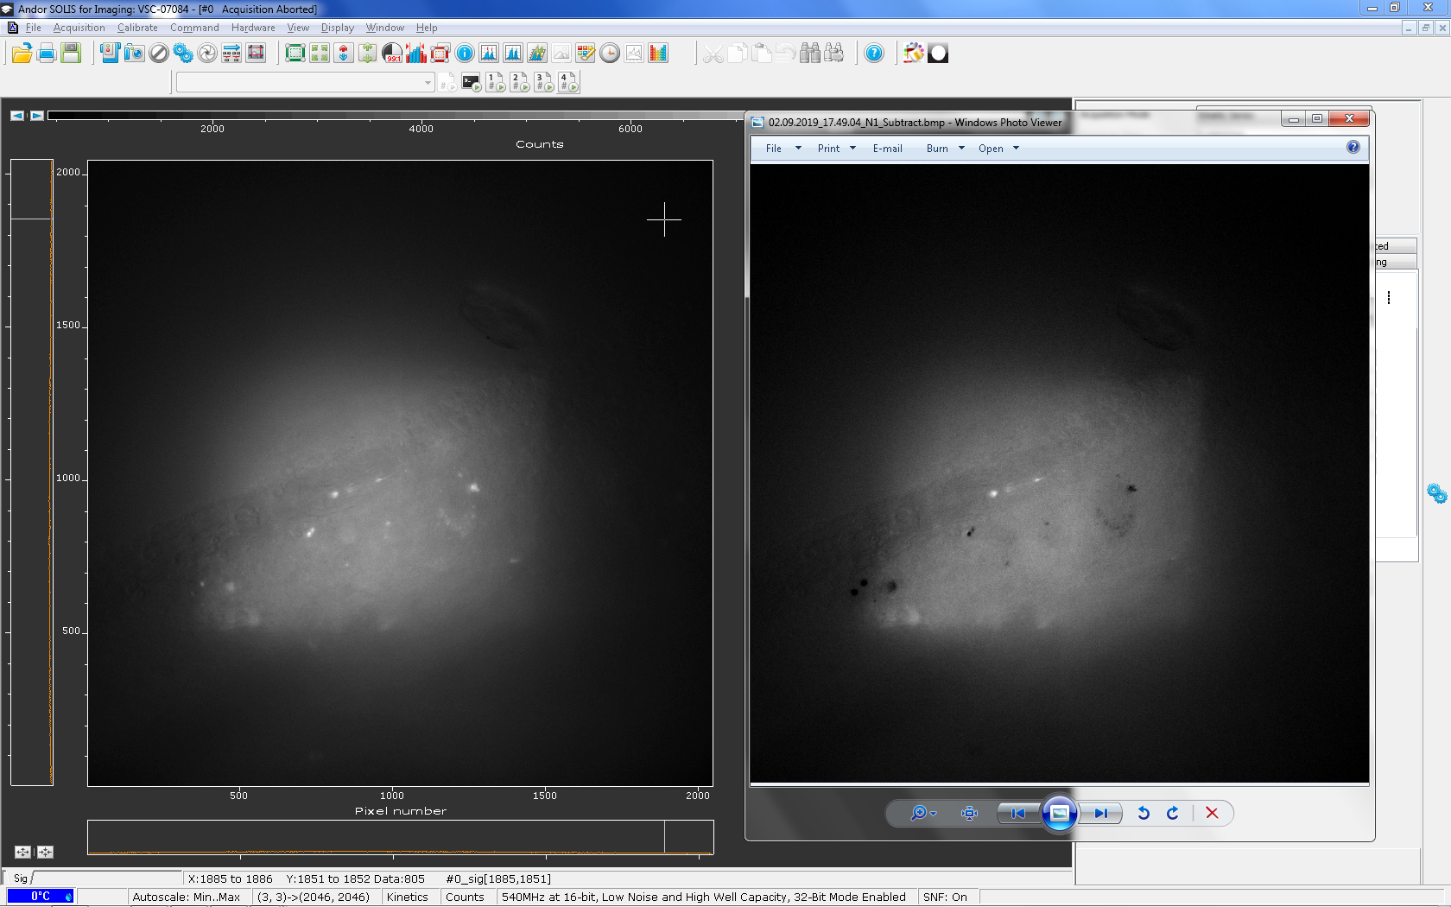
2.2.7 Result of the subtraction of “red image” from “Yellow image”
Scaled “Yellow image”
Result of subtraction
Bright elements are
iGlu_{u}-positive structures
Grey pixels are
background
Dark elements are
autofluorescence

Slide 6
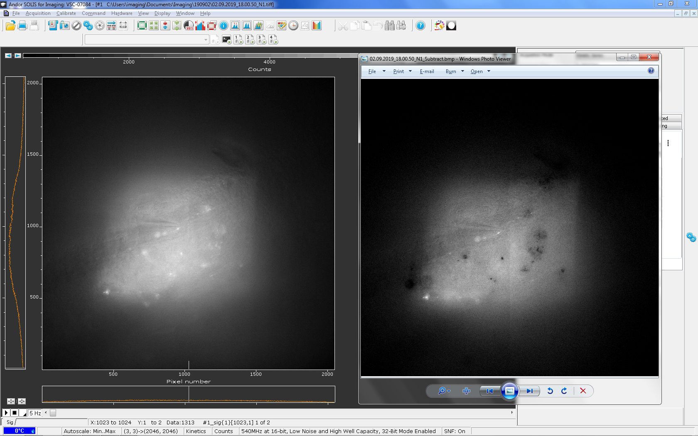
2.3.2 Positioning of the stimulation electrode
Image shows the position of the stimulation electrode near from the iGlu_{u} bouton, shown on the previous slide
“Yellow image” with electrode
Subtracted image with electrode

Slide 7
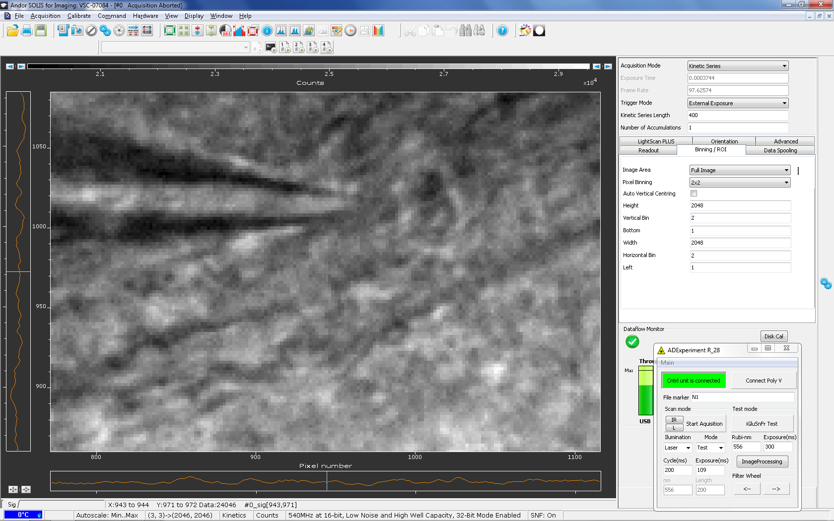
2.3.2 Positioning of the stimulation electrode
Magnified image of the stimulation electrode acquired with infra-red ilumination.

Slide 8
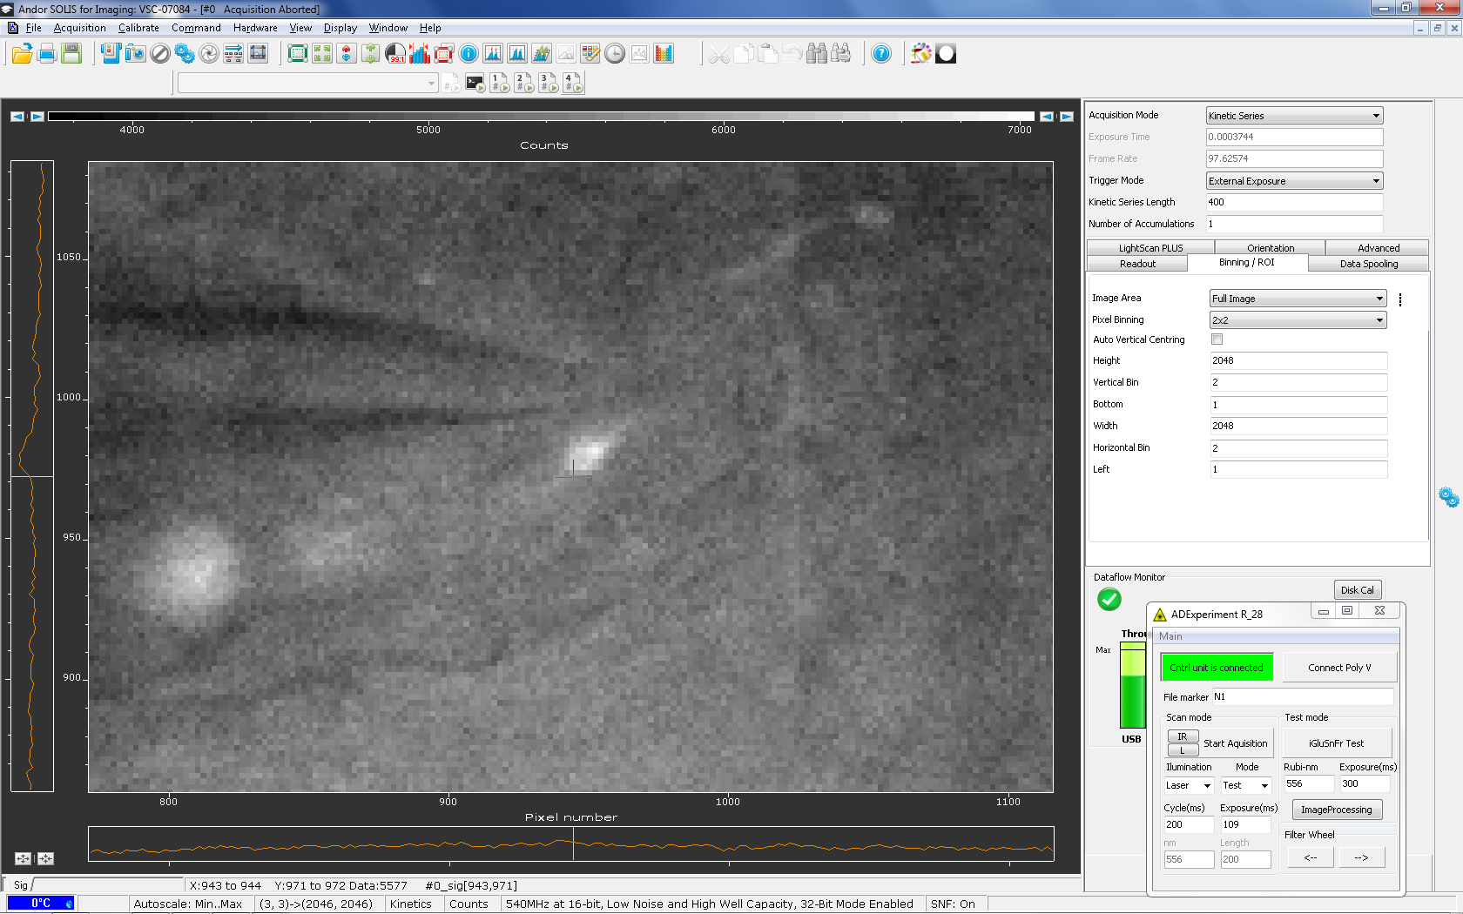
2.3.2 Positioning of the stimulation electrode
Same view filed, but acquired with laser illumination (note iGluu bouton in the centre and position of the electrode)

Slide 9
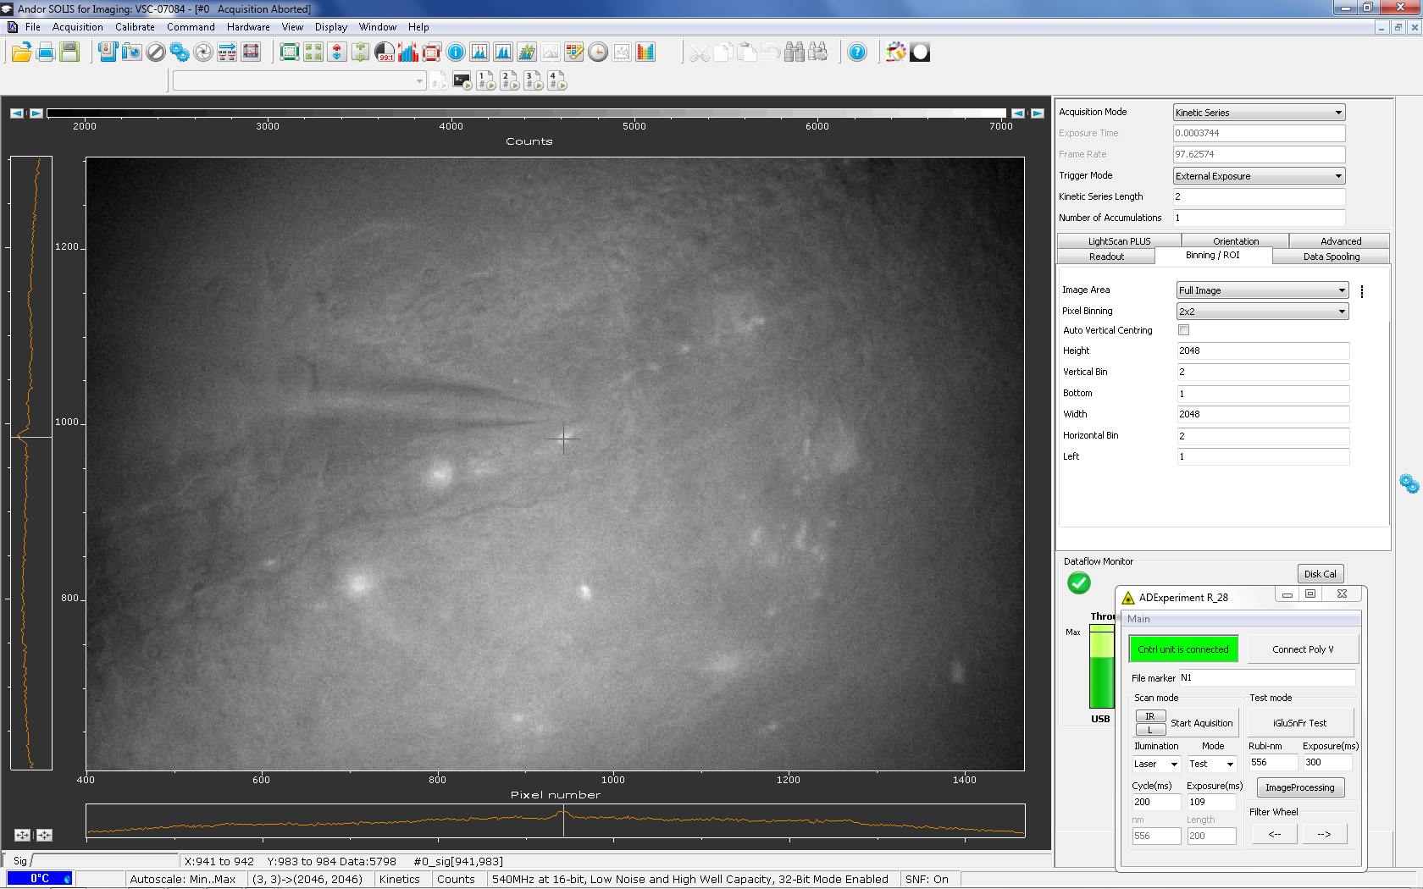
3.1.1 Determination of the bouton XY coordinates
The cross shows the bouton centre and has coordinates X=941, Y =983 px
Coordinates
of the cross

Slide 10
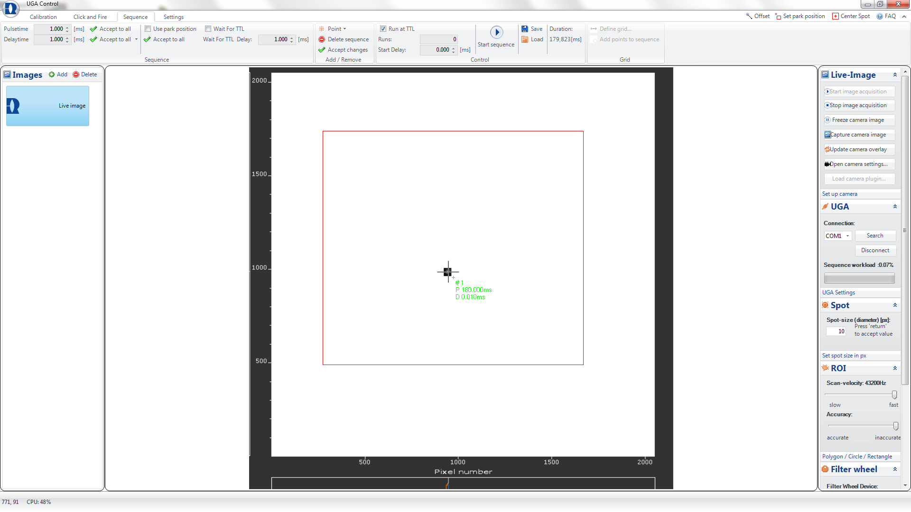
2.2.4,3.1.2-3.1.4 Determination of the bouton XY coordinates
Lase control software (Rapp OptoElectronics UGA)
Button to add the single point sequence
Parameters mentioned in 3.1.4
Laser pulse parameters (3.1.3)
Coordinates
of the laser
calculated
In 3.1.2

Slide 11
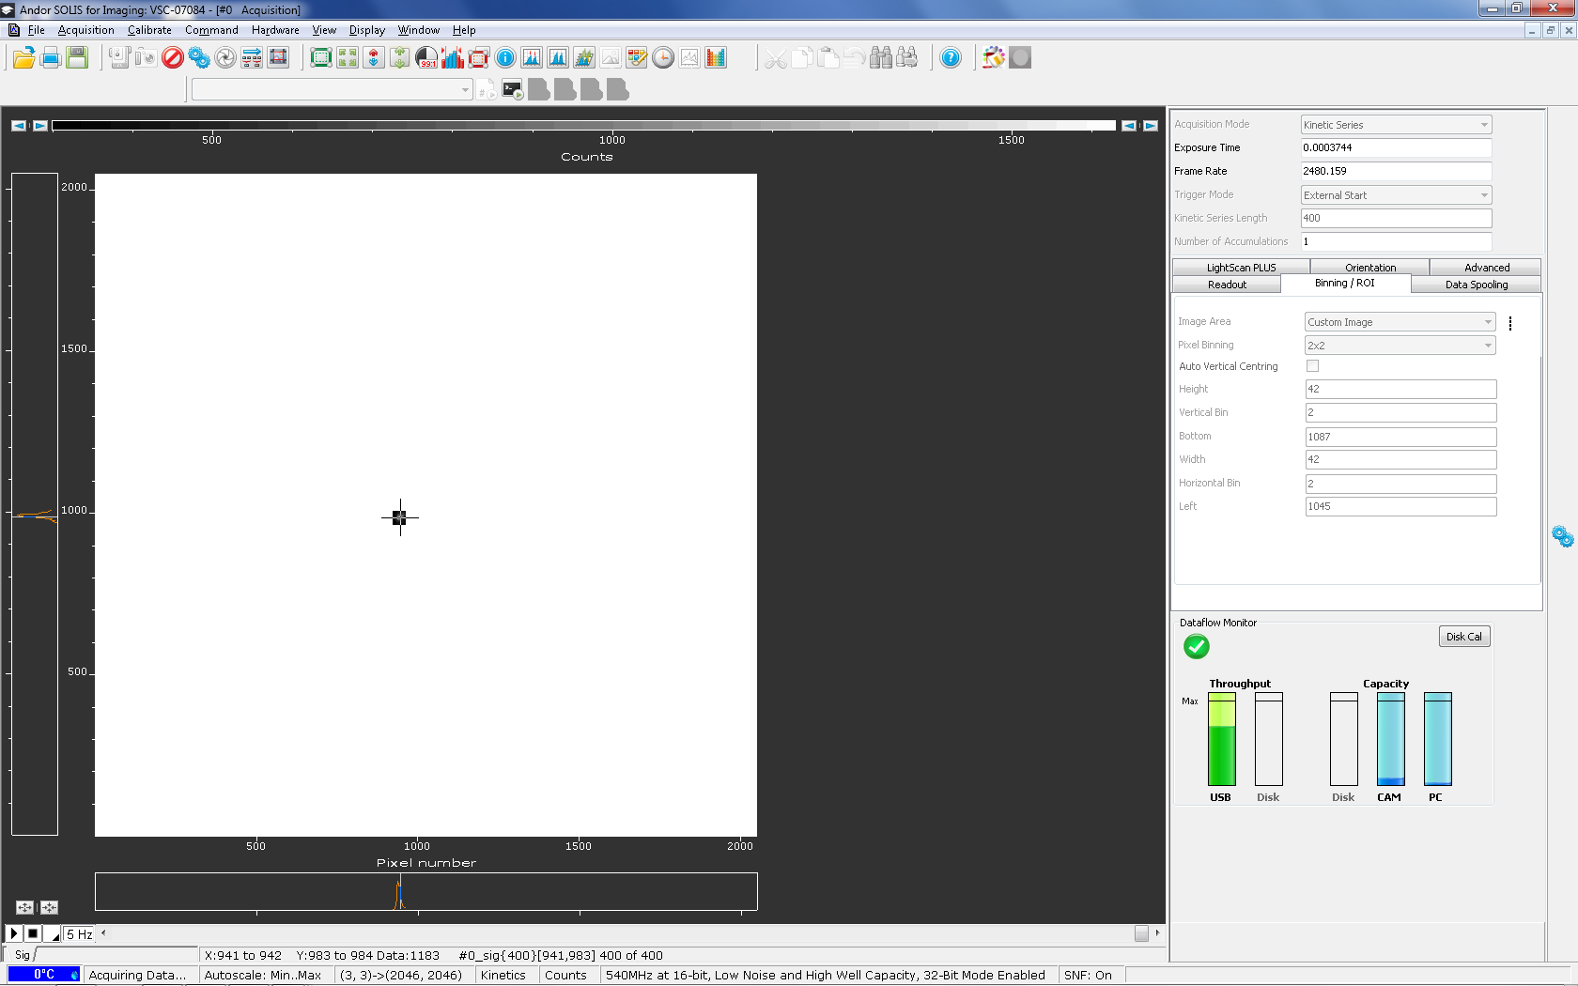
3.1.5-3.1.6 Recorded area
Take signal button is activated
Camera control software (Andor SOLIS)
Settings,
mentioned in
3.1.5
Recorded area

Slide 12
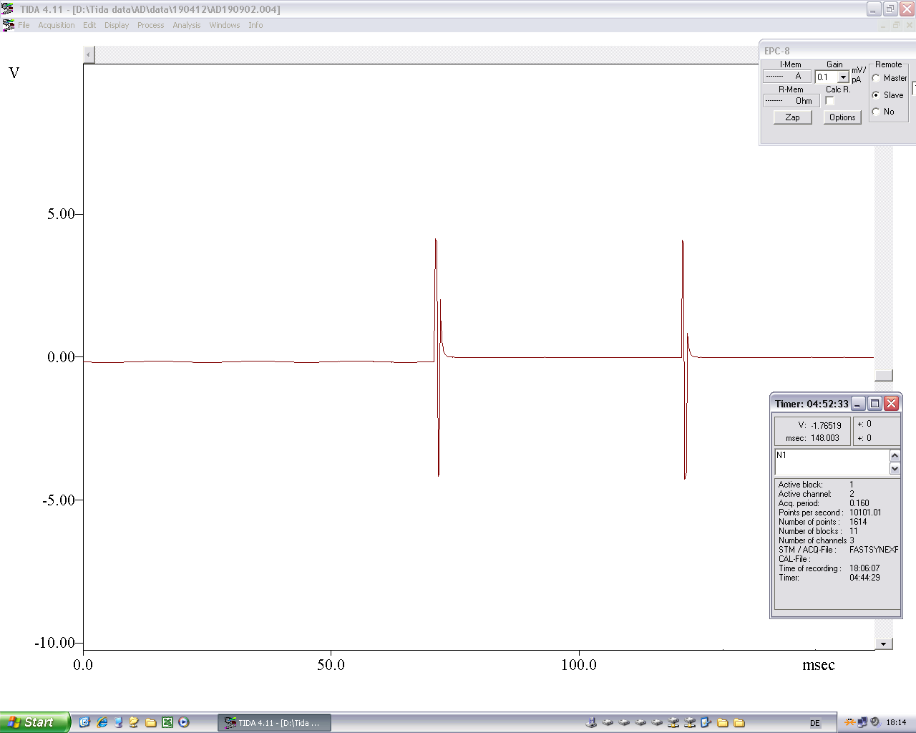
3.1.7-3.1.8. Electrical stimulation of the bouton
Trace shows stimulation voltage given to the 4 MOhm
stimulation electrode
Program (HEKA TIDA) for the electrical stimulation and for the devices triggering and synchronization

Slide 13
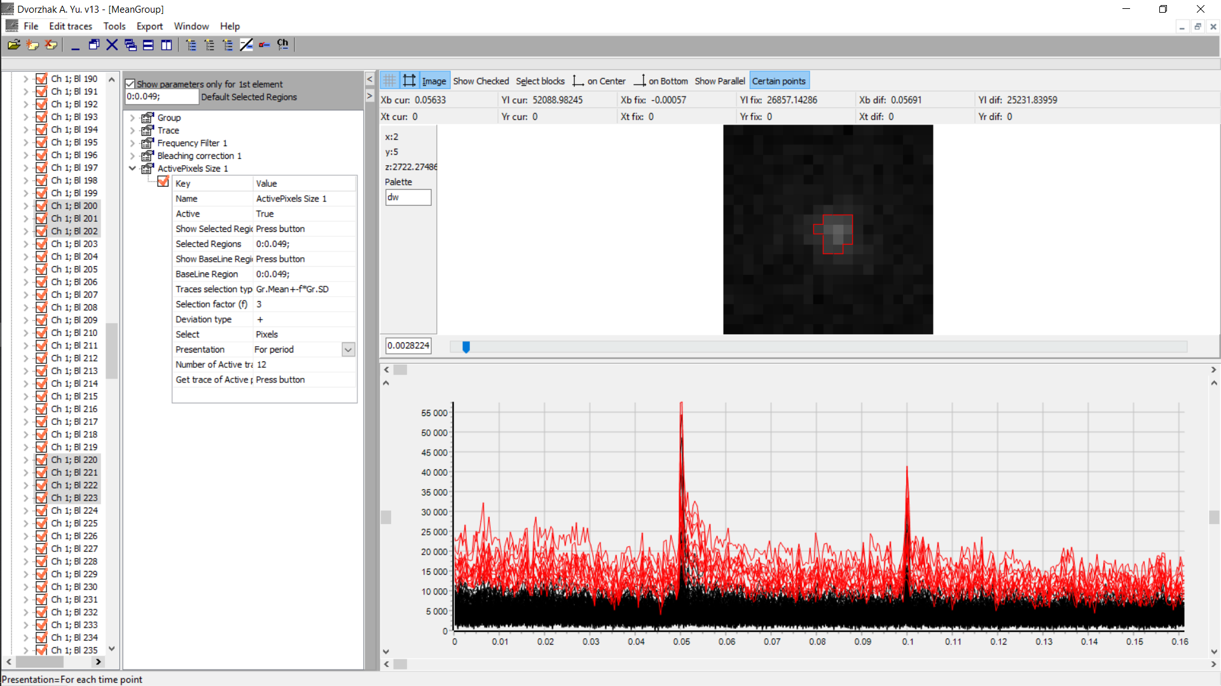
3.2.1.-3.2.2. Determination of the bouton size (Please, find “Original record for WT mouse.tiff” with original data)
Home written analysis program
Image of the iGluSnFr fluorescence intensity at rest (F ).
The red line shows 12 pixels with the average rest intensity more than mean + 3 SD intensity of all pixels at rest.
Traces of iGluSnFr fluorescence intensities for each pixel
Red traces shows 12 suprathreshold pixels

Slide 14
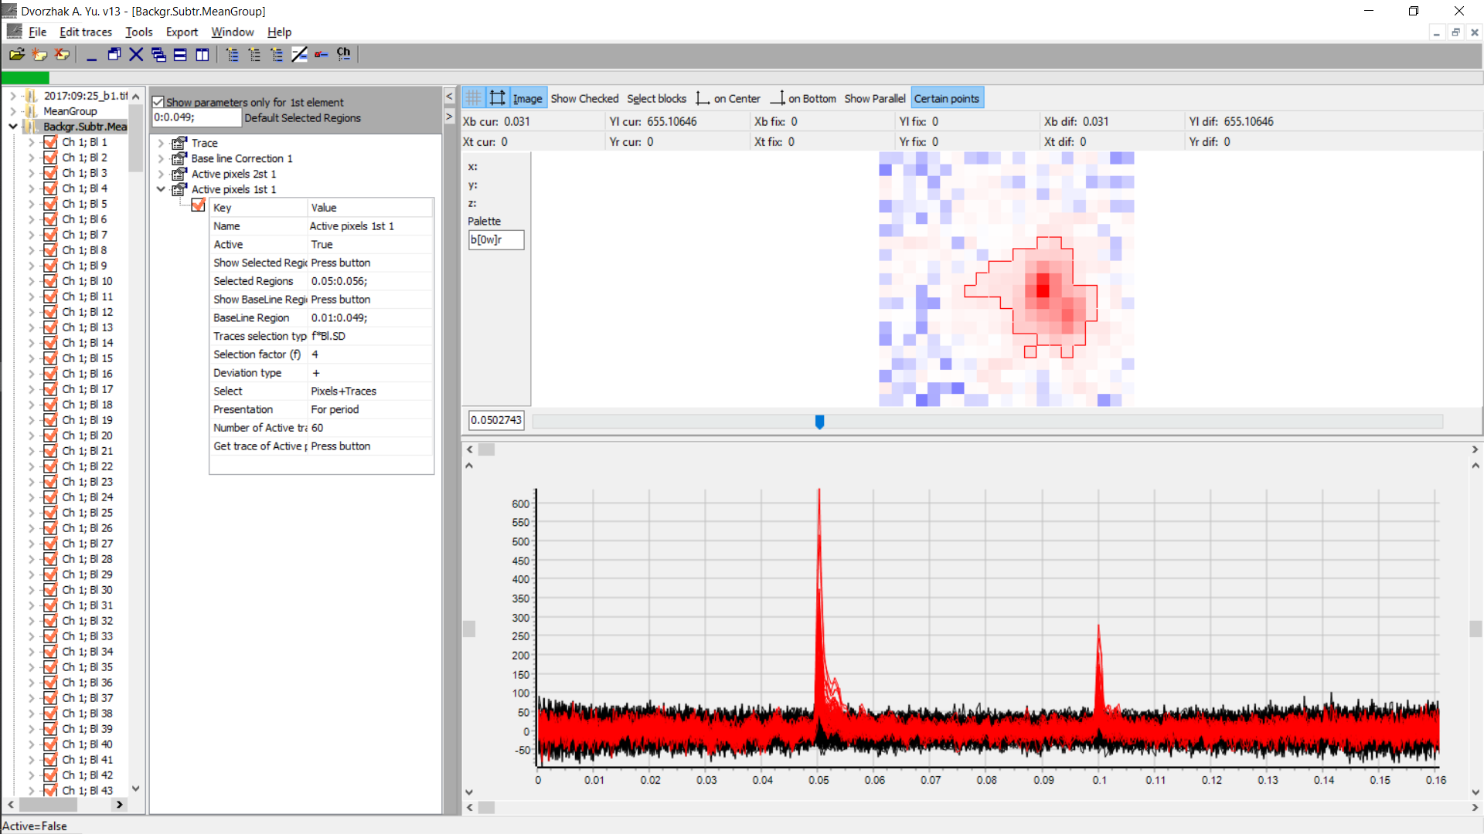

3.2.3, 3.2.5. ΔF/F transients for the bouton shown on the previous slide
Image of ΔF/F transients distribution in 2D space.
The red line shows 60 pixels the ΔF/F amplitude during first stimulation more than 4 SD of ΔF/F values at rest.
1px = 0.04 µm²
Traces of ΔF/F transients for each pixel
Red traces shows 60 suprathreshold pixels

Slide 15
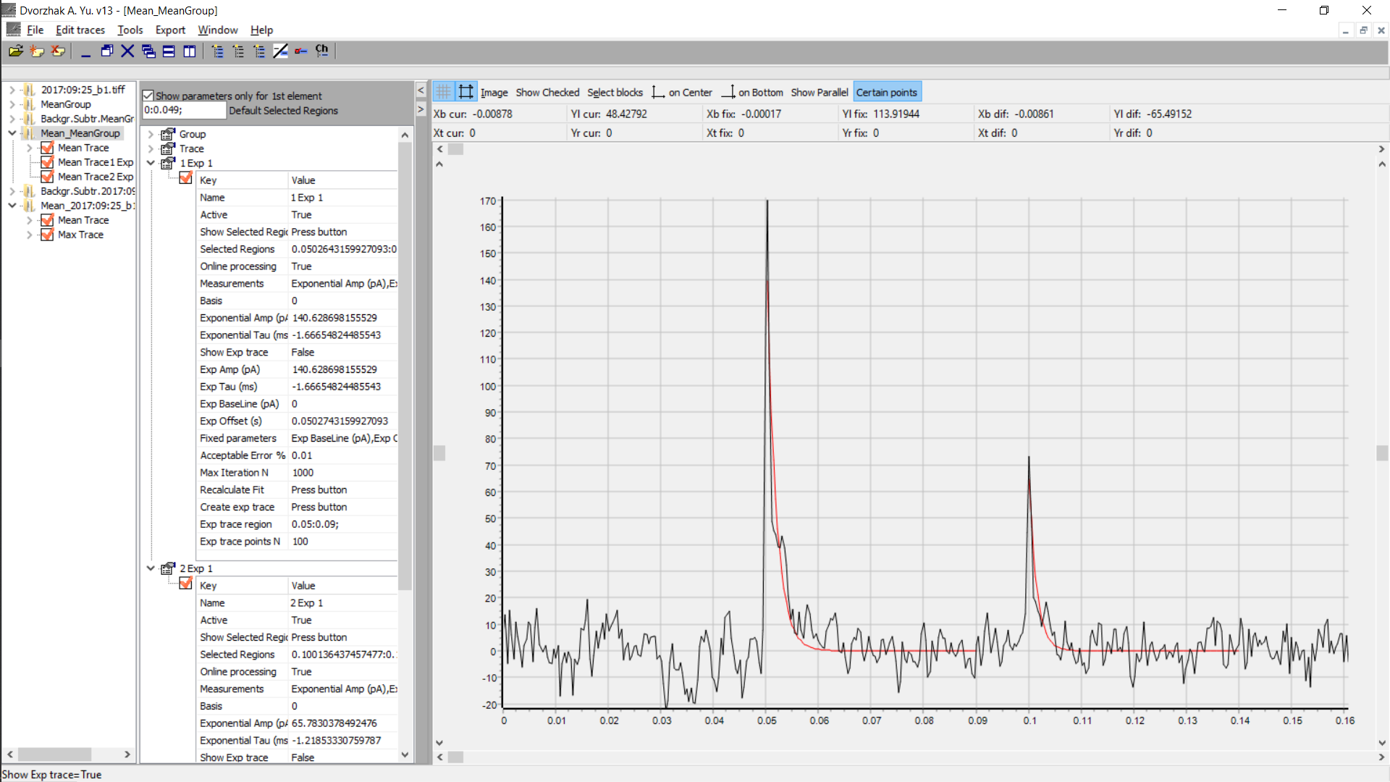
3.2.3 Determination of Determine the time constant of decay TauD of ΔF/F.
Mean ΔF/F trace for pixels selected on the previous slide
Red lines show monoexponential fittings curves.
TauD for first response equal -1.67 ms, for second – 1.22 ms

Slide 16
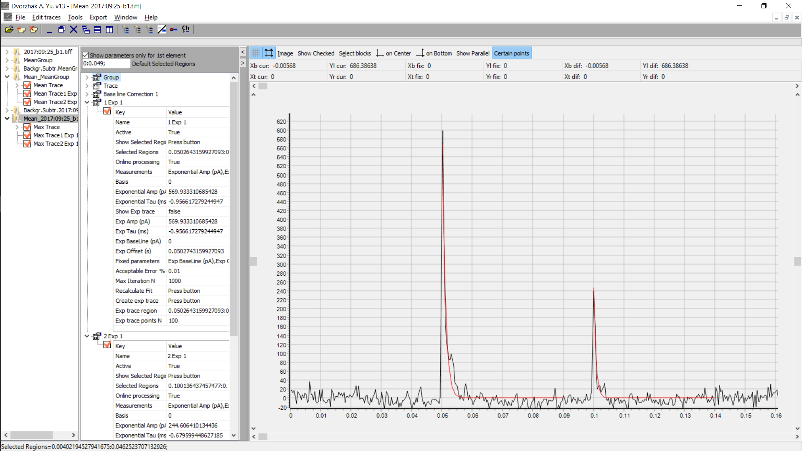
3.2.4 Trace with maximal ΔF/F amplitude
Trace with maximal ΔF/F amplitude
Red lines show monoexponential fittings curves.
TauD for first response equal -0.96 ms, for second – 0.68 ms

Slide 17
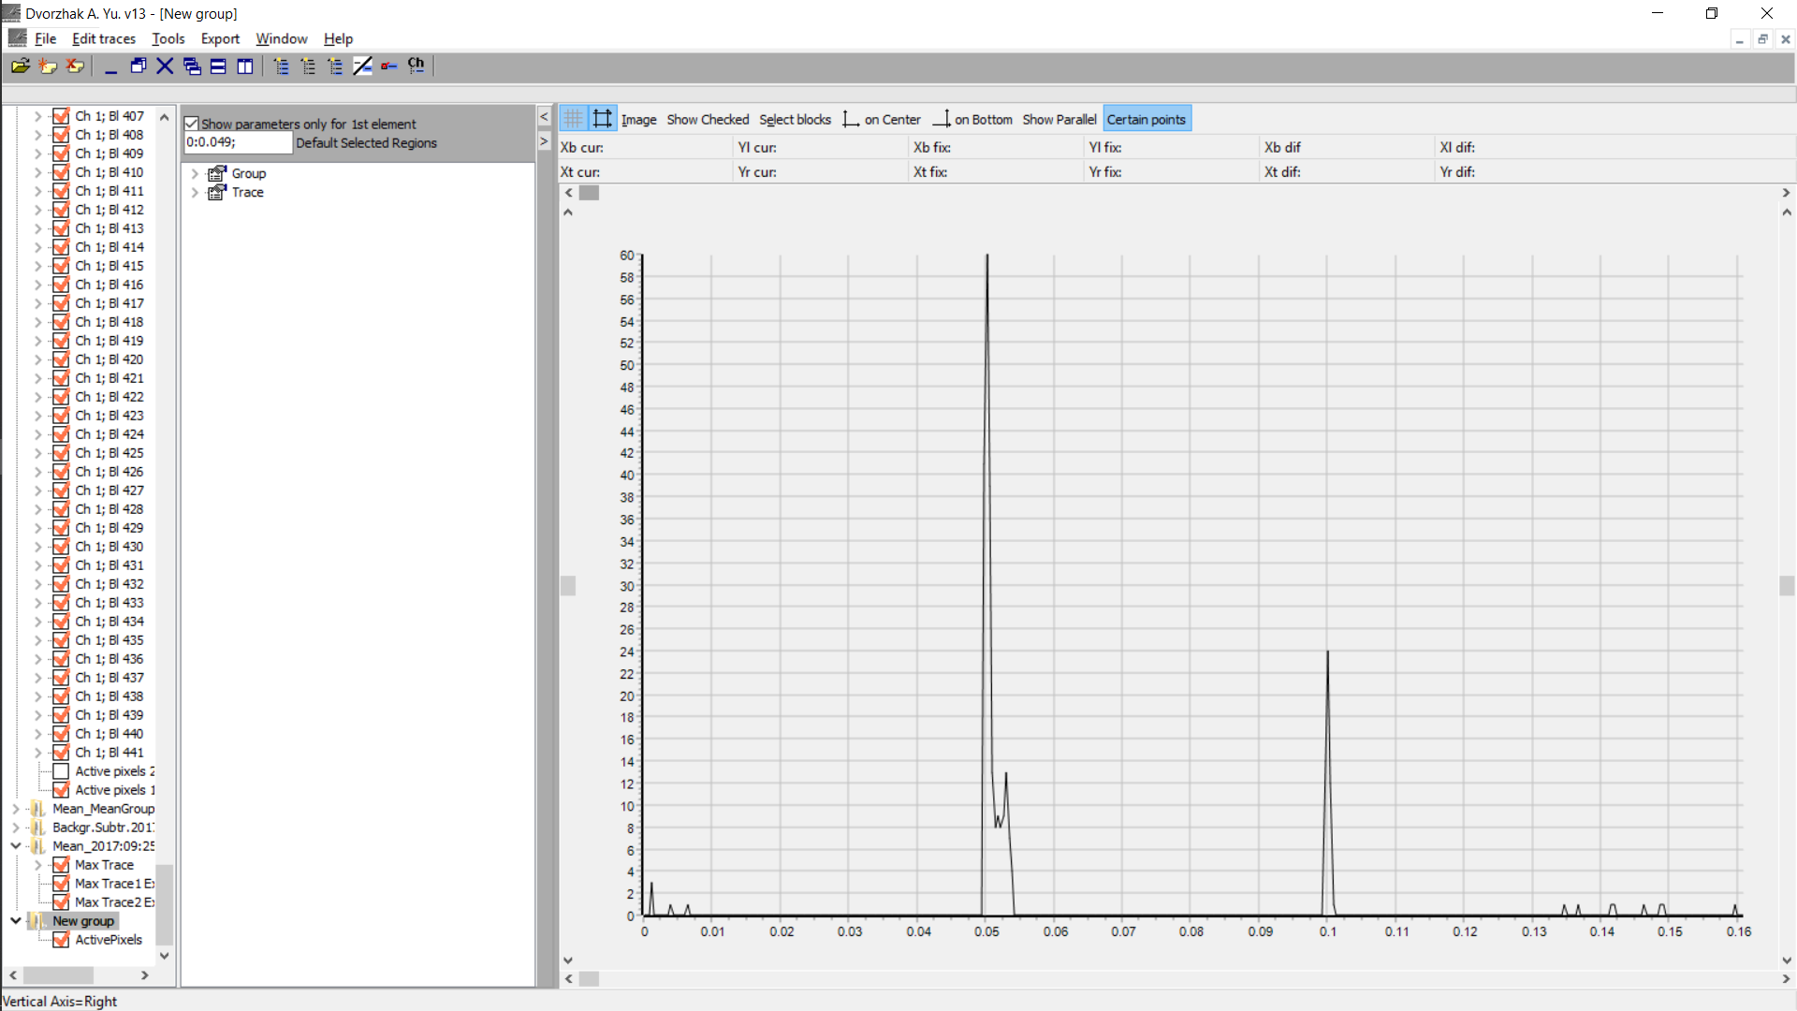
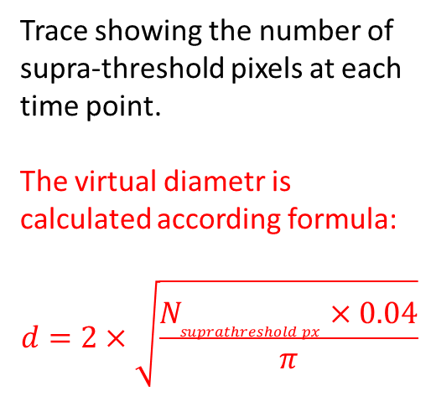
3.2.5 Trace with maximal ΔF/F amplitude
Trace showing the number of supra-threshold pixels at each time point.
The virtual diametr is calculated according formula:
$$d=2×\sqrt{\frac{N_{suprathreshold px}×0.04}{π}}$$

Slide 18
Additions
For better illustration of 3.2.1. – 3.2.5. I have added a video (Stack.avi) of the bouton stimulation shown on other slides.
To demonstrate the difference in the synaptic Glu release between WT and Huntington HET and HOM mice I have added following video (Q175_iGluSnFr-ultrafast_WT_HET_HOM_2fps.mp4)
To help you prepare the scrip I have add one of my presentation (AD_180314_v1.pptx) with some additional videos and explanations.

