Slide 1
Screenshot of stimulation electrode with calibration bars
2µm
5µm

Slide 2
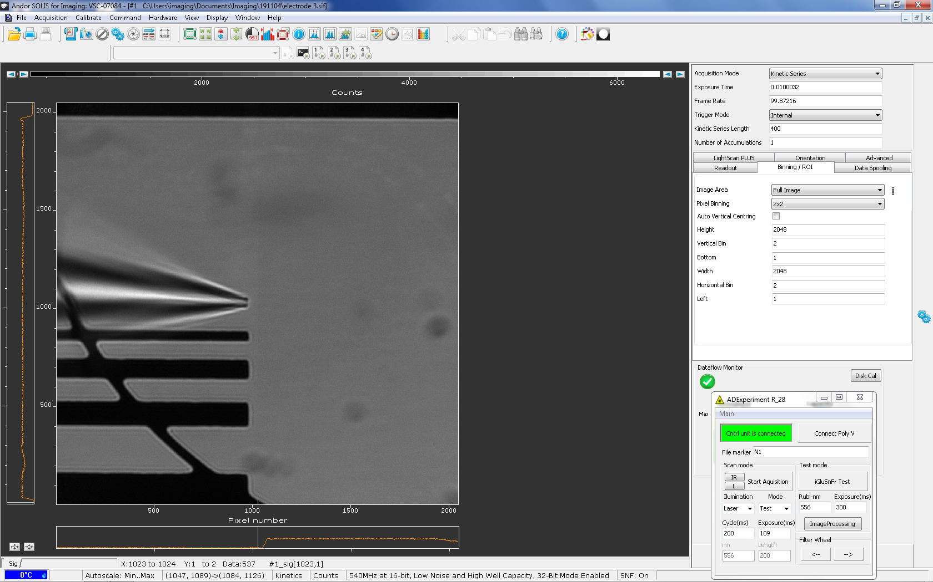
3.1.2 Version 2 (Magnification 252x, screen shot within SOLIS program)
2µm
5µm

Slide 3
Screenshot showing stimulation electrode with calibration bars
2µm
5µm
10µm

