Slide 1
3.1.2 Shot of at least one capillary (version 1 – magnification 252x [63x objective + 4x magnification lens])
Please, select one of the most suitable shot
2µm
5µm

Slide 2
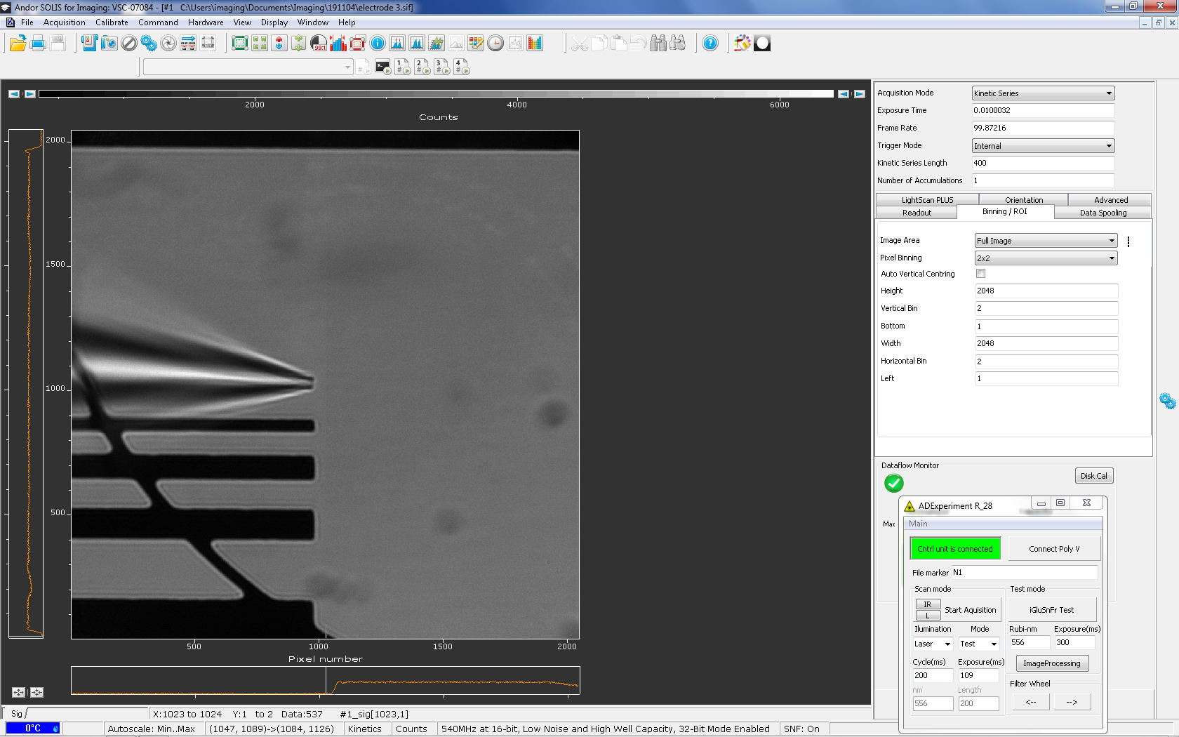
3.1.2 Version 2 (Magnification 252x, screen shot within SOLIS program)
2µm
5µm

Slide 3
3.1.2 Version 3 (Magnification 63x)
2µm
5µm
10µm

