Slide 1
The screenshots below show the analysis of Brassica napus sequence data
Step 4.1.1 – demultiplexing with bclfastq2
Command used:
$ nohup /opt/bcl2fastq2-2.18.12/bin/bin/bcl2fastq --runfolder-dir /runs/190301_NS500446_0582_AHLWC3BGX9 --ignore-missing-bcl --output-dir Demultiplex_Output_190301_NS500446_0582_AHLWC3BGX9 --barcode-mismatches 1 --aggregated-tiles AUTO -r 16 -d 16 -p 16 -w 16
Output (screenshot of a read in fastq format):
@NS500446:582:HLWC3BGX9:1:11101:10309:2245 1:N:0:GGTAGC
TCGCTTCAATGTCGAGAAAGAGGGATGTAAAATGGAATTCTCGGGTGCCAAGGAACTCCAGTCACGGTAGCATCTCGTATGCCGTGTTCTGGTTTAAAAAAAAAAGGGGGGGGGGGGGGGGGGGGGGGGGGGGGGGGGGGGGGGGGGGGG
+
AAAAAEEEEAEEEEEEEEEEEEEEEEEEEEEEEEEEEEEEEEEEEEEEEEEEEEEEEEEEEEEEEEEEEEEAA//////A//E//////////<//AEEEEE66///</AAEEE/<EEEEEEEEAEEAAAEAEEEEEEEEEEEEEEEEE<
NOTE: the sequences indicated in red and blue are the adapter sequences that will be removed during steps 4.1.2 and 4.1.3. The sequence in light purple is the miRNA sequence

Slide 2
Step 4.1.2 – adapter trimming
Command used:
$ /opt/cutadapt-1.15/bin/cutadapt -a TGGAATTCTCGGGTGCCAAGG -n 5 -O 4 -m 10 -j 0 --nextseq-trim 10 -o Sample1_Brassica_R1_cutadapt.fastq.gz Sample1_Brassica_R1.fastq.gz
Output (screenshot of a read in fastq format after trimming):
@NS500446:582:HLWC3BGX9:1:11101:10309:2245 1:N:0:GGTAGC
TCGCTTCAATGTCGAGAAAGAGGGATGTAAAA
+
AAAAAEEEEAEEEEEEEEEEEEEEEEEEEEEE

Slide 3
Step 4.1.3 – trimming of random nucleotides from the HD adapters
Command used:
$ seqtk trimfq -b 4 -e 4 Sample1_Brassica_R1_cutadapt.fastq > Sample1_Brassica_R1_4bp_trimmed.fastq
Output (screenshot of read in fastq format after trimming):
@NS500446:582:HLWC3BGX9:1:11101:10309:2245 1:N:0:GGTAGC
TTCAATGTCGAGAAAGAGGGATGT
+
AEEEEAEEEEEEEEEEEEEEEEEE

Slide 4
Step 4.1.4 – Discard sequences shorter than 10 nucleotides
Command used:
$ awk 'BEGIN {FS = "\t" ; OFS = "\n"} {header = $0 ; getline seq ; getline qheader ; getline qseq ; if (length(seq) >= 10) {print header, seq, qheader, qseq}}' Sample1_Brassica_R1_4bp_trimmed.fastq > Sample1_Brassica_R1_4bp_trimmed_more_than_10bp_long.fastq

Slide 5
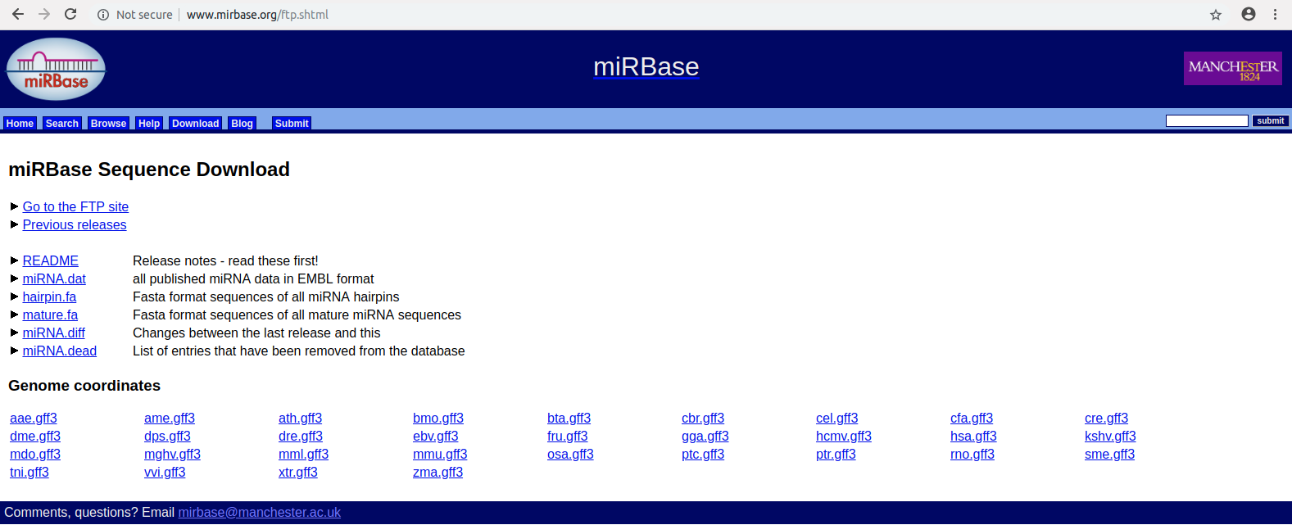
Step 4.2.1 – Mapping to miRBase
Download mature miRNA sequences (mature.fr database):
Replace U residues by T using the following command:
$ sed -i '/^>/! s/U/T/g' mature.fa

Slide 6
Step 4.2.2 – select your organisms of interest
Command used:
$ awk '/Brassica napus/{print; nr[NR+1]; next}; NR in nr' mature.fa > mature_Brassica_92mirs.fa
Output (screenshot of B. napus sequences):
>bna-miR156a MIMAT0004445 Brassica napTs miR156a
TGACAGAAGAGAGTGAGCACA
>bna-miR171g MIMAT0004446 Brassica napTs miR171g
TGATTGAGCCGCGCCAATATCT
>bna-miR393 MIMAT0004447 Brassica napTs miR393
TCCAAAGGGATCGCATTGATC

Slide 7
Step 4.2.3 – build an index for the file created in step 4.2.2
Command used:
$ bowtie2-build mature_Brassica_92mirs.fa mature_Brassica_92mirs

Slide 8
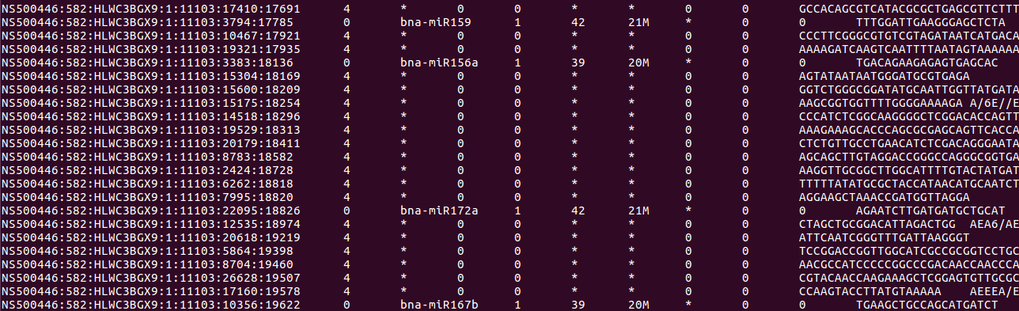
Step 4.2.4 – Align the sequencing reads to the database, requiring that a read maps entirely to a miRNA of the database, without any mismatches
Command used:
$ bowtie2 -N 0 -L 10 --score-min C,0,0 --end-to-end --time -x mature_Brassica_92mirs -U Sample1_Brassica_R1_4bp_trimmed_more_than_10bp_long.fastq -S Sample1_Brassica_EXACT_end_to_end.sam
Output (screenshot of alignment results):

Slide 9
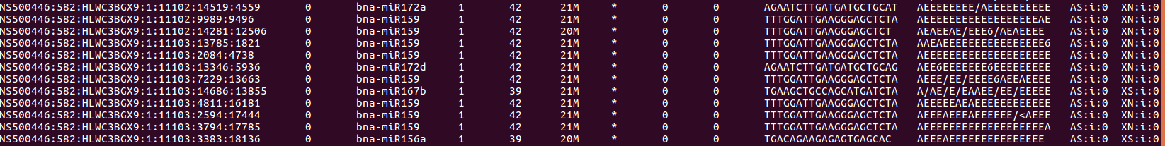
Step 4.2.5 – Discard the reads that did not align
Command used:
$ samtools view -F 4 Sample1_Brassica_EXACT_end_to_end.sam > Reads_aligned_to_Mirs.sam
Output (screenshot of aligned reads):

