Slide 1
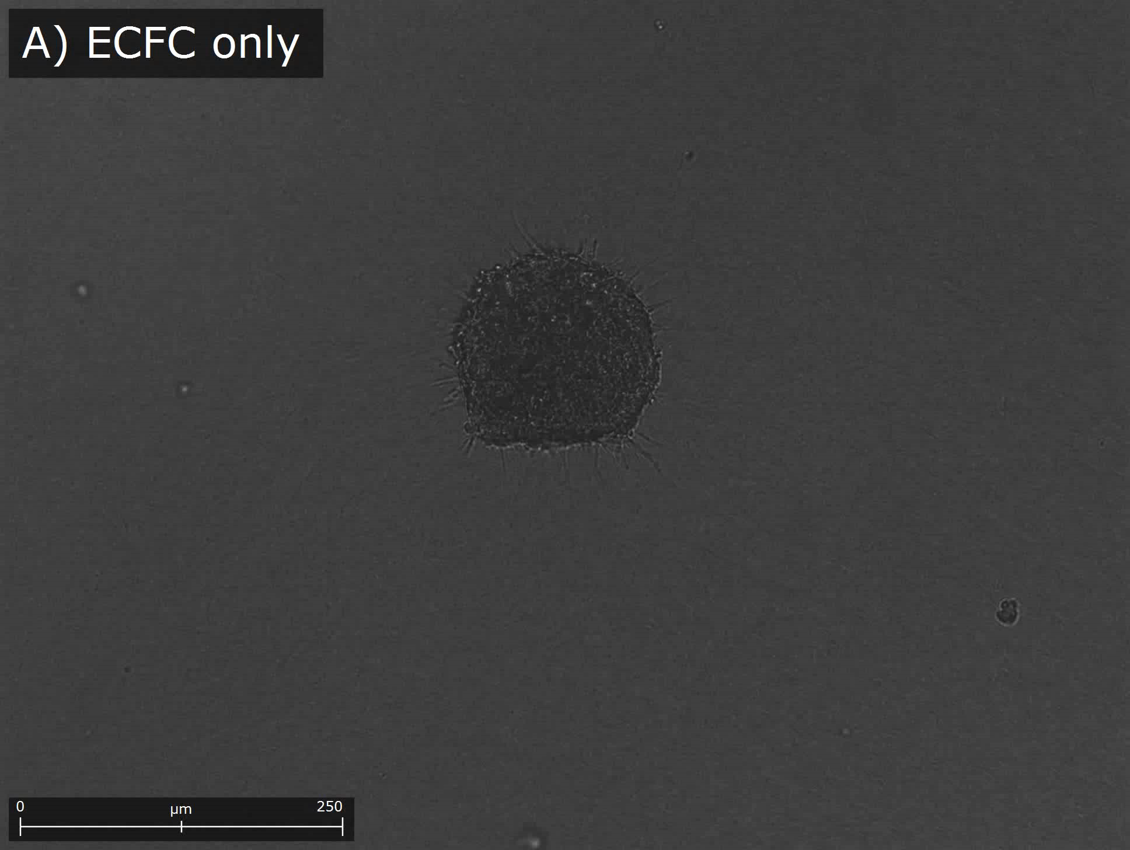
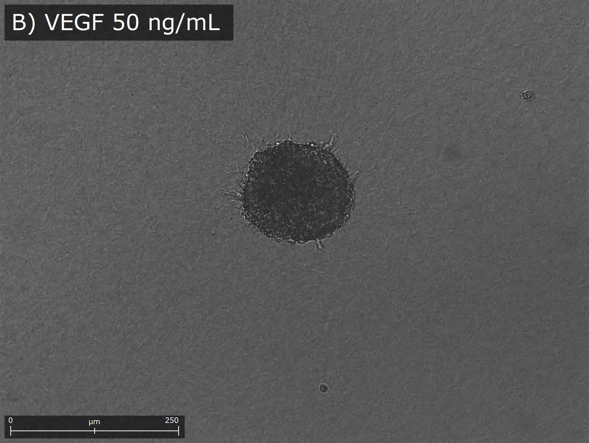
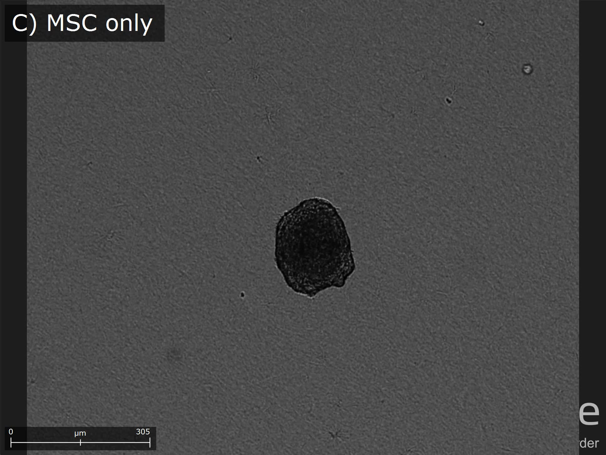
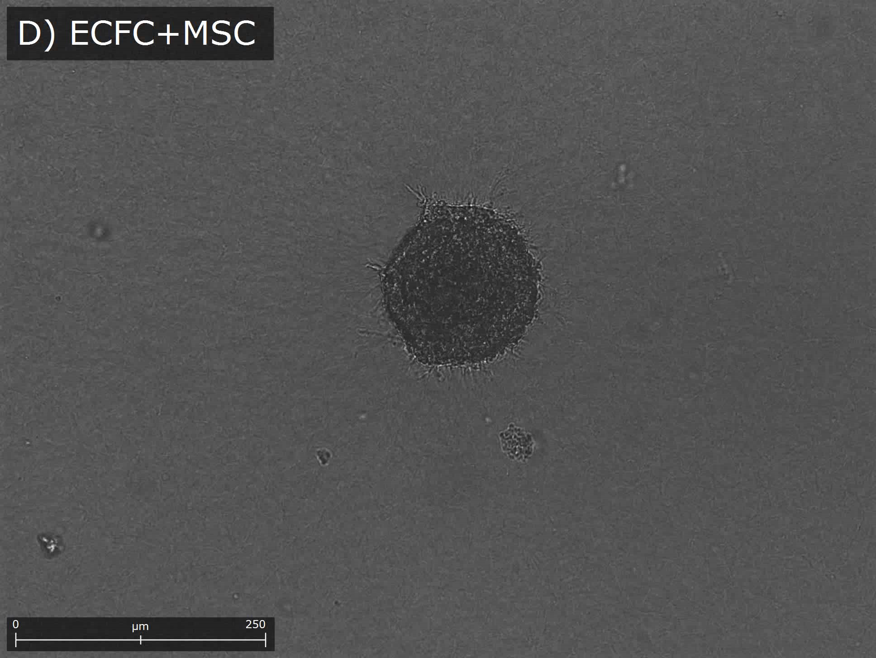
Supplemental Video 1.
Video clips of sprout formation from each spheroid
Video clip was generated with 1-hour interval images taken by real-time cell recorder for 24 hours. (A) Sprout formation of an ECFCs-only spheroid. (B) Sprout formation of an ECFCs-only spheroid with VEGF treatment (50ng/mL). (C) Sprout formation of a MSCs-only spheroid. (D) Sprout formation of an ECFCs+MSCs spheroid.

Slide 2
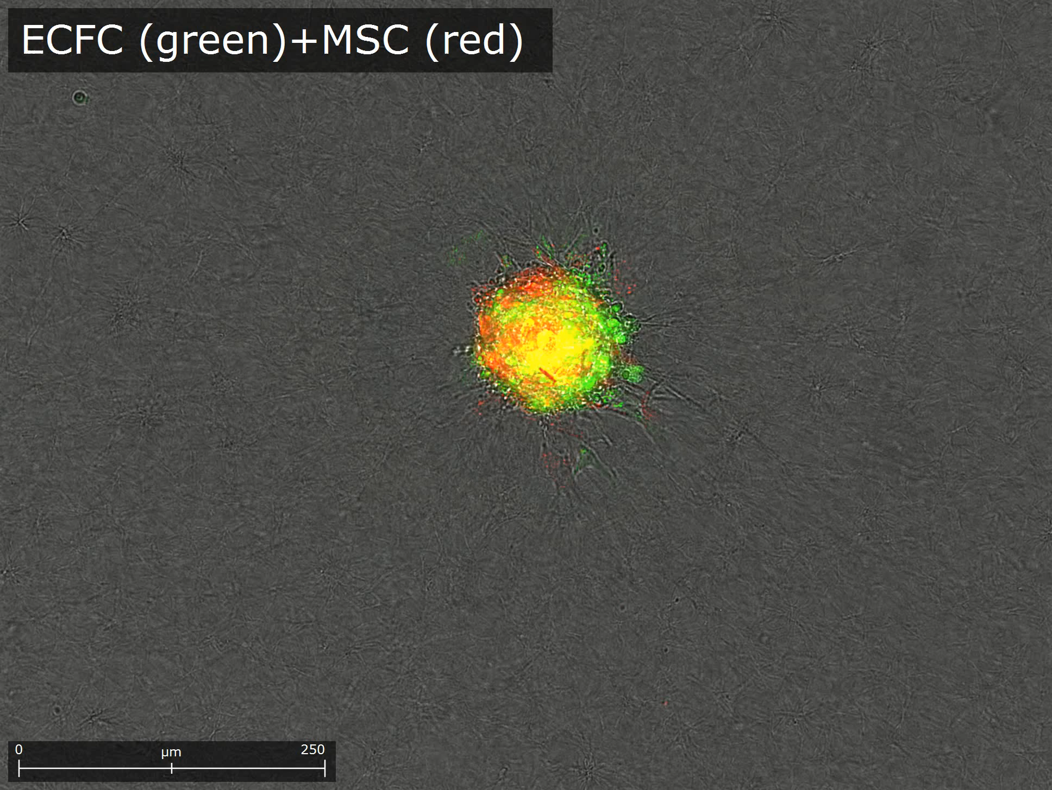
Supplemental Video 2.
Video clip of sprout formation from ECFCs+MSCs spheroid with fluorescence labeling.
Live cell fluorescence labeling of ECFCs and MSCs was performed before spheroid formation using PKH67 (green) and PKH26 (red), respectively. Video clip was generated with 1-hour interval images taken by real-time cell recorder for 24 hours.

