Slide 1
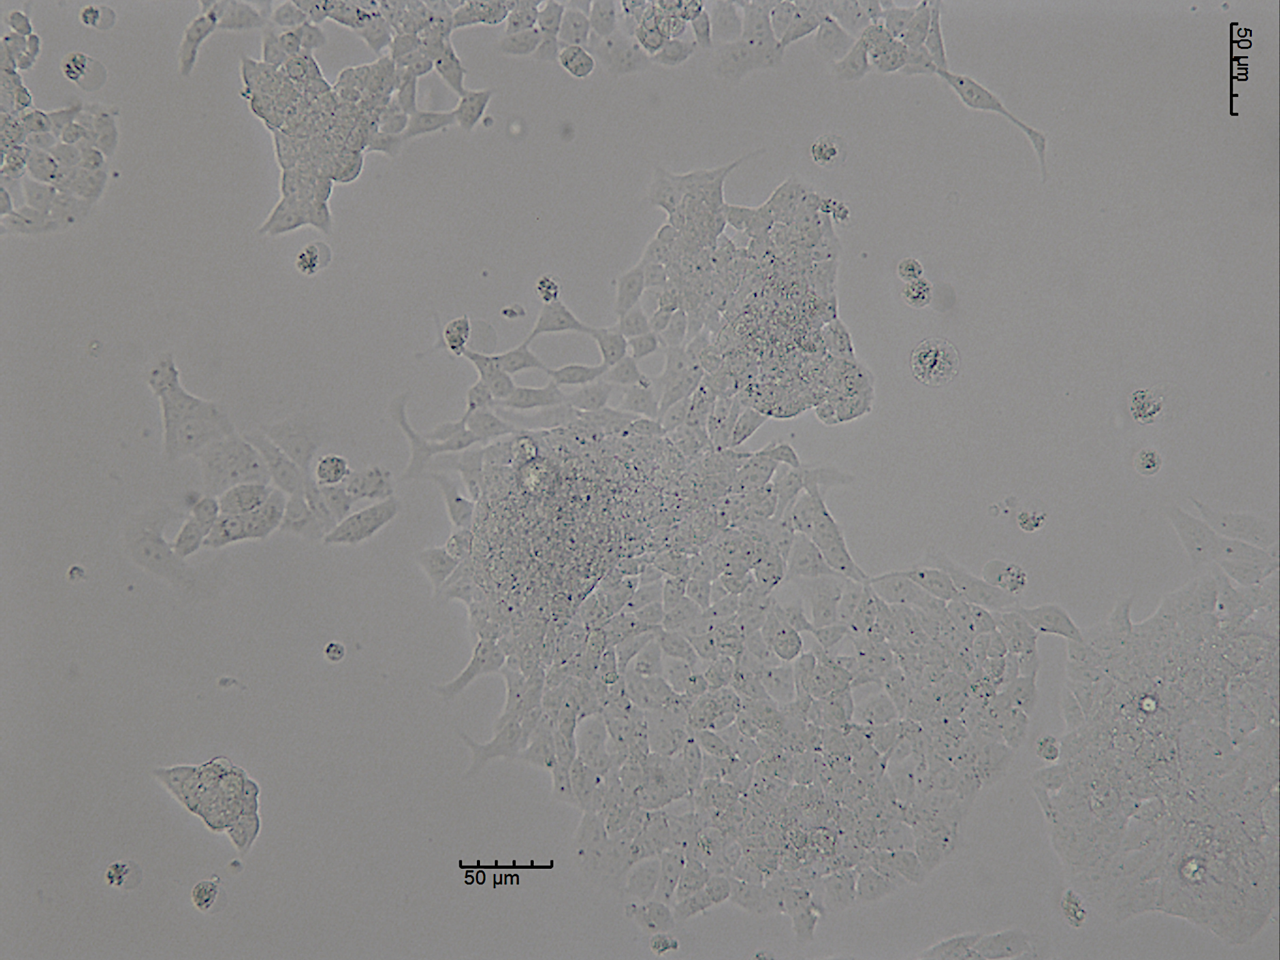
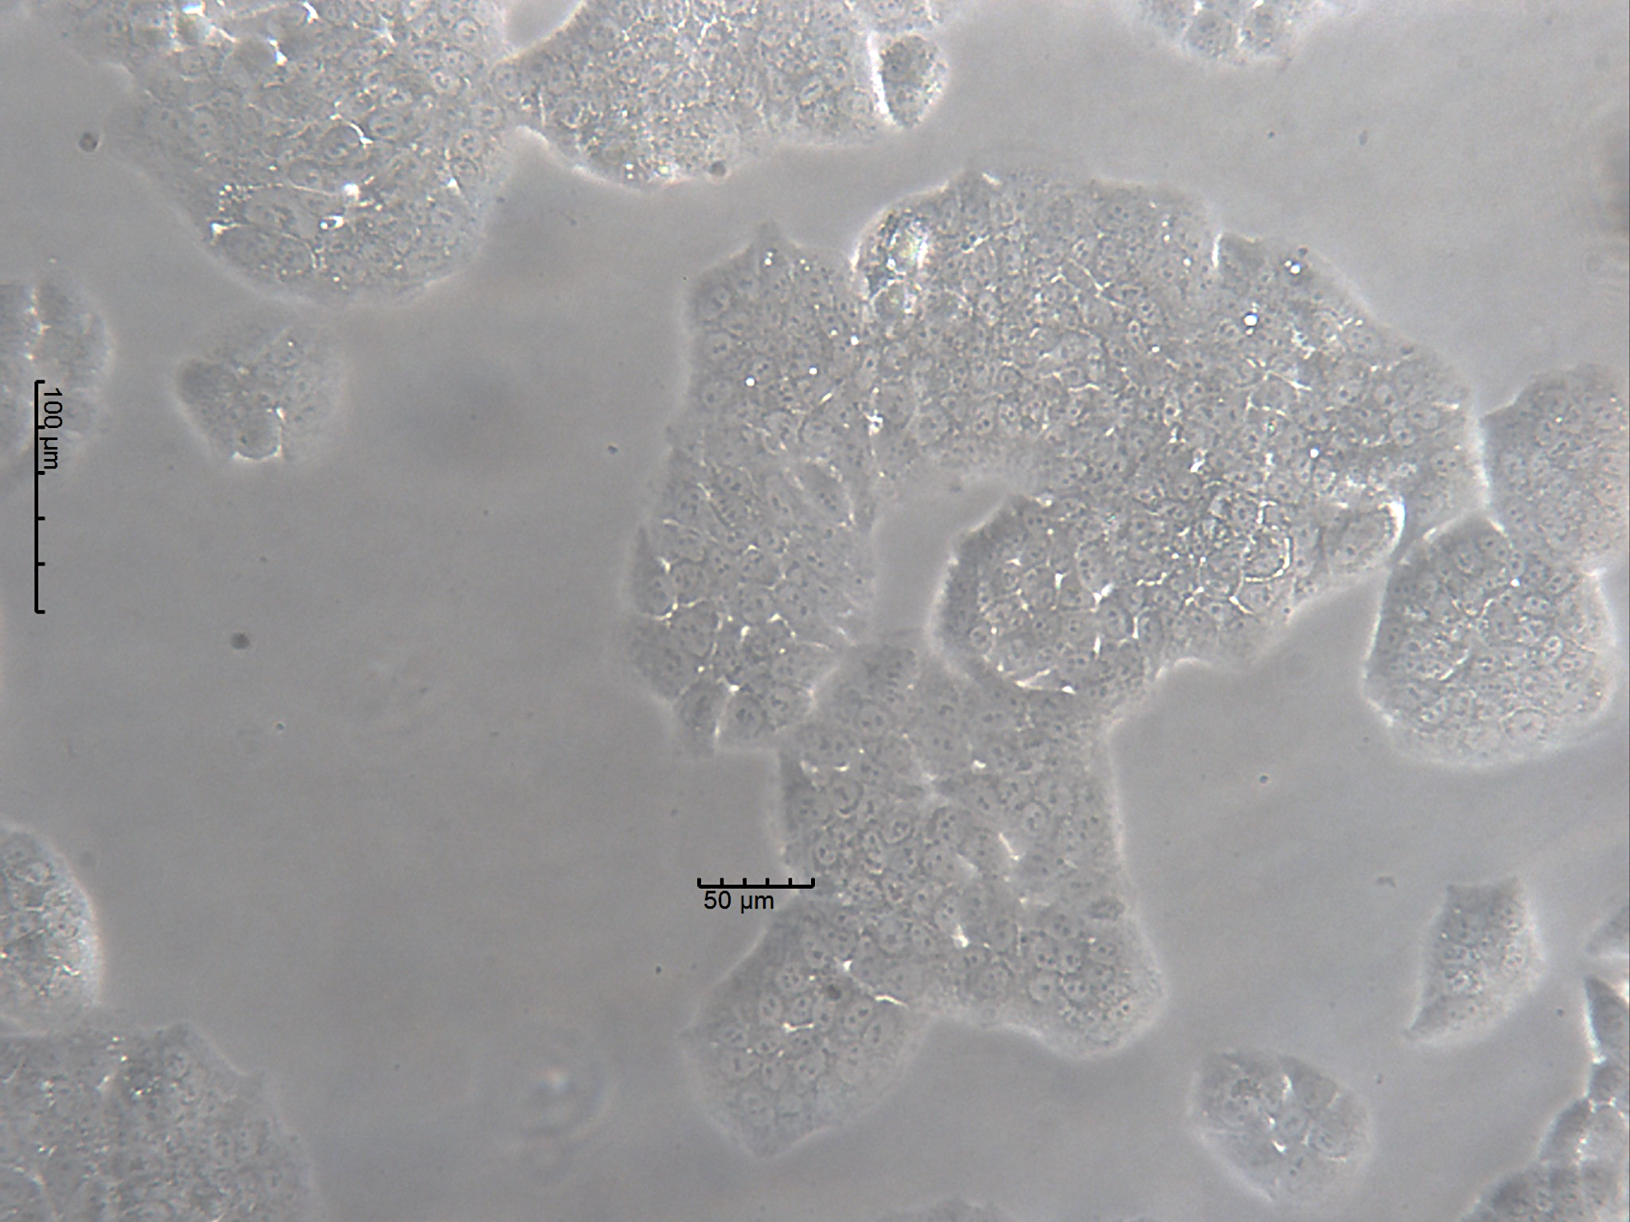
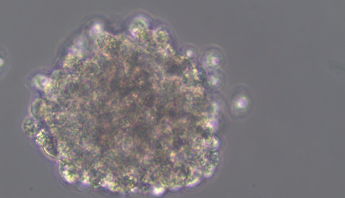
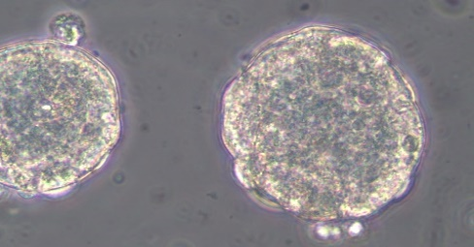
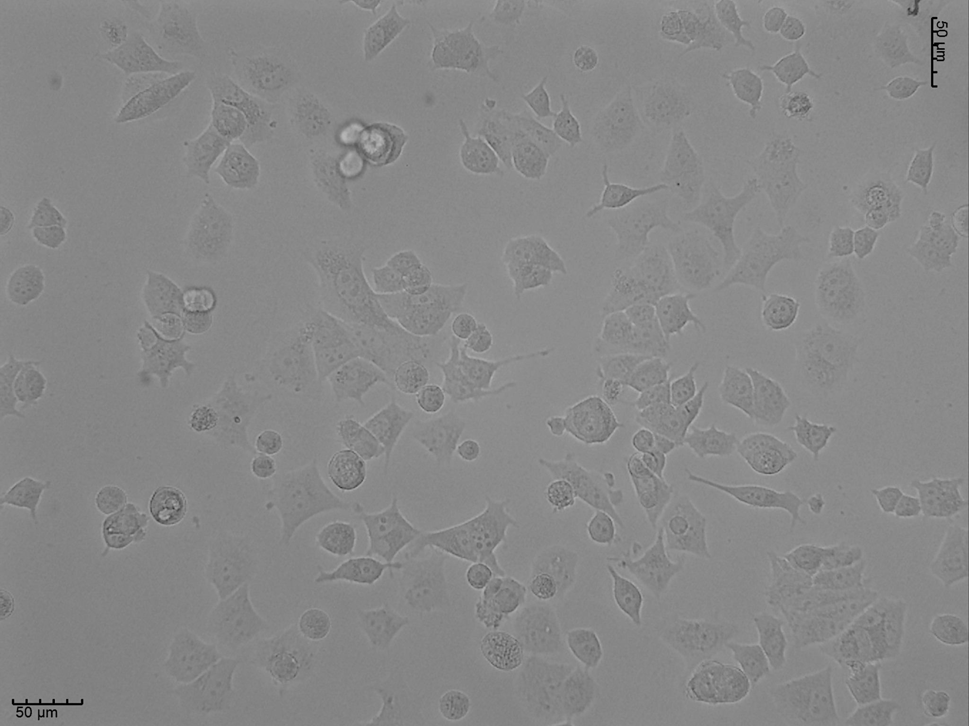
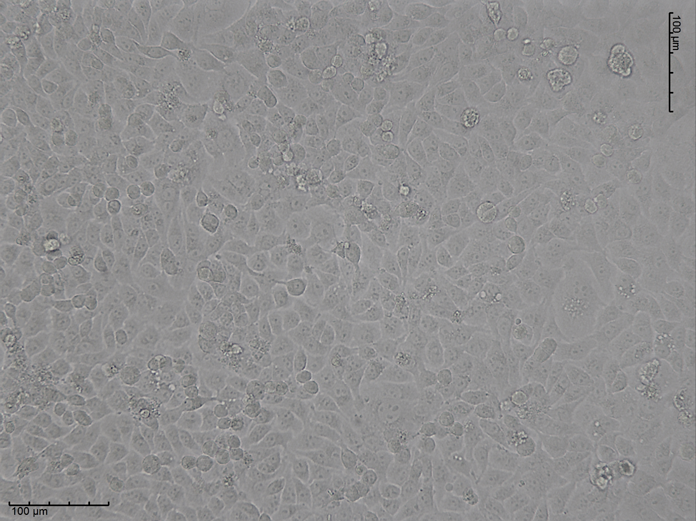
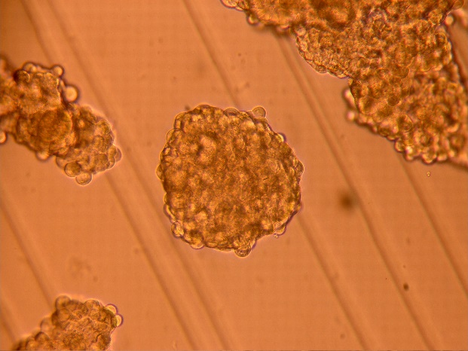
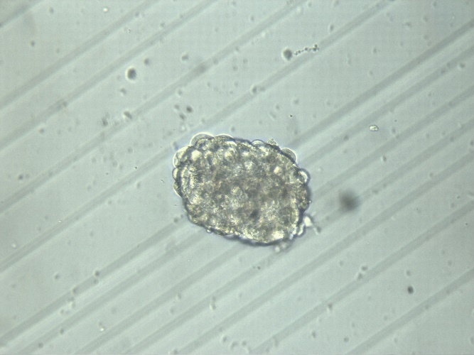
RL95-2
ECC-1
ES1 RL95-2
ES1 ECC-1
MCF7
HCC1806
MS1 MCF7
MS1 HCC1806
The sphere-forming protocol allows spherical colonies to be obtained in suspension from several endometrial and breast cancer cell lines [1]

Slide 2
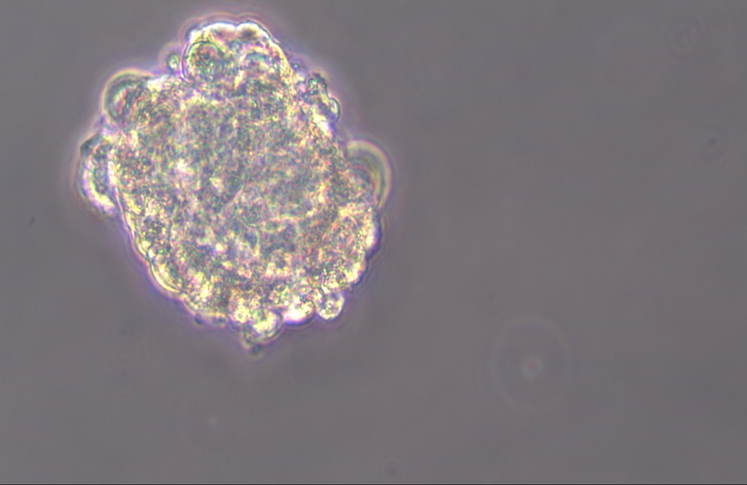
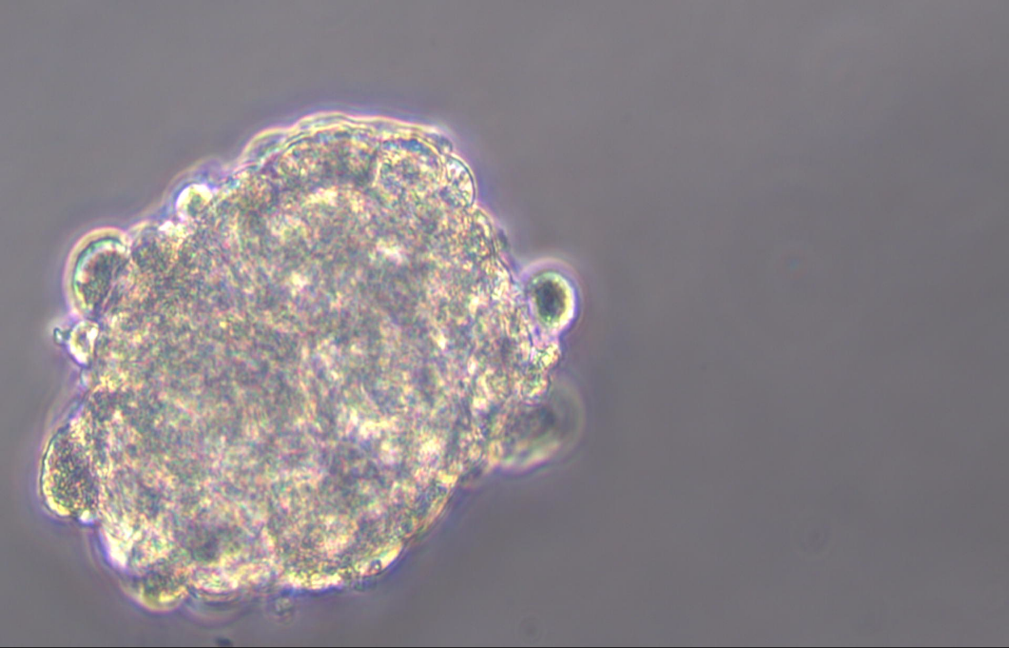
RL95-2
ECC-1
ES1 RL95-2
ES1 ECC-1
MCF7
HCC1806
MS1 MCF7
MS1 HCC1806
ES1 Human Tumor
or after gentle enzymatic digestion of tissues from human tumor samples [2].

Slide 3
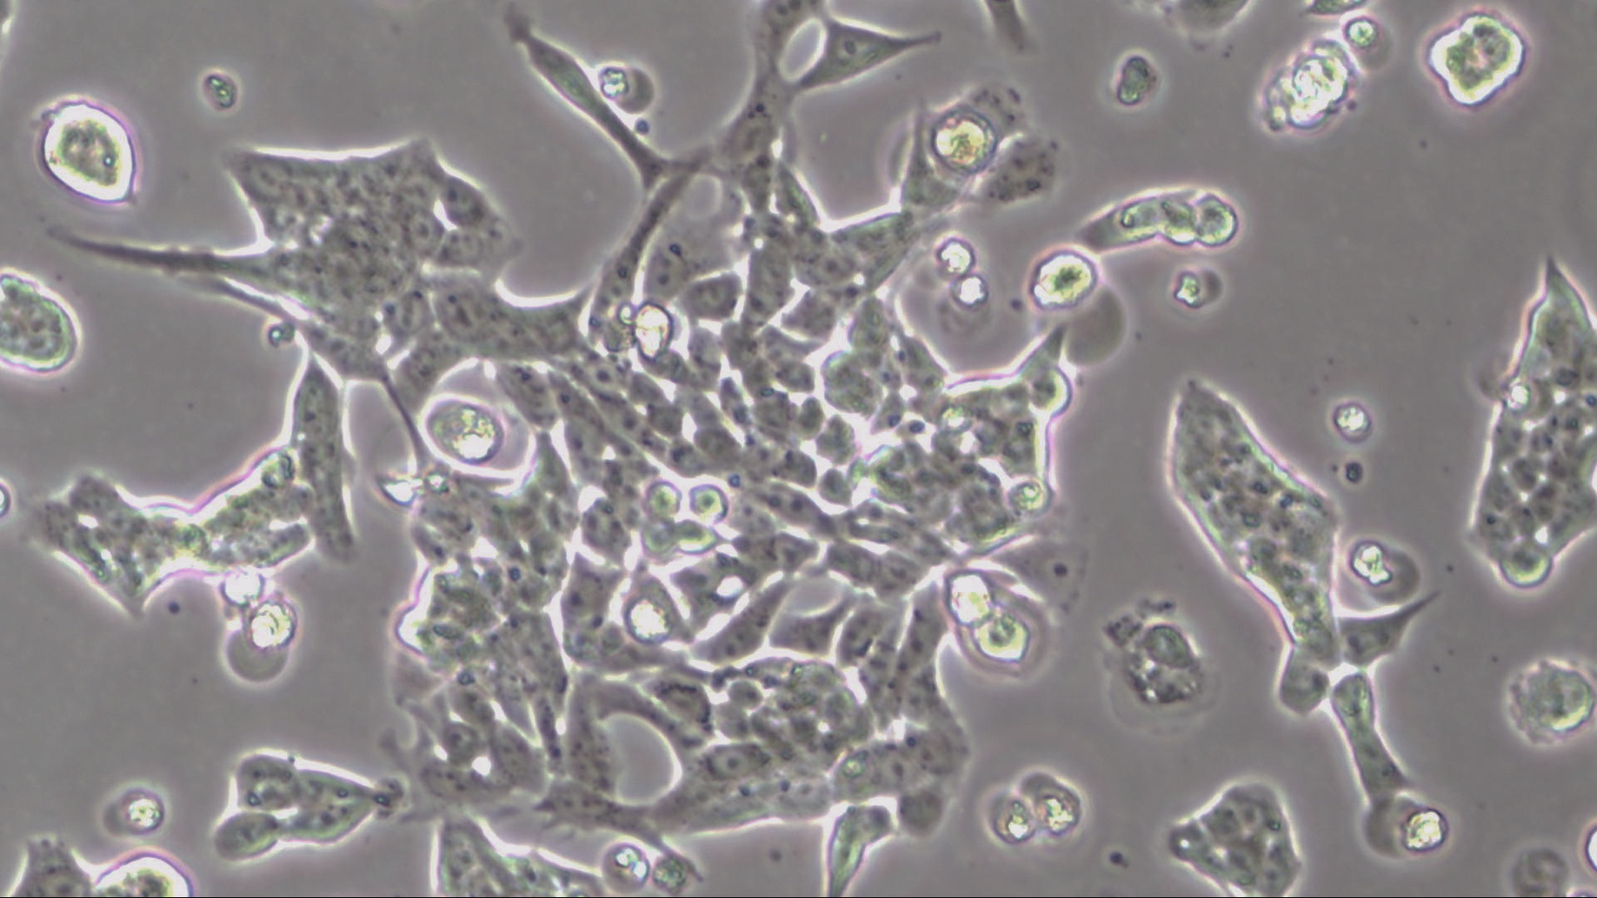
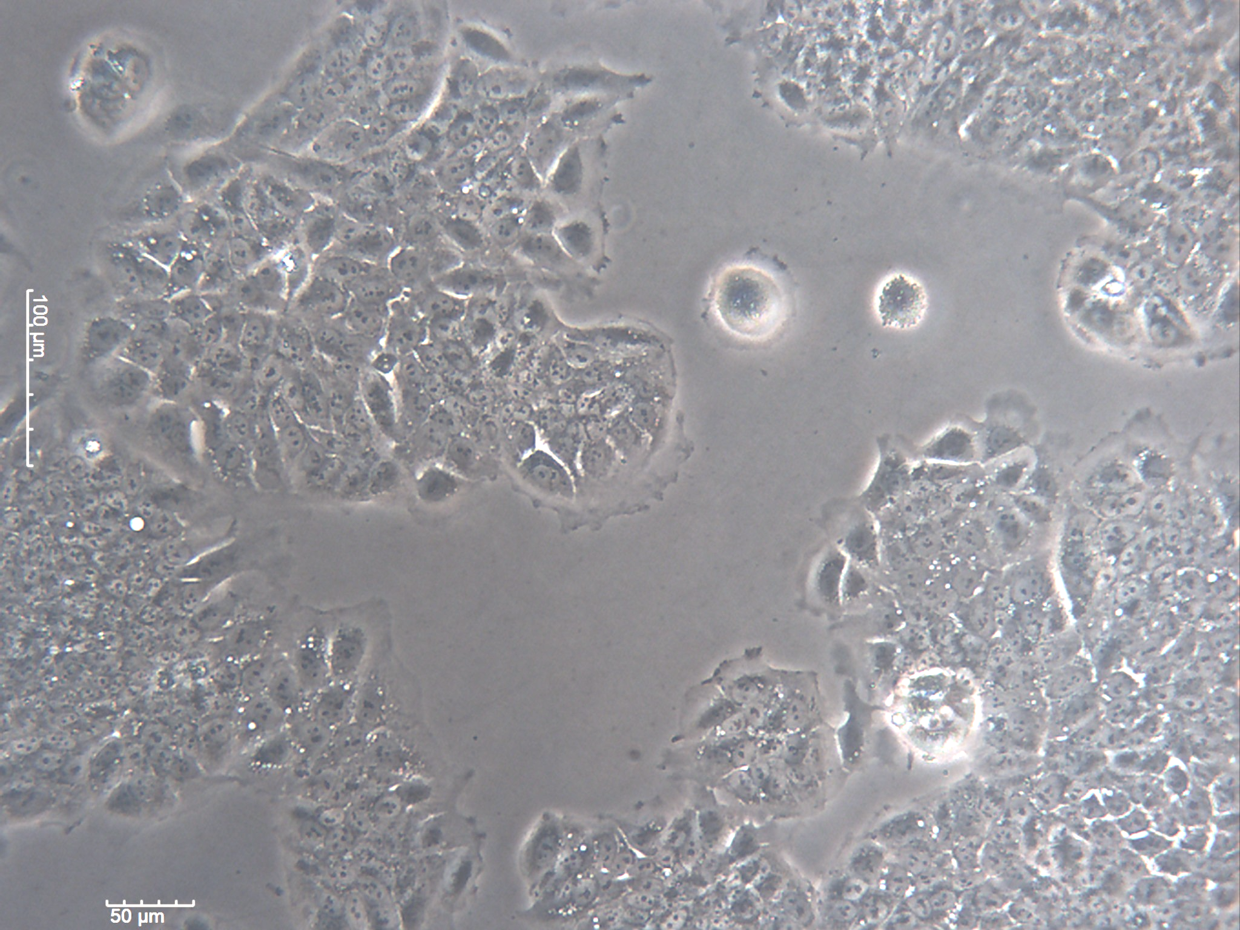
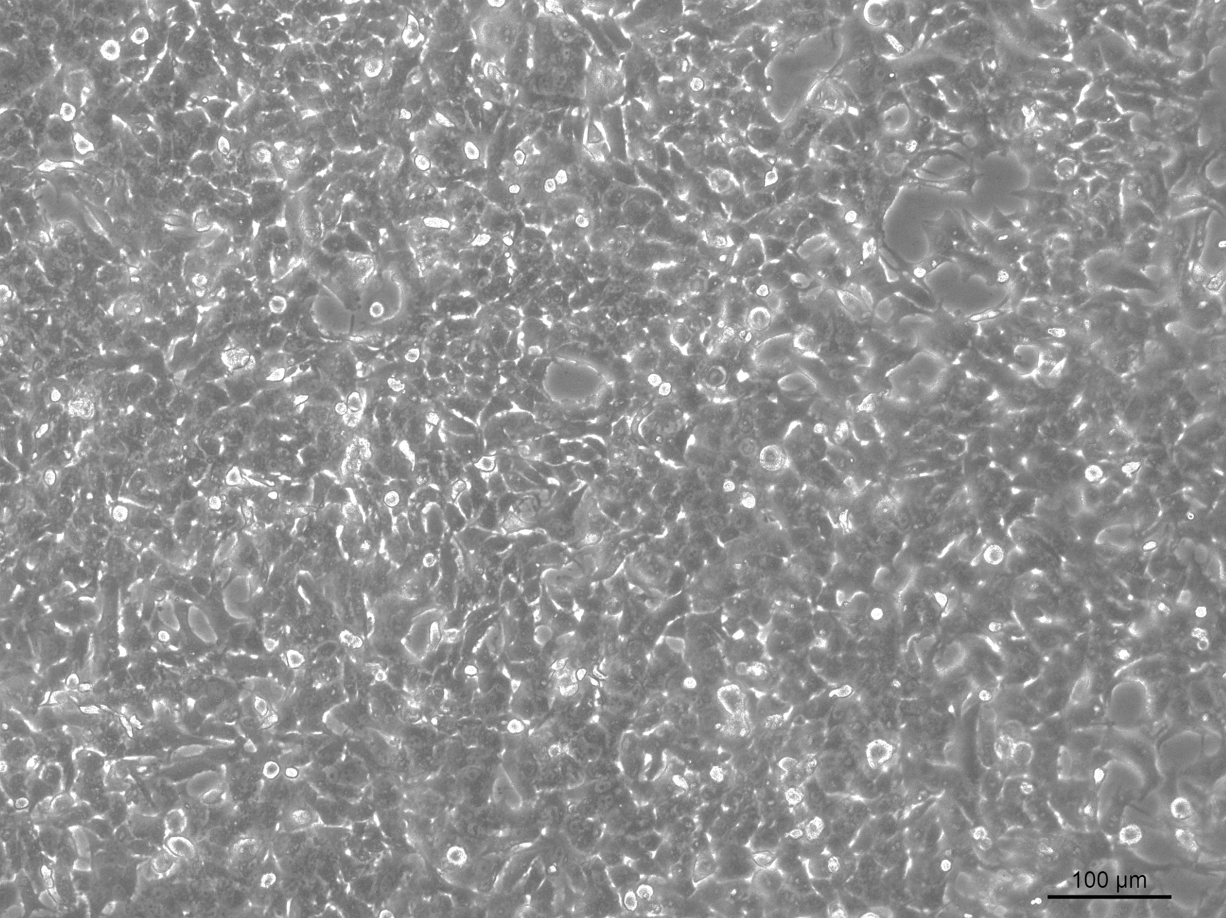
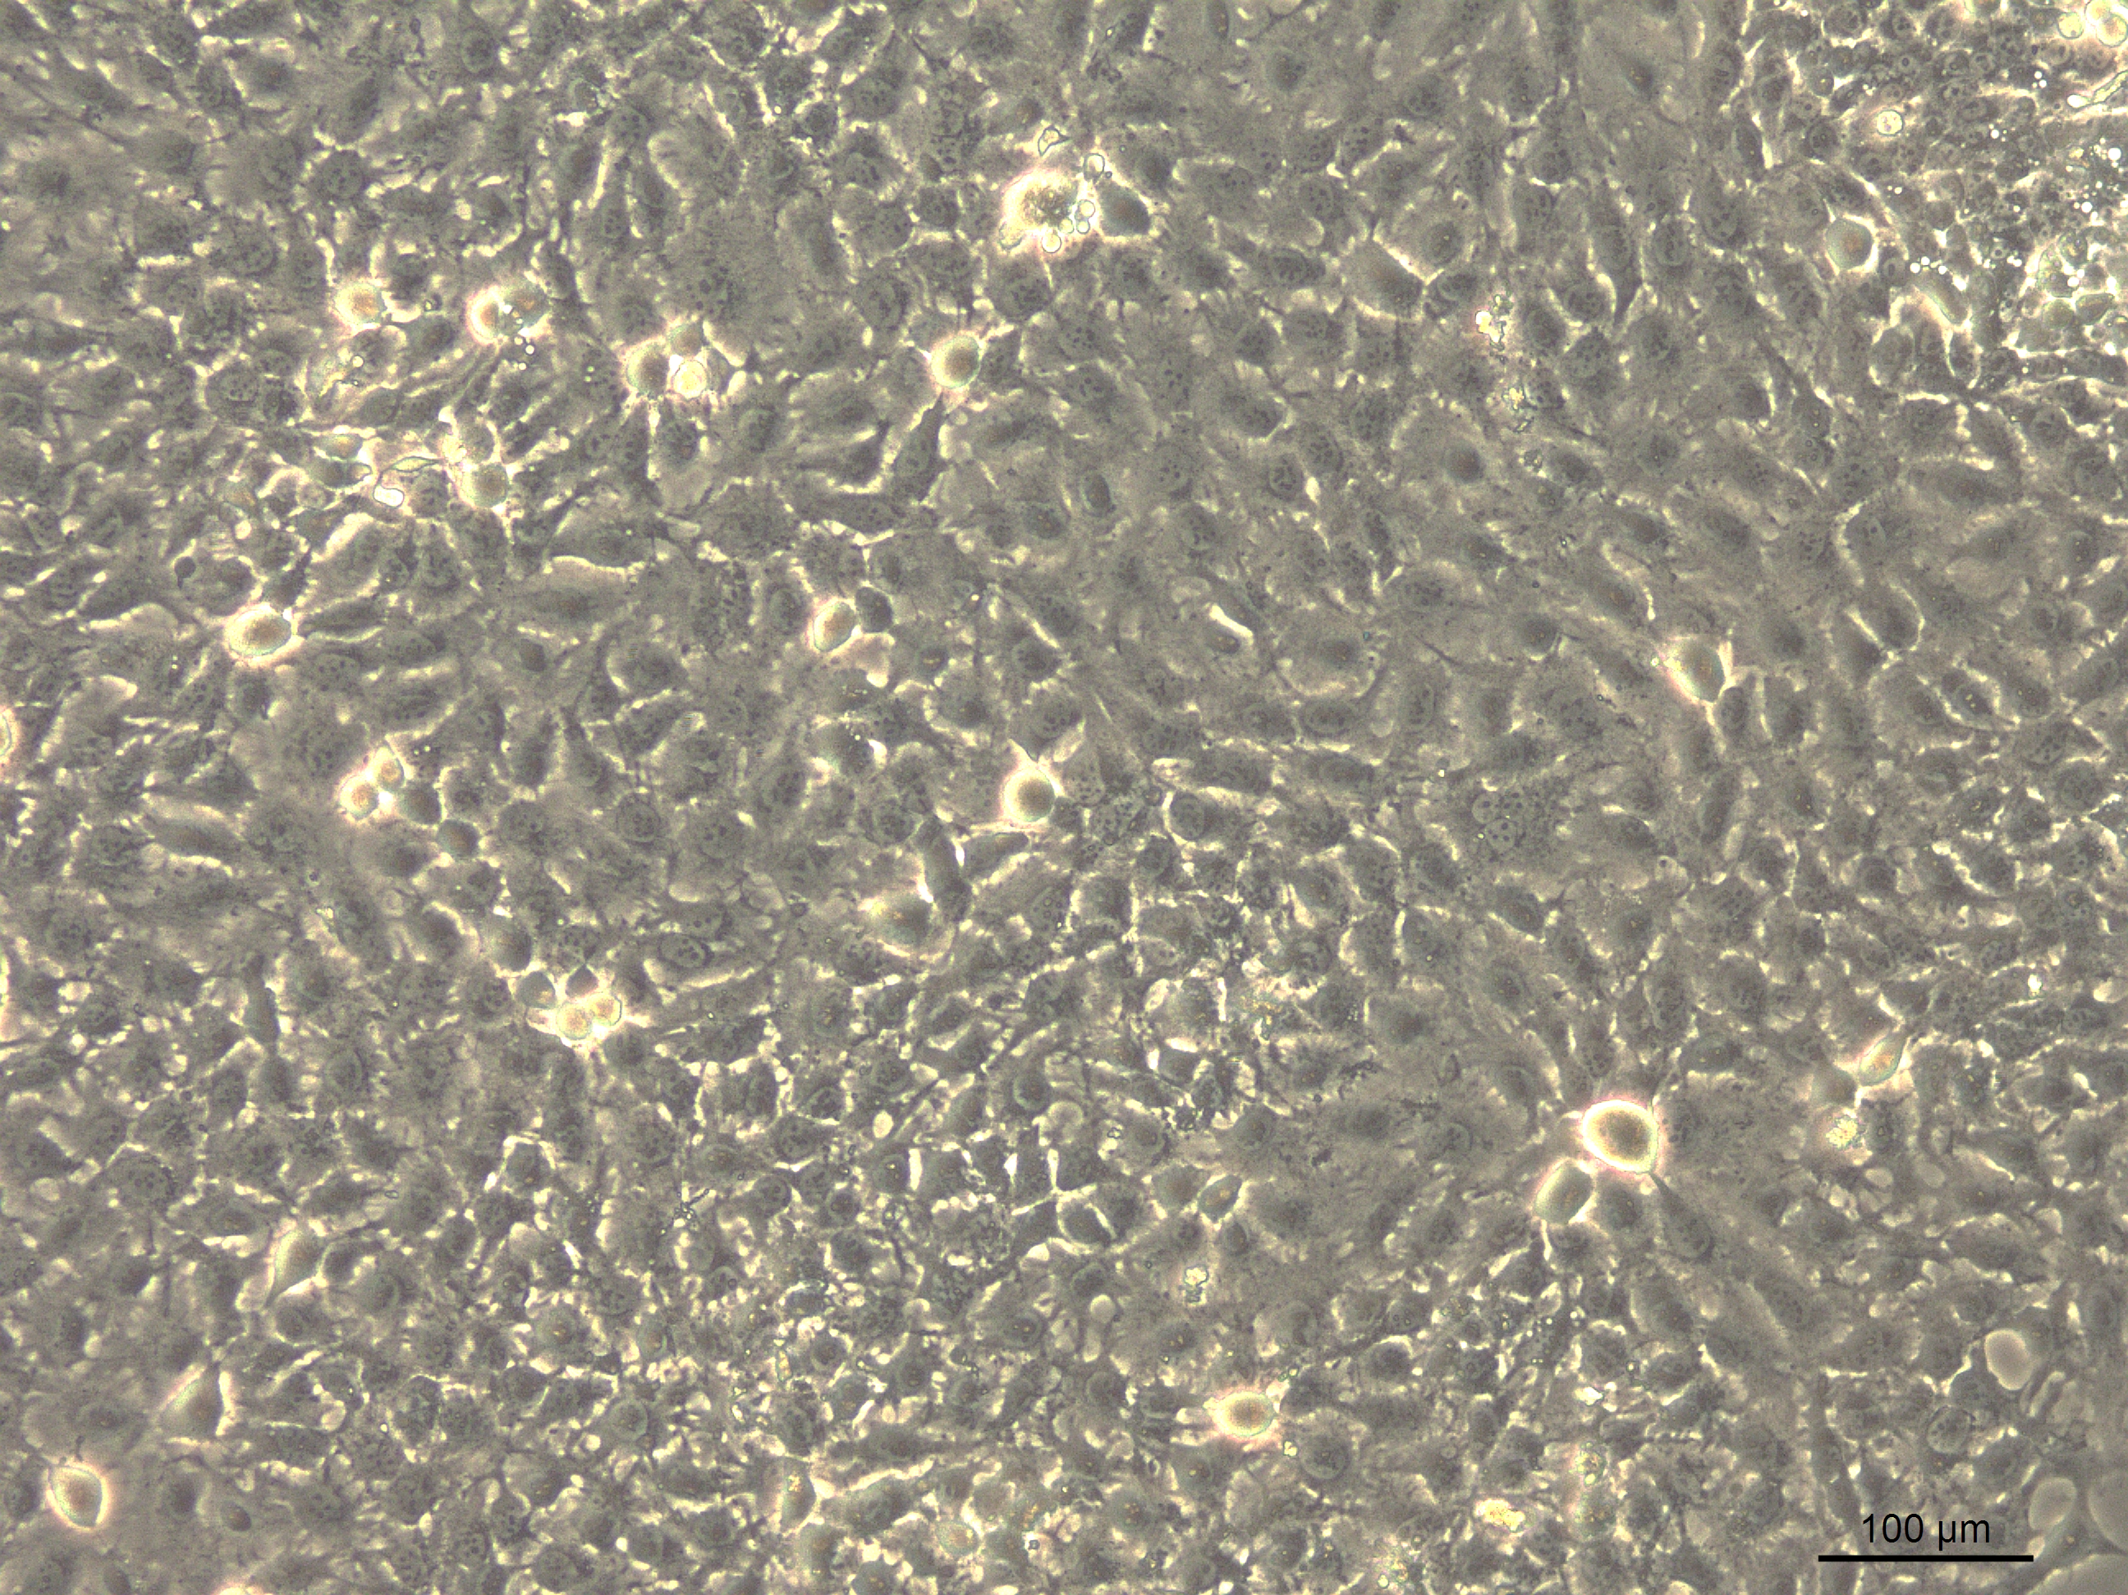
RL95-2
ECC-1
ES1 RL95-2
ES1 ECC-1
G1 RL95-2
G1 ECC-1
MCF7
HCC1806
MS1 MCF7
MS1 HCC1806
G1 MCF7
G1 HCC1806
ES1 Human Tumor
Both endometrial and breast cancer spheres give rise to a cell monolayer with similar morphologies to their cell line of origin 1-2 days after plating [1].

