Slide 1
After the training, all participants got several comprehension tests to see how well they had learned the alien language.
The tests at the end were the same for all participants.
The first test was a forced choice single word vocabulary test.
Instructions for participants:
Next, you’ll see two pictures on the screen and hear a description.
Click on the picture that matches the speech you hear.
Unlike earlier, you will not receive any sort of feedback after you answer.

Slide 2




x
m

Slide 3
After the vocabulary test, participants did another forced choice test of the same format, this time with longer phrases.
The example trial in this demo shows a grammar test trial. In order to pick the correct answer, the participant has to know how singular and plural are encoded in the alien language.

Slide 4
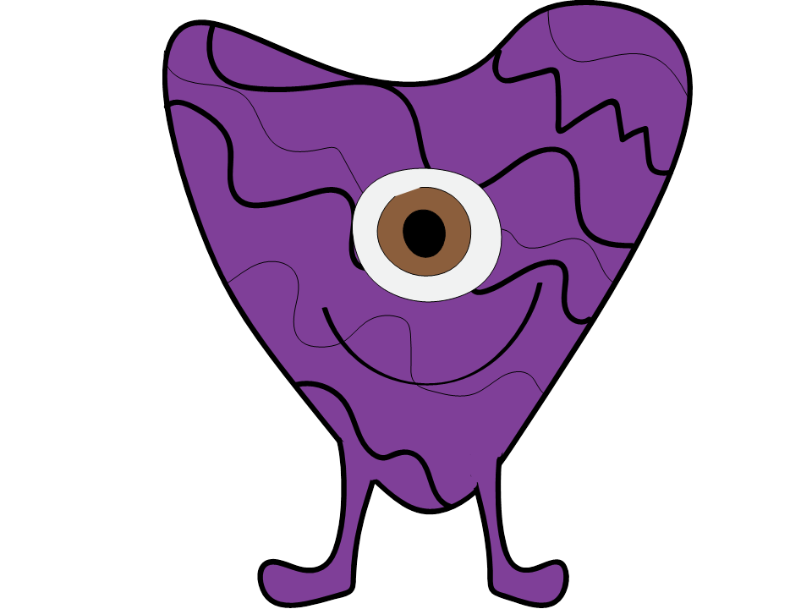
x
m

Slide 5
Here’s the sentence of that demo forced choice trial written out, with the grammatical information highlighted:
“Vus Safus Weemus Traw Ot”
Specifically, words ending in –us and –ok are singular, words ending in –usu and –oko are plural.
Thus, the correct answer here was the single alien on the left side of the screen.
Participants never explicitly get told this rule, but have to pick up on it implicitly through the passive exposure and active learning training.

Slide 6
After the full forced choice test, participants did an error monitoring test.
In this test, they heard a sentence in the alien language and had to indicate whether it was grammatical or not.
Instructions for participants:
In this final test, you will hear a sentence.
Your job is to indicate whether this could be a correct sentence in the novel language (by clicking =) or whether there is a mistake in the sentence (by clicking ≠).
Note that you will ony HEAR a sentence, you will not see a picture on the screen!

Slide 7




Slide 8
Here’s the sentence of that demo error monitoring trial written out, with the grammatical error highlighted:
“Vok Fumok Zoutoko Stam Ot Pavok Kredel”
So, this sentence contains an error because the suffix ‘oko’ is plural and doesn’t agree with the suffix on the other words in the sentence like the determiner ‘ok’.
Note that real participants never saw the alien language written, they only ever heard it.

Slide 9
End of testing demo

