Slide 1
This demo will give you an example of all training trial-types from the artificial language experiment.
The original experiment had 2 between subjects conditions:
production and comprehension.
The only difference between the two conditions was in the active training trials.
This demo will include both active production and active comprehension training trials, but remember that in the original experiment, participants only ever got one of these two types of training trials.
In this demo you will only learn a couple of words. Remember that real participants got more trials and learned many more new words.

Slide 2
The demo starts with passive exposure trials.
Participants in all conditions started with this type of trial.
Instructions for participants:
In what follows, you'll see a picture and hear the word for it in a new language.
To help you learn each word, you will see the picture and hear the word twice in a row.
You do not need to do anything in this part, just try to learn the words.

Slide 3

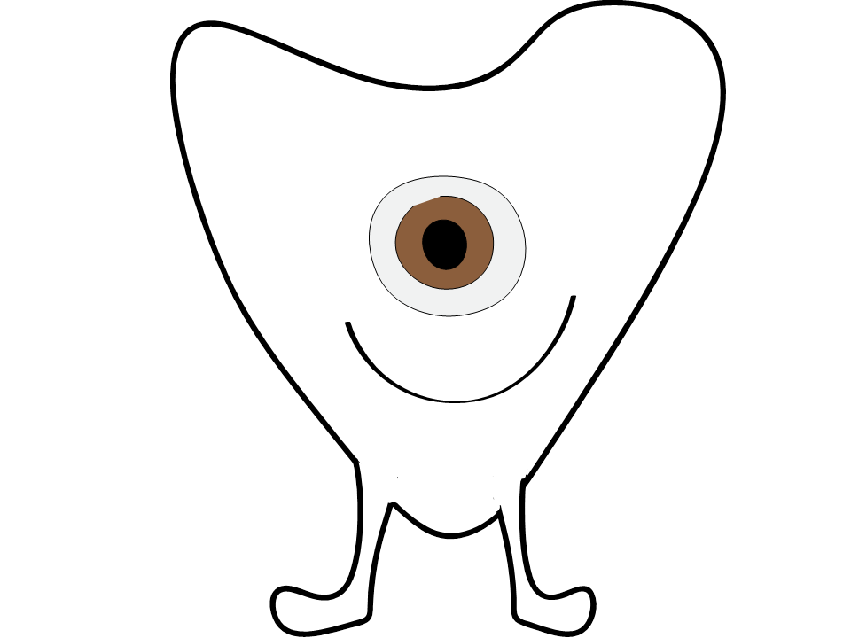

Slide 5
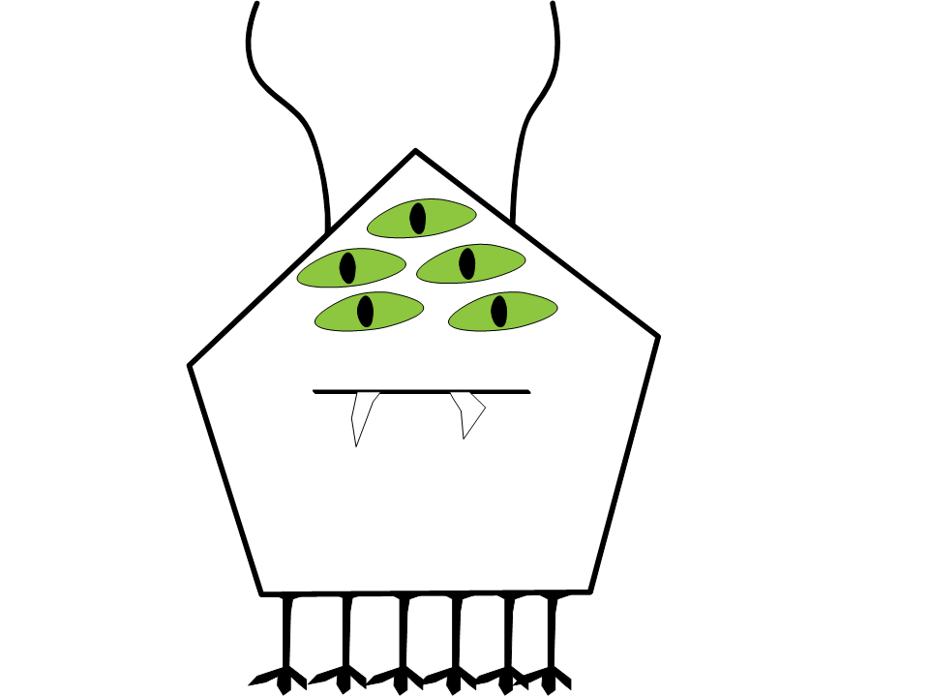

Slide 7
Active learning trials were different for participants in different conditions. This demo will start with showing the active comprehension trials that comprehension participants got.
Instructions for participants:
In these active comprehension trials, you will see a picture and hear some speech. Your job is to decide whether the picture and the speech match (=) or do not match (≠) by clicking on one of the two buttons next to the picture.
After you make your choice, you will get feedback:
you will see a green checkmark if you were correct
you will see a red cross if you were wrong.
After the feedback, you will hear the same speech again and you will see the picture that matches that speech.
.

Slide 9




Notes:
DEMO PARTICIPANT CLICKS ISNOT ON THE LET

Slide 11
So in this first demo trial, the speech initially did not match the picture.
The demo participant correctly clicked ≠.
So, they got feedback that their choice was correct.
Then, they heard the same speech and saw the picture that does match the speech, with a green square around it.
Let’s view another demo trial, since there is a lot going on in these active comprehension trials.

Slide 13


Slide 15
So in this second demo trial, the speech initially did match the picture.
The demo participant incorrectly clicked ≠.
So, they got feedback that their choice was incorrect.
Then, they heard the same speech and saw the same picture,
with a green square around it.
Let’s look at two more demo trials, this time without explanation.

Slide 16
Remember that active learning trials were different for participants in different conditions.
The demo will now move to the active production training trials that production participants got.
Instructions for participants:
In these active production trials, you will see a picture and a microphone icon.
Your job is to try to describe the picture out loud in the alien language.
After you are done speaking you will hear the correct description of the picture.

Slide 17

Notes:
“vus pexus”

Slide 19
So in this production trial, we hear the demo participant say
“… vus .. pexus …”
After that, we hear the target phrase is
“vok pexok”

Slide 20
Notes:
“ummm ok ummm Vus Weemus”

Slide 22
So in this second demo trial, we hear the demo participant say
“… uhm…. ok … uhm … vus .. weemus …”
After that, we hear the target phrase is
“vus weemus”

Slide 23
End of training demo

