Slide 1
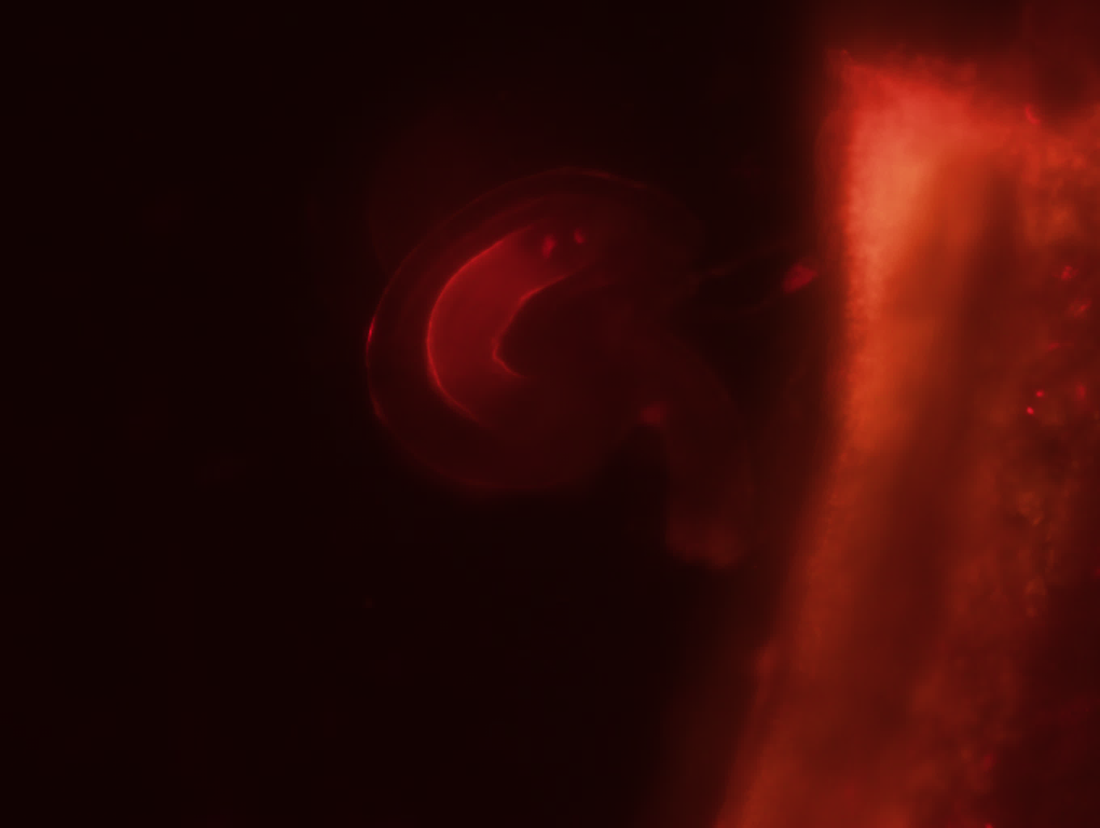


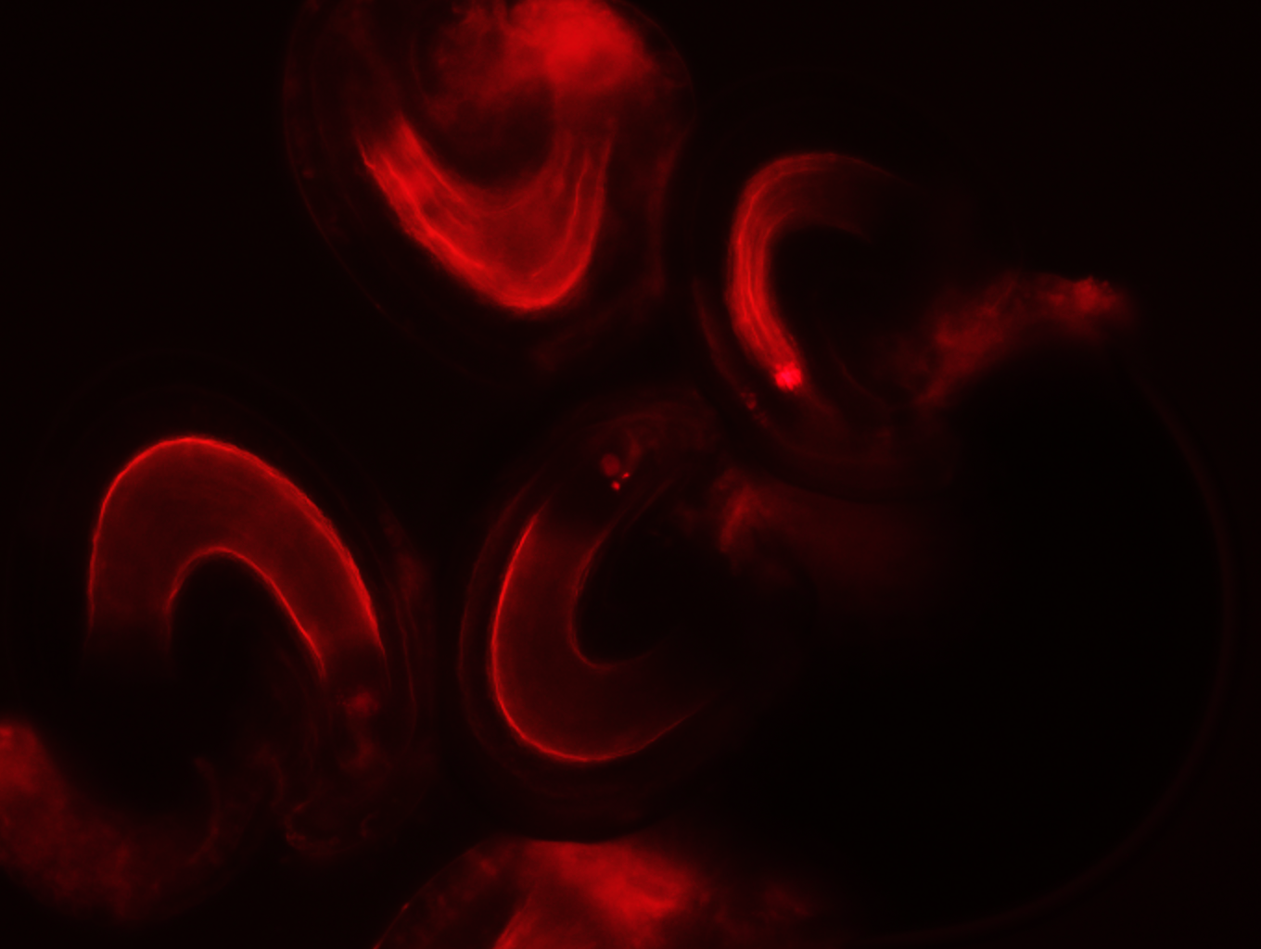
Figure 3
A
B
C
D
EN
E
Ovule
CHZ
ES
CC
EC
SC
MP

Slide 2
Figure 4
A
B

