Slide 1
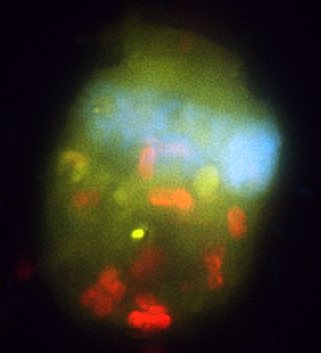
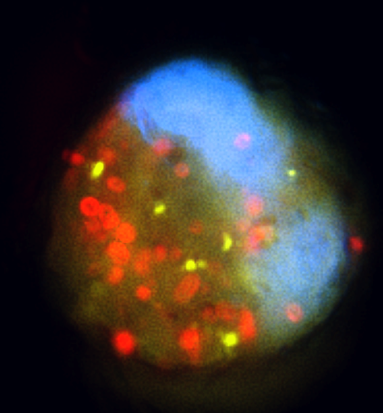
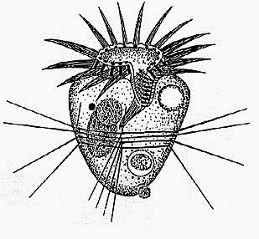
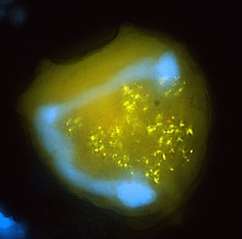
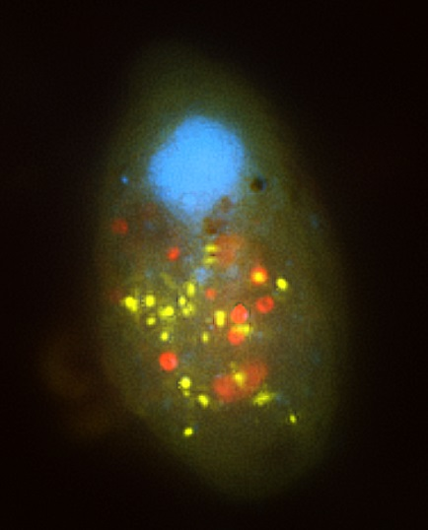
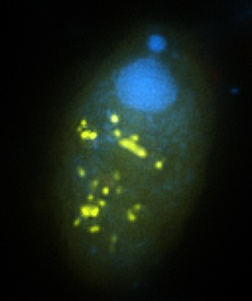
Ciliate feeding ecology in diverse habitats
Z-stack of multicolor
fluorescence images
DAPI, nuclei
algae
FLBs, yellow
Chlorophyll, red
Bacterivory vs algivory
Role of omnivory
picocyanobacteria
bacteria

Slide 2
To optimize a number of FLB per ciliate
cell under different water temperature
- one can manipulate:
1. Tracer amount of FLB (%) added
2. Exposition time (in minutes) with FLB

