Slide 1
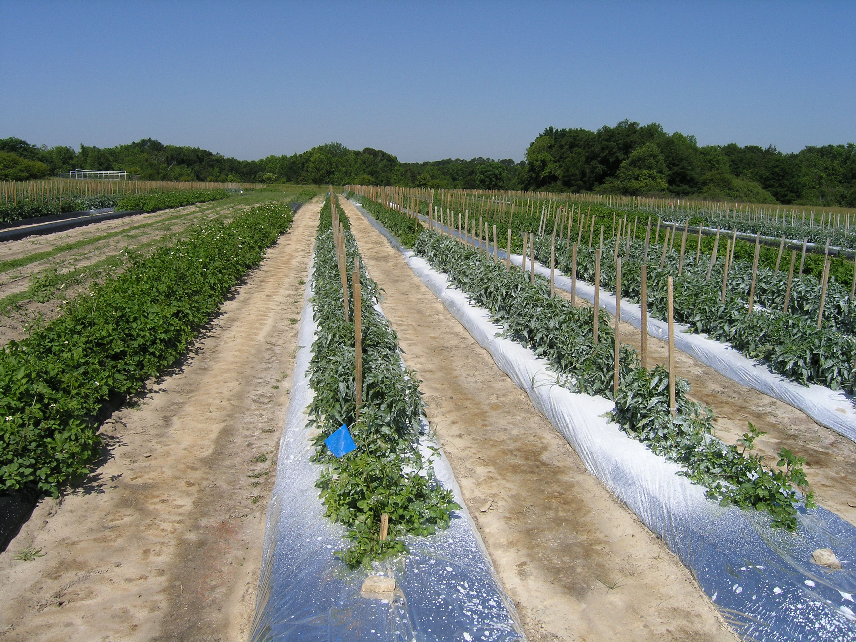
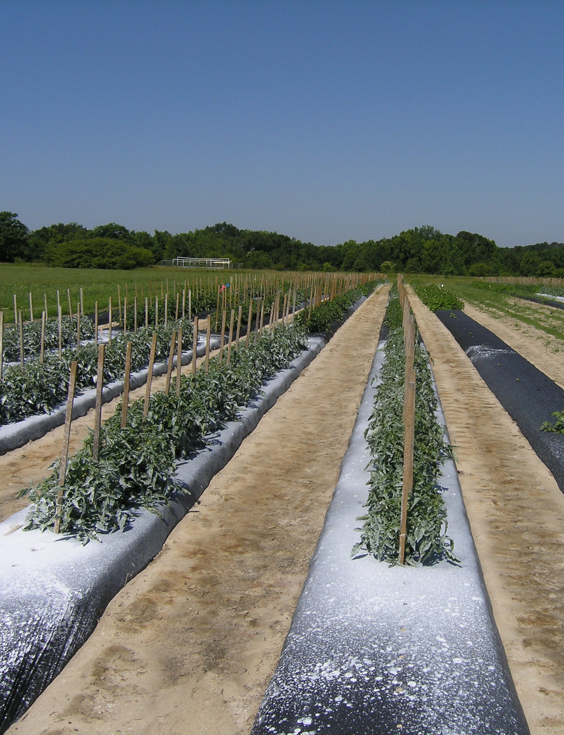
Kaolin + UV mulch
Kaolin + black mulch

Slide 2
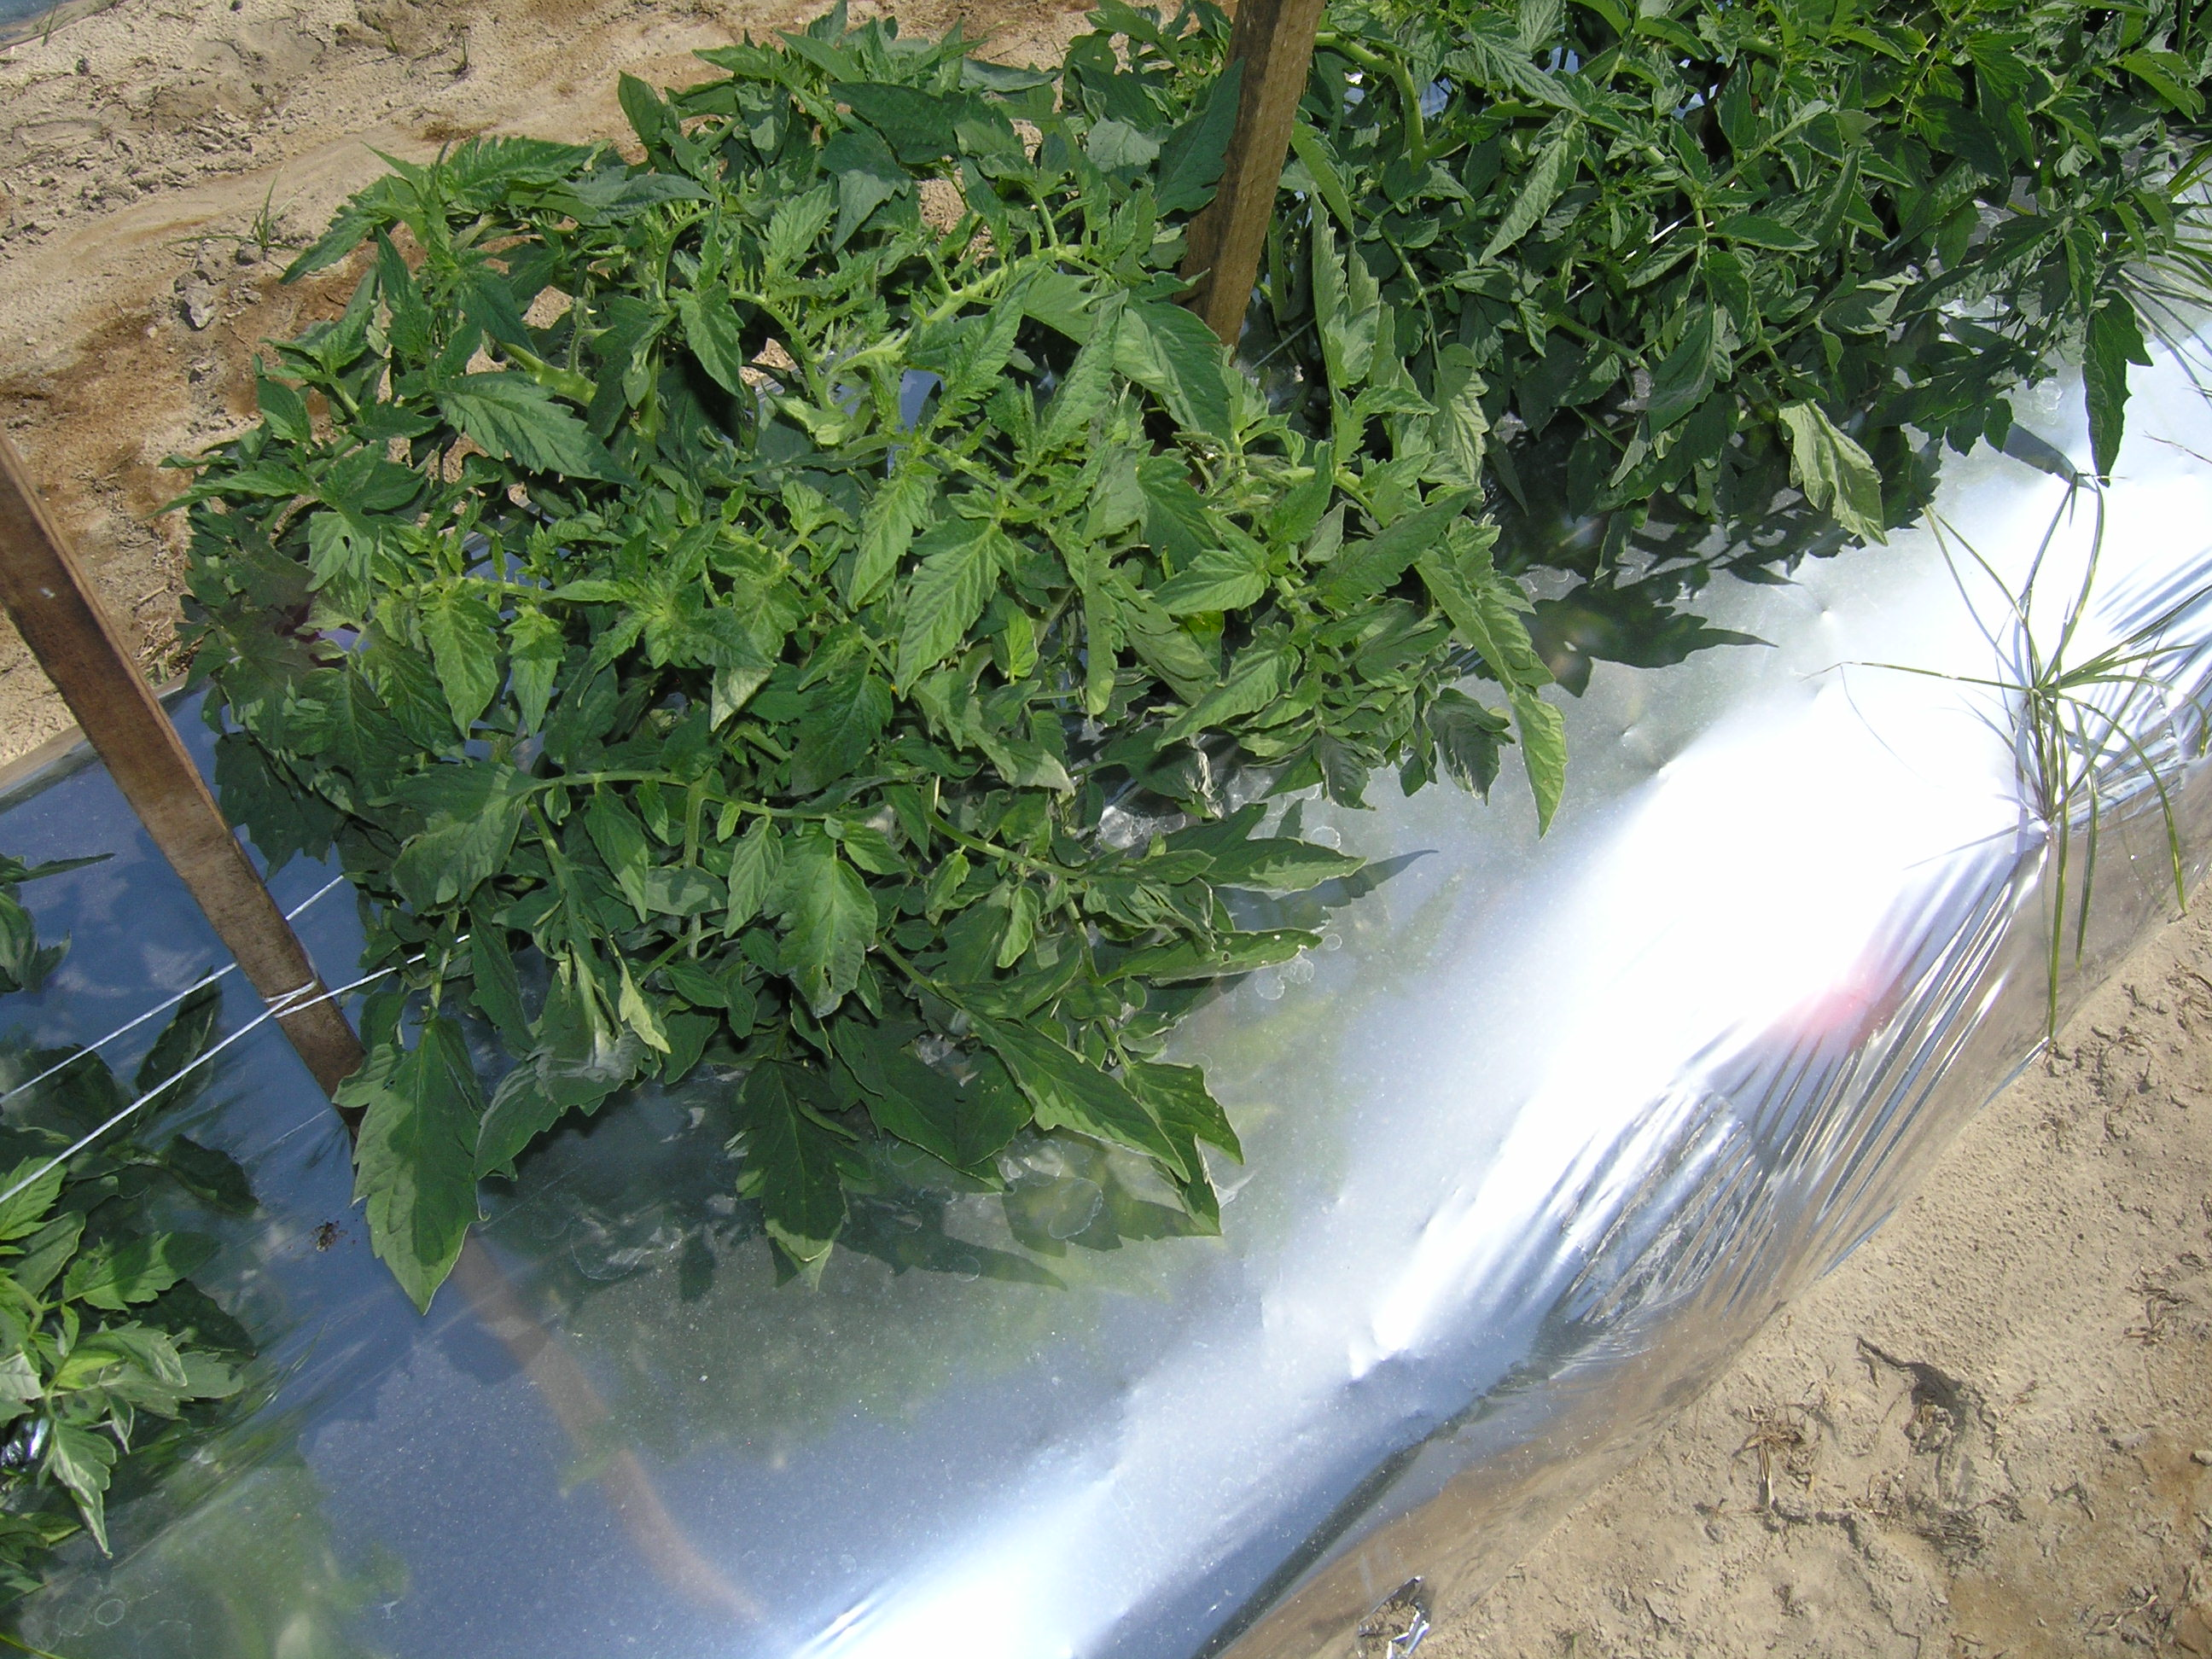
UV mulch, no kaolin

Slide 3
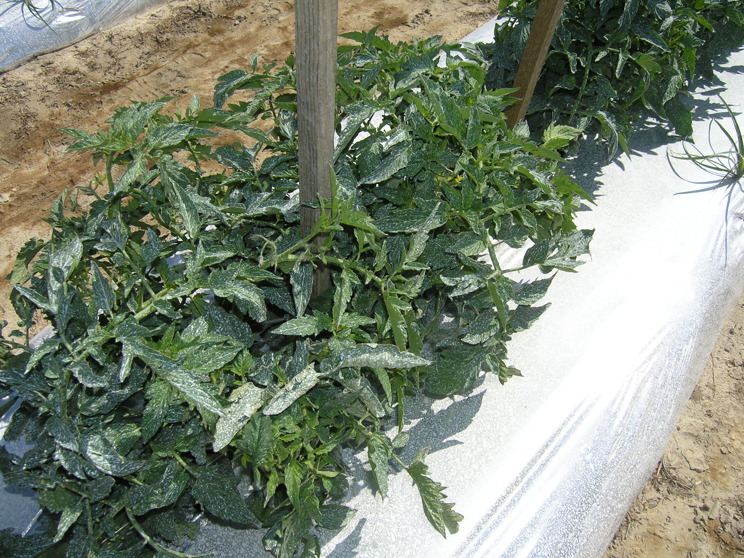
UV-mulch, kaolin

Slide 4
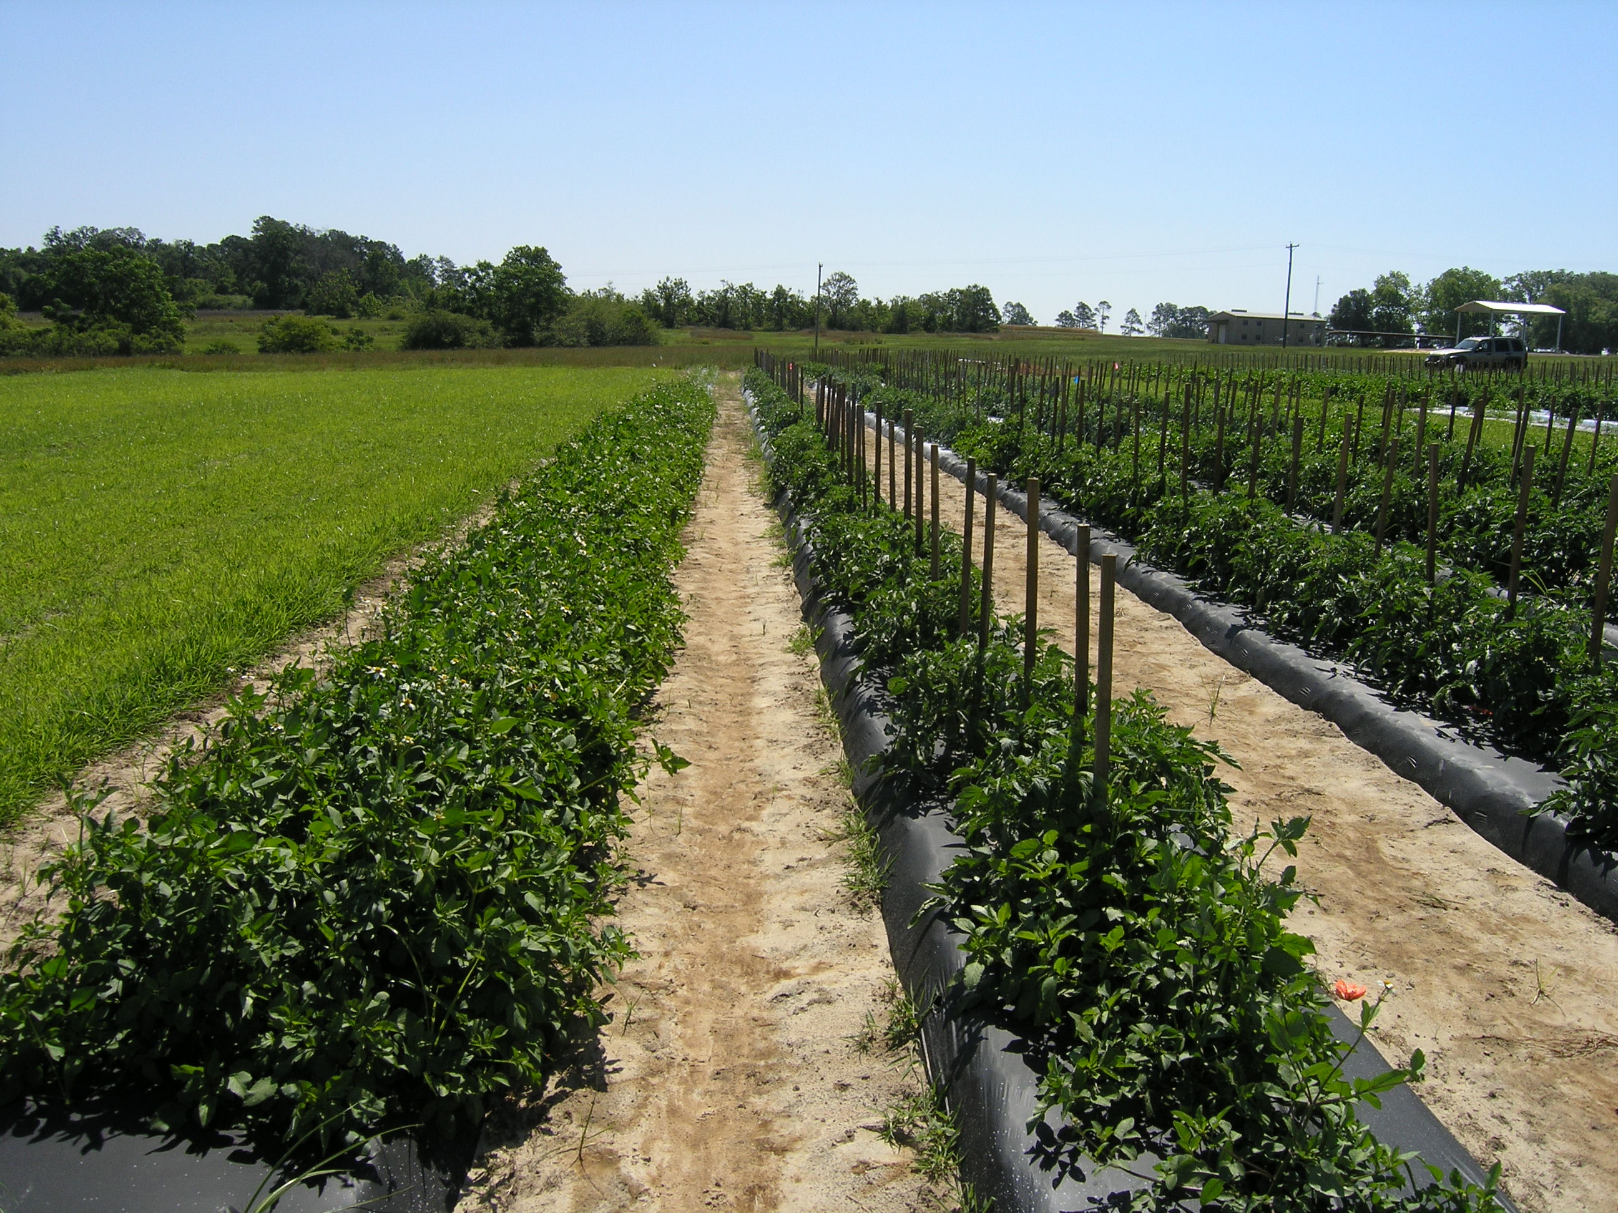
Black mulch, no kaolin, companion plants (first row on left)

Slide 5
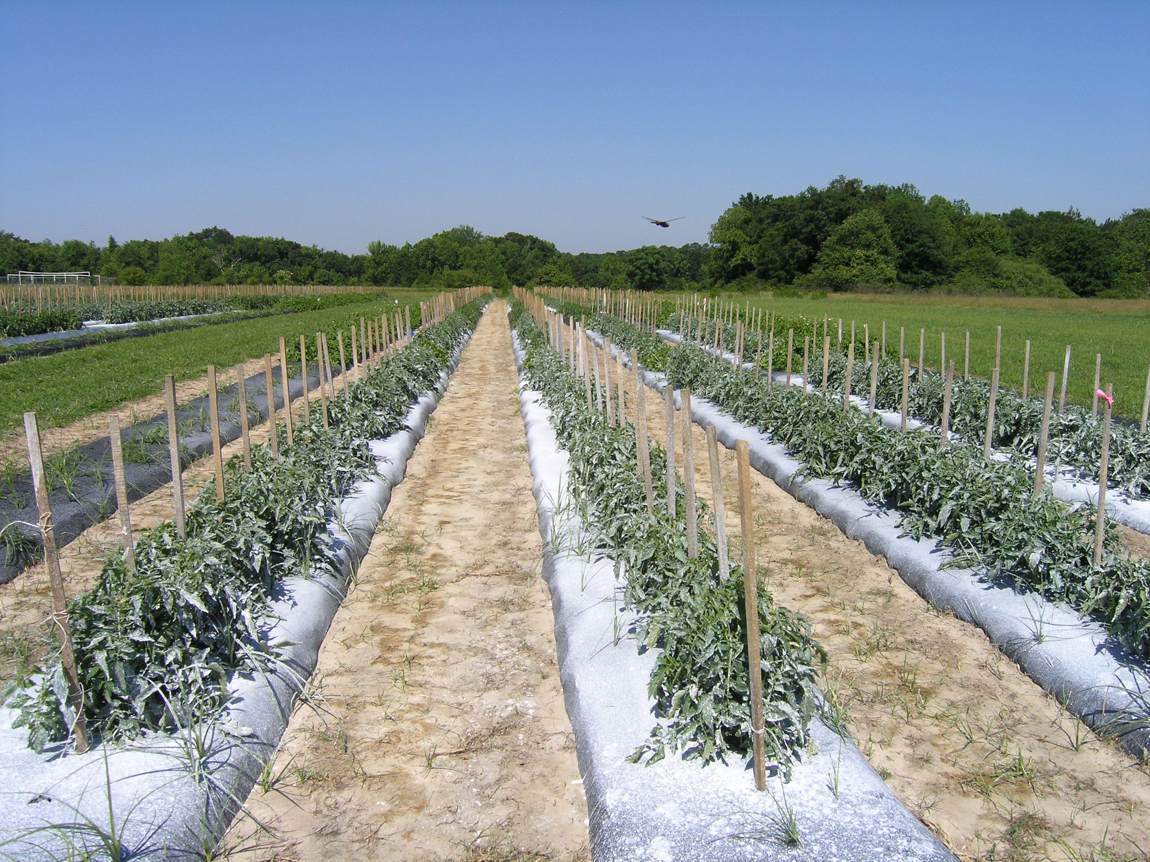
Black mulch, kaolin

Slide 6
UV-mulch, kaolin, companion plants (first row on left)

