Slide 1
Singh et al
Jove

Slide 2
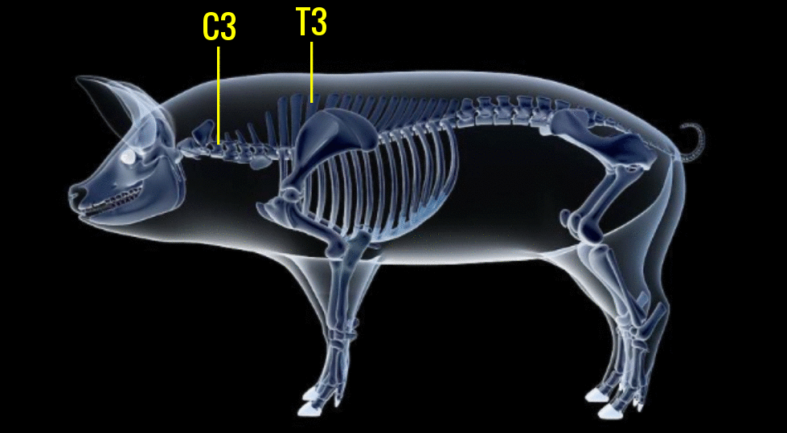
Cartoon 1

Slide 3
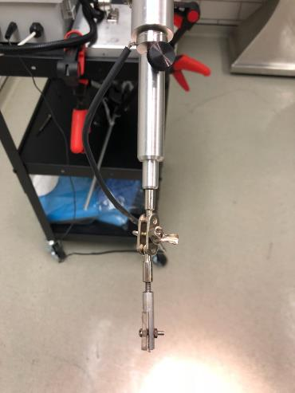
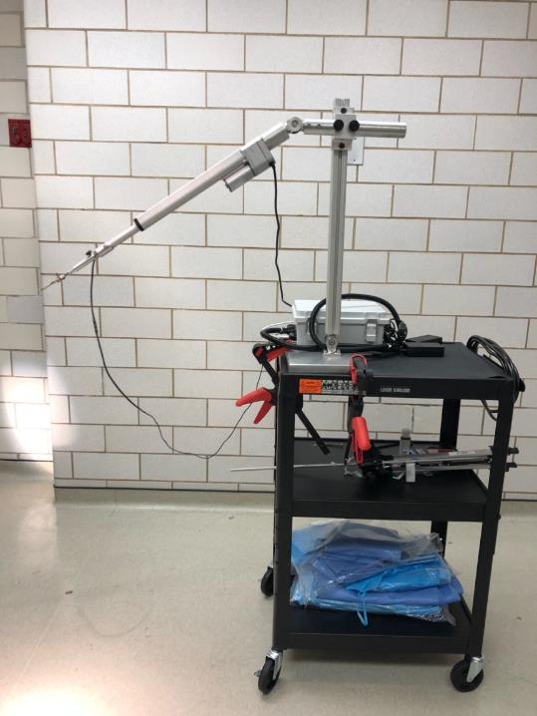
Cartoon 2
Actuator
Clamp
Load Cell
Control Box

