Slide 1
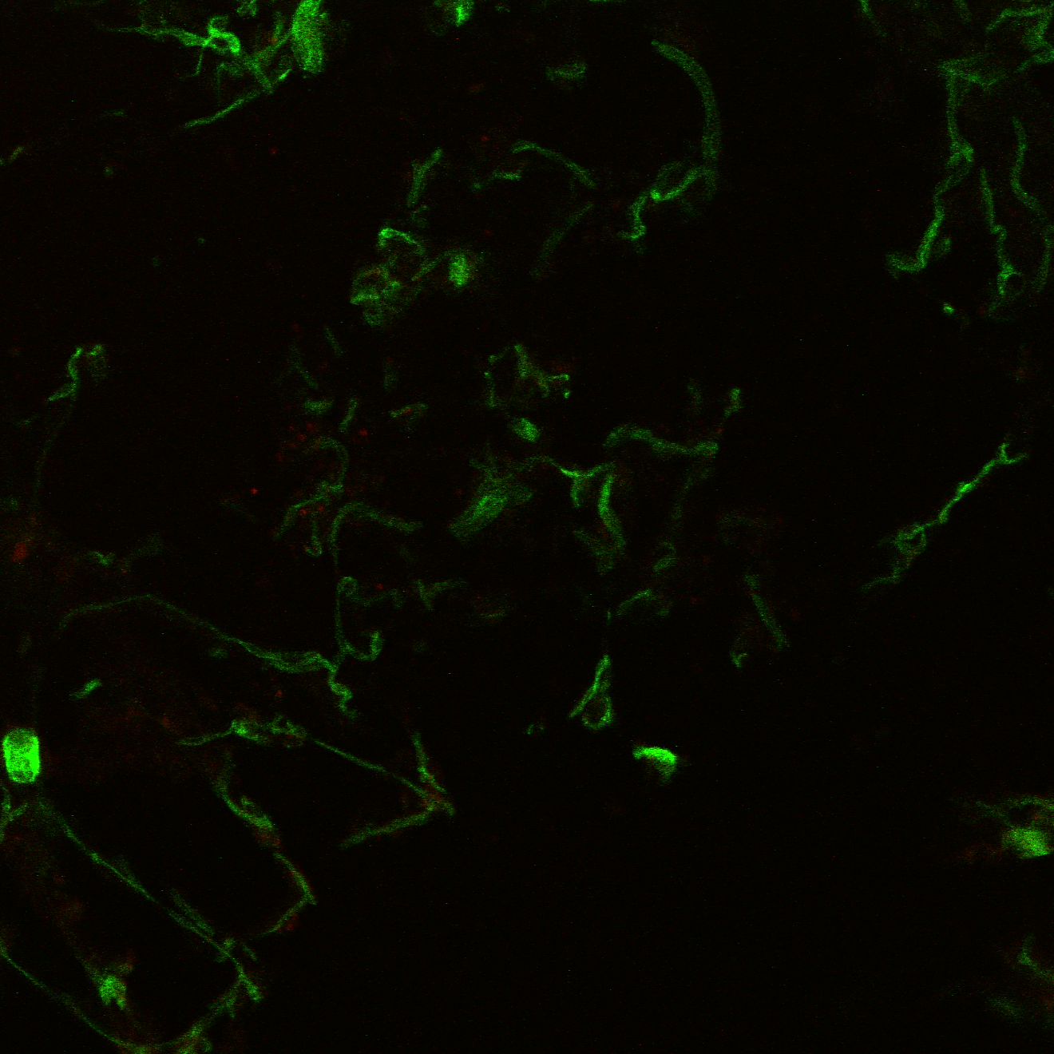
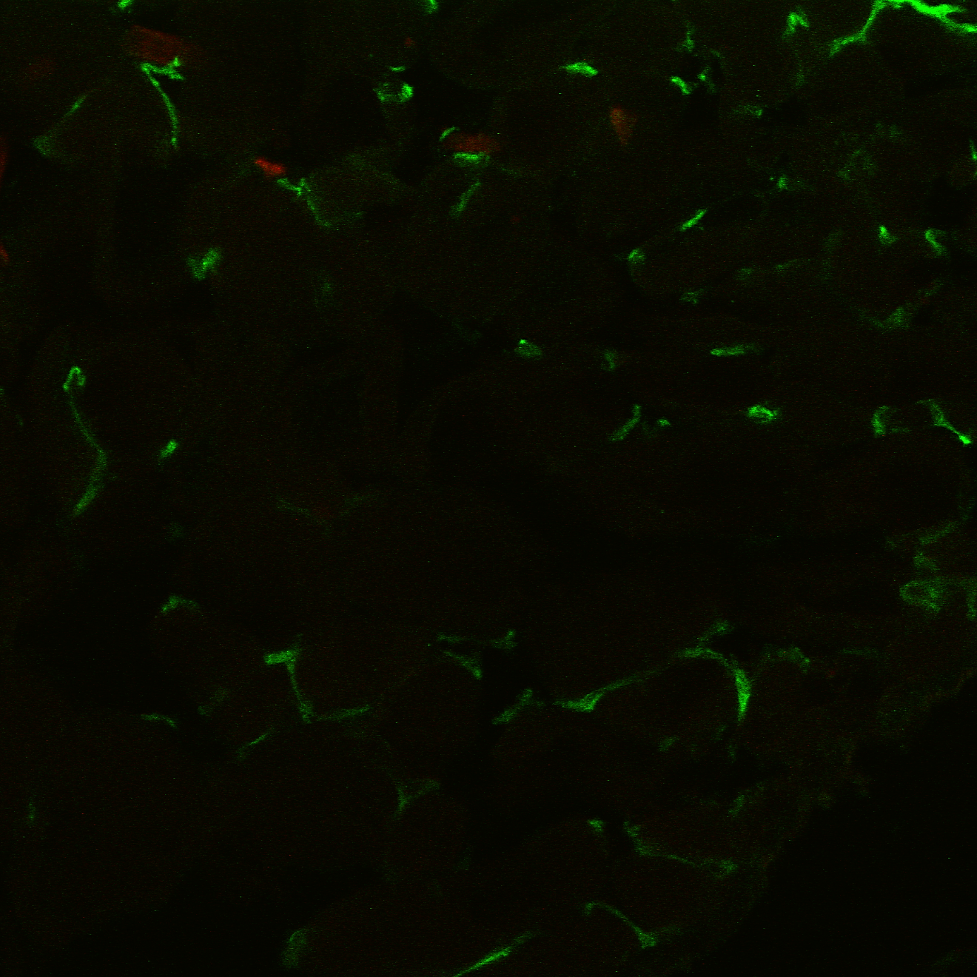
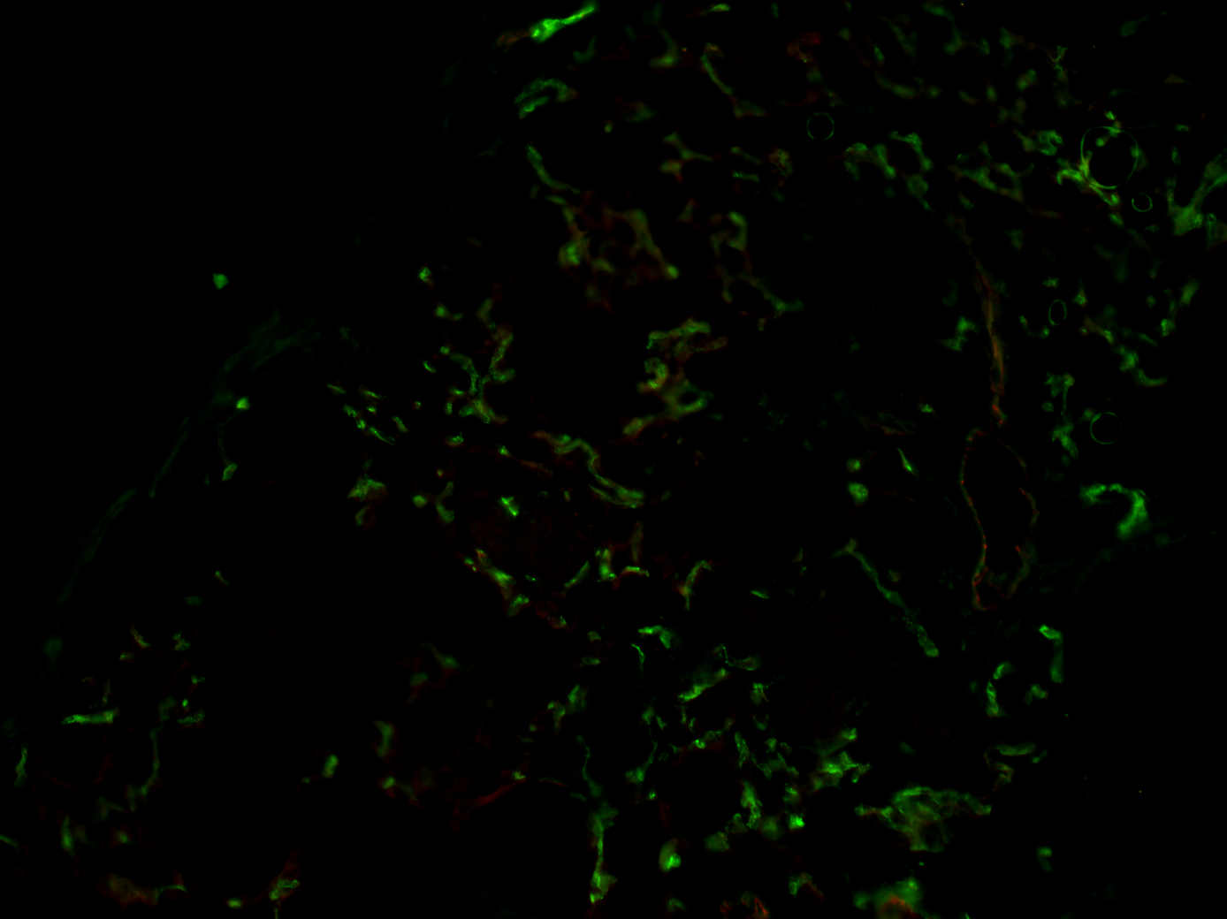
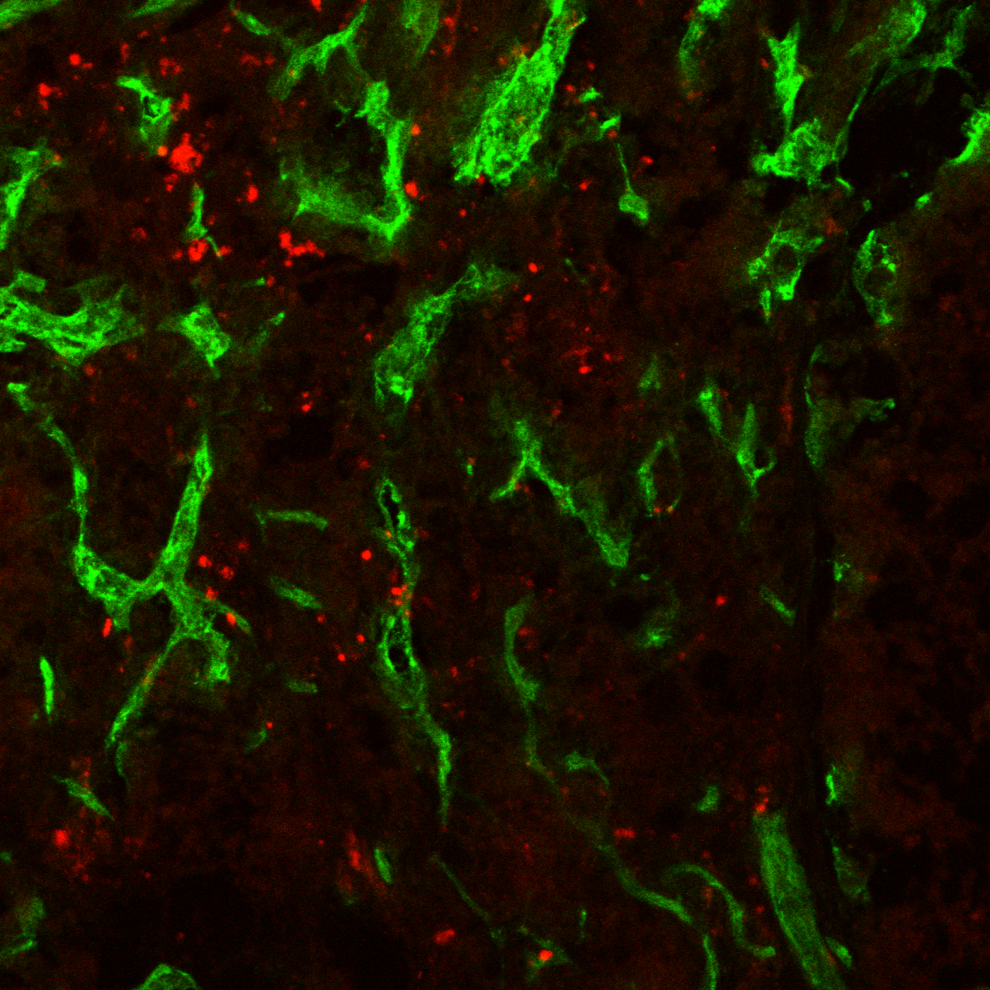
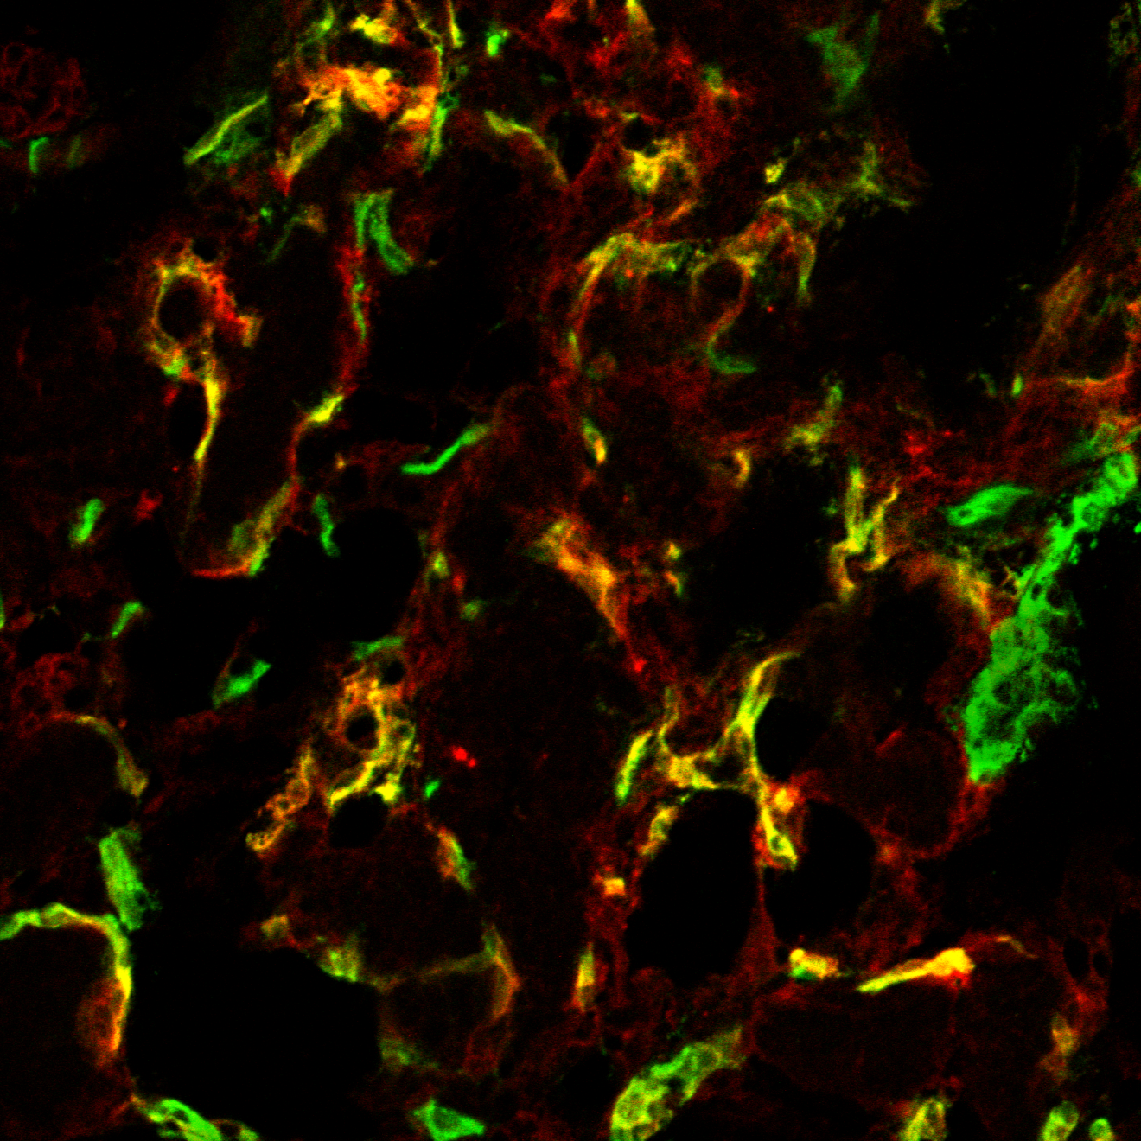
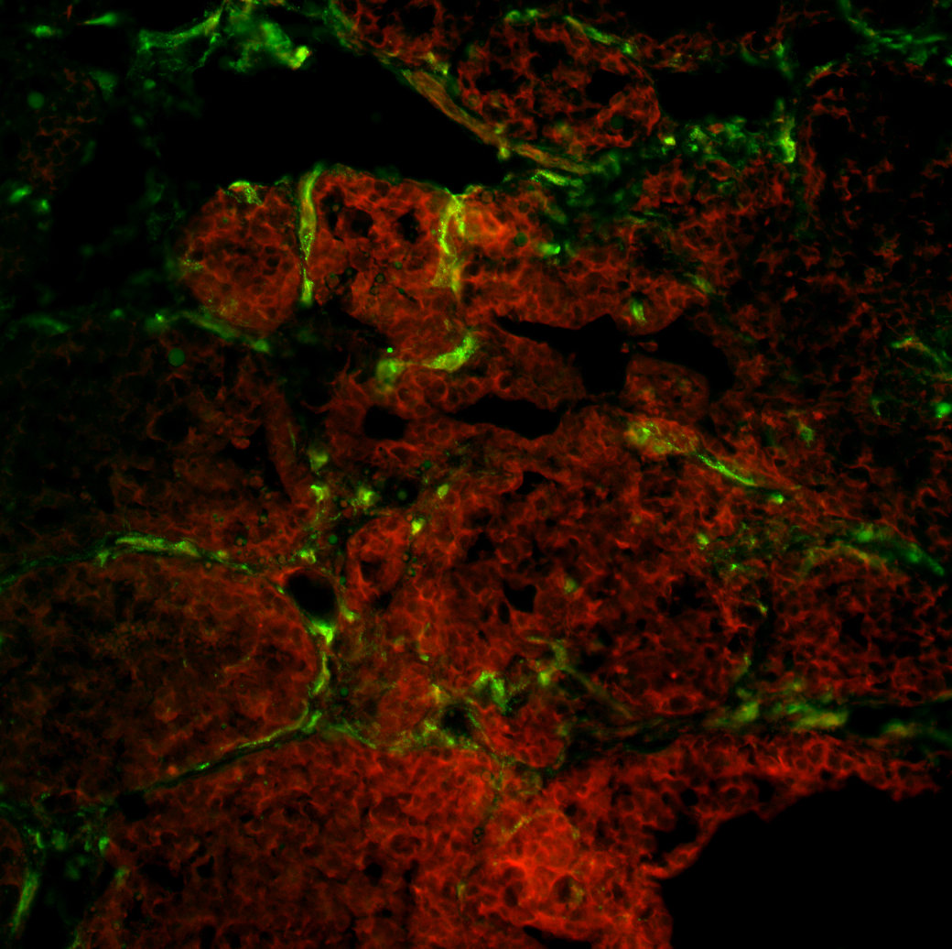
Scale Bar =100 µm
Figure 1. IVIL of B7-H3 Accumulation in Murine Mammary Glands
IVIL Method - Isotype
IVIL Method - Specific
Standard IF
Iso-Ab
CD31
B7-H3-Ab
CD31
B7-H3-Ab
CD31
Normal Mammary
Glands (20X)
Iso-Ab
CD31
B7-H3-Ab
CD31
B7-H3-Ab
CD31
Invasive Mammary
Tumors (20X)

