Slide 2
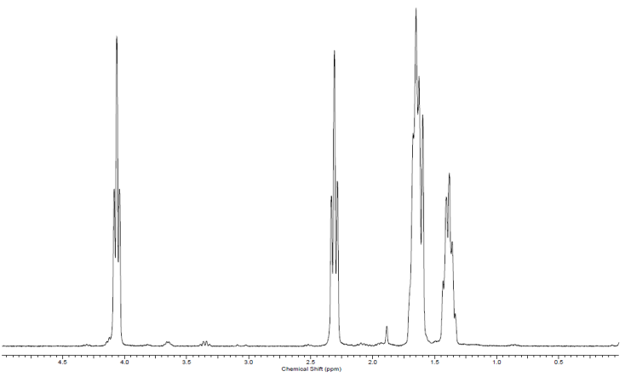

a)
b)
c)
d)
e)

Slide 3
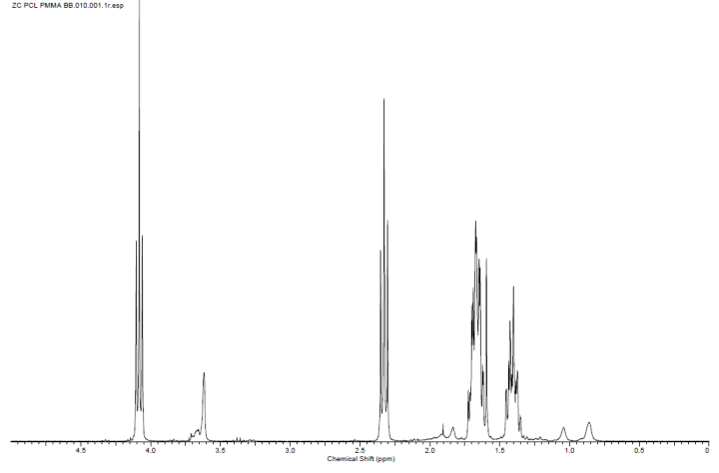
a)
b)
c)
d)

Slide 4
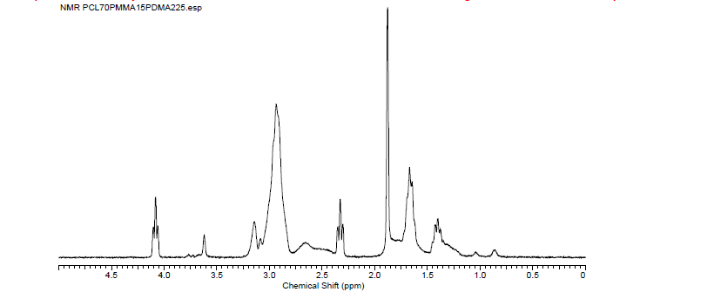
a)
b)
c)
d)

Slide 5
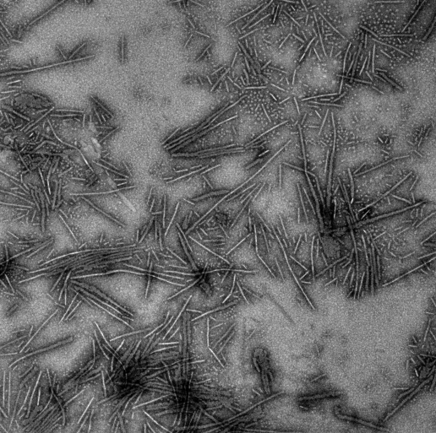
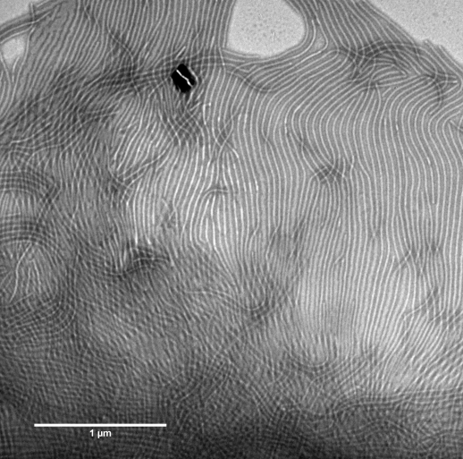
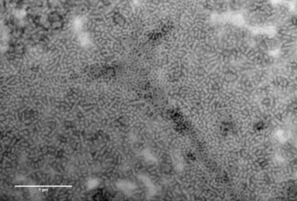
a)
b)
c)

Slide 6
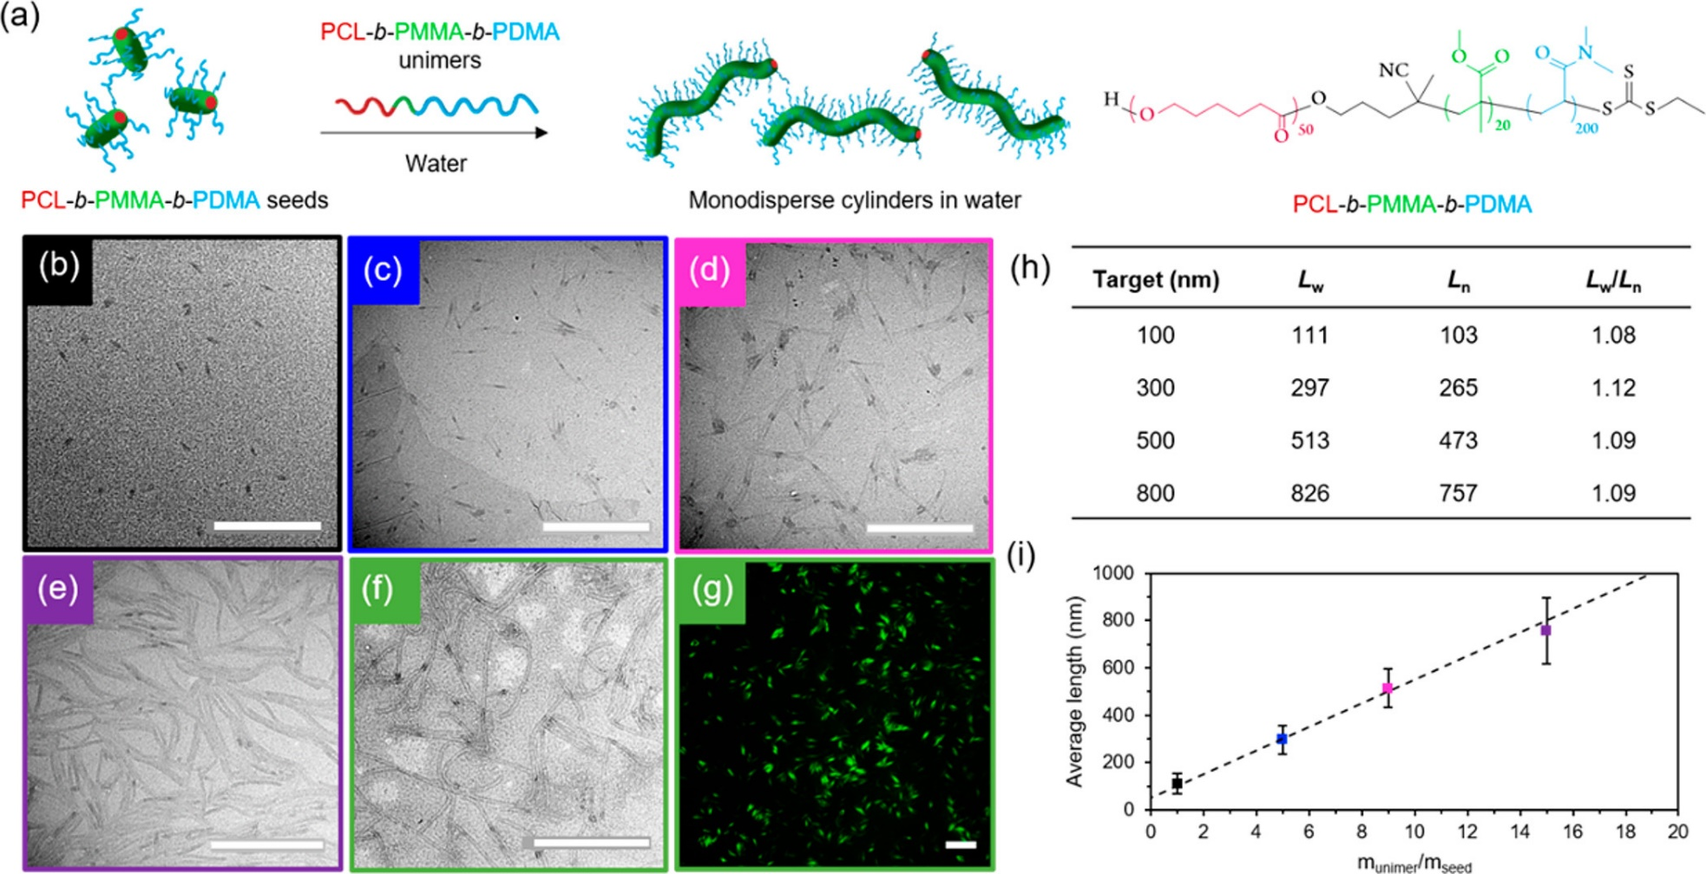
Figure 5: a) scheme depicting the sonication and living CDSA of the triblock copolymer, b-g) TEM images of the living CDSA up to 500 nm, h) the properties of the particles and i) the relationship between the average length of the micelles and seed/unimer mass ratio. Figure reproduced by from

Slide 7
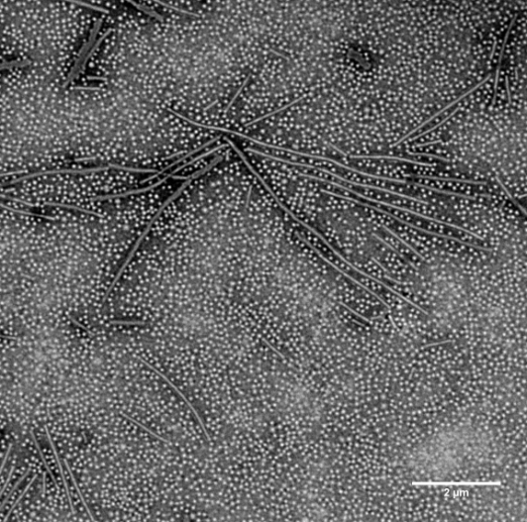
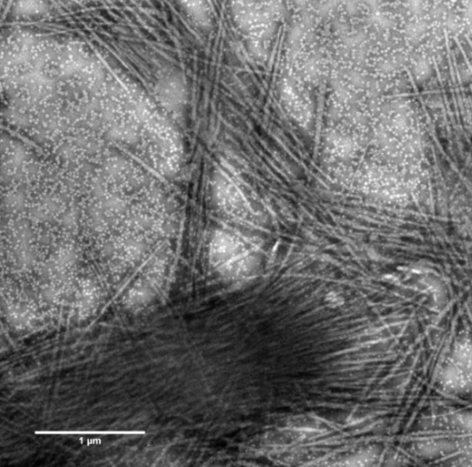
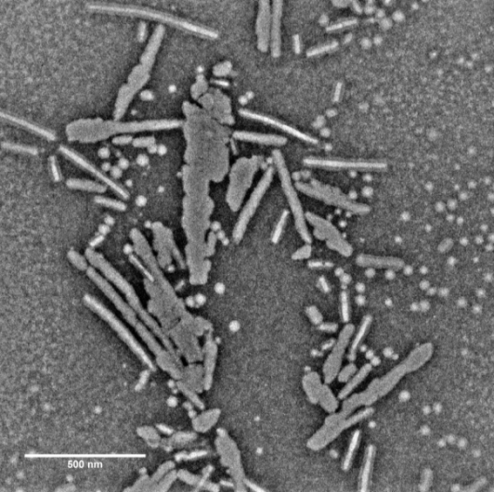
a)
b)
c)
Figure 6: TEM images of structures a) formed by CDSA of a triblock copolymer with a low molecular weight shoulder, b) formed by the incorrect sonication of long cylinders and c) formed by the addition of a high volume of common solvent to the seed dispersion.

