Slide 1






Lumen
Endothelium
Smooth muscle
Perivascular
adipose tissue
(PVAT)

Slide 2
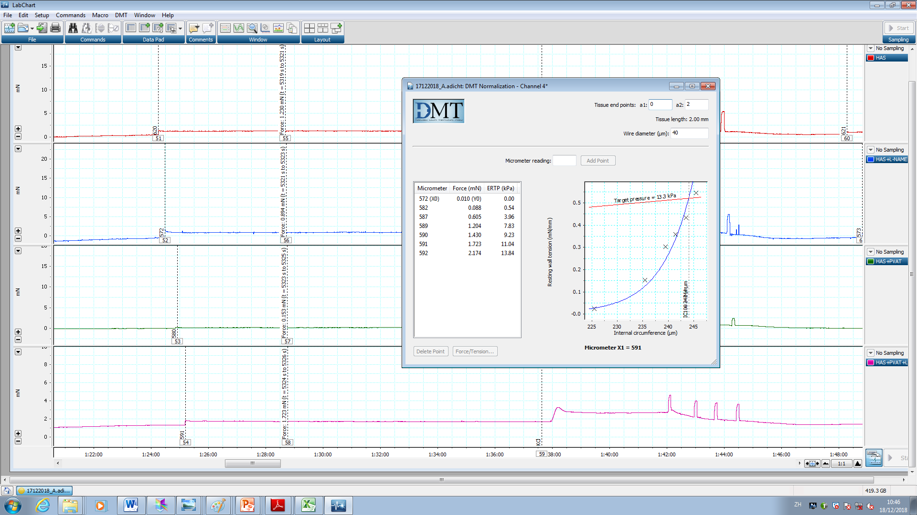
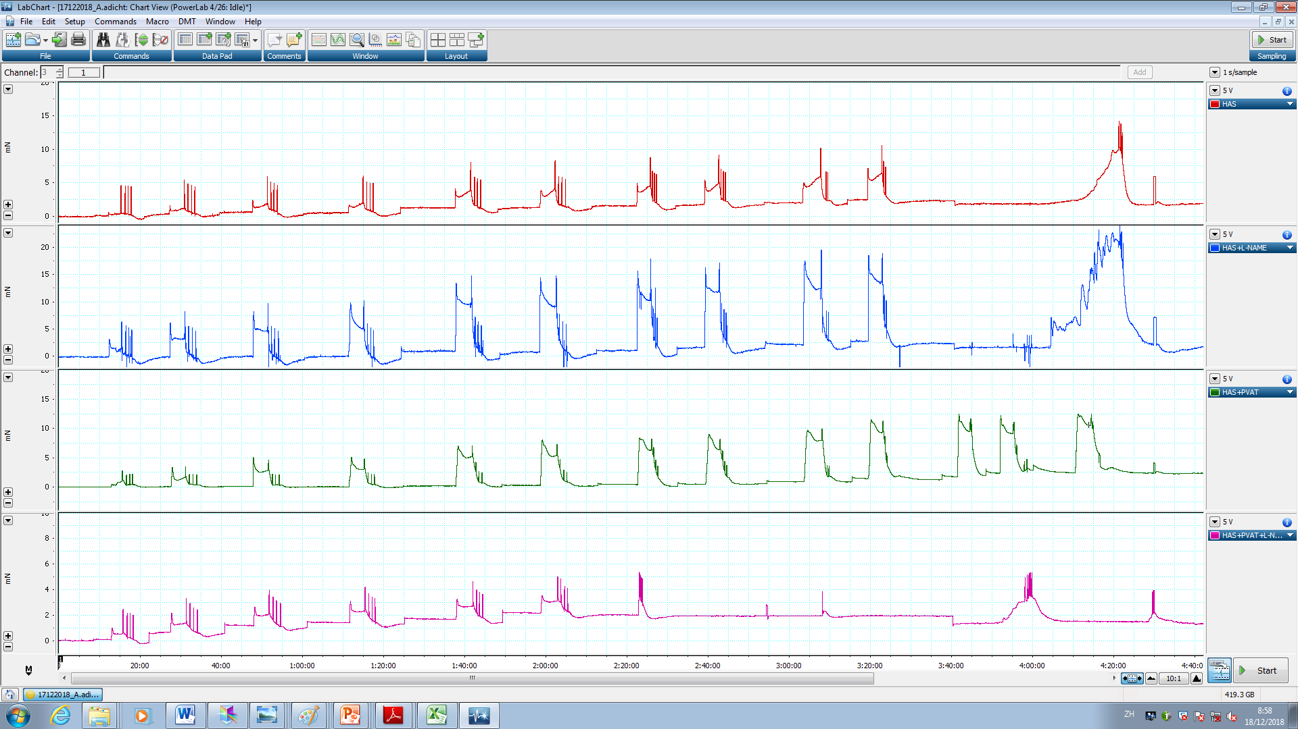
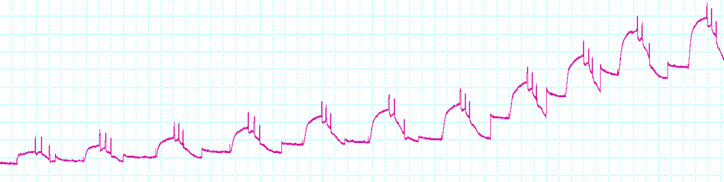
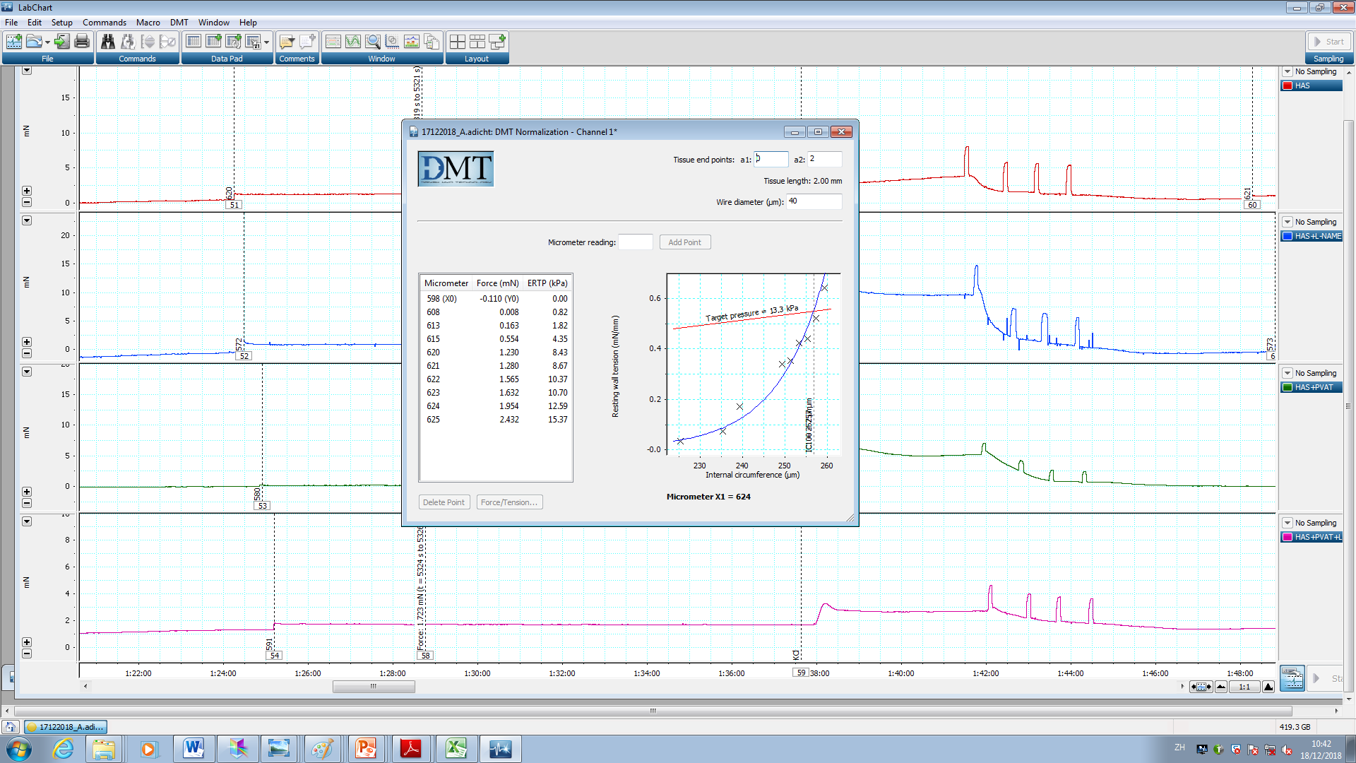
Passive Stretch
KCl stimulation
Target pressure= 13.3kPa
6
0.5
STC
0.4
IC1=243.6
IC100=244
k=0.998
4
0.3
Tension (mN)
Wall Tension (mN/mm)
0.2
2
0.1
0.0
0
225
230
235
240
245
5:00
20:00
35:00
50:00
Internal Circumference (IC), μm
(minutes)
0.5
Target pressure= 13.3kPa
6
0.4
HFD
IC1=260.6
IC100=261
k=0.998
4
0.3
Wall Tension (mN/mm)
Tension (mN)
0.2
2
0.1
0
0.0
245
250
255
260
5:00
20:00
35:00
50:00
Internal Circumference (IC), μm
(minutes)

Slide 3
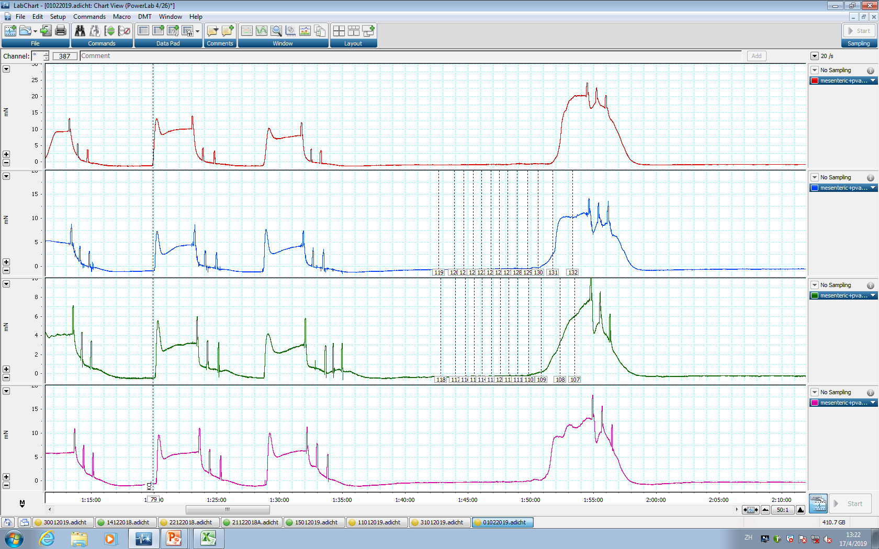
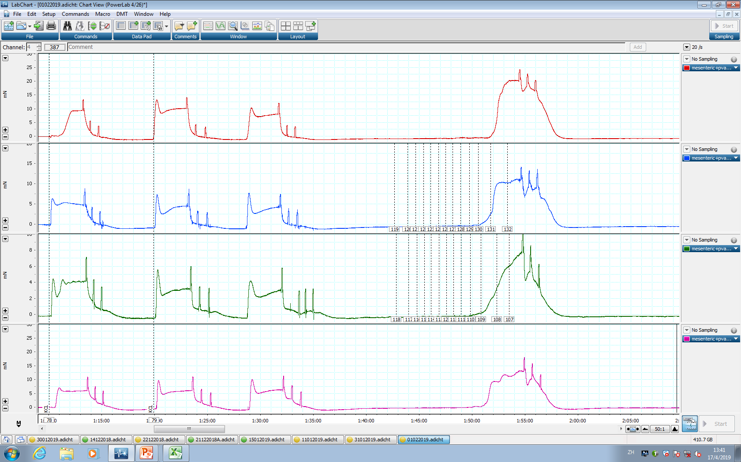
A
-PVAT
B
6
-4.5
-4
Emax
4
Phenylephrine (logM)
-5
200
-5.5
-
-PVAT
150
2
-6
Tension (mN)
Change in tension
(% of KCl contraction)
-9.5
-9
-8.5
-7.5
100
-10
-8
-7
-6.5
+PVAT
0
60:00
70:00
80:00
90:00
50
(minutes)
0
KCl stimulation
-10
-9
-8
-7
-6
-5
-4
Wash out
C
+PVAT
Phenylephrine (logM)
4
-4.5
-5
Tension (mN)
-5.5
-4
2
-6
-10
-9.5
-8.5
-7.5
-9
-8
-7
-6.5
0
60:00
70:00
80:00
90:00
(minutes)

Slide 4
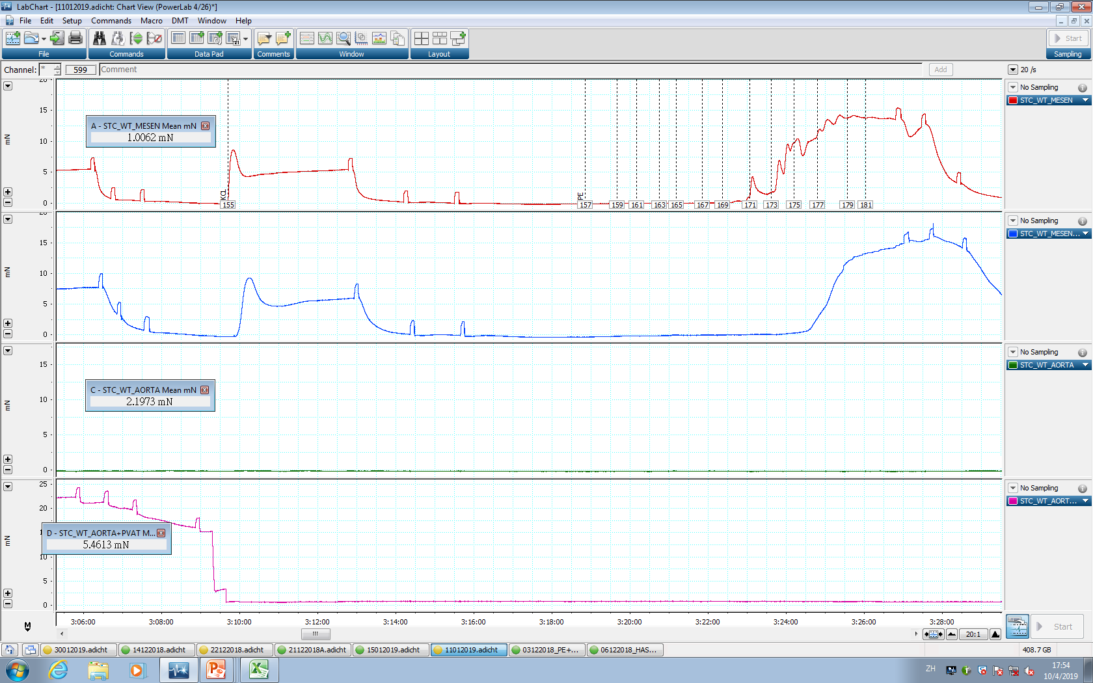
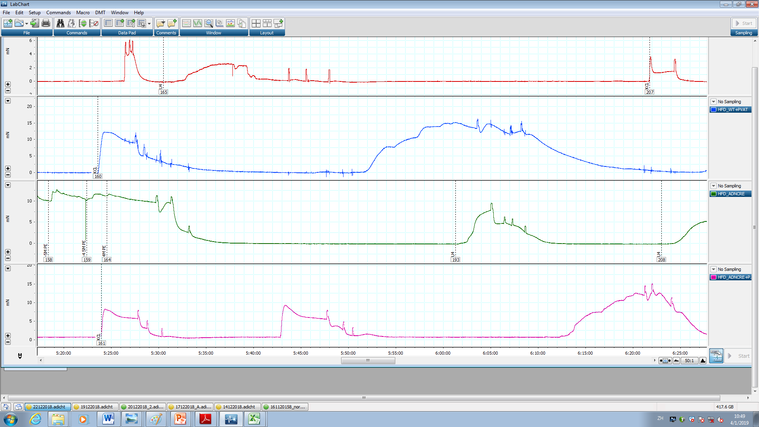
A
KCl stimulation
-4
6
Wash out
-4.5
-4
-5
6
Phenylephrine (logM)
-4.5
Phenylephrine (logM)
-5.5
-5
4
4
-5.5
-6
Tension (mN)
-6
Tension (mN)
-6.5
2
L-NAME
-6.5
2
-9.5
-8.5
-7.5
-10
-9
-8
-7
-10
-9
-7
-9.5
-8
30mins
-8.5
-7.5
0
0
65:00
75:00
85:00
95:00
65:00
105:00
125:00
145:00
(minutes)
(minutes)
B
500
C
-PVAT/+L-NAME
400
1000
-PVAT/-L-NAME
300
800
Change in tension
+PVAT/+L-NAME
(% of KCl Contraction)
600
200
AUCC
(Arbitrary units)
100
+PVAT/-L-NAME
400
0
200
-9
-8
-7
-6
-5
-4
0
-100
Phenylephrine (logM)
PVAT
L-NAME
- - + +
- + - +

Slide 5
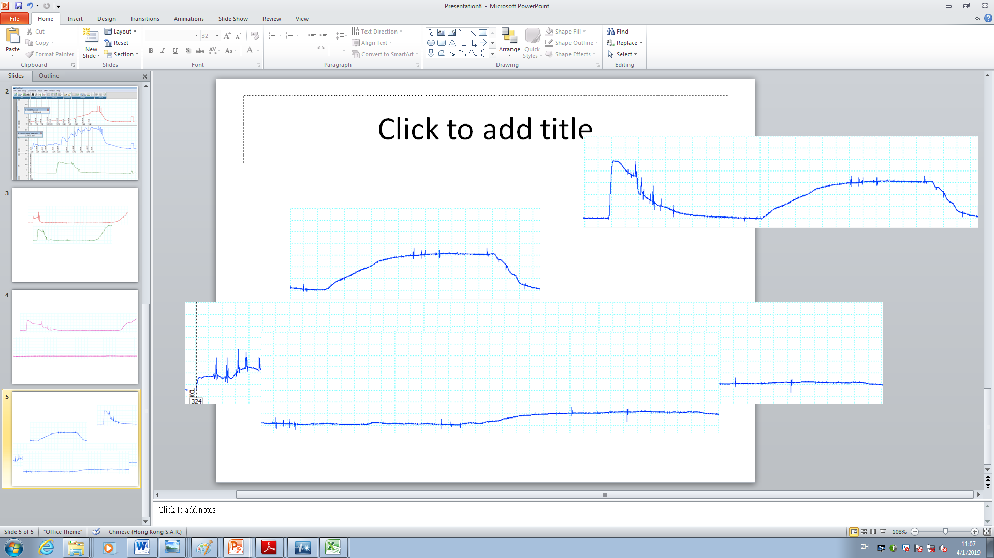
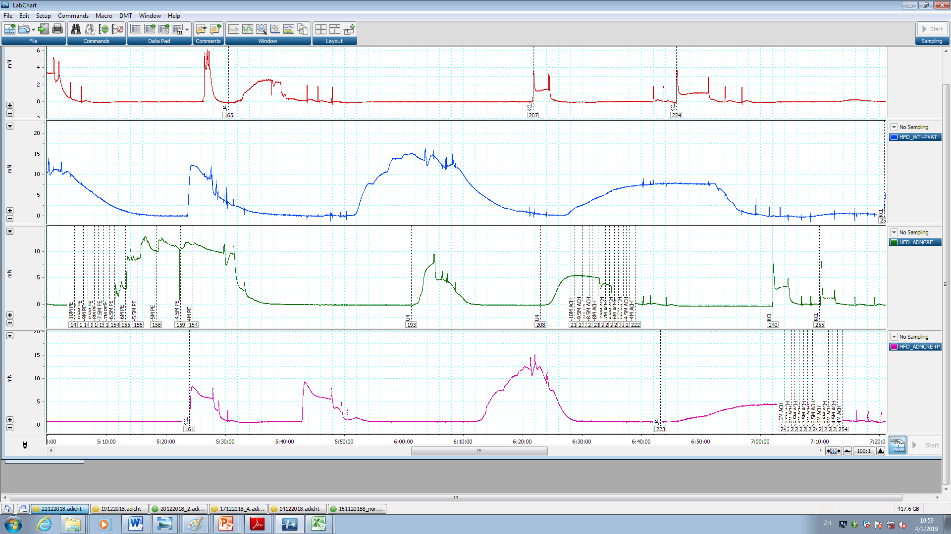
A
KCl stimulation
Wash out
Acetylcholine (logM)
6
-9.5
-9
-8.5
-10
-8
-7.5
-7
4
U46619
-6.5
Tension (mN)
-6
-5.5
-5
2
-4.5
-4
0
60:00
70:00
80:00
100:00
(minutes)
B
C
Acetylcholine (logM)
-10
-9
-8
-7
-6
-5
-4
400
0
20
+PVAT/+L-NAME
300
40
200
-PVAT/+L-NAME
(Arbitrary units)
Change in tension
AARC
60
(% of KCl Contraction)
80
100
100
+PVAT/-L-NAME
-PVAT/-L-NAME
120
0
PVAT
-
-
+
+
L-NAME
-
+
-
+

Slide 6
A
200
-L-NAME
+L-NAME
150
100
Change in tension
(% of KCl contraction)
ΔAUCC
50
0
-9
-8
-7
-6
-5
Phenylephrine (log M)
B
Acetylcholine (log M)
200
-9
-8
-7
-6
-5
0
150
AARC
Arbitrary units
25
ΔAARC
Change in tension
(% of U41699 contraction)
100
50
75
50
100
0
-L-NAME
+L-NAME
ΔAARC
C

