Slide 1
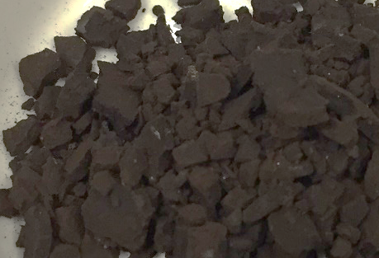
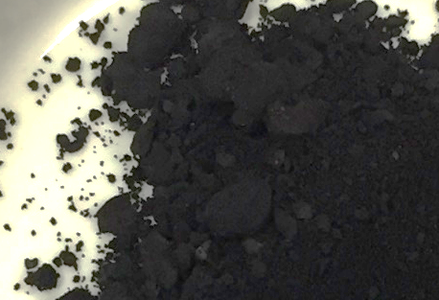

HTC
275 ⁰C
STEP 1
STEP 2

