Slide 1
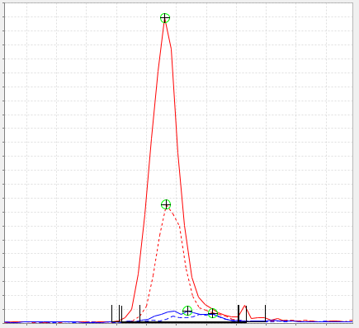
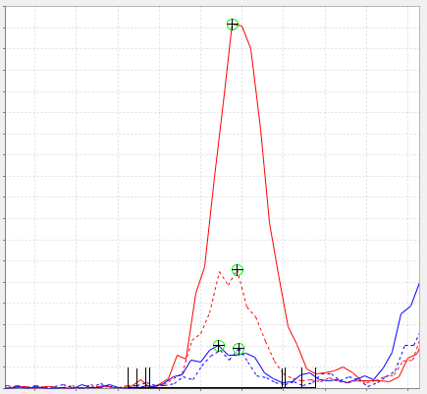
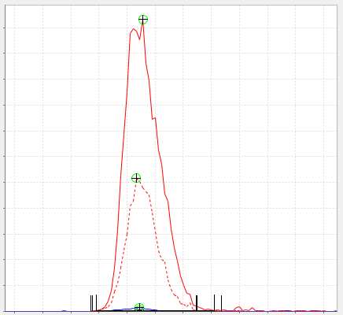
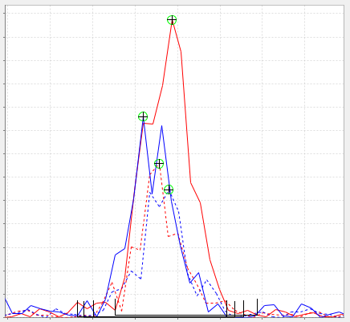
A
B
23,000
Gluconic acid
4,500
G6P
Intensity
Intensity
0
7.75
Time (min)
8.25
0
9.40
Time (min)
9.85
C
D
55,000
6PG
650
NADP+
Intensity
Intensity
0
0
14.0
Time (min)
15.1
9.05
Time (min)
9.35

