Slide 1
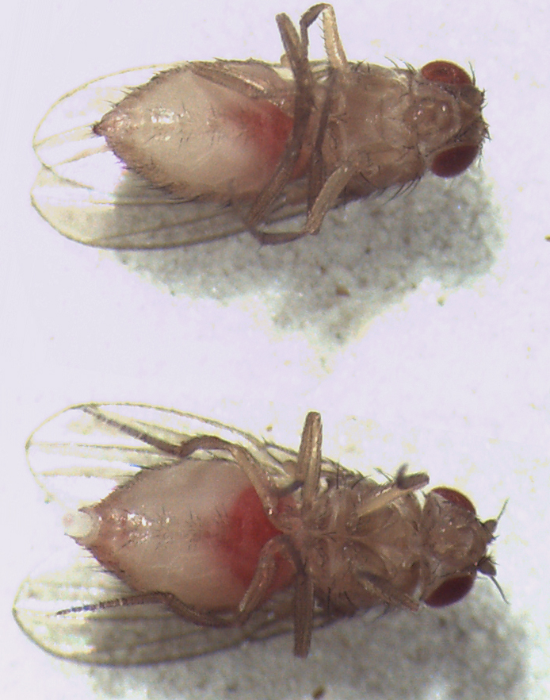
Feeding Assay
Isogenic Stock
Medium +
EDC
Feed 1 Day
inspect
Medium + solvent
(control)

