Slide 1
R26Y
Trp53^{L}
WT
WT
Homo
Homo
WT
WT
Homo
Homo
500bp
370bp
250bp
288bp
Figure 1: Representative PCR genotyping results for the R26Y and Trp53^{L} alleles. WT = wild-type; Homo = homozygote.

Slide 2
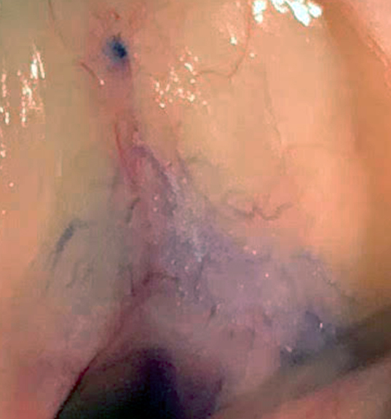
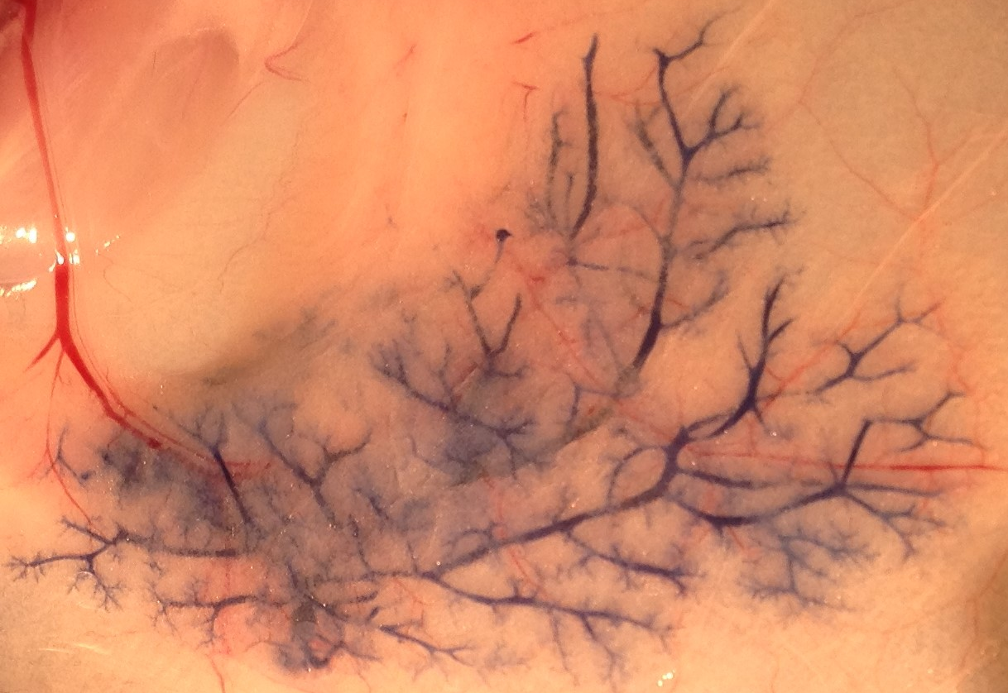
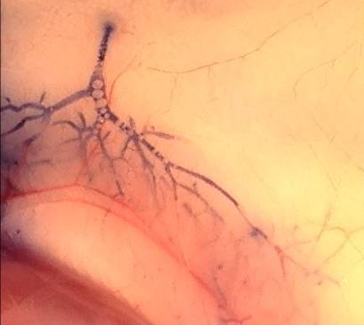
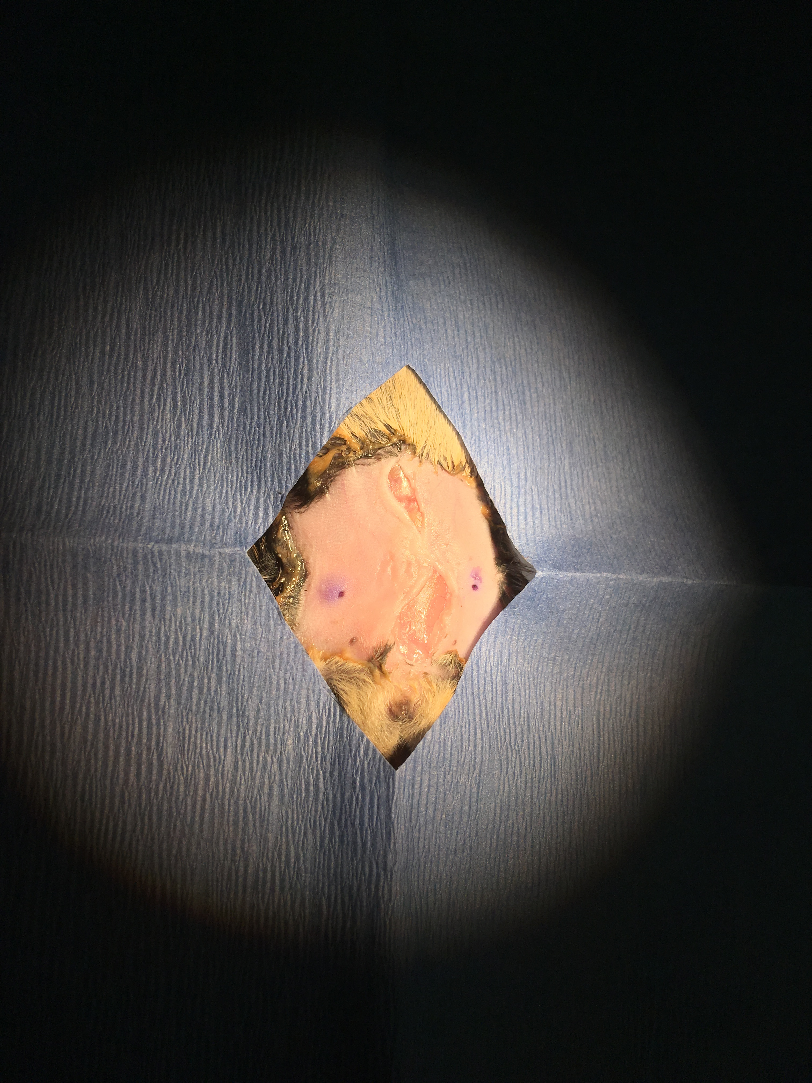
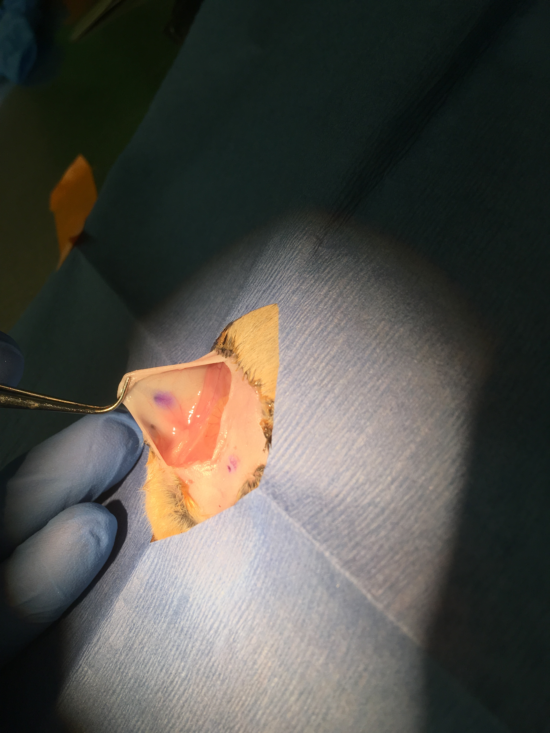
A
C
Nipple
Stroma
Ducts
Figure 4: Visualization of a successful intraductal injection into the entire mammary ductal tree. (A) An example of the intraductal injection of 3 µL of injection mixture (with bromophenol blue) into an MG of a 3-week-old female mouse. (B) Intraductal injection of 5 µL of injection mixture into an MG of a young adult female mouse. (C) Intraductal injection of 10 µL of injection mixture into an MG of a female mouse at early/mid-gestation. (D) An example of a mammary fat pad injection rather than a successful intraductal injection. Intraductal injection of 5 µL of injection mixture into an MG of a young adult female mouse. (a) The skin area surrounding the injected nipple; (b) The other side of the skin flap showing the mammary fat pad; yellow circle indicates dye diffused into the fat pad.
Blood vessel
Ducts
Blood vessel
B
Nipple
D (a)
D (b)
Nipple
Ducts
Stroma
Blood vessel
Blood vessel
Nipple

