Slide 1
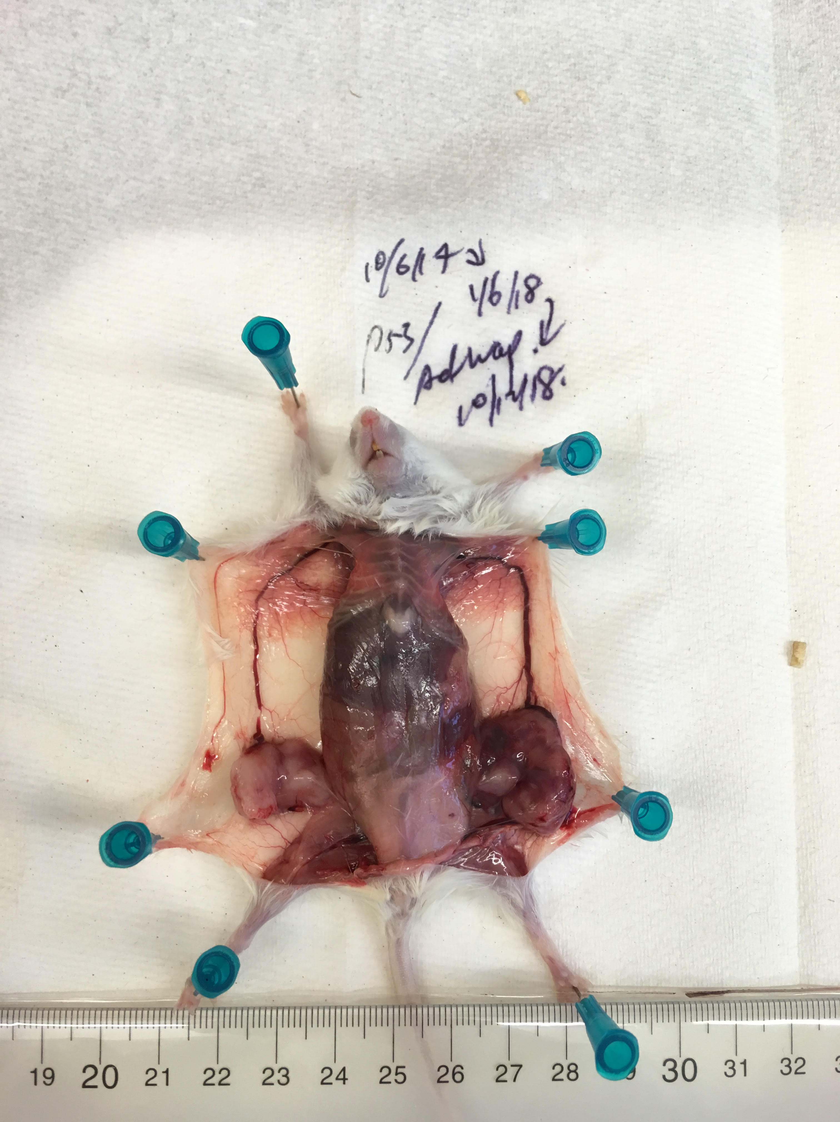
YFP+
8.8%
Notes:
1 cm

