Slide 1
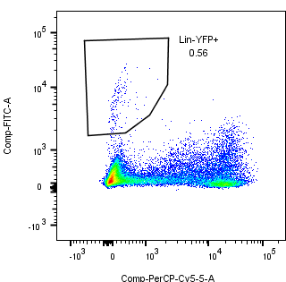
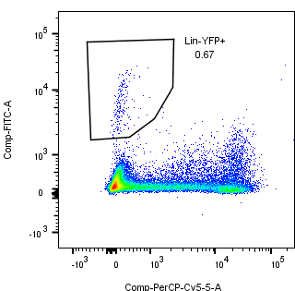
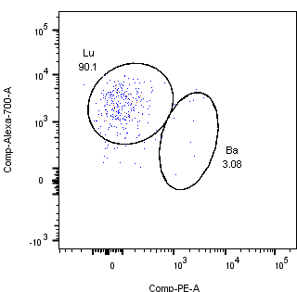
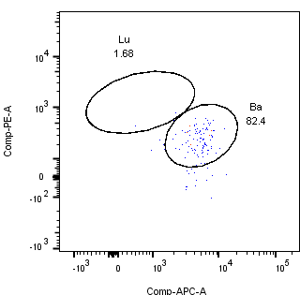
Ad-K8-Cre
Ad-K5-Cre
YFP+ 0.56%
YFP+ 0.67%
YFP
Lineage
Lu 90.1%
Ba 82.4%
CD24
CD29

