Slide 1
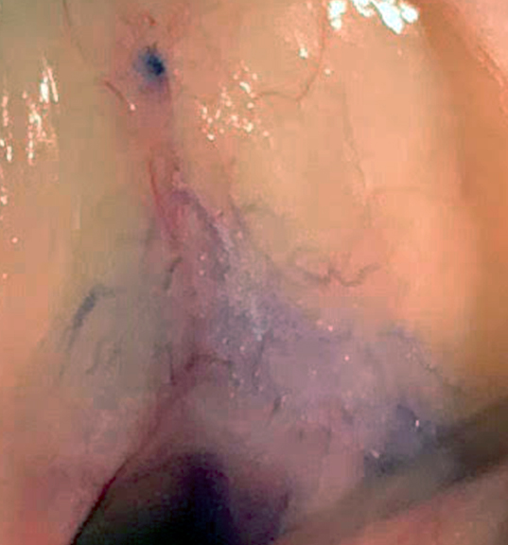
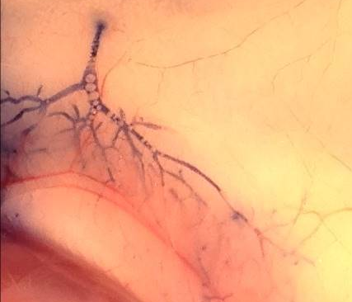
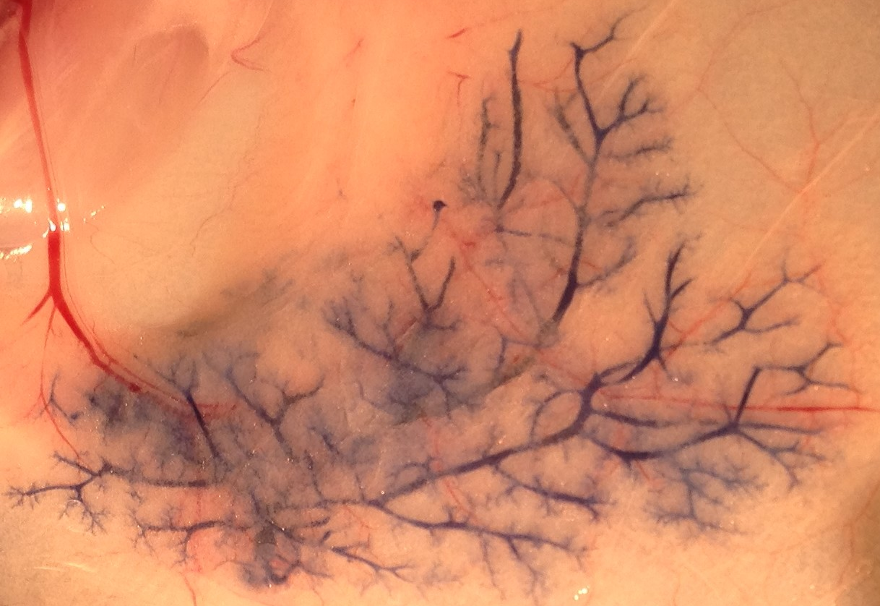
Nipple
Nipple
Stroma
Ducts
Blood vessel
Ducts
Ducts
Blood vessel
Stroma
Blood vessel
0.1 cm
0.1 cm
1 cm
Notes:
1 cm

