Slide 1
Exp. 1 Animation
Notes:
In this experiment, we use TTX and Cd2+ to block action potential and Ca2+-dependent vesicular release.

Slide 2
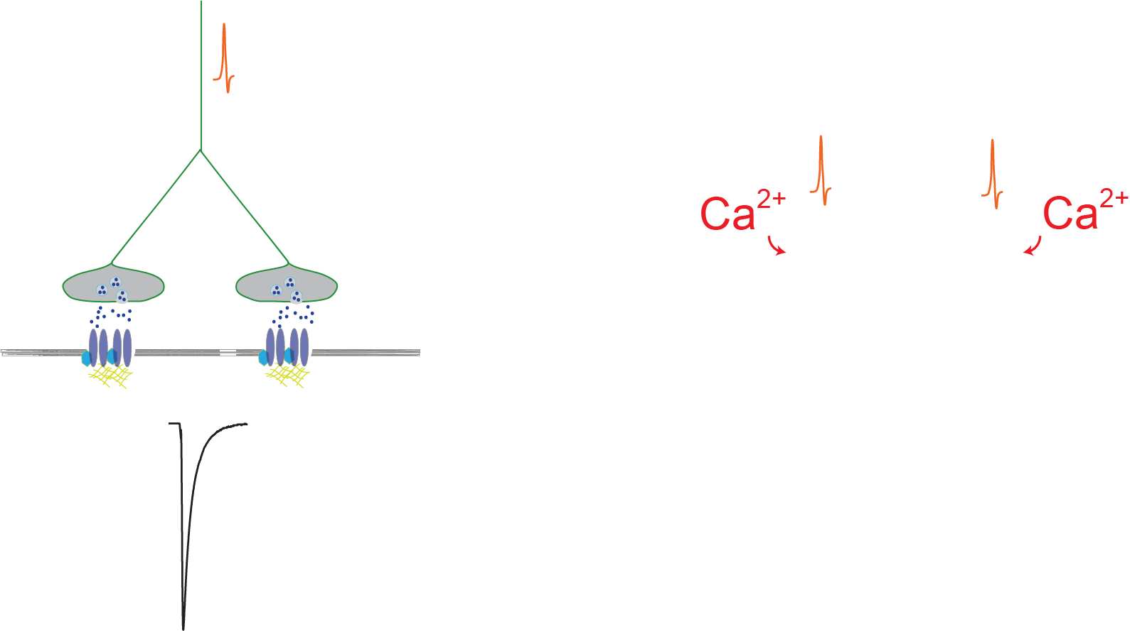
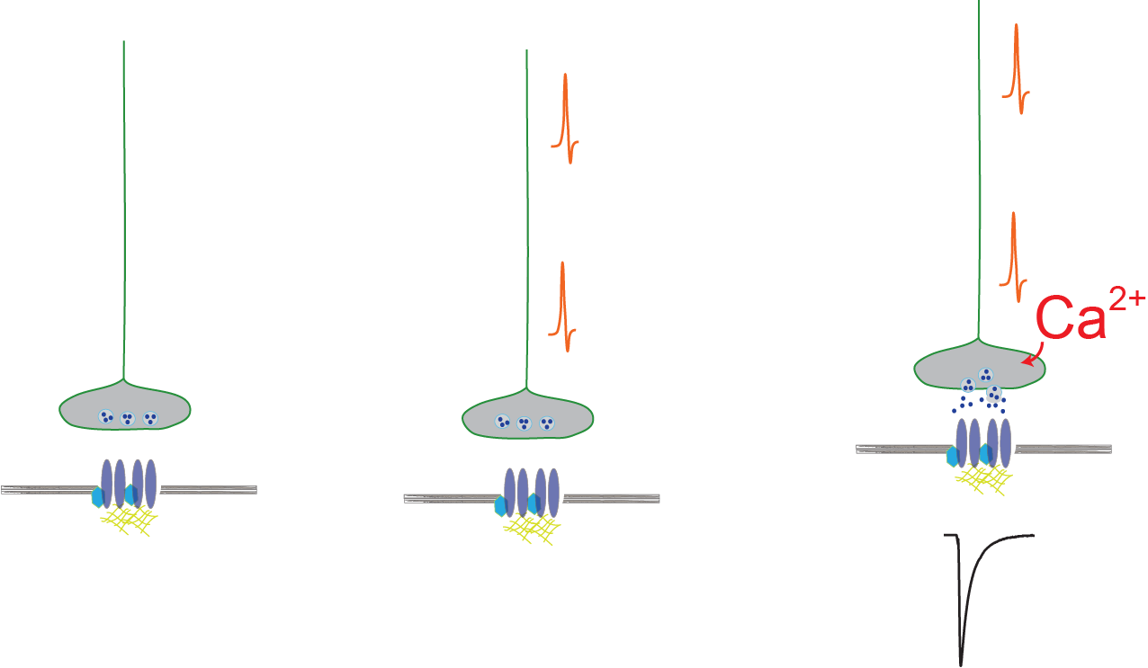
Multiplicity
PSC
Notes:
When there is multiplicity, an action potential causes the synchronized release of neurotransmitter, which summate and generate a larger amplitude of the postsynaptic current.

Slide 3
TTX
TTX
Multiplicity
No Multiplicity
Cd²⁺
Cd²⁺
Cd²⁺
x
PSC
Notes:
When there is multiplicity, blocking action potentials prevents the summation of PSCs, and decreases the amplitude of PSC. By contrast, when there is no multiplicity, blocking action potentials will have no effect on the PSC amplitude

Slide 4
Exp. 2 Animation
Notes:
In this experiment, we replace extracellular Ca2+ with Sr2+.

Slide 5
Multiplicity
Sr²⁺
Sr²⁺
x
x
x
PSC
Notes:
Sr2+ will desynchronize the release of synaptic vesicles. Therefore, if multiplicity is present, this should decrease the amplitude of PSCs

Slide 6
Exp. 3 Animation
Notes:
Multiplicity can involve multivesicular release

Slide 7
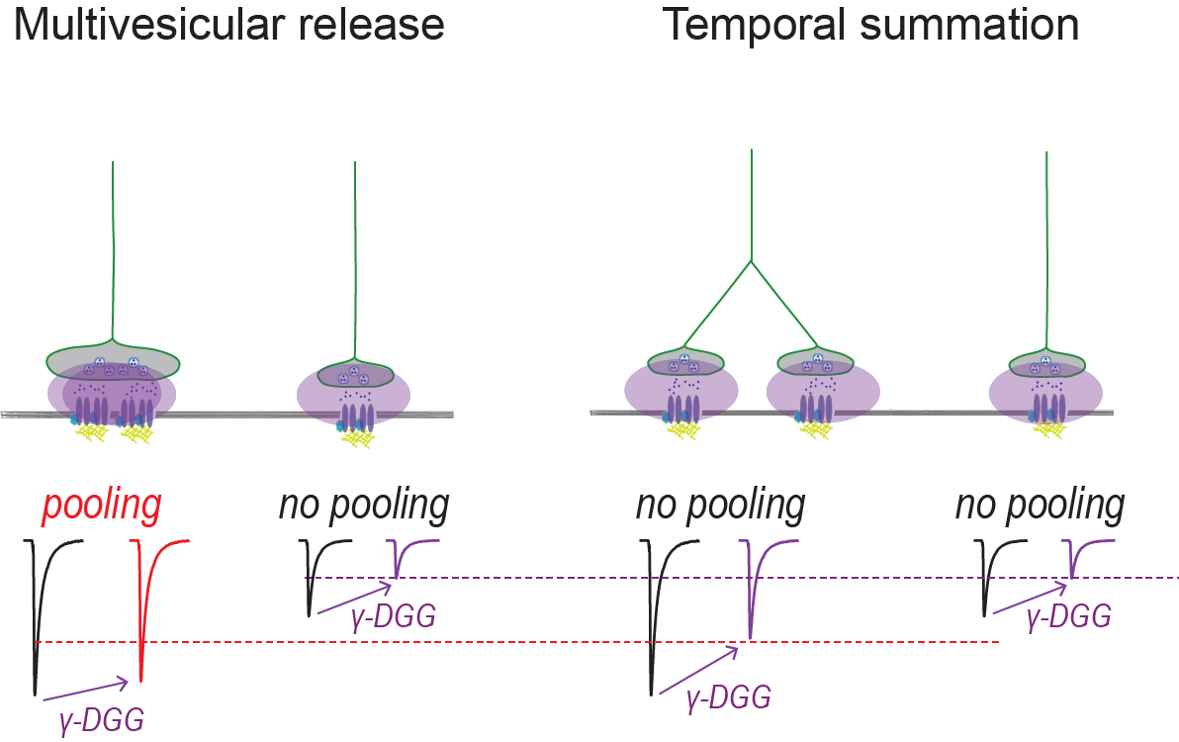
Notes:
This causes higher neurotransmitter concentration in the synaptic cleft, and γ-DGG, a low affinity AMPA receptor antagonist, is less effective at inhibiting larger, multiquantal compared to smaller, uniquantal PSCs.

Slide 8
Notes:
Without multivesicular release, γ-DGG will be equally effective on larger and smaller PSCs.

Slide 9
Exp. 4 Animation
Notes:
Bursts of synaptic activity can transiently increase spontaneous action potential firing and release probability of the stimulated afferents.

Slide 10
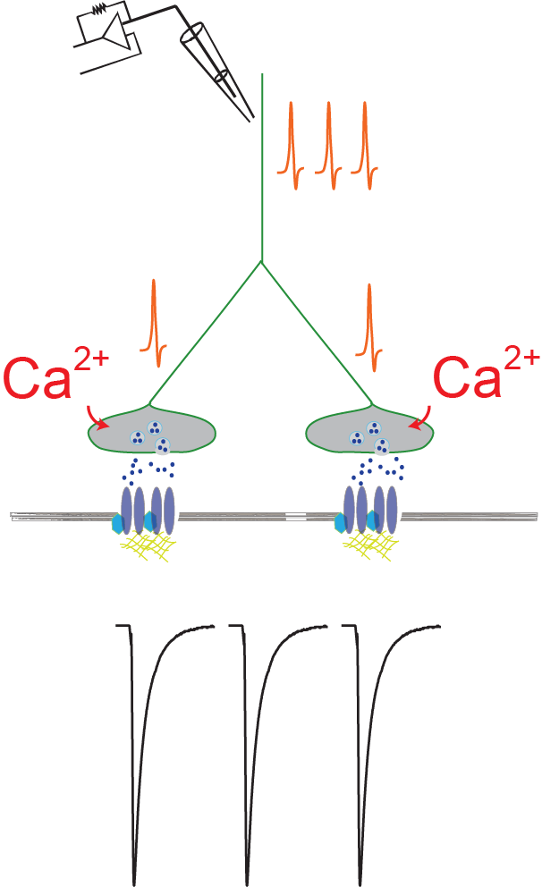
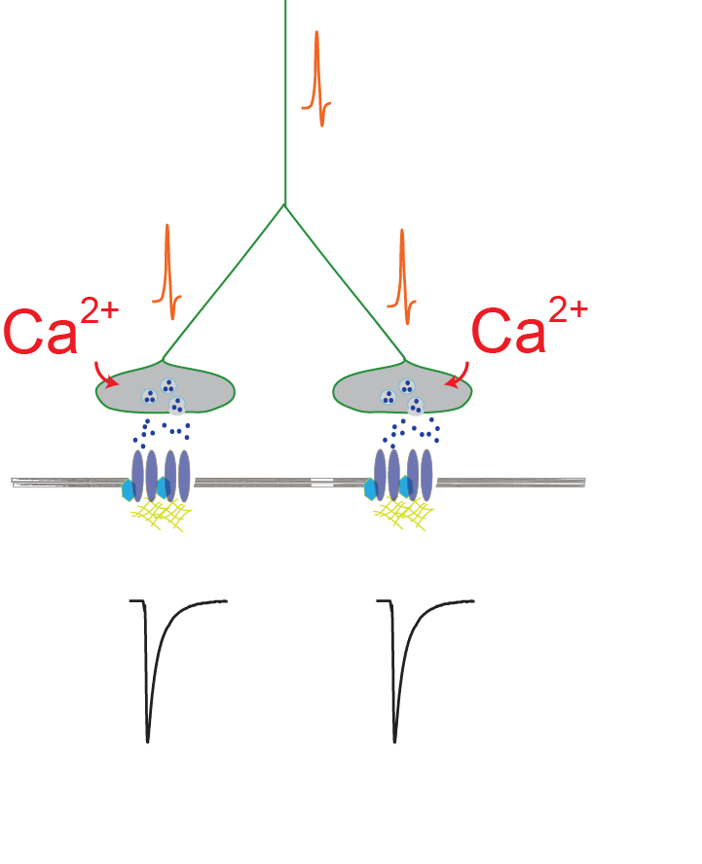
Notes:
If neurons exhibit multiplicity, the increase in action potentials should cause a transient increase in the amplitude of PSCs.

