Slide 1
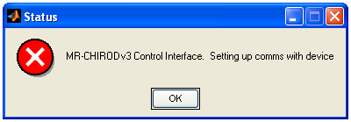
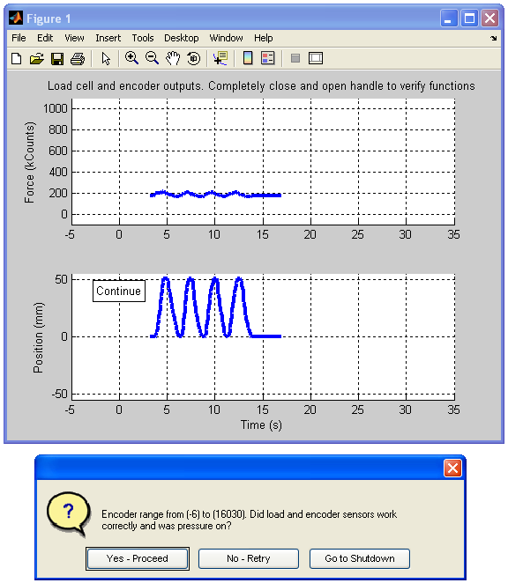
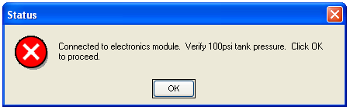
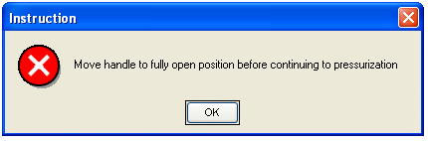
Start operator interface
Minimal pressure applied, verify sensor function
Load Cell
Connection successful?
Encoder
Check compressor pressure
Sensor function/range verified?

Slide 2
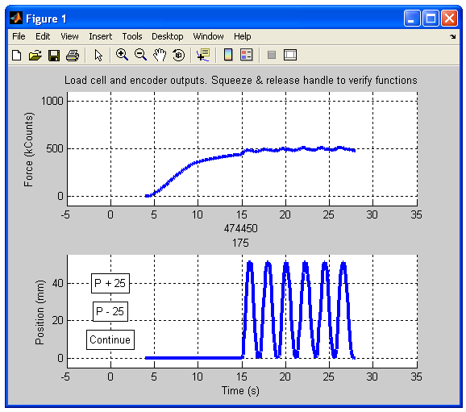
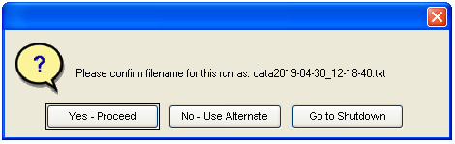
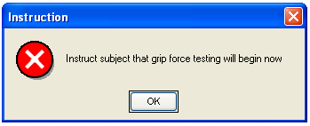
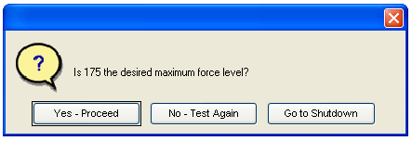
Adjust filename if needed
Increase force by 2.5% (25 counts)
Subject reached maximum grip strength?
Automatically increase force to 5%

Slide 3
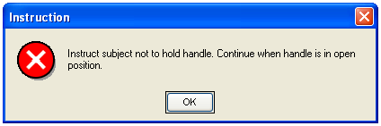
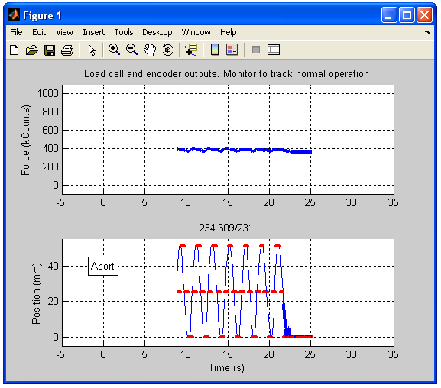
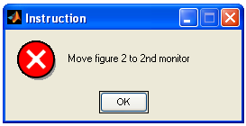
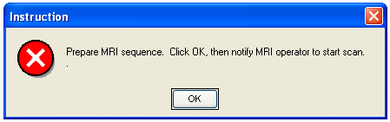
Start MRI sequence, auto visual stimulus start
raw force
Automatically set up visual stimulus, set force to 60% of maximum
visual stimulus state
encoder position
STOP
Repeat at 40% and 20% force

