Slide 1

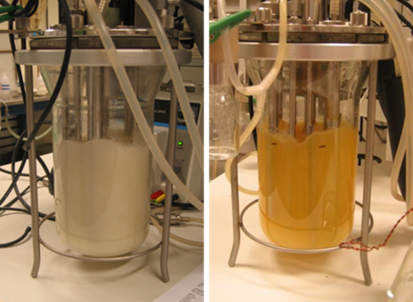



A 3-GENE PATHWAY ENABLES CAROTENOID PRODUCTION IN SACCHAROMYCES CEREVISIAE

Slide 2
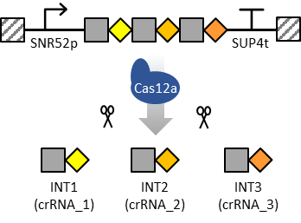
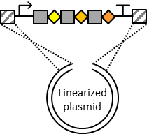
MULTIPLEX GENOME ENGINEERING USING CAS12A AND A SINGLE crRNA ARRAY

Slide 3
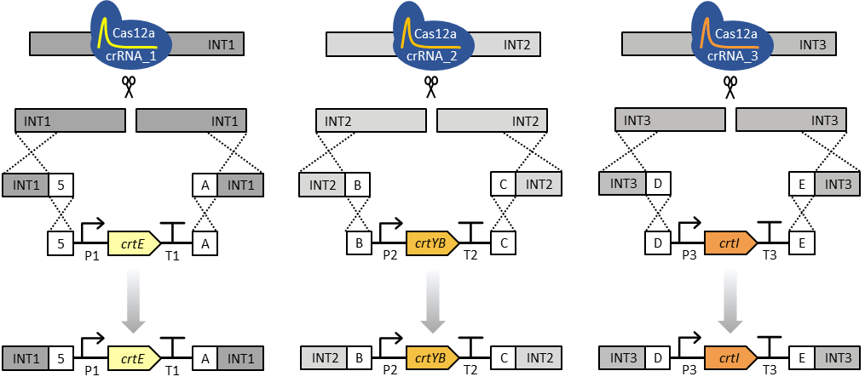
MULTIPLEX GENOME ENGINEERING USING CAS12A AND A SINGLE crRNA ARRAY

