Slide 1
Title??

Slide 2
Table of Contents?

Slide 3
Shot of hand icon only, feet icon only, hand and feet icons [2.1.2]

Slide 4
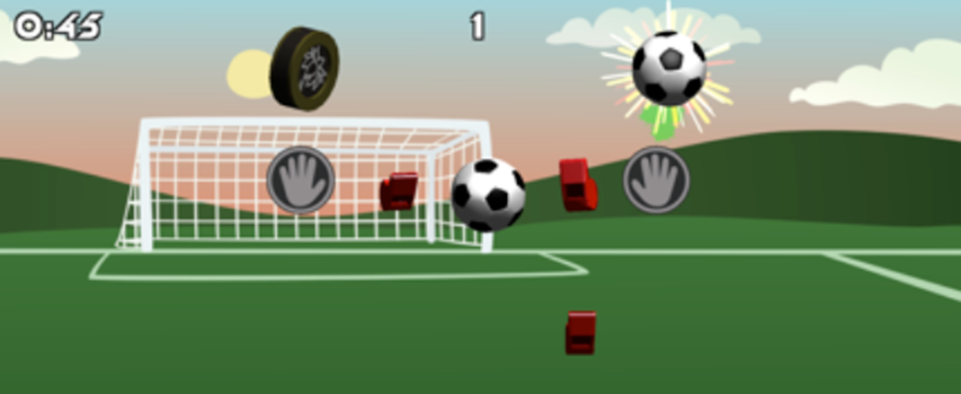
Shot of hand icon only, feet icon only, hand and feet icons [2.1.2]

Slide 5
Record accurate timing of start and end of each session/phrase for processing

Slide 6
TEXT: Allow subject to rest before, between, and after games [2.7.1]

