Slide 1
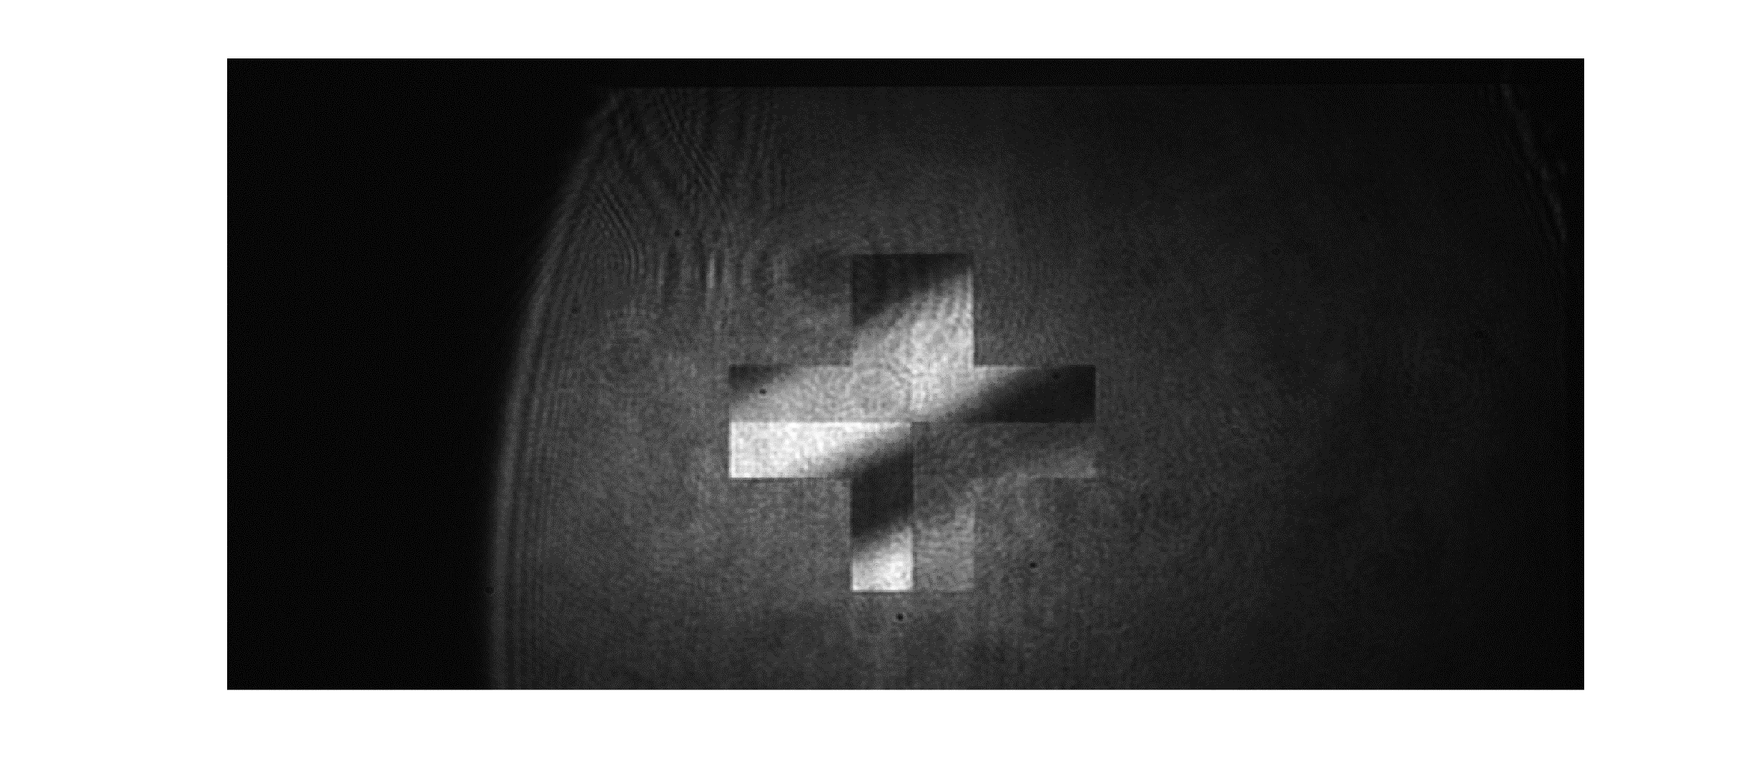
camera image once the two polarizer positions are fixed

