Slide 1
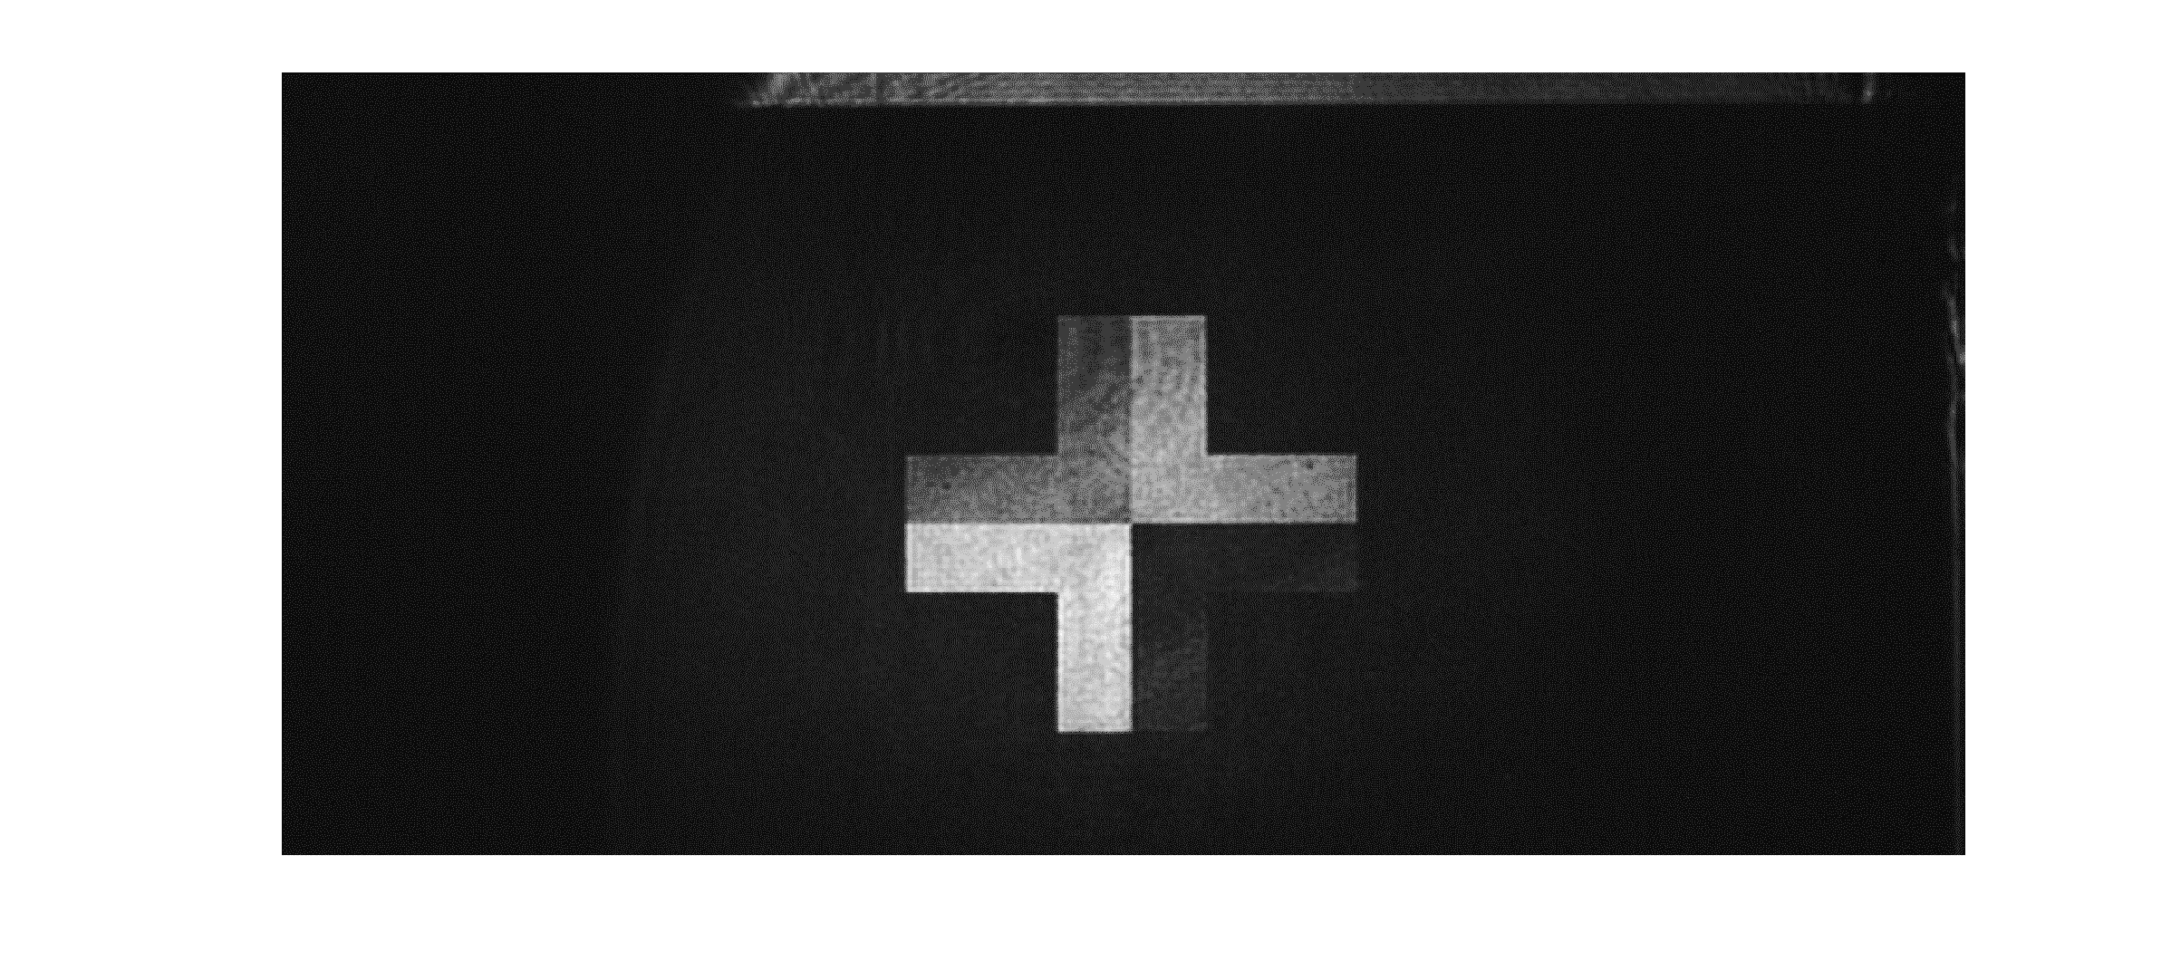
minimum light transmittance or sharpest image

Slide 2
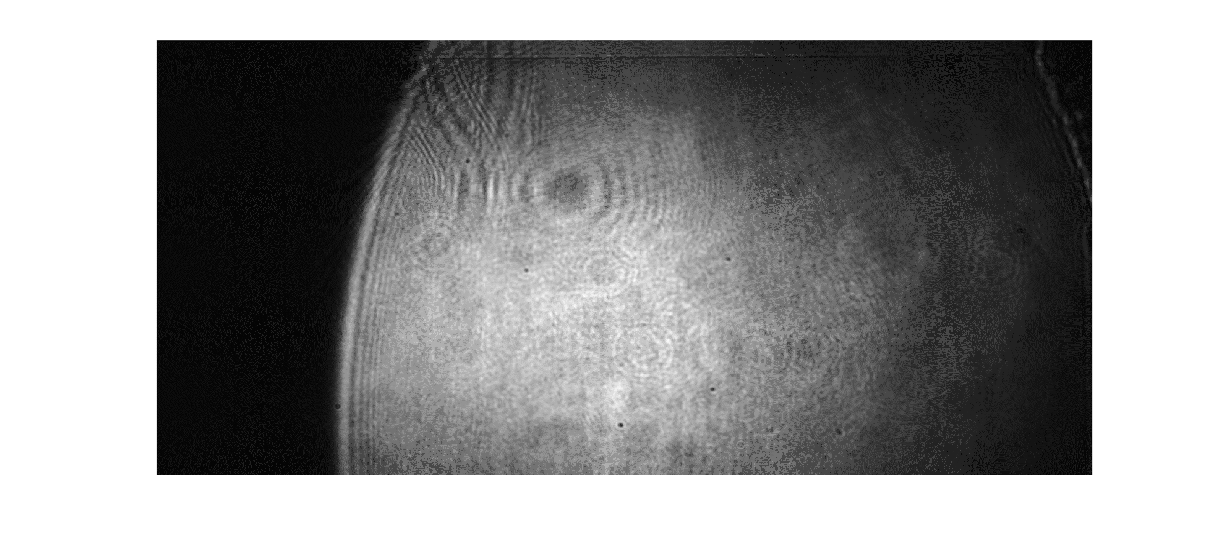
maximum light transmittance or most blurred image

