Slide 1
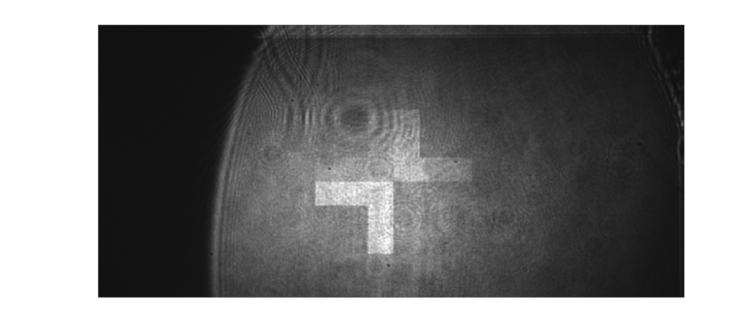
camera image once the polarizer position is fixed

